Slide 1
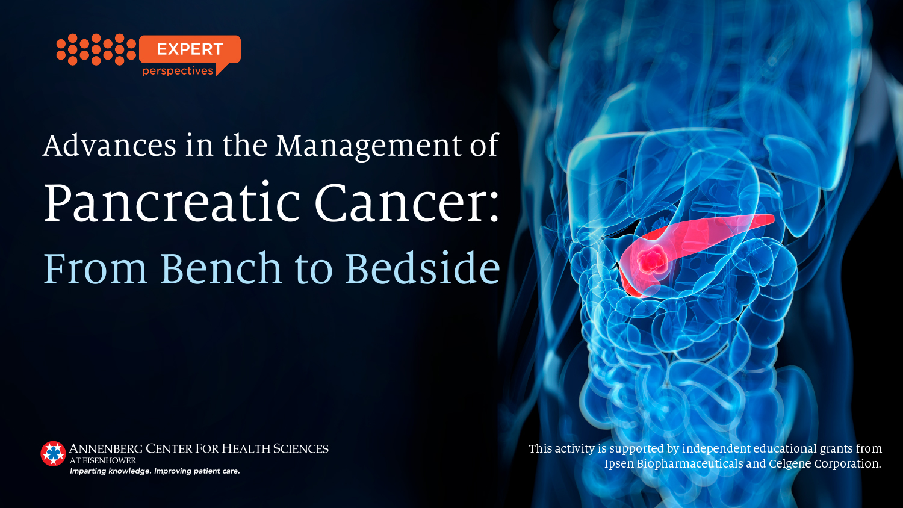
Notes:
Pancreatic cancer poses a number of challenges, not least of all is that the incidence of this disease is on the rise. It's anticipated that this year in the US there will be over 55,000 people diagnosed with this cancer. It ranks disproportionately high on the list of leading causes of cancer-related mortality relative to its incidence, and there's been a steady, about a half to 1% increase in the frequency of this disease over the last number of decades. If we take into account all-comers diagnosed with this disease, the 5-year overall survival (OS) is about 8%; but it is of note that OS has been slowly but steadily increasing

Slide 2
Pancreatic Cancer
The Problems and Challenges
US 2019¹
  New diagnoses: 56,770
  Mortality: 45,750
  9th (females) and 10th (males) most common cancer (3%)
2nd cancer-related deaths by 2030²
5-Year OS: 8.5%³
Median OS in patients with advanced disease <1 year⁴
1. Siegel RL, et al. CA Cancer J Clin. 2019;69:7-34; 2. Rahib L, et al. Cancer Res. 2014;74:2913-2921; 3. SEER Cancer Statistics Review; 4. Neoptolemos JP, et al. Nat Rev Gastroenterol Hepatol. 2018;15:333-348.
Notes:
Pancreatic cancer poses a number of challenges, not least of all is that the incidence of this disease is on the rise. It's anticipated that this year in the US there will be over 55,000 people diagnosed with this cancer. It ranks disproportionately high on the list of leading causes of cancer-related mortality relative to its incidence, and there's been a steady, about a half to 1% increase in the frequency of this disease over the last number of decades. If we take into account all-comers diagnosed with this disease, the 5-year overall survival (OS) is about 8%; but it is of note that OS has been slowly but steadily increasing.

Slide 3
PDAC
Challenging Biology
Stroma as a barrier to drug delivery
Complex and poorly understood microenvironment
Multiple gene mutations
Non-druggable oncogenes and tumor suppressor genes
Few validated biomarkers
Treatment resistance
Neoptolemos JP, et al. Nat Rev Gastroenterol Hepatol. 2018;15:333-348; Krantz BA, O'Reilly EM. Clin Cancer Res. 2018;24:2241-2250.
Notes:
A common question is, why is this cancer so challenging? There are many factors that are put forward. We know that the microenvironment in the whole stromal context is very important with this disease, and it provides a physical barrier to drug delivery—it's relatively avascular, and it's hypoxic—so it can be considered a hostile microenvironment. Also, the genetics of PDAC are complex in that we see a number of frequent tumor suppressor genes and oncogenes that are mutated, none of which are effectively targetable in 2018. However, there are a number of lower frequency genetic events, some of which are targetable in this disease.
Arguably, we do not have validated biomarkers for routine treatment decision-making, although during the course of this review, we'll touch upon some that have become and are increasingly integrated into practice. And I think it's fair to say that, while our current therapies may work well for a proportion of patients, there's an inherent primary and acquired treatment resistance to the best available agents that we have in practice.

Slide 4
PDAC
Molecular Pathogenesis
Ghaneh P, et al. Gut. 2007;56:1134-1152. Reproduced with permission from BMJ Publishing Group Ltd.
Notes:
Looking at the molecular pathogenesis of PDAC, this has now been well-described pathway for development of this disease where normal ductal epithelial cells undergo progressive neoplastic change to pancreatic intraepithelial neoplasia (PanIN) 1, PanIN 2, ductal carcinoma in situ, and ultimately invasive cancer. Timelines for this may be protracted over several decades, and as this process happens, there's an accumulation of genetic changes that are characteristic of each PanIN time point. And it's also important to know that PanIN 1 is common as we all get older, and probably the committal step in terms of development of invasive disease comes up at a level of PanIN 2.
We know that at least 10%, and that's probably a conservative figure, of this disease is associated with a genetic predisposition, and in some there are a number of single gene mutations that are well-described. So, for example, hereditary breast and ovary cancer syndrome, via 2 breast cancer susceptibility genes (BRCA1 and BRCA2), contributes to the risk of this disease. The Lynch syndrome genes that are associated with stomach, endometrial, and urothelial malignancies, account for a small proportion of the incidence of this malignancy. And then there is a group of individuals where we see 2 and sometimes 3 relatives in a family where we do not know what the genetic link is, but presumably there is a genetic link that just has not been identified yet for these individuals. And that's actually the biggest group that have a potential familial predisposition to develop this cancer.

Slide 5
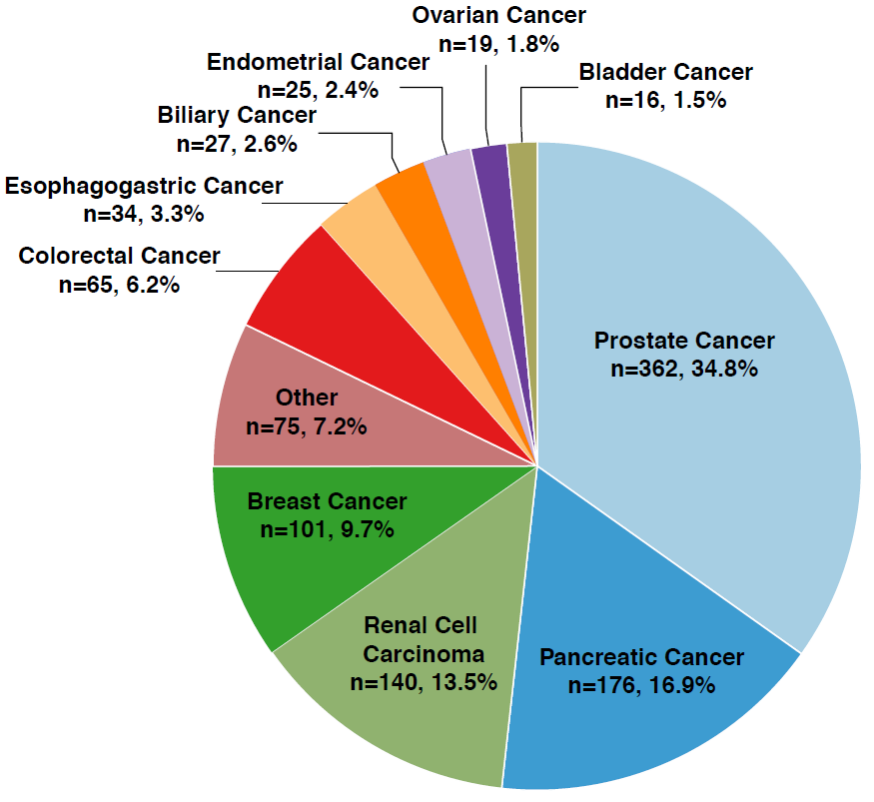
MSK IMPACT
Germline Testing
N = 1040
PDAC (n=176, 16.9%)
BRCA 1
BRCA 2
CDKN2A
PALB2
ATM
CHEK2
APC
MUYTH
Mandelker D, et al. JAMA. 2017;318:825-835.
Notes:
This is an analysis from ~1,000 patients who underwent initially somatic profiling in pancreatic cancer, and then this was an evaluation of the paired germline genetic analysis that was done across a variety of cancers at Memorial Sloan Kettering. In this first pass of 176 patients with PDAC, we identified that about 16% had a germline genetic mutation, with BRCA1, BRCA2 being most common, the next most common was CDKN2A, and then PALB2, ATM, and a number of other lower frequency events.

Slide 6
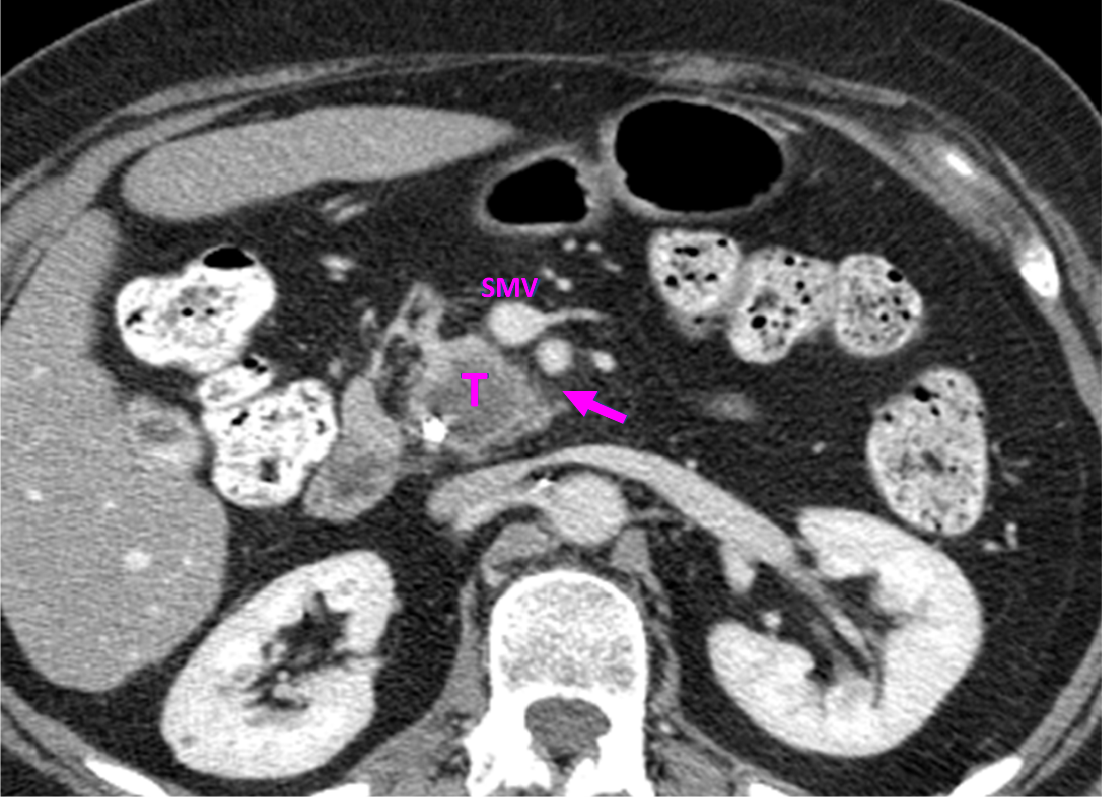
PDAC
Resectable (Stage I, II)
Notes:
This is an example of what a resectable pancreas cancer looks like. If you look at the T, that's the tumor, it's a hypovascular lesion. There's a stent in place there. And in this graphic, you'll see that the superior mesenteric vessels are clear of the tumor. There's a fat line, so there's a good probability that if this individual went directly to the operating room, that a complete removal would be able to be done.

Slide 7
PDAC
Staging
Criteria | Resectable | Borderline Resectable | Localized Unresectable
Evidence of extrapancreatic disease | None | None | Lymph nodes beyond field of resection
SMA encasement | No evidence | ≤ 180º | > 180º
SMV/portal vein | Patent SMPV | Impingement/ short segment occlusion | Unreconstructable occlusion
Celiac encasement | No evidence | ≤ 180º (tail) | > 180º (body/tail)
Hepatic artery | No arterial tumor contact | Abutment or encasement | Invasion or encasement
Callery MP, et al. Ann Surg Oncol. 2009;16:1727-1733; NCCN Guidelines. Version 1.2019.
Notes:
With regard to staging of localized PDAC, we have the AJCC classification, but in greater utility is the breaking up of PDAC into the spectrum of resectable disease and locally advanced, and unresectable, which is characterized by T4 tumors with arterial involvement, where it isn't possible to do a complete or a zero oncologic resection. And then that group of tumors in the middle, which are about 15% of people with PDAC presentation called borderline resectable disease where there are venous involvements, but not encasements, and to a lesser extent, limited arterial involvement. And the designation of borderline resectable means that an individual technically could go to the operating room tomorrow, but there's a high probability of having a margin-positive resection, so we don't recommend that. And increasingly, this group of patients is recommended neoadjuvant therapy.

Slide 8
PDAC
Role of High-Volume Treatment Centers
Improved diagnostic, management, and resectability decisions through use of appropriate imaging studies and multidisciplinary consultation
Improved surgical outcomes
Improved utilization of chemotherapy, chemoradiotherapy, and targeted therapy
NCCN Guidelines. Version 1.2019.
Notes:
It is important to emphasize the role of high-volume treatment centers with improved diagnostic management and complex multi-disciplinary decision-making. We know that surgical outcomes are optimized when patients are treated in centers where there's a high level of expertise in looking after patients with PDAC, and that includes not only the surgical care, but the postoperative care, management of complications, and the optimal use of systemic therapy, radiation therapy where it's indicated, and integration of targeted opportunities where they exist for individuals.

Slide 9
Resectable, Borderline Disease
Surgical Considerations
For Resectable Disease, 2 Options:
Upfront surgery (Whipple, distal, total)
  Diagnostic laparoscopy, if there is suspicion for occult metastatic disease
  (CA 19-9, distal site)
Neoadjuvant chemotherapy +/- chemoradiation followed by restaging, attempted surgical resection
For Borderline Resectable Disease:
Favor neoadjuvant, restaging, surgical resection if no progression or evidence of distant spread
Vascular resection (portal/superior mesenteric vein)
Katz MH, et al. J Am Coll Surg. 2008;207:106-120; Isaji S, et al. Pancreatology. 2018;18:2-11; NCCN Guidelines. Version 1.2019.
Notes:
Looking at resectable and borderline disease, for patients who have operable PDAC, the traditional approach is upfront surgery followed by adjuvant systemic therapy. If there's suspicion of more advanced disease, for example, if an individual has a very elevated CA 19-9 level or a distal site—so a body or tail location—then often it will be recommended to do a laparoscopy to rule out subradiological disease before committing to a complete resection .
An area of evolution in terms of approach is to recommend neoadjuvant therapy for patients with resectable PDAC. We don't have randomized trial data to indicate that this is a superior approach, but there's been a move in that direction by surgeons and medical oncologists for patients with resectable cancer. We have some studies that will mature out over the next year or so that will further inform the data to support this approach in this population. And we talked about an upfront systemic therapy for resectable disease often including chemoradiation, and subsequently surgical resection is the paradigm that's undertaken.

Slide 10
CONKO-001
Trial Design
Patients
Gemcitabine
(N=179)
R
A
N
D
O
M
I
Z
E
D
Resected Pancreas Adenocarcinoma
(N=368)
(1:1)
Observation
(N=175)
Stratification:
    R0 vs R1; T-stage; Node (+) vs (-)
Primary endpoint: DFS
Oettle H, et al. JAMA. 2007;297:267-277; Oettle H, et al. JAMA. 2013;310:1473-1481.
Notes:
Adjuvant therapy is a standard of care essentially for all patients who undergo resection, and I'm talking about now patients who go directly to surgery. A traditional approach was evaluating gemcitabine, and the data to support this comes from the CONKO-001 trial looking at gemcitabine compared to observation for resected PDAC .

Slide 11
CONKO-001
Efficacy (Median Follow-up 11 Years)
 | Gemcitabine n = 179 | Observation n = 175 | HR/P-value
Median DFS | 13.4 mos | 6.9 mos | HR 0.55 (CI 0.44- 0.69) P<0.001
Median OS | 22.8 mos | 20.2 mos | HR 0.76 (CI 0.61- 0.95) P=0.01
5-year OS | 20.7% | 10.4% | -
10-Year OS | 12.2% | 7.7% | -
Oettle H, et al. JAMA. 2007;297:267-277; Oettle H, et al. JAMA. 2013;310:1473-1481.
Notes:
These are the data that were reported now a number of years ago that showed that there was a significant improvement in disease-free survival (DFS) for patients who received gemcitabine compared to observation supported by a more modest improvement in median overall survival (OS), likely related to the fact that a lot of patients who were allocated to the observation arm went on to receive gemcitabine as their therapy in the advanced disease setting.

Slide 12
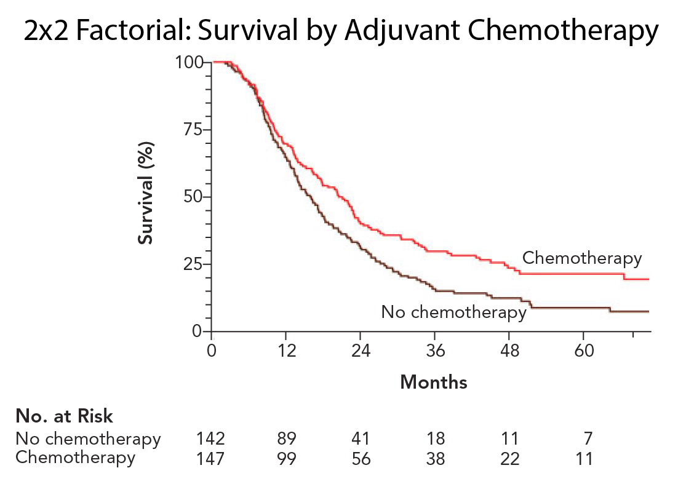
ESPAC-1
5-FU/LV Efficacy
 | OS 2-Year | OS 5-Year | OS Median
5-FU/LV | 40% | 21% | 20.1 mos
No CT | 30% | 8% | 15.5 mos
HR= 0.71 (CI 0.55- 0.92), P=0.009
Neoptolemos JP, et al. N Engl J Med. 2004;350:1200-1210.
Notes:
This trial had 2 components. One of the analyses compared 5-flurouracil (5-FU) and leucovorin (LV) given in the old Mayo Clinic style (every 4 weeks) compared to no chemotherapy. As you can see there was a clearly superior statistical difference in outcome.

Slide 13
ESPAC-4
Trial Design
Gemcitabine
1,000 mg/m² d 1,8,15
q4 wks x6
(N=366)
Patients
R
A
N
D
O
M
I
Z
E
D
R
A
N
D
O
M
I
Z
E
D
R0/R1 Resected PDAC
WHO ≤ 2; ≤ 12 wks
(N=730)
(1:1)
Gemcitabine +
Capecitabine 1,660mg/m² d1-21 q4 wks x6
(N=364)
Stratification:
    R0 vs R1; Country (UK vs rest)
Primary endpoint: OS
Stratified log-rank 5% 2‑sided alpha 10% diff. 2 year survival (47.5% ➤ 57.5%, 90% power 480 deaths)
N= 722
Neoptolemos JP, et al. J Clin Oncol. 2016;34:LBA4006; Neoptolemos JP, et al. Lancet. 2017;389:1011-1024.
Notes:
A more recent studies that have led to practice change. The first of these is ESPAC-4 . These data were presented a couple of years ago and now fully reported in The Lancet. Essentially, the trial looked at the combination of gemcitabine and capecitabine compared to gemcitabine in a large cohort of patients, approximately 730. This study was conducted primarily in the UK and some European countries, with a primary endpoint of overall survival .

Slide 14
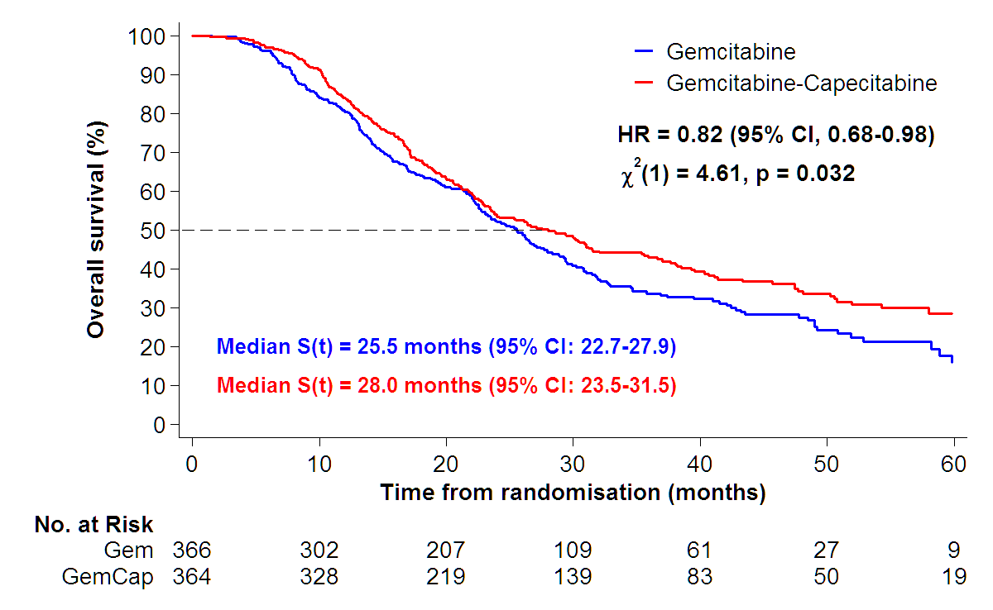
ESPAC-4
OS by Treatment
Neoptolemos JP, et al. J Clin Oncol. 2016;34:LBA4006; Neoptolemos JP, et al. Lancet. 2017;389:1011-1024.
Notes:
And these are the outcomes. There was a statistically significant improvement in OS for the gemcitabine-capecitabine combination compared to gemcitabine on its own. And for the period of 2016 and '17 and early part of 2018, gemcitabine and capecitabine has been for many the go-to regimen for patients with resected PDAC.

Slide 15
PRODIGE 24/CCTG PA.6
Trial Design
mFOLFIRINOX
Oxaliplatin 85 mg/m², Leucovorin 400 mg/m²
Irinotecan 180 mg/m² (reduced 150 mg/m2)
5-Fluorouracil IV infusion 2.4 g/m²/ 46 hours
Every 2 weeks; 12 cycles
(N=247)
Patients
R
A
N
D
O
M
I
Z
E
D
R
A
N
D
O
M
I
Z
E
D
R0/R1 PDAC
CA19-9 level <180 U/mL
ECOG 0-1
(N=493)
(1:1)
Gemcitabine
1000 mg/m²,
weekly 3 out of 4 weeks (1 cycle)
6 cycles
(N=246)
  Primary endpoint: DFS
  Stratification: Center, Resection Margin, Ca 19-9 (<90 vs 91-179), pN0 (<12 vs >12) vs N1
  Imaging: q3 mos
Conroy T, et al. J Clin Oncol. 2018;36:LBA4001; Conroy T, et al. N Engl J Med. 2018;379:2395-2406.
Notes:
However, we have significant data that's led to a major practice change in 2018. These data were presented by Dr. Conroy and colleagues at ASCO in the spring of 2018. The trial compared modified FOLFIRINOX to gemcitabine. Again, this was a population that went directly to surgery. Patients were stratified based on their R0 or R1, so margin positive vs negative resection status. The CA 19-9 level had to be less than 180 at the time of enrollment. Patients had to have a good performance status, and primary endpoint here was a DFS, and patients underwent imaging every three months.
A few points about the chemotherapy. It started at full dosing of FOLFIRINOX, however, during the conduct of the study, it was noted that there was a significant rate of grade 3 diarrhea that led to an upfront reduction of the dose of irinotecan to 150 milligrams per meter squared, and this was instituted after about a third or so of patients were enrolled.

Slide 16
Adjuvant Phase 3 Trials
Pending Data
Sponsor | Trial | N
RTOG 8048 NCT01013649 | Gemcitabine/Combination +/- ChemoRT Erlotinib randomization removed Primary: OS | 952
APACT NCT01964430 | Gemcitabine +/- Nab-Paclitaxel Primary: DFS (accrual complete; pending 2019) | 800
Italy GIP-2 NCT02355119 | FOLFOXIRI vs Gemcitabine Primary: DFS | 310
Notes:
So, what data are pending here? The RTOG 0848 study has completed enrollment. This trial will evaluate the addition of adjuvant chemoradiation after patients have received either gemcitabine or a gemcitabine-based combination in the adjuvant setting, and we look forward to seeing those data in the not-too-distant future. And the impact trial, which evaluates gemcitabine with or without nab-paclitaxel in a resected patient population very similar to the design of the modified FOLFIRINOX trial. This trial will likely mature out in 2019, and it's possible this will add to the standard of care choices for patients receiving adjuvant therapy after successful resection.

Slide 17
PDAC
Why Neoadjuvant Therapy?
Pros
Near absolute risk of systemic failure
Selects out biology, avoidance of surgery
Enhanced treatment delivery: 20%–25% not well enough/don’t receive adjuvant therapy
Theoretically, ↑Ro, ↓lymph node positivity, ↓local recurrence, ‘downstaging’
Decreased leak/fistula rates (RT included)
Cons
Lost opportunity for surgical resection?
  Estimate 5%–10%
Notes:
A couple of comments on neoadjuvant therapy. There's a lot of interest in this as we've said. It's a "standard approach" in the study of borderline resectable PDAC and stems from the high risk of systemic failure; the ability to avoid a surgery for patients who present with systemic disease; we also know that a significant group of people who do undergo surgery are not well enough to be able to receive adjuvant therapy in a timely way, and that means that theoretically, neoadjuvant therapy may get more modalities of treatment, be it systemic therapy, be it radiation or surgery, into more people, and that in and of itself could improve outcomes; and there's some data, certainly when radiation's included, that margin-negative resection rates are higher and lymph node retrieval rates and lymph node positivity rates are lower. I think with modern cytotoxic regimens, there's evidence that we can truly downstage some patients.
The con of course is that we may lose the ability to successfully resect patients. That, in my opinion, speaks to biology and probably not the treatments per se, and that individual who demonstrates early disease progression probably would not have benefited from an upfront surgical approach in the first place.

Slide 18
PREOPANC-1
Trial Design
Surgery
Adjuvant
Gemcitabine
x 5 cycles
Patients
R
A
N
D
O
M
I
Z
E
D
R
A
N
D
O
M
I
Z
E
D
Resectable or borderline resectable pancreatic cancer
ECOG 0-1
(1:1)
Neoadjuvant
Gemcitabine x 1 cycle
Gemcitabine-RT
Gemcitabine x 1 cycle
Surgery
Adjuvant
Gemcitabine
x 4 cycles
  Primary endpoint: OS
  Stratification: Resectability, Institution
  Hypothesis: Improvement median OS from 11-17 mos
van Tienhoven G, et al. J Clin Oncol. 2018;36:LBA4002.
Notes:
So, speaking of recent data, the PREOPANC-1 trial was presented at ASCO this year, and this looked at a neoadjuvant chemoradiation approach compared to a traditional surgery and adjuvant gemcitabine approach. And I'll just point out here that the treatment was essentially single-agent systemic therapy, so not what we recommend or use.

Slide 19
Neoadjuvant/Adjuvant Trials
Pending Data
Study | Duration | N | Treatment Arms | Endpoint
NEOPAC NCT01521702 | 2009-2014 | 310 | Neoadj GemOxaliplatin + Adjuvant GemAdjuvant Gemcitabine | DFS
NCT01150630 Phase 2 (3) PACT-15 | 2010-1016 | 88 | Adjuvant Gemcitabine (control) 23%¹ Adjuvant PEXG 50%¹ Neoadjuvant/adjuvant PEXG 66%¹ | Ph 2 Event-Free 1-Yr (Ph 3 OS)
NEPAFOX Phase 2-3 NCT02172976 | 2014-2020 | 126 | Resectable, Borderline resectable Neoadj/Adj FOLFIRINOX Adjuvant Gemcitabine | OS 24 months
SWOG S1505 NCT02562716 | 2015-2018 | 150 | Neoadj/adj FOLFIRINOX/FOLFOX Neoadj/Adj Gem/nab-Paclitaxel | OS 24 months
NEONAX Phase 2 NCT02047513 | 2015-2019 | 166 | Perioperative Gem/nab-Paclitaxel Adjuvant Gem/nab-Paclitaxel | DFS 18 months
HEAT NCT01077427 | 2012-2017 | 336 | Adjuvant Gemcitabine Adjuvant Gem+Cisplatin+Hyperthermia | OS 24 months
1. Reni M, et al. Lancet Gastroenterol Hepatol. 2018;3:413-423.
Notes:
To sum up with regard to neoadjuvant and adjuvant therapy, we're actually awaiting a lot of studies that are on the relatively-speaking smaller side, mostly phase 2s, one phase 3 here that will potentially inform this question for patients with borderline resectable disease and with patients with resectable disease. And these studies are here for your reference.

Slide 20
PDAC
Approved Therapies
Gemcitabine +
Erlotinib (?Kras WT)
Gemcitabine
Nab-paclitaxel
Gemcitabine
FOLFIRINOX
1994
1998
2002
2006
2010
2013 2015 2017
S1*
Nano-liposomal irinotecan/5-FU
Pembrolizumab
MSI-H
*Approved in Japan
Notes:
This is the landscape of therapeutics that are available for PDAC. You'll see it's dominated by cytotoxics and more recently by gemcitabine/nab-paclitaxel and FOLFIRINOX.
There are 2 areas highlighted in red, and these represent targeted agents. Although, of note, erlotinib was approved in combination with gemcitabine for unselected patients, we now know that it may have a role for about the 5% of patients that are KRAS wild type. And pembrolizumab received an FDA disease agnostic approval in 2017 for patients with mismatch repair deficiency, and that's about 1% of people with PDAC.

Slide 21
Advanced PDAC
Gemcitabine vs 5-FU
100
Gemcitabine
Bolus 5-FU
80
Median survival
5.65 vs 4.41 mo (P=0.0025)
1-year survival
18% vs 2%
Clinical benefit*
23.8% vs 4.8% (P=0.0022)
Response rate:
5.4% vs 0% (P=NS)
60
Patients Surviving (%)
40
20
0
0
2
4
6
8
10
12
14
16
18
20
Survival Time (Mos)
*Composite of measurements of pain (analgesic consumption and pain intensity), Karnofsky performance status, and weight
Burris HA 3rd, et al. J Clin Oncol. 1997;15:2403-2413.
Notes:
One of the studies that led to the use of routine cytotoxics in PDAC was this older study from about 20 years ago looking at gemcitabine compared to 5-FU and demonstrating a clearly superior outcome for gemcitabine. And that launched a whole series of trials comparing new drugs to gemcitabine and adding new drugs to gemcitabine.

Slide 22
PRODIGE – ACCORD 11
FOLFIRINOX vs Gemcitabine
FOLFIRINOX
(N=167)
Patients
R
A
N
D
O
M
I
Z
E
D
R
A
N
D
O
M
I
Z
E
D
Untreated Metastatic PDAC
ECOG 0-1
(1:1)
Gemcitabine
(N=169)
  Primary endpoint: OS
  Stratification: PS 0 vs 1; Primary tumor location; Center
Conroy T, et al. N Engl J Med. 2011;364:1817-1825.
Notes:
I'm going to move to the key recent developments. This is the landmark study evaluating FOLFIRINOX. These data were initially presented in 2010. This trial evaluated FOLFIRINOX compared to a single-agent gemcitabine in patients with good performance status, metastatic PDAC.

Slide 23
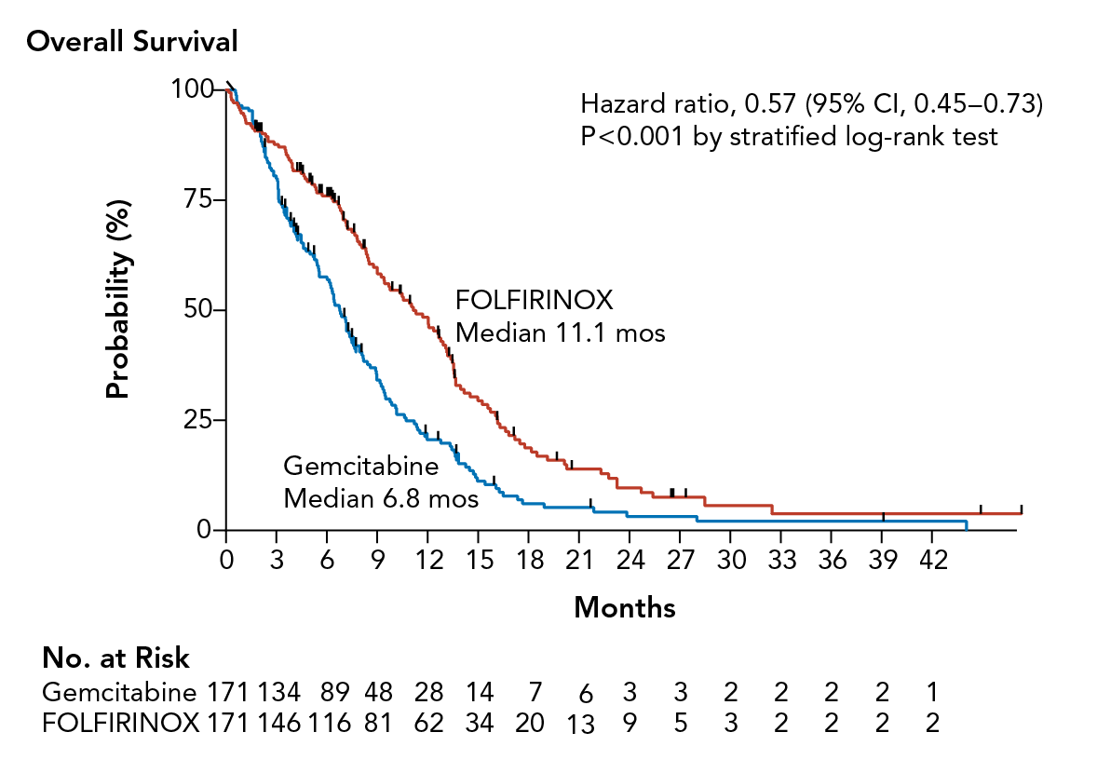
PRODIGE – ACCORD 11
OS
Conroy T, et al. N Engl J Med. 2011;364:1817-1825.
Notes:
As you can see there was a nice difference in outcomes for patients who received FOLFIRINOX, a hazard ratio of .57, compelling P value, and this has led to this being integrated as a standard of care, now essentially in every setting of PDAC.
The other point of interest I think is an important one. We know that this disease induces a significant quality of life detriment for patients, but we also see in practice that when we treat this disease successfully and when patients respond, they undoubtedly feel better, they're eating better, putting on weight, more active, their pain is decreased.

Slide 24
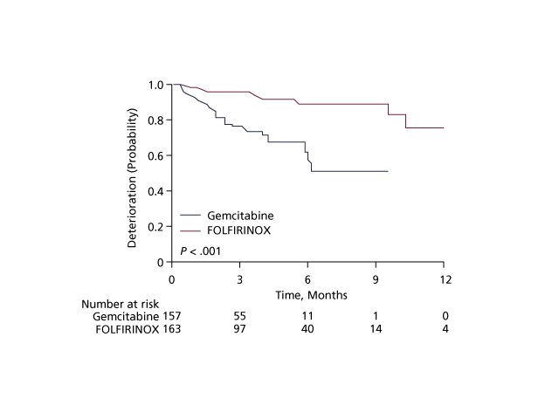
FOLFIRINOX
Delays QoL Worsening
Time until definitive deterioration > 20 points in EORTC-QLQ C30 global health status
Gourgou-Bourgade S, et al. J Clin Oncol. 2013;31: 23-29.
Notes:
And this is captured here in the secondary analysis from that study showing that despite the inherent relative toxicity of this regimen, if disease is responding and people are feeling better, their quality of life as interpreted by the individual is better for longer.

Slide 25
MPACT
Nab-Paclitaxel + Gemcitabine vs Gemcitabine
Nab-Paclitaxel + Gemcitabine
(N=431)
Patients
R
A
N
D
O
M
I
Z
E
D
R
A
N
D
O
M
I
Z
E
D
Untreated Metastatic PDAC
KPS 70–100%
(1:1)
Gemcitabine
(N=430)
  Primary endpoint: OS
  Stratification: PS (90-100 vs 70-80); Liver metastases (present vs absent); Region
Von Hoff DD, et al. N Engl J Med. 2013;369:1691-1703.
Notes:
The other major regimen in the advanced disease space is gemcitabine and nab-paclitaxel. This is the study that led to its FDA approval, comparison being single-agent gemcitabine. Make a note that compared to the FOLFIRINOX trial, this included a broader group of patients with performance status spanning from 70% to 100%, and it had no age limit in contrast to the FOLFIRINOX population.

Slide 26
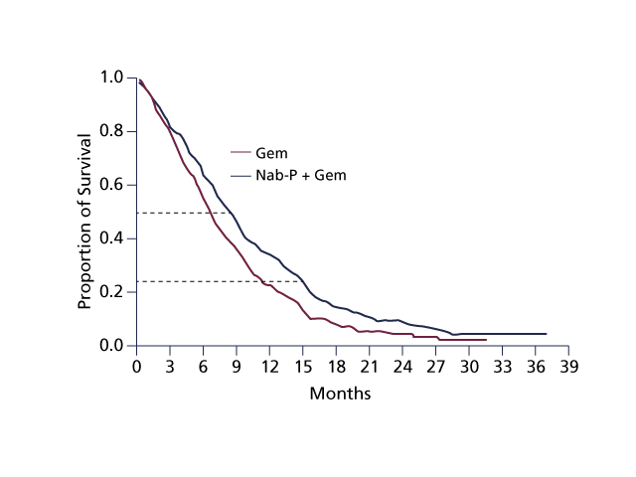
MPACT
OS
OS, months
Median (95% CI)
8.5 (7.89-9.53)
6.7 (6.01- 7.23)
HR= 0.72, 95% CI (0.617-0.835)
P= 0.000015
Von Hoff DD, et al. N Engl J Med. 2013;369:1691-1703.
Notes:
These are the outcomes: statistically significant improvement for gemcitabine and nab-paclitaxel hazard a ratio of .72 and compelling P value.

Slide 27
Second-Line Treatment
Oxaliplatin: Mixed Data in PDAC
 | CONKO-003¹ |  | PANCREOX²
 | 5-FU/LV | OFF | 5-FU/LV | mFOLFOX
Med OS | 3.3 mos | 5.9 mos | 9.9 mos | 6.1 mos
 | HR 0.068 |  | HR 1.78
Med TTP | 2 mos | 2.9 mos
Med PFS |  |  | 2.9 mos |  | 3.1 mos
1. Oettle H, et al. J Clin Oncol. 2014;32:2423-2429; 2. Gill S, et al. J Clin Oncol. 2016;34:3914-3920.
Notes:
A couple of comments on second-line therapies for PDAC. Traditionally, oxaliplatin-fluoropyrimidine combinations have been used. We have 2 trials to draw upon. They have discordant conclusions. CONKO-003 supporting the use of oxaliplatin, infusional 5-FU, while the PANCREOX study coming to the conclusion that a fluoropyrimidine infusion was better. Hard to know what to make of that, and there are limitations to both of these studies.

Slide 28
NAPOLI-1
Gemcitabine-Pretreated
MM-398 100 mg/m2 q3 wks (N=151)
Patients
R
A
N
D
O
M
I
Z
E
D
R
A
N
D
O
M
I
Z
E
D
mPDAC
Prior Gemcitabine
KPS 70–100%
(N=417)
Infusional 5-FU/LV
wkly x 4 q6w
(N=149)
MM-398 +Inf. 5-FU/LV q2 wks
(N=117)*
  Primary endpoint: OS
  Secondary endpoints: PFS, RR, CA 19-9, Safety, QoL
  Stratification: Albumin, KPS, Ethnicity
*Trial amended after N= 63 to include 3rd arm MM-398+5-FU/LV
Wang-Gillam A, et al. Lancet. 2016;387:545-557.
Notes:
We have NAPOLI-1 trial, which evaluated nanoliposomal irinotecan compared to infusional 5-FU and leucovorin.

Slide 29
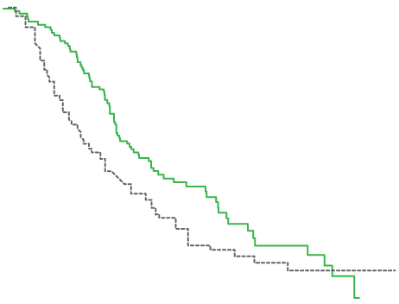
NAPOLI-1
OS: MM-398/5-FU/LV vs 5-FU/LV
Log-Rank P= 0.014, HR= 0.68 (95% CI: 0.50-0.93)
MM-398+5-FU/LV
6.1 mths (4.8, 8.5)
5-FU/LV
4.2 mths (3.3, 5.3)
Wang-Gillam A, et al. Lancet. 2016;387:545-557.
Notes:
This particular trial showed that there was a clear survival advantage to nanoliposomal irinotecan and 5-FU compared to 5-FU on its own.

Slide 30
Advanced PDAC
Additional Key Points
Important prognostic features
  Locally advanced vs metastatic; PS
Two front-line options for good PS patients
  FOLFIRINOX
  Gemcitabine + nab-paclitaxel
FDA-approved 2nd line + beyond
  Nanoliposomal irinotecan + infusional 5-FU/LV
  Oxaliplatin-based therapy
Impaired PS
  Single-agent gemcitabine
  Gemcitabine + capecitabine, gemcitabine + erlotinib
NCCN Guidelines. Version 1.2019.
Notes:
Summing up with regard to advance disease, and we haven't focused on this, but just to point out key prognostic factors are the stage of disease, stage III locally advanced vs metastatic, performance status of course. We have 2 good regimens, FOLFIRINOX or gemcitabine and nab-paclitaxel. For those who have a less robust performance status, either single-agent therapy or some of the older combinations may have a role.

Slide 31
Advanced PDAC
Palliative and Supportive Care
Biliary and/or gastric outlet obstruction
Cancer-related abdominal pain
Exocrine enzyme insufficiency
Thromboembolic disease
GI bleeding
Anxiety, depression, and malnutrition
NCCN Guidelines. Version 1.2019.
Notes:
And then pointing out that supportive care and integration of symptom-directed management is critical to optimizing outcomes for patients with this disease. We know that patients can develop obstructive processes in the GI tract very commonly, biliary obstruction in the sequelae of cholangitis and occluded stents or duodenal obstructions, also known as gastric outlet obstruction, and that can be palliated often with endoscopic stenting and more rarely surgical bypasses.
Pain is a substantive issue in this disease. Generalized abdominal pain, back pain in particular, and a whole variety of strategies are part in part of routine care for these patients. Nutritional consideration and addressing issues of pancreatic insufficiency is key. Thromboembolic complications occur pretty frequently, and some patients will present with pulmonary emboli or DVT, and as the disease process evolve, thromboembolic sequelae occur and probably in up to 50% of patients at some point during the trajectory of their disease. This will need to be addressed.
There are psychosocial issues for patients in the family associated understandably with a disease with an ultimately limiting prognosis in terms of anxiety, depression, and other consequences. So just to emphasize again how important addressing these considerations as optimally as we can is critical to maximizing the outcome for a particular individual.

Slide 32
Advanced PDAC
Current Approach to Treatment Sequencing
Gemcitabine-Nab-Paclitaxel
FOLFIRINOX
1st line
MM-398 + 5-FU/LV
5-FU/LV; Cape
Gemcitabine-Based
2nd line
FOLFOX/CapeOx?
3rd line
Notes:
Leaving you with this schema for how one might think about sequencing therapies for patients with newly diagnosed advanced PDAC. One approach for patients who received gemcitabine and nab-paclitaxel-based therapy would be at the time of progression nanoliposomal irinotecan, 5-FU, and potentially subsequently FOLFOX. For those who receive a fluoropyrimidine-based regimen upfront, gemcitabine-based treatment is the logical go-to, and kind of overarching here to all is the consideration of clinical trials.

Slide 33
PDAC
Where Do We Go From Here?
Stromal depletion
Targeted therapy for genetic subgroups
Targeting stem cells
Targeting DNA damage response/repair pathway
Immunotherapy
Specific inhibitors of key signaling pathways
Radioimmunotherapy
Emerging metabolic therapies
Krantz BA, et al. Chin Clin Oncol. 2017;6:30.
Notes:
Moving now to new therapeutic approaches for PDAC, and the nice news is there's a lot on the horizon. And some of the strategies that we'll discuss look at stroma modulation, look at targeting genetic subgroups, immune-based approaches, and then there are a lot of opportunities with regard to key signaling pathways in PDAC, radioimmune therapy strategies, emerging metabolic therapies for PDAC, some of which are now in late-stage trial development.

Slide 34
PDAC
Plethora of Targets
A lot of approaches being actively evaluated in
the clinic
  Early phase for the most part (phase 1, phase 2), and some later phase studies
Krantz BA, et al. Chin Clin Oncol. 2017;6:30. Reproduced with permission from AME Publishing Company.
Notes:
This slide is adapted from a publication and summarizes some of the major approaches that are in development. These are early phase, for the most part, in terms of phase 1, phase 2, and some later phase studies impact. And I think this is where a lot of excitement comes because there's a lot of approaches being actively evaluated in the clinic.

Slide 35
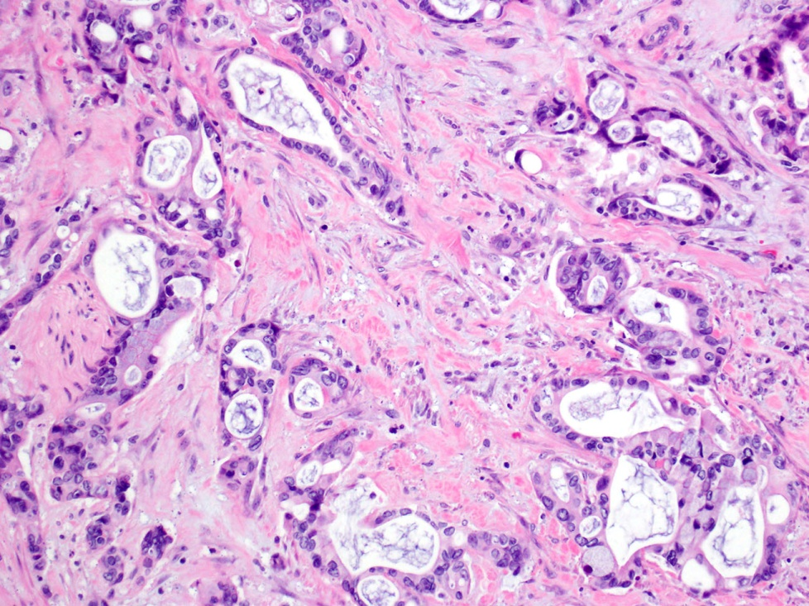
PDAC
Microenvironment
Hypovascular, hypoxic
Physical stromal barrier
  Hyaluronan (HA) glycosaminoglycans
  Increased EMT, chemoresistance
PEGPH20 recombinant human hyaluronidase
  Depletes HA in stroma
  Improves drug delivery
Courtesy: J. Shia (MSKCC)
Jacobetz MA, et al. Gut. 2013;62:112-120; Provenzano PP, et al. Cancer Cell. 2012;21:418-429.
Notes:
Moving to the stroma and the microenvironment targeting for PDAC, and just a reminder again that this stroma is characterized again by a relative absence of epithelial malignant cells and a predominant presence of stroma, which is composed of hyaluronan and glycosaminoglycans, and this provides a physical barrier, may inhibit drug delivery. A pegylated hyaluronidase enzyme has been shown to degrade the stroma, to alter the physiology and dynamics from the vascular perspective, and to facilitate drug delivery. And this approach has been taken to late stage clinical development in PDAC following early promising signals.

Slide 36
HALO 202
Nab-Paclitaxel/Gemcitabine +/- PEGHPH20
nab-P + Gem + PEGPH20
3μg/kg IV x 2 wk (C1) ➔ wkly
(N=166)
Patients
R
A
N
D
O
M
I
Z
E
D
R
A
N
D
O
M
I
Z
E
D
Untreated mPDAC
KPS 70–100%
(N=279)
nab-P + Gem
(N=113)
  Primary endpoint: PFS, TE rate
  Secondary: PFS by HA level, ORR, OS, Safety
  Exploratory: OS by HA level, duration of response, DOR
Hingorani SR, et al. J Clin Oncol. 2018;36:359-366.
Notes:
These data were fully published earlier this year looking at the addition of pegylated PEGPH20, combined with gemcitabine and nab-paclitaxel and compared to gemcitabine and nab-paclitaxel for patients with untreated advanced disease. And looking, here, at progression-free survival and looking at thromboembolic outcomes, and then there was secondary analysis by hyaluronan level as adjudicated by tissue immunohistochemical analysis from a baseline biopsy or archival tissue.

Slide 37
HALO 202
Thromboembolic Events
TE Rate, % (n/N) | All Pts
 | PAG N= 166 | AG N= 113
Stage 1 (pre-prophylaxis) | 43% (32/74) | 25% (15/61)
Stage 2 40 mg/day enoxaparin 1 mg/kg/day enoxaparin | 14% (12/86) 28% (5/18) 10% (7/68) | 10% (4/39) 29% (2/7) 6% (2/32)
Hingorani SR. J Clin Oncol. 2017;35:Abstr.4008; Hingorani SR, et al. J Clin Oncol. 2018;36:359-366.
Notes:
During the conduct of the study, it was paused because of, early on, an excess of thromboembolic events that were noted in the triplet's combination arm. This resulted in a primary prophylaxis strategy where patients were initiated on low molecular weight heparin, and you'll see for the stage II patients, though after the hold and reopening of the study, if you look at the bottom line here, you'll see that thromboembolic event rates were sort of neutralized with the addition of low molecular weight heparin. And this has now become standard practice for studies that are underweight with this particular combination.
The key study for which we'll hope to see results some time later in 2019 is the HALO-301 trial. This study is being conducted in a biomarker-selected subgroup of patients with elevated levels of hyaluronan and looking at primary outcome of overall survival. And this study will enroll, in view of its recently updated statistical analysis, approximately 500 patients.

Slide 38
SWOG S1313
mFOLFIRINOX +/- PEGPH20
 | mFOLFIRINOX N= 56 | mFOLFIRINOX + PEGPH20 + LMWH N= 45
Therapy Exposure | 8 cycles | 4 cycles | P=0.05
Overall Survival | 14.4 months | 7.7 months | HR 0.45
PFS | 6.2 months | 4.3 months | HR 0.58
Response Rate | 45% | 29%
Grade 3-5 Toxicity |  | Higher | OR 2.77
TE Events (LMWH) | 5% | 9%
Ramanathan RK, et al. Gastrointestinal Cancers Symposium, 2018.
Notes:
I want to draw your attention to an evaluation of modified FOLFIRINOX with PEGPH20. This was a randomized phase IB, a randomized phase 2 [trial] that was conducted by the SWOG Cooperative Group, and it yielded some surprising results. Firstly, the control arm did well, and did better maybe than even the original phase 3 had suggested, and that's important as this was across a swath of community and academic sites. That part was good.
The part that was disappointing, and unexpected, was that for the group of patients who received modified FOLFIRINOX and PEGPH20, their outcome was inferior to standard therapy alone, with a median survival of 7.7 months. Unclear whether this was related to the higher rates of toxicity, which were present for this particular combination. Also, this was not a biomarker-selected group, and we're hoping that there may be some retrospective analyses that will be able to further inform the observations of the study. But the key kind of take-home point here is PEGPH20 and FOLFIRINOX do not go together at this juncture.
Moving now to genetic targeting of PDAC. We've known for a while that there's a subset of patients who have defects in DNA repair and may benefit from selected targeting of a DNA damage response/repair pathway. And the concept behind this in BRCA-deficient cells is the concept of synthetic lethality, where individuals with BRCA-driven malignancies have an ineffective ability to repair DNA damage, and alternative mechanisms which are much more unstable and lead to cell death and depletion, lead to potentially higher therapeutic advantage in BRCA-deficient cells for some platinum and potentially PARP inhibitor strategies.
Bruton’s tyrosine kinase (BTK) is a key enzyme in the B-cell receptor pathway. While the BTK inhibitors (BTKi) such as ibrutinib and acalabrutinib are currently indicated for the treatment of patients with various B-cell malignancies, because BTK signaling appears to play multiple roles in pancreatic adenocarcinoma (PDAC) and its inflammatory stroma, the role of BTKi has also been investigated in preclinical and clinical settings of PDAC.
The largest clinical trial (RESOLVE), evaluated ibrutinib in combination with nab-paclitaxel and gemcitabine vs nab-paclitaxel, gemcitabine and placebo, as the first-line therapy in patients with metastatic PDAC.3 Recently, however, it has been reported that the study did not meet its primary and secondary endpoint of improving progression-free survival and overall survival, respectively.
The largest clinical trial (RESOLVE), evaluated ibrutinib in combination with nab-paclitaxel and gemcitabine vs nab-paclitaxel, gemcitabine and placebo, as the first-line therapy in patients with metastatic PDAC. Recently, however, it has been reported that the study did not meet its primary and secondary endpoint of improving progression-free survival and overall survival, respectively.

Slide 39
PDAC (BRCA+ vs BRCA-)
Phase 1B: Cisplatin, Gemcitabine, and Veliparib
O'Reilly EM, et al. Cancer. 2018;124:1374-1382.
Notes:
This is an example of a study. This was a prospective multicenter small trial in 2 cohorts of patients, those who had a germline BRCA mutation and those that did not. For those who did have a germline BRCA mutation, frontline therapy with platinum and PARP combined, we saw significant responses. We saw no objective responses in the non-BRCA mutation group.

Slide 40
Phase 1B: Duration on Study
BRCA+ vs BRCA-
O'Reilly EM, et al. Cancer. 2018;124:1374-1382.
Notes:
Similarly , some of these responses were very durable, going on for a number of years.

Slide 41
Phase 1B: OS
BRCA+ vs BRCA-
Germline BRCA(-): OS 11 months (95% CI: 1.5-12.1)
Germline BRCA(+): OS 23.3 months (95% CI: 3.8-30.2)
Predictive vs Prognostic effect
O'Reilly EM, et al. Cancer. 2018;124:1374-1382.
Notes:
And again, in this small subset—a caveat to note that it was prospective and multicenter—we saw approximately a doubling of survival for patients who received platinum-based therapy as their initial treatment strategy compared to those that did not have a germline BRCA mutation. It's sort of unclear how much of this is predictive versus prognostic effect, but our understanding is that it is primarily a predictive effect of platinum in the BRCA-mutated subgroup.

Slide 42
PDAC (BRCA/PALB2)
Randomized Phase 2 Trial: Results Pending
Arm A:
Cisplatin, Gemcitabine
+ Veliparib
Patients
R
A
N
D
O
M
I
Z
E
D
R
A
N
D
O
M
I
Z
E
D
Untreated Stage III–IV PDAC
ECOG 0-1
(N=50–70)
(1:1)
Arm B:
Cisplatin, Gemcitabine
  Primary endpoint: Response Rate
O'Reilly EM, Kelsen D. NCT01585805.
Notes:
And that's led to a series of studies. This particular trial has just completed recruitment and will evaluate platinum and PARP inhibitor upfront as opposed to platinum-based therapy on its own for germline BRCA and PALB2 mutated individuals with advanced PDAC.

Slide 43
Platinum Therapy → Olaparib vs Placebo
Phase 3 Trial (POLO): Results Pending
Olaparib
300 mg PO BID
Patients
R
A
N
D
O
M
I
Z
E
D
R
A
N
D
O
M
I
Z
E
D
Metastatic PDAC
Germline BRCAm
Prior Platinum
ECOG 0-1
(N=145)
(3:2)
Placebo
  Primary endpoint: PFS (central review mRECIST 1.1)
Golan T, Kindler H. NCT02184195.
Notes:
And a very important study we hope will read out in 2019 evaluates a maintenance approach of using a PARP inhibitor following platinum stabilization for patients with, again, a germline mutated PDAC. The study builds on themes of PARP inhibitors in ovary cancer and in breast cancer where significant benefits have been identified, and we hope that this will be also seen in PDAC.

Slide 44
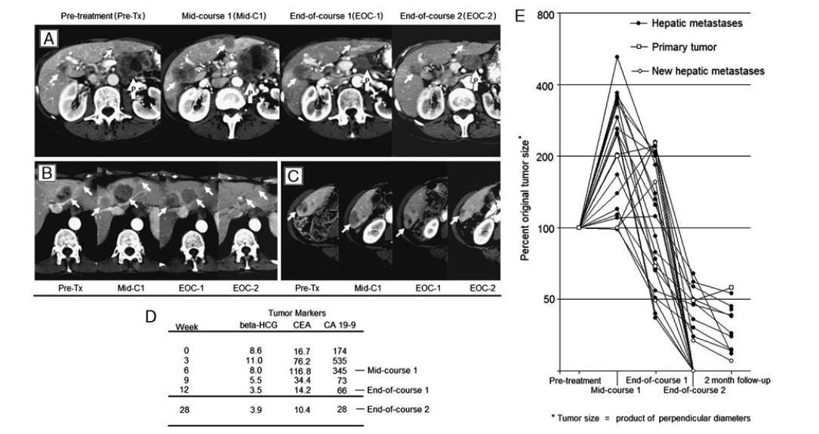
Ipilimumab
Phase 2 Trial: Delayed Tumor Response
Royal RE, et al. J Immunother. 2010;33:828-833. Reproduced with permission from Wolters Kluwer Health, Inc.
Notes:
Moving to the issue of immune therapies and genetic profiling in PDAC. So firstly, do checkpoint inhibitors work? We have some older data. This particular study looks at ipilimumab, the anti-CTLA-4. There was 1 individual who had a delayed response.

Slide 45
Randomized Phase 2 Trial (ALPS)
Durvalumab (D) + Tremelimumab vs D
O’Reilly EM, et al. Gastrointestinal Cancers Symposium, 2018. NCT02558894
Notes:
Single-agent checkpoints have some limited activity. We know that patients with MSI-high mismatch repair-deficient disease are those who certainly stand to potentially benefit from checkpoint inhibitors, but for most people with advanced PDAC, single-agent checkpoint inhibitors are insufficient, and that leads to a variety of combination approaches. So, "Okay, 1 checkpoint is insufficient. What about 2?" This trial suggests to us that 2 does not move the bar in a meaningful way for patients unselected with advanced PDAC.

Slide 46
PARKER Consortium
First-Line Phase 1b/2 Trial: Results Pending
Gemcitabine/nab-P,
Nivolumab
Patients
R
A
N
D
O
M
I
Z
E
D
R
A
N
D
O
M
I
Z
E
D
Untreated Stage IV PDAC
ECOG 0-1
(N=105 [35/arm])
Gemcitabine/nab-P, CD40 (APX005M)
Gemcitabine/nab-P, Nivolumab, APX005M
NCT03214250
Notes:
But I think a very interesting strategy that's being assessed now across a number of platform studies, and this is an example of Parker Institute Consortium trial, is looking at combination chemo and immunotherapy in a frontline setting with patients with untreated advanced PDAC. This particular study is looking at nivolumab or CD40 or the combination of both nivolumab and the agonistic antibody CD40 with frontline therapy. And this has completed phase 1B testing and is actively accruing in a randomized phase 2 setting.
Given the technological advances facilitating genetic subtyping of PDAC, the relevant question has become whether mutational signatures can be used to develop personalized therapy for patients with this cancer? Recent data strongly suggest that, indeed, mutational signatures may be used to guide personalized treatment approaches for a subset of patients with PDAC.

Slide 47
PDAC
MSI-H, dMMR and Testing
Occurs in:
Germline mutation in MMR genes: MLH1, MSH2, MSH6, PMS2
Hypermethylation of MLH1 (BRAF V600), MSH6 promotors, Cp6 island methylator phenotype (CIMP)
Testing
  IHC mismatch repair protein expression
  PCR amplification of microsatellites (5 markers): >2= MSI-H
  Can’t identify specific gene
Next generation sequencing
  Mutation load
  MSI Sensor score (low purity, low coverage)
Niu B, et al. Bioinformatics. 2014;30:1015-1016.
Notes:
Next, the issue of mismatch repair testing in PDAC. We know there are a variety of ways to do it. Classic ways are using IHC to look for loss of protein expression or for PCR analysis looking for microsatellite. Increasingly, and I would say in particular in PDAC, because of some of these antigens that next generation sequencing brings in terms of tissue conservation and learning about other therapeutic opportunities, we have ways of assessing mutation load and bioinformatics analysis to evaluate MSIsensor score.

Slide 48
PDAC
Pembrolizumab Approval 2017*
Single-arm, non-randomized, 5 trials N= 149
MMR status determined via IHC or MSI
  Results
  Overall RR 40%: 7% CRs, 32% PRs; 80% duration > 6 mos
  N= 59 MMR-D non-CRC: RR 46% (14 cancer types)
  N= 6 MMR-D PDAC: RR 83% (5/6)
*Disease-agnostic approval based on biomarker
Le DT, et al. N Engl J Med. 2015;372:2509-2520; Le DT, et al. Science. 2017;357:409-413.
Notes:
Here's a reminder regarding pembrolizumab approval, and these are the data that supported that approval. Remember, these were nonrandomized studies. But there are 6 patients in the 5-pool trials that led to approval. Sorry, 6 patients with PDAC in the 5 studies, and there was a high response rate identified in this particular population.

Slide 49
PDAC and MMR-D
MSKCC
N=833 NGS
7/833 (0.8%) MMR-D; all Lynch syndrome (germline)
  MSH2
  4 anti-PD1 therapy; 4 response (1 CR, 2 PR, 1 SD)
  MMR-D PDAC associated with:
  Loss of MMR protein expression
  High mutational tumor load
  Elevated MSI sensor score (> 10)
Hu ZI, et al. Clin Cancer Res. 2018;24:1326-1336.
Notes:
And our group chose to evaluate this in some detail and confirm that mismatch repair-deficient PDAC is rare. We saw it in about 1% of patients, and in this analysis of an ultimately large cohort, all of these patients had an underlying Lynch syndrome, so they had a germline mutation and associated mismatch repair-deficiency gene. We saw that these patients had loss of protein expression, high mutation load, and an elevated MSI sensor score.

Slide 50
PDAC
Mutational Load
Typical PDAC patient
Mutational load 3-4/Mb
MSI-High/MMR
Mutational load > 50/Mb
Hu ZI, et al. Clin Cancer Res. 2018;24:1326-1336.
Notes:
Looking at this graphically, you'll see that typical individual PDAC has 3 to 4 mutations per megabase, but those with mismatch repair deficiency, and again, in this analysis, all germline Lynch syndrome, had a high mutational load. And there's a group of individuals here which have a more intermediate mutational load for which we're currently learning whether or not this might be a possible subgroup for which immune-based strategies may have a role.

