Slide 2
Epidemiology
Global: Women comprise 50% of HIV-infected population
US: Women comprise ~19% new HIV diagnoses
Women from minority populations disproportionately affected
61% African American
19% Caucasian
16% Latina/Hispanic
HIV diagnoses decreasing among women
Acquisition of HIV via injection drug use similar between men and women
Route of transmission differs by race
64% African American women acquire HIV via heterosexual contact vs 16% Caucasian women
UNAIDS Data 2017. http://www.unaids.org/sites/default/files/media_asset/20170720_Data_book_2017_en.pdf
CDC. HIV Among Women. https://www.cdc.gov/hiv/group/gender/women/index.html
CDC. HIV Surveillance Report. 2017.
Notes:
Globally, women comprise approximately half the people living with HIV. However, in the United States, it has always been a disease that has predominately affected men. Right now, women comprise approximately 19% of new HIV diagnoses. HIV diagnoses in women have actually declined over time. However, still 1 out of 5 is a significant proportion of those with HIV, and hence we need to understand how best to treat them. One thing that has been consistent from the beginning of the epidemic, is that women are disproportionately affected with HIV if they come from communities of color. Sixty-one percent of the women with HIV in the United States are African American vs 12%-13% of the general population. Nineteen percent are Caucasian and 16% are Latino or Hispanic. Acquisition of HIV rates, and the route of transmission, does appear to differ by ace. Sixty-four percent of African American women acquire HIV via heterosexual contact vs only 16% of Caucasian women with HIV.

Slide 3
Recommended Initial ART Regimens: 2018
DHHS | IAS
INSTI plus 2 NRTIs: BIC/TAF/FTC (AI) DTG/ABC/3TC (AI)—if HLA-B*5701 negative DTG plus tenofovir /FTC (AI for both TAF/FTC and TDF/FTC) RAL plus tenofovirb /FTC (BI for TDF/FTC, BII for TAF/FTC) | Bictegravir/TAF/emtricitabine Dolutegravir/abacavir/lamivudine Dolutegravir plus TAF/emtricitabine
In women who are pregnant or of childbearing potential, before prescribing one of these regimens:
Test for pregnancy prior to ART initiation
Discuss the benefits and risks of using DTG
BIC is not recommended
EVG is not recommended
DHHS. Guidelines for the use of antiretroviral agents in HIV-1-infected adults and adolescents. 2018.
Saag MS, et al. JAMA. 2018;320(4):379-396
Notes:
What are now the recommended initial antiretroviral regimens? All of them are based on the same principle. They include 2 nucleoside reverse transcriptase inhibitors, [00:04:30] tenofovir and emtricitabine, or abacavir lamivudine. And then they include an unboosted integrase inhibitor, either bictegravir or dolutegravir. The Department of Health and Human Services’ guidelines recommend bictegravir, TAF, FTC; dolutegravir, abacavir, 3TC; dolutegravir plus tenofovir, FTC or TAF FTC; and raltegravir plus tenofovir FTC or TAF FTC. Now these are much more inclusive guidelines than those in the International AIDS Society which were updated in 2018.
Here, just 3 regimens are recommended, all of them containing unboosted integrase inhibitors. Again, bictegravir, TAF, FTC; dolutegravir, abacavir, lamivudine; or dolutegravir plus TAF, emtricitabine. The main difference in these 2 guidelines is that the [inaudible no longer includes raltegravir since it is a 2 pill a day regimen and is not formulated. In addition, dolutegravir and bictegravir [00:05:30] have higher resistance barriers. One thing the guidelines stress is that women who are pregnant or of childbearing potential, before prescribing one of these regimens, we should test for pregnancy before ART initiation, discuss the benefits and risks of using dolutegravir which is an important drug for initial therapy—we'll cover that more in the course of this lecture. Remember that bictegravir is not recommended [for women] who are pregnant because there are very little data on the use of bictegravir in pregnancy. [00:06:00] And also, the boosted integrase inhibitor, elvitegravir should not be used during pregnancy because there are inadequate drug levels, in particular, of cobicistat.

Slide 4
Recently Approved INSTI: Bictegravir
Approved as fixed dose, single-pill combination
Resistance not reported in clinical trials
Percentage of participants with HIV-1 RNA less then 50 copies per mL by visit
Sax PE, et al. Lancet HIV. 2017; 390:2073-2082.
Notes:
let's take a look at a recent clinical trials data on the use of bictegravir as initial therapy. This is a study that was conducted— multinational study—that I was the lead investigator on. It compared bictegravir, TAF, FTC vs dolutegravir, TAF, FTC. The results were very similar. About 90% of patients were successfully treated in both treatment arms. If you look at the protocol analysis, 99% were successfully treated by week 48. Importantly, in neither study arm was there any resistance in any study subject. I think what this study shows us, is that with our currently recommended regimens, essentially all of the people [who] were taking their medications successfully with good adherence are going to be suppressed, virally suppressed.

Slide 5
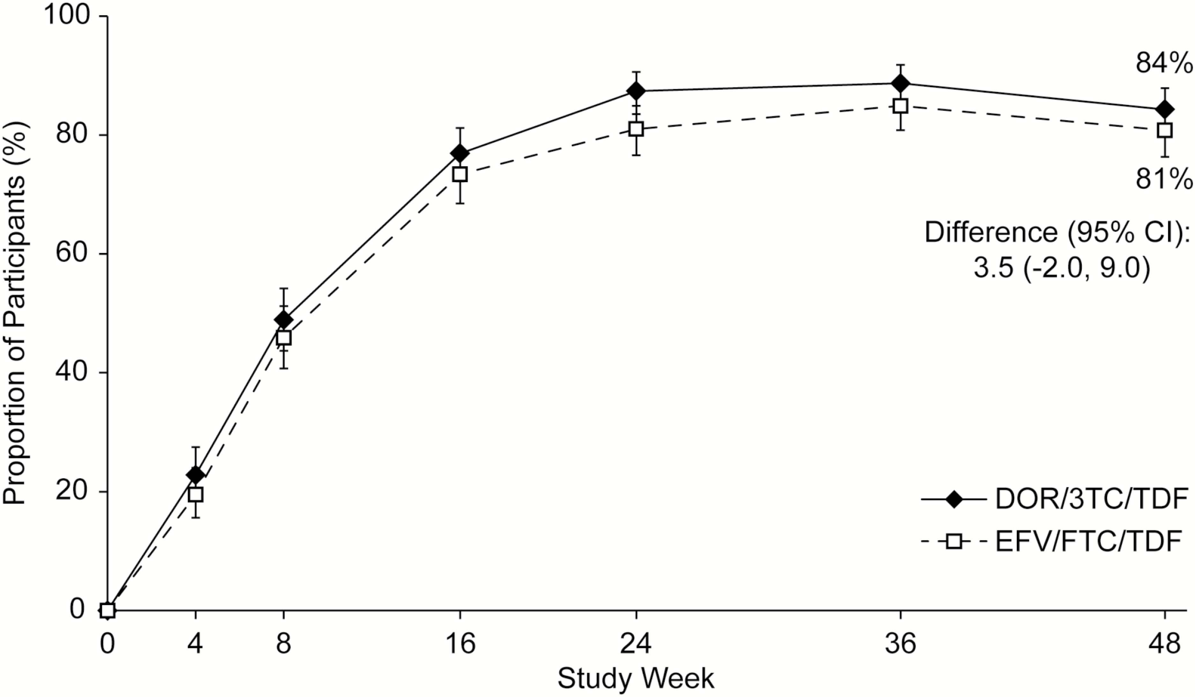
Recently Approved NNRTI: Doravirine
New NNRTI approved September 2018
Comparable virologic efficacy with efavirenz- and darunavir-based regimens in randomized trials
Fewer central nervous system side effects than efavirenz
Better lipid profile than efavirenz and darunavir
Proportion of participants with HIV-1 RNA of less than 50 copies per mL by visit¹
Proportion of participants with Human Immunodeficiency Virus–1 RNA of <50 copies/mL over time²
1. Molina JM, et al. Lancet HIV. 2018;5(5):e211-e220.
2. Orkin C, et al. Clin Inf Dis. 2018. Used under terms of the Creative Commons CC-BY-NC-ND license.
Notes:
One other regimen worth mentioning that is not on the guidelines yet, except as an alternative, is doravirine. Doravirine is a new, non-nucleoside reverse transcriptase inhibitor, approved in September of 2018. It has been shown to have comparable virologic efficacy with efavirenz and darunavir as part of initial regimens in the data shown here on the slide. It's known to have fewer CNS adverse events than efavirenz and a better lipid profile within both efavirenz and darunavir. There are very few women enrolled in these clinical trials, and, as a result, we do not have any experience with doravirine in pregnancy. I should mention though, that the NNRTI class there is a long-standing use of NNRTIs in pregnancy and it's possible that doravirine will have a role for treatment of HIV infected women of childbearing potential in the future.

Slide 6
GEMINI 1 and GEMINI 2: 2018
Phase 3 data for dolutegravir + lamivudine presented 2018*
Study | DTG/3TC, % | DTG/TDF/FTC, %
GEMINI 1 | 90 | 93
GEMINI 2 | 93 | 94
AEs *Headache *Diarrhea *Nasopharyngitis | 10 9 8 | 10 11 11
Drug-related AEs | 18 | 24
Emergent drug resistance | 0 | 0
For treatment-naïve patients who cannot take tenofovir or abacavir
*Cahn P, et al. Presented at the 22nd International AIDS Conference (AIDS 2018), 23-27 July 2018, Amsterdam, The Netherlands.
Cahn P, et al. Lancet. 2018. Epub ahead of print.
Notes:
What about 2-drug combination regimens for initial therapy? The best data come from the GEMINI I and GEMINI II studies which were identical. They compared a 2-drug regimen of dolutegravir lamivudine vs the 3-drug regimen of dolutegravir plus TDF and FTC. As demonstrated in the table, virologic response rates were excellent, again in the low 90% range. There were no patients who developed treatment emergent resistance during the course of the study.
One thing that's important is that the DHHS guidelines now list this regimen, dolutegravir lamivudine as an important option for treatment naïve patients who cannot take tenofovir or abacavir. Because this is really changing the paradigm of HIV therapy, going from 3 drugs to 2 drugs, we await further follow-up data of this regimen to ensure that patients do not develop resistance or other problems.

Slide 7
2-Drug Regimens in Clinical Trials: Cabotegravir + Rilpivirine
Safety and efficacy of monthly dosing in treatment-naïve and treatment-experienced patients
First Long-Acting Injectable Regimen (FLAIR) = cabotegravir + rilpivirine vs abacavir/dolutegravir/lamivudine
Antiretroviral Therapy as Long-Acting Suppression (ATLAS) = cabotegravir + rilpivirine vs any triple-drug combination
Non-inferior to oral therapy*
*https://www.viivhealthcare.com/media/press-releases/2018/viiv-healthcare-reports-positive-48-week-results-for-first-pivotal-phase-iii-study-for-novel-long-acting-injectable-hiv-treatment-regimen.aspx
Notes:
One other 2-drug regimen to mention as a suppressive regimen is cabotegravir and rilpivirine. This is only for treatment-experienced patients who are virologically suppressed. It's a long-acting injection of cabotegravir and rilpivirine and the first of these studies. The FLAIR studies and the ATLAS study, we know from a press release that these are noninferior to continued oral therapy. So when I talked about changing the paradigm with 2-drug treatment, and the dolutegravir lamivudine GEMINI studies, this particular regimen[a once monthly injection of 2 different antivirals—really does change the way we approach treatment. We await data on this in this population that we're discussing today, HIV infected women. There are some data that cabotegravir may have a longer half-life, slower rate of elimination than in women than it does in men. Suggest “and, the first of these studies—the FLAIR studies and the ATLAS study—we know from a press”

Slide 8
Additional Clinical Trials of DTG + 3TC
ASPIRE: Pilot trial of DTG + 3TC vs triple therapy for maintenance of virologic suppression
Results demonstrated no significant difference in treatment failure
TANGO study is designed to evaluate dolutegravir + lamivudine as a switch strategy for subjects receiving triple therapy, including tenofovir alafenamide
Taiwo BO, et al. Clin Inf Dis. 2018;66(11):1794-1797.
Notes:
Additional clinical trials of dolutegravir and lamivudine should be mentioned, including a small pilot study that I was involved in, called ASPIRE, which showed that patients who are switched from a triple-therapy regimen, the dolutegravir lamivudine, did maintain virologic suppression. A much larger study called TANGO is currently ongoing and we expect to see data on the strategy from this study later this year.

Slide 9
Guidelines for HIV Testing
Testing as a foundation for access to treatment and care
Screen adolescents and adults aged 15-65 years
Screen pregnant women for HIV
Including those who present in labor who are untested and show HIV status is unknown
Offer HIV testing to women who are:
Pregnant—off HIV test as early as possible in pregnancy*
Diagnosed with a sexually transmitted infection
Injecting drug users
Sex workers
From countries with a high HIV prevalence
With an HIV-positive partner or a partner at high risk of acquiring HIV
US Preventive Services Task Force. HIV screening. 2013.
*Panel on Treatment of Pregnant Women with HIV Infection and Prevention of Perinatal Transmission. 2019.
Notes:
The current guidelines recommend screening adolescents and adults age 15 to 65, screening pregnant women for HIV, and recent Department of Health and Human Services perinatal guidelines recommend that women should be tested for HIV as early as possible in the pregnancy.
For those women who test HIV negative initially, repeat testing in the third trimester is recommended for those who are at risk for acquiring HIV during the pregnancy, and specifically, it's recommended that women be tested in the third trimester as well if they are in a facility that has an HIV incidence of greater than 1 for 1,000 cases. HIV testing should be offered to women at other times, particularly those who are diagnosed with sexually transmitted diseases, those who inject drugs, commercial sex workers, and women from countries with high HIV prevalence, such as sub-Saharan Africa. Also noteworthy is that women with an HIV-infected partner, or a partner who is at high risk for acquiring HIV, should be tested as well

Slide 10
Barriers to HIV Testing Often Delay or Prevent Access to Care for Women
Psychological
Fear of disclosure
Social/Economic
Low familiarity with testing
Cultural mistrust
Access to care
Poverty
Sexism
Stigma
Lack of discretion at testing facility
Denial
Lack of insurance
Physical
Risk of intimate partner violence
Racism
There are common barriers among women as well as group-specific cultural and ethnic barriers.
McDougall GJ, Jr., et al. HIV/AIDS 2016;2016(Se1):S9-s13; Messer LC, et al. AIDS Patient Care STDs. 2013;27(7):398-407; Gruskin L, et al. J Urban Health. 2002;79(4):512-524.
Notes:
Barriers to HIV testing among African American and other populations of women include lack of access to health care services, internalized stigma and fear about a reactive HIV test result, and concerns about privacy and confidentiality.

Slide 11
Barriers to HIV Testing: Immigrant Women
Study in Washington DC showed that few East African women seek HIV testing due to the barriers below:
Assumptions | Emotions | Potential Reactions
Implies I have engaged in ‘bad behavior’ Implies I am HIV positive | Fear of HIV diagnosis and what it might mean for me Worry about others’ gossip and negative judgments Worry that HIV information is not confidential Discomfort with invasive questions | Getting an HIV test can: Signal distrust, disrespect, infidelity Lead to argument with family members
De Jesus M, et al. Sex Trans Inf. 2015;91(8):569-575.
Notes:
Specific barriers have been identified among certain groups of women, for example immigrant women. And in this slide, a study in Washington, DC, that assessed barriers among women immigrating from East Africa show that there were assumptions that they felt that individuals would have about them, such as they’re HIV positive—even if they've tested negative. There were emotions, a fear of diagnosis, a discomfort about the questions, and also, there were potential reactions that are shown there which suggested a lack of trust in the health care institution, and also a fear of reaction among family members. And I think just really having an understanding of the wide range of barriers that various populations experience is an important understanding to have

Slide 12
Barriers to HIV Testing: Transgender Women
Low awareness of HIV status¹
Social challenges:
Accessing health care
Incarceration
Homelessness
Sex work
Limited education
Lack of support if test is positive²
Apprehension about using health care services that are stigmatizing to transgender women
Cost of testing²
1. Bukowski LA, et al. J Acquir Immune Defic Syndr. 2018; 2. Frye V, et al. AIDS Patient Care STDs. 2015;29(11):617-624.
Notes:
Transgender women have a very high prevalence of HIV infection and also have a very high prevalence of undiagnosed HIV infection, well in excess of 2-times the general population in the US. And I think therefore this is a really important group to consider. There are social challenges shown there. This was based on a study of transgender women that associated incarceration, homelessness, sex work, and limited education, with decreased access to HIV testing. Other factors have been identified, as well such as a lack of support if the tests were to be positive. And so I think it's critically important to understand that transgender women are an important group in which HIV testing should be done, and that there may be special barriers affecting testing in that group of individuals.

Slide 13
Opportunities for HIV Testing in Women
When seeking contraceptive advice
Accessing pregnancy-related services including termination
Undergoing breast screening or Pap tests
Incarceration settings provide an opportunity to test women not accessing other services
Offer HIV testing for women across the reproductive continuum
DHHS. Guidelines for the use of antiretroviral agents in HIV-1-infected adults and adolescents. 2018.
Notes:
I think there are a lot of opportunities for HIV testing among women. I think often in busy practices, we miss those. And some of those are shown here at the time of contraceptive prescription, accessing pregnancy relating services, or ongoing preventive care, such as breast screening and pap smears. In addition, incarceration settings also provide an opportunity to test women who may not have availability of HIV testing services at other times.

Slide 14
Facilitators in HIV Testing Among Women
Level | Facilitator
Patient | Already sick and seeking care Pregnant—not wanting to infect fetus Partner/drug-partner testing Partner tested positive
Provider | Good relationship Testing included in annual exam
Clinic | Responsive clinic environment Counseling provided to support self-care Testing part of ongoing care Interdisciplinary care
Community | Community awareness of HIV, risk factors, and testing availability Routine testing Availability of testing in prison and syringe exchange sites
Messer LC, et al. AIDS Patient Care STDs. 2013;27(7):398-407; De Jesus M, et al. Sex Trans Inf. 2015;91(8):569-575.
Notes:
The factors shown have been demonstrated to be facilitators of HIV testing among women. I think that it's important ... there are important critical times in individual's lives such as when they're pregnant and not wanting to infect [the] fetus, that an individual may be more receptive to HIV testing. I think providers, it's incumbent that testing be included in annual exams, sort of the routinization of HIV testing is critically important. And I think it goes without saying, obviously, a trusting, good relationship between the health care provider and the patient is really essential to facilitate testing.
I think, also, clinic environments are important. Those environments that really offer privacy as well as counseling to promote self-care are important. And then community awareness is critically important. There have been a number of media campaigns in recent years in various areas that have shown to be an effective in increasing HIV testing. I would add also that given the increase in some areas of the country with injection drug use, syringe exchange sites are a very important site where individuals at risk and increased risk for HIV infection can be tested.

Slide 15
ART Initiation for Women with HIV
ART increases life expectancy among HIV-seropositive individuals¹
Current guidelines recommend ART for all HIV-seropositive people to reduce disease progression and prevent HIV transmission²
Overall ART efficacy similar for women and men³
Lower virologic suppression among black women in US vs white women⁴
1. Samji H, et al. PloS One. 2013;8(12):e81355; 2. DHHS. Guidelines for the Use of Antiretroviral Agents in Adults and Adolescents Living with HIV. 2018; 3. Soon GG, et al. AIDS Patient Care STDs. 2012;26(8):444-453; 4. Nwangwu-Ike N, et al. JAIDS. 2018;79(2):e56-e68.
Notes:
Multiple studies have demonstrated that early treatment with antiretroviral therapy (ART) reduces disease progression, prevents HIV transmission, and increase life expectancy among HIV infected individuals.¹ Current 2018 Department of Health and Human Services Guidelines for the Use of Antiretroviral Agents in HIV-1-Infected Adults and Adolescents recommend initiation treatment for all HIV-sero-positive persons.² Overall, studies have shown similar efficacy of ART among men and women,³ though a number of studies have demonstrated lower virologic suppression rates among black women in the United States (US) vs white US women.⁴ It is important to initiate ART as soon as possible after establishing a diagnosis, and, if possible, the same day.² Both DHHS and International AIDS Society guidelines recommend integrase inhibitors,⁵ the newest class of antiretroviral agents, which are associated with excellent tolerability and convenience for patients.
Bictegravir, dolutegravir, and raltegravir are recommended in combination with 2 nucleoside reverse transcriptase agents, either tenofovir or abacavir, and then either 3TC or FTC. Prior to ART selection, clinicians are advised to discuss a plan for contraception with women who have no plans to conceive and provide counseling about safe sex practices. A pregnancy test should be conducted in all women before prescribing antiretroviral therapy.
References
Samji H, Cescon A, Hogg RS, et al. Closing the gap: increases in life expectancy among treated HIV-positive individuals in the United States and Canada. PloS One. 2013;8(12):e81355.
Panel on Antiretroviral Guidelines for Adults and Adolescents. Guidelines for the use of antiretroviral agents in HIV-1-infected adults and adolescents. Department of Health and Human Services. 2018. https://aidsinfo.nih.gov/guidelines/html/1/adult-and-adolescent-arv/10/initiation-of-antiretroviral-therapy
Soon GG, Min M, Struble KA, et al. Meta-analysis of gender differences in efficacy outcomes for HIV-positive subjects in randomized controlled clinical trials of antiretroviral therapy (2000-2008). AIDS Pat Care STDs. 2012;26(8):444-453.
Centers for Disease Control and Prevention. Vital signs: HIV prevention through care and treatment -- United States. MMWR Morb Mortal Wkly Rep. 2011;60:1618-1621.
Saag MS, et al. JAMA. 2018;320(4):379-396

Slide 16
Best Practices in Initiating ART
Initiate ART as soon as possible after establishing a diagnosis of HIV infection
Address barriers to ART initiation
Depression
Cognitive problems
Alcohol/drug use
Review
Social support
Health insurance + continuity of medication supply
Therapy-related factors
Offer preconception counseling and discuss options for pregnancy
Continue this conversation throughout HIV care continuum
Discuss contraceptive choices and drug interactions with oral contraceptive agents
DHHS. Guidelines for the use of antiretroviral agents in HIV-1-infected adults and adolescents. 2018.
Notes:
A number of best practices that have been identified in initiating antiretroviral therapy among women are shown on this slide. It has, in recent years, become important to initiate antiretroviral therapy as soon as possible after establishing a diagnosis. Indeed, there are successful programs that initiate antiretroviral therapy the same day as diagnosis. However, I would say that it is critically important to personalize that to the individual situation of the patient and the availability of doing this in any particular community.
Three barriers that are important to address before antiretroviral initiation, are shown: depression, cognitive problems, and substance use and alcohol. Also important is a review of social support, health insurance, and the ability to assure continuity of antiretroviral therapy once prescribed. Nothing is worse for the patient than to get a prescription and then subsequently find that the health insurer will not cover that particular drug. So it's really, I think, incumbent on us to figure those things out ahead of time.
Also important for women of childbearing age is a discussion of options for pregnancy if pregnancy is desired, and certainly the availability of contraception, if that is a choice of the women. It's important that these things are identified before initiation of treatment because they effect selection of the antiretroviral agent, as we'll discuss.

Slide 17
Recommended Initial ART Regimens: 2018
DHHS | IAS
INSTI plus 2 NRTIs: BIC/TAF/FTC (AI) DTG/ABC/3TC (AI)—if HLA-B*5701 negative DTG plus tenofovir /FTC (AI for both TAF/FTC and TDF/FTC) RAL plus tenofovir /FTC (BI for TDF/FTC, BII for TAF/FTC) | Bictegravir/TAF/emtricitabine Dolutegravir/abacavir/lamivudine Dolutegravir plus TAF/emtricitabine
In women who are pregnant or of childbearing potential, before prescribing one of these regimens:
Test for pregnancy prior to ART initiation
Discuss the benefits and risks of using DTG
BIC is not recommended
EVG is not recommended
DHHS. Guidelines for the use of antiretroviral agents in HIV-1-infected adults and adolescents. 2018.
Saag MS, et al. JAMA. 2018;320(4):379-396
Notes:
Shown in this slide are the most recent recommendations for initiation of antiretroviral therapy. It's on the left side is the Department of Health and Human Services, the US recommendations, and on the right are the International AIDS Society, and they're remarkably similar. All ... both sets of recommendations really are focusing on integrase inhibitors, the newest class of antiretroviral agents, and they've been a class that's really been associated with excellent tolerability and convenience.
The alphabet soup is showing, but basically, if you look at the DHHS bictegravir, dolutegravir, raltegravir, are the 3 integrase inhibitors that are recommended in combination with 2 nucleoside reverse transcriptase agents, either tenofovir or abacavir, and then either 3TC or FTC. And as you can see, they're remarkably similar to the IAS recommendations.
In the discussion before selection of antiretroviral therapy, when clearly the woman has said she has no plans to conceive, and I would suggest that no plans to conceive really includes then a plan for contraception, or obviously, in the event if the woman is not really of childbearing potential, if she has had a hysterectomy or tubal ligation, I think that counseling about safe sex practices is really critical, and a pregnancy test should be conducted in all women before prescribing antiretroviral therapy.
The choice should be guideline-driven. I think some important points that should be considered when prescribing antiretroviral therapy to the women with no plans for conception, and I would add that that then means that there is a plan for contraception, or that perhaps she's not of childbearing potential, perhaps she's had a tubal ligation or a hysterectomy. But this is clearly for the individuals who are not planning to conceive.
A pregnancy test, however, should be conducted in all women before prescribing antiretroviral therapy. If oral contraceptives or hormonal contraceptives are to be prescribed, one needs to consider that some antiretroviral agents, most commonly the boosted protease inhibitors or efavirenz, may have drug interactions with some antiretroviral agents, though by and large, one of the attractive issues with integrase inhibitors is they have fewer drug-drug interactions. If a dolutegravir regimen is selected, the patient should be advised to the potential birth defects that have been recently associated with this drug, and we will discuss those in just a minute.
Other considerations when selecting an antiretroviral therapy should be the pill burden. There are many 1 pill, once-a-day regimens, though some, even in the DHHS recommended guidelines, have more than 1 pill. Dosing frequency. We talked about the potential for drug interactions. But there are others, for example, comorbidities. Some antiretrovirals, for example, the bictegravir, tenofovir alafenamide, and emtricitabine, is not recommended in individuals who have a creatinine clearance less than 30. So it's important to really identify if any comorbidities exist.
Also important is to identify the presence of resistance to antiretroviral agents. Even though individuals may not have been on antiretroviral agents in the past—it's a new diagnosis—it is not infrequent that there is transmission of drug resistance at the time of HIV acquisition, and so a resistance test should be done for all individuals. And then special considerations, there are some regimens, though none of those on the top recommended list for CD4 and viral load requirements, so one needs to bear that in mind. And the other is that the HLA-B*5701 testing must be done in the event that you are planning to prescribe abacavir. HLA-B*5701 actually predicts occurrence of a hypersensitivity which can be a life-threatening complication, so it's important to remember that.

Slide 18
ART for Women With No Plans to Conceive
Comprehensive reproductive and sexual health counseling for women who are HIV positive
Safe sex practices
Reproductive desires and options
A pregnancy test should be conducted in all women before prescribing ART
Select ART based on efficacy and safety – usually this means selection of DTG or BIC as initial therapy
Consider that some ARVs have significant PK interactions with hormonal contraceptive
If DTG regimen selected, advise patient of potential for birth defects and emphasize need for adherence to contraceptive regimen
DHHS 2018 Recommendations | IAS 2018 Recommendations
INSTI plus 2 NRTIs: BIC/TAF/FTC (AI) DTG/ABC/3TC (AI)—if HLA-B*5701 negative DTG plus tenofovir /FTC (AI for both TAF/FTC and TDF/FTC) RAL plus tenofovir /FTC (BI for TDF/FTC, BII for TAF/FTC) | Bictegravir/TAF/emtricitabine Dolutegravir/abacavir/lamivudine Dolutegravir plus TAF/emtricitabine
1. DHHS. Guidelines for the use of antiretroviral agents in HIV-1-infected adults and adolescents. 2018.
2. Saag MS, et al. JAMA. 2018;320(4):379-396.
Notes:
For women who plan to conceive, and this includes women who say, "Yes, I would like to get pregnant in the near future," but also the women who say, "I have no plans to get pregnant," but who have no form of contraception, and I think that you really need, in that case, to also consider that it is not infrequent that an individual will conceive. Treatment-naïve patients who are planning to conceive, and are not using contraception, should switch to an antiretroviral regimen that does not contain dolutegravir. And this is because, as we'll show in a minute, there's been a recent association with dolutegravir and neural tube defects in the infant when dolutegravir was taken at the time of contraception.
Women who become pregnant on efavirenz may continue, as recent analysis has shown no apparent fetal risk of neural tube defect. Animal studies in the drug development of efavirenz demonstrated neural tube defect, however, data now for years suggest that that does not appear to really be ... put the fetus at increased risk for development.

Slide 19
ART for Women With Plans to Conceive
Treatment-naïve women who are either planning to conceive or not using effective contraception should switch to an ART regimen that does not contain dolutegravir due to the potential risk of neural tube defects¹
Women who become pregnant on EFV may continue as recent metanalysis show no apparent excess fetal risk²
1. DHHS. Guidelines for the use of antiretroviral agents in HIV-1-infected adults and adolescents. 2018.
2. Zash R, et al. JAID. 2016;71(4):428-436.
Notes:
There has been a recent association of dolutegravir at conception with neural tube defects. The Botswana and Harvard partnership actually changed in 2016 to routinely providing dolutegravir regimens for all individuals starting on antiretroviral therapy. An unplanned review of outcomes in the spring of 2018 demonstrated that individuals who ... women who were on dolutegravir at conception had a much higher risk for having an infant with a neural tube defect.

Slide 20
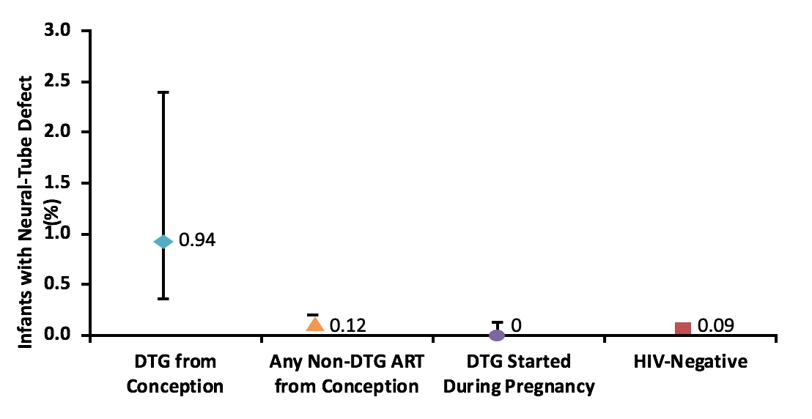
DTG at Conception and Neural Tube Defects
Updated prevalence of DTG exposure at conception is 4/596 (0.67%, 95% CI 0.26%, 1.7%)
-- 95% CI still does not overlap with any other exposure group
No. of Infants with Defect | 4 | 4 | 14 | 0 | 61
No. of Exposures | 426 | 596 | 11,300 | 2812 | 66,054
Percent with Defect (95% CI) | 0.94 (0.37 to 2.4) | 0.67 (0.26-1.7) | 0.12 (0.07 to 0.21) | 0.0 (0.0 to 0.13) | 0.09 (0.07 to 0.12)
Difference in Prevalence | Reference |  | –0.82 | –0.9489 | –0.85
(95%-CI, Percentage Points) |  |  | (–0.24 to –2.3) | (–0.35 to –2.4) | (–0.27 to –2.3)
Zash R, et al. AIDS 2018. 23–27 July 2018. Symposia session TUSY15.
Notes:
Neural tube closure occurs in the third to fourth week following conception or the fifth to sixth week of gestation; therefore, the most vulnerable period for the development of neural tube defects (NTDs) is in preconception and first trimester exposures to antiretroviral therapy (ART).
In 2018, a large study in Botswana reported that 4 infants with NTDs were born to HIV-infected women with HIV using dolutegravir (DTG) at conception.¹ Subsequent studies have examined this putative link between antiretroviral therapy (ART) and NTD. Data from the Canadian Perinatal HIV Surveillance Program, and other small cohorts in Frankfurt and Eastern/Central Europe, presented at HIV Glasgow, confirmed no additional association between DTG and NTDs.²⁻⁴ However, researchers caution that sample sizes are small and additional data are required.
1.Zash R, Makhema J, Shapiro R. Neural-tube defects with dolutegravir treatment from the time of conception. N Engl J Med. 2018 Sep 6;379(10):979-981.
2. Money D et al. An analysis of congenital anomalies in pregnant women living with HIV in Canada: no signal for neural tube defects in women exposed to dolutegravir. HIV Glasgow. 28–31 October 2018. Glasgow, UK. Poster abstract P001.
3. Weisman D et al. Use of integrase inhibitors in HIV-positive pregnant women: data from the Frankfurt HIV Cohort. HIV Glasgow. 28–31 October 2018. Glasgow, UK. Poster abstract P002.
4. Kowalska J et al. Exposure to dolutegravir in pregnant HIV-positive women in Central and Eastern Europe and neighbouring countries: data from the ECEE Network Group. HIV Glasgow. 28–31 October 2018. Glasgow, UK. Poster abstract P004.

Slide 21
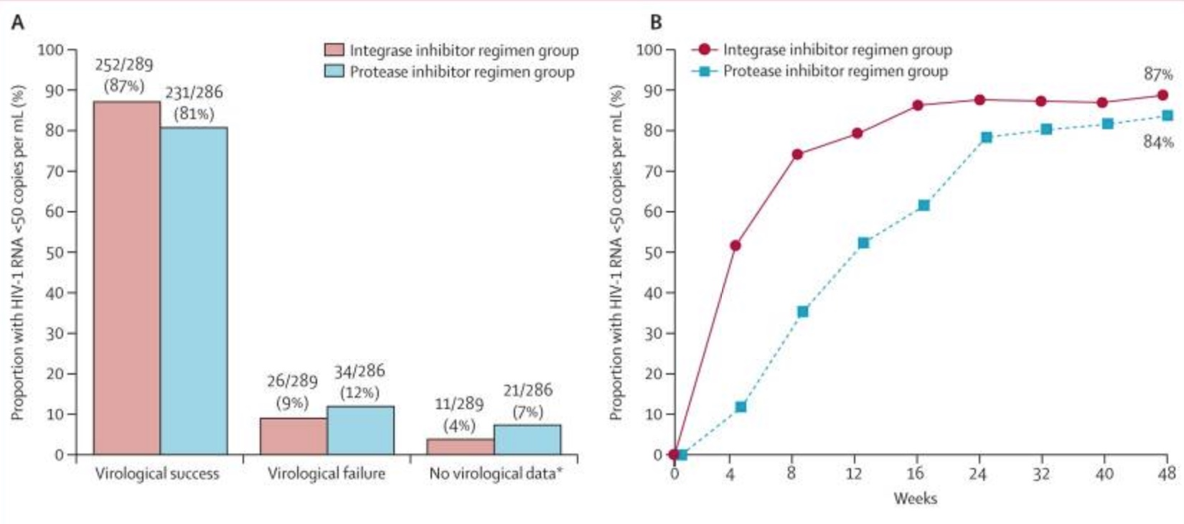
WAVES: Comparison of 2 ART Regimens in Treatment-Naïve Women
n=575, EVG/COBI/FTC/TDF vs ATV + RTV/FTC/TDF
87% in integrase inhibitor group had plasma HIV-1 RNA <50 copies/mL vs 81% in protease inhibitor group
No virologic failure with resistance in integrase group vs 1% in protease group
Proportion of participants who were responders
Proportion of participants with HIV-1 RNA load <50 copies/mL
Squires K, et al. Lancet HIV. 2016;3(9):e410-e420.
Notes:
Looking at a comparison of antiretroviral regimens among naïve women. Over the past couple of years, there have been just a few trials done exclusively among women, and that's important because historically, antiretroviral trials had small percentages of women on the order of 10% or 20%. The data shown in the WAVES study compared 2 regimens. One was the integrase regimen, elvitegravir, boosted with cobicistat, and emtricitabine, and tenofovir, compared with a ritonavir-boosted atazanivir along with tenofovir and emtricitabine. And as you can see, both groups had a high rate of viral suppression that were not significantly different, and there was no virologic failure with resistance in the integrase group vs 1% in the protease group.
I think noteworthy is, on the graph of viral suppression, the integrase group showing in red does actually attain virologic suppression sooner, and that is really seen across the class of integrase inhibitors compared with older, either non-nucleoside reverse transcriptase or a protease regimens.
I think given the previous discussion of dolutegravir, it begs the question what do we know about neural tube defects among other integrase inhibitors? We don't have a lot of data about that. In fact, one of the issues is newly-approved antiretroviral agents usually do not have substantial pregnancy data for years after they are approved, and often it's the antiretroviral pregnancy registry [that] is critically important to be able to understand whether these drugs are safe or not.

Slide 22
Risk of Neural Tube Defects in Infants Exposed to Elvitegravir or Bictegravir in Utero
Analysis of global safety database identified 630 pregnancies with EVG exposure
No prospective cases of NTDs reported
One retrospective case of an NTD reported in a pregnancy of a woman exposed to EVG prior to conception
No cases of NTDs reported among 25 BIC-exposed pregnancies
Currently no evidence of increased NTDs risk with EVG- or BIC-containing products during pregnancy
Pharmacovigilance monitoring is ongoing
Total Pregnancy Reports, n (%) | Prospective Reports (n = 264; 41.9%) |  |  | Retrospective Reports (n = 318; 50.5%) |  |  | Unknown if Retrospective or Prospective (n = 48; 7.6%) |  |  | Total
 | Preconcep-tion or 1st Trimester | After 1st Trimester | Unknown | Preconcep-tion or 1st Trimester | After 1st Trimester | Unknown | Preconcep-tion or 1st Trimester | After 1st Trimester | Unknown
EVG exposure | 155 (24.6) | 22 (3.5) | 87 (13.8) | 218 (34.6) | 69 (11.0) | 31 (4.9) | 16 (2.5) | 3 (0.5) | 29 (4.6) | 630
APRegistry 2018. 2. Farrow T, et al. Glasgow 2018. Abstract P030.
Notes:
Similarly, at present, there is no evidence of increased NTDs risk with integrase inhibitors elvitegravir (EVG)- or bictegravir (BIC)-containing products during pregnancy. Analysis of a global safety database with 630 pregnancies exposed to EVG found no prospective cases of NTDs.¹ One retrospective case was reported of an NTD in a pregnancy of a woman exposed to EVG prior to conception. The same study reported no cases of NTDs among 25 BIC-exposed pregnancies. Pharmacovigilance monitoring is ongoing.
1. Farrow T, Deaton C, Ngyuen N, et al. Cumulative safety review of elvitegravir and bictegravir use during pregnancy and risk of neural tube defects. Presented at HIV Glasgow, 28-31 October 2018. Abstract P030.

Slide 23
Considerations for Therapy Selection
Pill burden
Dosing frequency
Potential for drug interactions
Food requirements
Comorbidities
Presence of resistance to antiretroviral agents
Special considerations:
CD4 and/or viral load requirements
HLA-B 5701 testing
1. DHHS. Guidelines for the use of antiretroviral agents in HIV-1-infected adults and adolescents. 2018.
2. Zash R, et al. JAID. 2016;71(4):428-436.
Notes:
Zash R, Souda S, Chen JY, et al. Reassuring Birth Outcomes with Tenofovir/Emtricitabine/Efavirenz used for Prevention of Mother to Child Transmission of HIV in Botswana. Journal of acquired immune deficiency syndromes (1999). 2016;71(4):428-436.

Slide 24
ART Regimens in Pregnancy
Many women with HIV are diagnosed during pregnancy
Women with HIV may choose to become pregnant
ART in pregnancy has reduced HIV transmission rate to newborn from approximately ~30% to <1% in resource-rich settings¹
Early ART initiation in pregnancy = effective strategy for achieving viral load suppression²⁻³
Dosing increases might be warranted for some women during pregnancy, particularly antiretroviral-experienced women
eg, Atazanavir to 400 mg daily, boosted with low-dose 100 mg ritonavir
eg, Darunavir-ritonavir 600mg/100mg twice daily
1. CDC. MMWR. 2006;55(21):592-7; 2. Patel M, et al. JIAPAC. 2018;17:232; 3. Gilbert EM, et al. J Human Pharm Drug Ther. 2015;35(9):838-55; 4. DHHS. Recommendations for Use of Antiretroviral Drugs in Pregnant HIV-1-Infected Women for Maternal Health and Interventions to Reduce Perinatal HIV Transmission in the United States. 2018.
Notes:
Centers for Disease Control and Prevention (CDC). Achievements in public health. Reduction in perinatal transmission of HIV infection--United States, 1985-2005. MMWR Morb Mortal Wkly Rep. 2006 Jun;55(21):592-7.
Patel M, Tedaldi E, Armon C, Nesheim S, Lampe M, Palella Jr F, Novak R, Sutton M, Buchacz K. HIV RNA Suppression during and after Pregnancy among Women in the HIV Outpatient Study, 1996 to 2015. Journal of the International Association of Providers of AIDS Care (JIAPAC). 2018 Jan 20;17:2325957417752259.
Gilbert EM, Darin KM, Scarsi KK, McLaughlin MM. Antiretroviral pharmacokinetics in pregnant women. Pharmacotherapy: The Journal of Human Pharmacology and Drug Therapy. 2015 Sep 1;35(9):838-55.
Panel on Treatment of HIV-Infected Pregnant Women and Prevention of Perinatal Transmission. Recommendations for Use of Antiretroviral Drugs in Pregnant HIV-1-Infected Women for Maternal Health and Interventions to Reduce Perinatal HIV Transmission in the United States. http://aidsinfo.nih.gov/guidelines/html/3/perinatal-guidelines/0/ (Accessed on October 19, 2017).

Slide 25
Effects of Pregnancy on ART Adherence
Pregnant women are more likely to adhere to ART regimens
Increased confidence in ART effectiveness
Improved safety profiles of ART regimens
Benefits of ART¹⁻⁴
Having an uninfected baby
Living to experience motherhood
1. Black S, et al. AIDS Care. 2014;26(6):736–741; 2. Elwell K. AIDS Care. 2016;28(8):971–975; 3. Katirayi L, et al. J Int AIDS Soc. 2016;19(1):20919; 4. Treffry-Goatley A, et al. PLoS ONE. 2016;11(2):e0148801.
Notes:
Black S, Zulliger R, Marcus R, Mark D, Myer L, Bekker LG. Acceptability and challenges of rapid ART initiation among pregnant women in a pilot programme, Cape Town, South Africa. AIDS Care. 2014;26(6):736–741.
Elwell K. Facilitators and barriers to treatment adherence within PMTCT programs in Malawi. AIDS Care. 2016;28(8):971–975.
Katirayi L, Namadingo H, Phiri M, et al. HIV-positive pregnant and postpartum women’s perspectives about option B+ in Malawi: A qualitative study. J Int AIDS Soc. 2016;19(1):20919.
Treffry-Goatley A, Lessells R, Sykes P, et al. Understanding specific contexts of antiretroviral therapy adherence in rural South Africa: A thematic analysis of digital stories from a community with high HIV prevalence. PLoS ONE. 2016;11(2):e0148801.

Slide 26
Birth Outcomes in Pregnancy: Dolutegravir vs Efavirenz-Based Regimens
Any adverse birth outcome | DTG-based ART (n=1729) | EFV-based ART (n=4593)
No. of women Unadjusted relative risk Adjusted relative risk Unadjusted risk difference Adjusted risk difference | 574 (33.2%, 31.0-35.5) 0.95 (0.88 to 1.03) 0.95 (0.88 to 1.03) -1.77% (-4.38 to 0.85) -1.76% (-4.39 to 0.87) | 1606 (35.0%, 33.6 to 36.4) 1 (ref) 1 (ref) 1 (ref) 1 (ref)
Any severe birth outcome
No. of women Unadjusted relative risk Adjusted relative risk Unadjusted risk difference Adjusted risk difference | 185 (10.7%, 9.3 to 12.3) 0.95 (0.81 to 1.11) 0.95 (0.81 to 1.11) 0.60% (-.2.32 to 1.12) 0.51% (-2.27 to 1.23) | 519 (11.3%, 10.4 to 12.3) 1 (ref) 1 (ref) 1 (ref) 1 (ref)
Zash R, et al. Lancet Glob Health. 2018 Jul;6(7):e804-e810.
Notes:
Zash R, Jacobson DL, Diseko M, Mayondi G, Mmalane M, Essex M, Gaolethe T, Petlo C, Lockman S, Holmes LB, Makhema J, Shapiro RL. Lancet Glob Health. 2018 Jul;6(7):e804-e810. doi: 10.1016/S2214-109X(18)30218-3. Epub 2018 Jun 4.

Slide 27
Treatment-Naïve Women Who are Pregnant
Recommendations for Use of Antiretroviral Drugs in Pregnant HIV-1-Infected Women
Preferred 2-NRTI ABC/3TC TDF/FTC or TDF/3TC | Alternative 2-NRTI ZDV/3TC
Preferred PI ATV/r plus preferred 2-NRTI DRV/r plus preferred 2-NRTI | Alternative PI LPV/r plus preferred 2-NRTI
Preferred Integrase Inhibitors RAL plus preferred 2-NRTI | Alternative Integrase Inhibitors EFV plus preferred 2-NRTI RPV/TDF/FTC (or RPV plus preferred 2-NRTI)
DHSS recommends against dolutegravir in women of childbearing potential who plan to conceive or are not using effective contraception
DHSS. Recommendations for Use of Antiretroviral Drugs in Pregnant HIV-1-Infected Women for Maternal Health and Interventions to Reduce Perinatal HIV Transmission in the United States. 2018.
Notes:
WHO guidance = tenofovir, lamivudine (or emtricitabine) and dolutegravir for adults + adolescents
Use with caution in women of childbearing potential
Can be used in women after 8 weeks gestation
BUT: DHSS. https://aidsinfo.nih.gov/guidelines/html/3/perinatal/489/table-9--arv-drug-use-in-pregnant-hiv-infected-women

Slide 28
DTG at Conception and Neural Tube Defects: Update
From 1 May-15 July, there were 2 more NTDs; 1 in an infant exposed to DTG started during pregnancy (8 weeks GA) and 1 birth to an HIV-uninfected woman
NTDs in DTG started in pregnancy: 1/3104 (0.03%, 95% CI 0.01%, 0.18%)
Updated prevalence of DTG exposure at conception is 4/596 (0.67%, 95% CI 0.26%, 1.7%)
Women who become pregnant while taking dolutegravir can continue taking this agent
Potential to switch if last menstrual period was within prior 8 weeks
Zash R, et al. AIDS 2018; Amsterdam, the Netherlands; July 23-27, 2018; Abst. TUSY1502.
DHSS. Recommendations Regarding the Use of Dolutegravir in Adults and Adolescents with HIV who are Pregnant or of Child-Bearing Potential. 2018.
Notes:
I want to update us on the data from dolutegravir taken at the time of conception and neural tube defects. So, after the initial publication of the data that Sally presented, there were 2 more babies who had neural tube defects. One in an infant who was exposed to dolutegravir started during pregnancy, very early on. And it's hard to know whether that's related to this adverse event. The second was in a woman who was HIV uninfected and so obviously she did not receive dolutegravir, so this lowered the estimate of neural tube defects in dolutegravir exposed women who conceived while receiving dolutegravir, somewhat. They've now projected that if there are no more cases, then the upper bound of the confidence might overlap with efavirenz. Even if there is 1 more case it might overlap with other ART. So, I think the point of showing this data is that the data on dolutegravir and neural tube defects are out there. It's a small number of cases—4. We don't know about causality yet and I think we really need to await further data before making any definitive conclusions, but for now, some of the cautionary language that I'm going to tell you about in these coming slides are necessary.

Slide 29
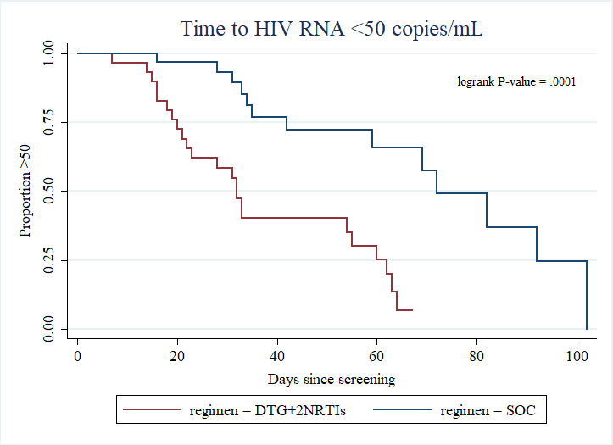
DOLPHIN: DTG vs EFV-based therapy in mothers initiating antiretroviral treatment in late pregnancy (28-36w gestation)
ITT (M=F) | DTG (N = 29) | EFV (N = 31) | P value **
HIV-1 RNA level at PP visit
<50 copies/mL * | 20 (69.0%) | 12 (38.7%) | 0.02
≥50 copies/mL | 9 (31%) | 19 (61.3%)
* <50 copies/mL or UD (Roche Ampliprep Cobas Taqman HIV-1 2.0)
** Pearson Chi-squared
Includes individuals missing or discontinued by visit
DTG = dolutegravir; EVF = efavirenz
Orrell C, et al. Presented at AIDS 2018, Amsterdam, the Netherlands; July 23-27,. Abst. THAB0307LB.
Notes:
I do want to mention in prospective study, looking at dolutegravir vs efavirenz in women starting therapy in late pregnancy, remember, integrase inhibitors lower viral load much faster than any other drug class, and that's shown in this figure. The women who started dolutegravir-based regimens late in pregnancy had a faster time to achieving viral loads shown in this Kaplan–Meier curves than those starting] efavirenz. Indeed, at a postpartum visit they were significantly more likely to have viral load less than 50, this might translate into a benefit in rapidly gaining virologic control and diminishing the risk of transmission to the newborn. This is, of course, late in pregnancy, 28-36 weeks is way beyond the time when the neural tube has been formed, so the concerns about the safety of dolutegravir in pregnancy here do not apply.

Slide 30
DHHS Recommendations for DTG in Pregnancy
Pregnant <8 weeks LMP
Pregnant ≥8 weeks LMP
Patients who desire pregnancy + have effective Rx options beyond DTG
Patients who desire pregnancy + do not have effective Rx options beyond DTG
Switch from DTG to an alternative option
Do not stop DTG without replacing with alternative
Discuss potential risk of DTG to fetus
DTG can be continued
Switch from DTG to an alternative option
Do not stop DTG without replacing with alternative
Discuss potential risk of DTG to fetus
Continue DTG
Discuss potential risk of DTG to fetus
DHHS. Guidelines for the use of antiretroviral agents in HIV-1-infected adults and adolescents. 2018.
Notes:
What are the recommendations for use of dolutegravir in pregnancy? Let's take each of these 4 columns. If a woman is pregnant at less [00:24:00] than 8 weeks after her last menstrual period, we recommend switching from dolutegravir to an alternative option, but we would not recommend stopping dolutegravir or choosing an alternative. The alternatives, choosing the options really are on that slide—a couple of slides ago—of the recommended regimens. If women are at greater than 8 weeks after their last menstrual period, dolutegravir can be continued because, remember, the neural tube has already been formed and there is now plenty of data showing that dolutegravir is safe if started during pregnancy.
What about women who say they would like to become pregnant and have effective treatment options aside from dolutegravir? I think that one should discuss the options with the patient and switch from dolutegravir to an alternate option if a woman expresses concern about the safety issues with dolutegravir. I would not mandate this. I would sort of discuss the pros and cons and the limitations of the data as best as we can.
How about women who desire pregnancy and do not have effective options except for dolutegravir? Here, well then, the benefits of continuing a dolutegravir-based regimen greatly exceed the risks, and so that should be continued. All in all, I think the message that we keep getting over and over from these particular studies and presentations is that the women really have a right to know the risks and benefits and have a right to also make decisions about their own treatment. Dolutegravir, as I've [attested] to was one of our best treatments for HIV today. So if you're doing trade-offs between the benefit for the mom and the potential risk to the newborn, often it may actually fall in favor of the benefit to the mom since the risk to the newborn appears to be very, very small.

Slide 31
Dolutegravir Label Update: 9/2018
Pregnancy Testing
Embryo-fetal toxicity may occur when used at the time of conception and in early pregnancy
Avoid use of dolutegravir at the time of conception through the first trimester of pregnancy
Advise adolescents and adults of childbearing potential to use effective contraception
Perform pregnancy testing before initiation of dolutegravir in adolescents and adults of childbearing potential
Due to risk of neural tube defects
Dolutegravir [Prescribing Information]. https://www.accessdata.fda.gov/drugsatfda_docs/label/2018/204790s016s018lbl.pdf. Accessed September 18, 2018.
Notes:
In the label for dolutegravir, it states the following: this was updated in September of 2018, perform pregnancy testing before starting dolutegravir in adolescents and adults of child bearing potential. It mentions this embryo fetal toxicity of neural tube defects when used at the time of conception. It does advise against using dolutegravir at the time of conception through the first trimester due to this potential risk of neural tube defects. And then, in general, it makes sense to advise adolescents and adults of childbearing potential to use effective contraception while they're receiving a dolutegravir-based regimen.

Slide 32
Post-Partum HIV Care in the US
Many women lost to HIV care during the postpartum period^{1,2}
Up to two-thirds of women drop out of care after delivery and are unable to maintain or achieve viral suppression postpartum³
Scheduling conflicts, limited access to transport, institutionalized stigma, depression, increased child + family responsibilities³
Improved engagement necessary
Care coordination, peer support interventions, technology-based interventions³
1. Currier JS, et al. PLoS One. 2017;12(5):e0176009. 2. Swain CA, et al. PLoS One. 2016;11(8):30160775. 3. Momplaisir FM, et al. AIDS. 2018;32(2):133-142.
Notes:
What happens after delivery? I'm going to skip, move away from any specific HIV therapy and then discuss this extremely important issue, and that is that many women who are cared for very fastidiously and very closely during pregnancy are then, unfortunately, lost to HIV care during the postpartum period. In some studies it's been as many as 2/3 of the women, and all kinds of reasons have been cited for this including scheduling conflicts, limited access to transportation, some of the stigma associated with HIV, postpartum depression, more child and family responsibilities. Almost by definition-not almost by definition—by definition, a woman who's just had a baby has more child and family responsibilities. So we really need to improve our engagement of these women after they deliver, and it really is the time to bring out our best care coordination and peer support interventions, and anything we can do to make things easier for women to stay in care after they've had—women with HIV to stay in care after they've had their baby.

