Slide 2
Faculty Disclosures
Peter D. Friedmann, MD, MPH, DFASAM, FACP
Chief Research Officer and Endowed Chair for Clinical Research, Baystate Health
Associate Dean for Research and Professor of Medicine, University of Massachusetts-Baystate
Reports legal consulting for Endo
Jonna Gaberman, MD
Internal Medicine, Baystate Medical Center
Assistant Professor of Medicine, Tufts University School of Medicine

Slide 3
Case Scenarios
31-year-old male started on an opioid 7 months ago to treat knee and neck pain he suffered during a skiing accident; opioid dose has increased ∼50% over past 5 months; complains of moderate-severe pain; PDMP shows he received hydrocodone from a PCP across town 3 times over past 6 months.
46-year-old female who has experienced chronic low back pain since suffering a work-related back injury 4 years ago; completed 3 months of physical therapy; has been taking a stable dose of an opioid for past 17 months.

Slide 4
Long-Lasting Abnormalities In Brain Dopamine Transporters
3
0
ml/gm
Normal Control
Methamphetamine d/o
(1 month detox)
Methamphetamine d/o
(24 months detox)
Volkow ND, et al. J Neurosci. 2001;21(23):9414-9418. Courtesy of the authors.

Slide 5
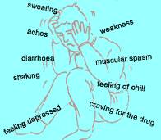
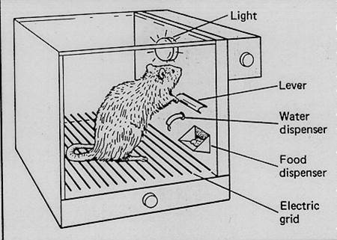
Opioid Withdrawal Syndrome
Excruciating!!
cessation
precipitated
Powerful negative reinforcer

Slide 6
Substance Use Disorder (DSM-V) (2-3: mild; 4-5: moderate; ≥6: severe)
Impaired Control
Larger amounts/longer period than intended
Inability to/persistent desire to cut down or control
Much time spent to obtain, use or recover from use
Craving and urges to use
Social Impairment
Not able to function at work, home or school b/o use
Continued use despite it causing interpersonal problems
Reduced social, occupational and recreational activities
Risky Use
Use in dangerous circumstances
Continued use despite physical or psychological problems caused or worsened
Physiological Manifestations
Tolerance
Withdrawal
American Psychiatric Association. https://www.psychiatry.org/psychiatrists/practice/dsm. Accessed July 23, 2018.

Slide 7
Substance Use Disorder (DSM-V) (2-3: mild; 4-5: moderate; ≥6: severe)
Impaired Control – SOME FEATURES SEEN WITH CHRONIC OPIOIDS
Larger amounts/longer period than intended
Inability to/persistent desire to cut down or control
Much time spent to obtain, use or recover from use
Craving and urges to use
American Psychiatric Association. https://www.psychiatry.org/psychiatrists/practice/dsm. Accessed July 23, 2018.

Slide 8
Substance Use Disorder (DSM-V) (2-3: mild; 4-5: moderate; ≥6: severe)
Social Impairment – OFTEN SEEN WITH CHRONIC PAIN
Not able to function at work, home or school b/o use
Continued use despite it causing interpersonal problems
Reduced social, occupational and recreational activities
American Psychiatric Association. https://www.psychiatry.org/psychiatrists/practice/dsm. Accessed July 23, 2018.

Slide 9
Substance Use Disorder (DSM-V) (2-3: mild; 4-5: moderate; ≥6: severe)
Risky Use
Use in dangerous circumstances
Continued use despite physical or psychological problems caused or worsened
Physiological Manifestations – OFTEN SEEN WITH CHRONIC OPIOIDS
Tolerance
Withdrawal
American Psychiatric Association. https://www.psychiatry.org/psychiatrists/practice/dsm. Accessed July 23, 2018.

Slide 10
The 4 C’s of Addiction
compulsive use
impaired control
continued use despite consequences
craving

Slide 11
Preventing Opioid Use Disorder Is Essential
Often begins with short-term opioid use for acute pain
Check prescription drug monitoring program
Use lowest effective dose of short-acting opioid for ≤3 days

Slide 12
Preventing OUD Is Essential (cont)
For chronic pain
Nonpharmacologic and nonopioid treatments preferred
Check prescription drug monitoring program
Screen for substance use disorder
Address psychological comorbidities, social stressors, lack of social support
Discuss realistic goals and treatment plan
Use opioid contract
Monitor- pill counts, urine testing

Slide 13
Who Is at Risk for OUD?
Abuse/addiction in chronic pain populations: 3-19%
Known risk factors for abuse in general population good predictors
Past cocaine use, h/o alcohol or cannabis use¹
Lifetime history of substance use disorder²
Family history of substance abuse, a history of legal problems, and drug and alcohol abuse³
Heavy tobacco use⁴
Depression or anxiety⁴
1. Ives T, et al. BMC Health Serv Res. 2006;6:46. 2. Reid MC, et al J Gen Intern Med. 2002;17(3):173-179. 3. Michna E, el al. J Pain Symptom Manage. 2004;28(3):250-258. 4. Akbik H, et al. J Pain Symptom Mange. 2006;32(3):287-293.

Slide 14
Opioid Risk Tool
Item | Score if female | Score if male
Family history of substance abuse Alcohol Illegal drugs Prescription drugs | 1 2 4 | 3 3 4
Personal history of substance abuse Alcohol Illegal drugs Prescription drugs | 3 4 5 | 3 4 5
Age 16-45 | 1 | 1
Female: history of preadolescent sexual abuse | 3 | 0
Psychological disease: attention deficit disorder, obsessive-compulsive disorder, bipolar, schizophrenia | 2 | 2
Depression | 1 | 1
Total score risk Low: 0 – 3; Moderate: 4 – 7; High: ≥ 8
Webster LR, et al. Pain Med. 2005;6(6):432-442.

Slide 15
Approach to Screening
Ask permission
Avoid stigmatizing language
Use nonjudgmental approach
Separate screening from feedback
Embed screening questions in larger health assessment
Probe about ranges
Thank the patient

Slide 16
“Single Question Screen”
“How many times in the past year have you used an illegal drug or used a prescription medication for nonmedical reasons?” (+ answer: > 0)
Smith PC, et al. Arch Intern Med. 2010; 170(13):1155-1160.

Slide 17
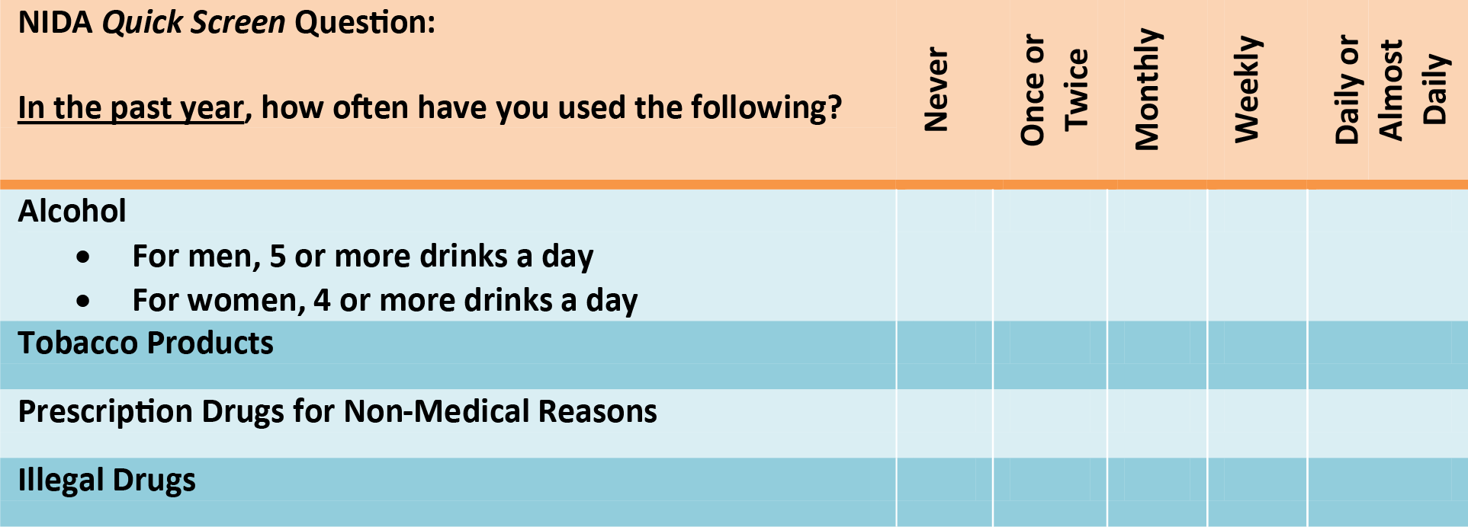
NIDA-Modified ASSIST
National Institute on Drug Abuse. https://www.drugabuse.gov/sites/default/files/pdf/nmassist.pdf. Accessed June 25, 2018.

Slide 18
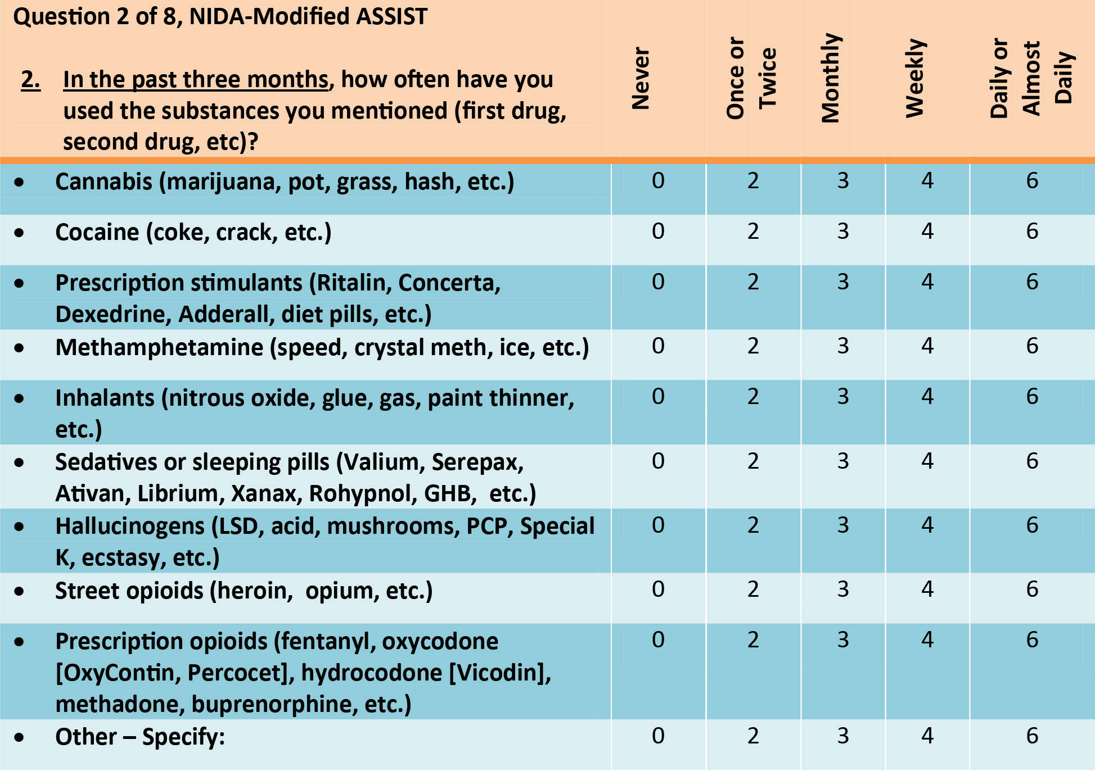
NIDA-Modified ASSIST
National Institute on Drug Abuse. https://www.drugabuse.gov/sites/default/files/pdf/nmassist.pdf. Accessed June 25, 2018.

Slide 19
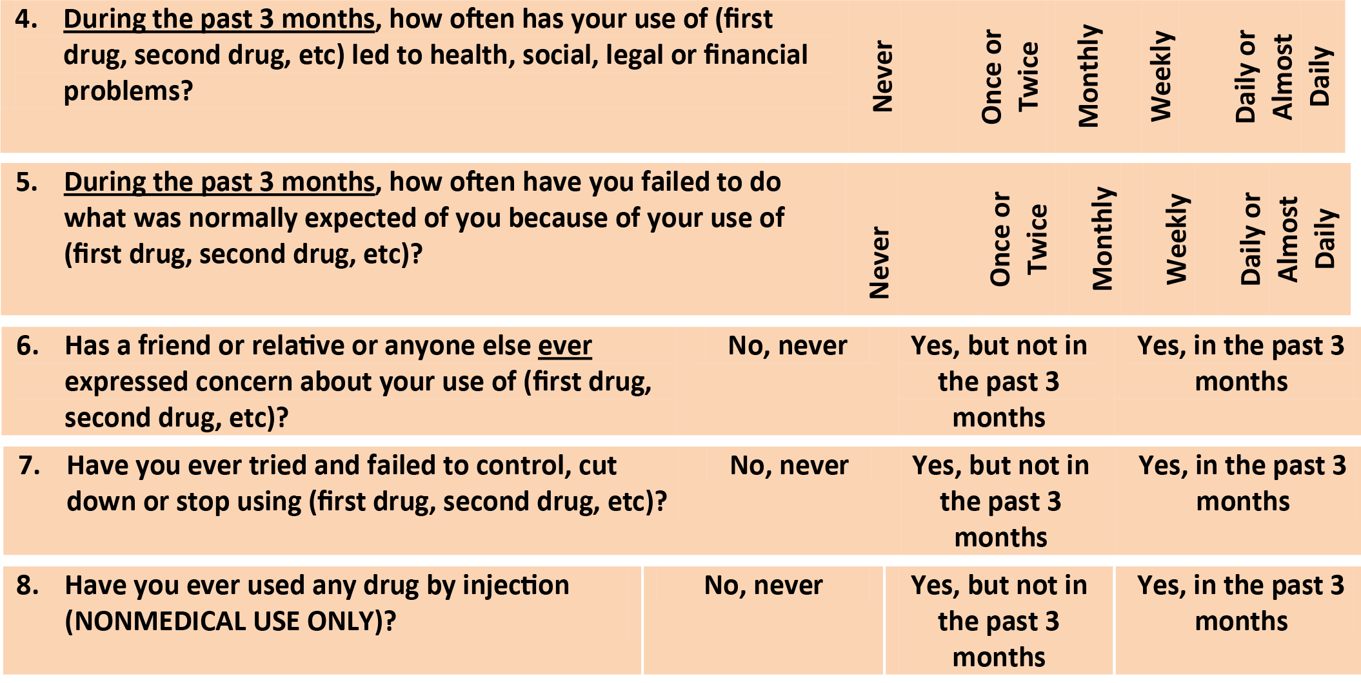
NIDA-Modified ASSIST
National Institute on Drug Abuse. https://www.drugabuse.gov/sites/default/files/pdf/nmassist.pdf. Accessed June 25, 2018.

Slide 20
Urine Drug Screen
Urine detection times for drugs of abuse
Heroin/morphine: 1-3 days
Cocaine: 1-3 days
Marijuana: occasional use: 1-3 days
chronic use: up to 30 days
Benzodiazepines: up to 30 days
Will not show on routine urine toxicology
Fentanyl
Oxycodone
Alprazolam, Lorazepam, +/- Clonazepam

Slide 21
Assess the Patient on the Spectrum of Substance Use
None or low risk
At risk
Mild
Moderate
Severe
Increasing amounts, higher-risk substances or situations
Craving, loss of control, consequences

Slide 22
Substance Use Disorder (DSM-V) (2-3: mild; 4-5: moderate; ≥6: severe)
Impaired Control – SOME FEATURES SEEN WITH CHRONIC OPIOIDS
Larger amounts/longer period than intended
Inability to/persistent desire to cut down or control
Much time spent to obtain, use or recover from use
Craving and urges to use
Social Impairment – OFTEN SEEN WITH CHRONIC PAIN
Not able to function at work, home or school b/o use
Continued use despite it causing interpersonal problems
Reduced social, occupational and recreational activities
Risky Use
Use in dangerous circumstances
Continued use despite physical or psychological problems caused or worsened
Physiological Manifestations – OFTEN SEEN WITH CHRONIC OPIOIDS
Tolerance
Withdrawal
American Psychiatric Association. https://www.psychiatry.org/psychiatrists/practice/dsm. Accessed July 23, 2018.

Slide 23
Next Steps for Patients Who Meet DSM-V Criteria for a Substance Use Disorder
Help accept diagnosis
Assess understanding of harms
Assess readiness for treatment
Negotiate
Engaging the patient is critical

Slide 24
Readiness: A “Quick” Version
“On a scale from 1 to 10, 10 being very much…”
“…How much do you right now want to stop using drugs?”
“Why did you say 3 and not 0?”
“What would it take to get you from 3 to 6?”
“If you did decide to change, how confident are you that you would succeed?”

Slide 25
Needs To Consider In The Treatment Plan
ASAM criteria can help guide
Acute intoxication/withdrawal potential
Biomedical conditions, complications
Emotional/behavioral/cognitive conditions & complications
Readiness to change
Continued use or continued problem potential
Relapse potential
Recovery environment
Structured and supportive?
Can the needs of the patient be addressed by available resources?

Slide 26
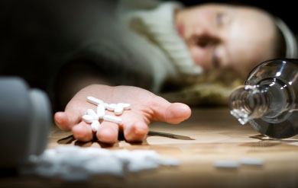
CDC Guideline 2016: Rec. 8: Assess Overdose Risk
Prior nonfatal overdose
History of substance use disorder
High daily doses of opioids
Switching from one opioid to another
Any opioid for pain + benzodiazepine or other sedative
Any opioid for pain + antidepressant
Any opioid for pain + respiratory problems
Any opioid for pain + renal/liver disease or other conditions
Centers for Disease Control and Prevention. https://www.cdc.gov/mmwr/volumes/65/rr/rr6501e1.htm. Accessed June 25, 2018.

Slide 27
Case Scenario 3
58-year-old female new to your practice with established rheumatoid arthritis; reports modest pain relief with various combinations of DMARDs; reports that only effective treatment is oxycodone extended-release 40 mg q12h plus oxycodone 5 mg prn up to 5/day for breakthrough pain.

Slide 28
Goals of Medication-Addiction Treatment
Substance-free is ideal but patients are not always ready
Interrupt use → enter into remission
Harm reduction is key, especially for patients who are not ready for treatment
Avoiding overdose and avoiding infections are major goals
Important to understand that relapse is common
Medication-free treatment after OUD → higher overdose risk

Slide 29
Treatment Principles
Meet each patient where they are
Implement strategies to reduce negative consequences of drug use
Acknowledge a continuum of drug using behaviors, with some being safer than others
Provide naloxone
Educate about needle programs
Harm Reduction Coalition. http://harmreduction.org/about-us/principles-of-harm-reduction/. Accessed June 26, 2018.
Boston University School of Public Health. http://www.bu.edu/bniart/sbirt-in-health-care/sbirt-brief-negotiated-interview-bni/. Accessed June 26, 2018.

Slide 30
Treatment Principles (cont)
Treat individuals with dignity
Begin the conversation by asking permission
Use medically specific words that don’t stigmatize
“person with substance use disorder” vs “addict”
“medication for addiction treatment” vs “replacement or substitution treatment”
Boston University School of Public Health. http://www.bu.edu/bniart/sbirt-in-health-care/sbirt-brief-negotiated-interview-bni/. Accessed June 26, 2018.

Slide 31
Treatment Principles (cont)
Comprehensive treatment goes beyond medication addiction treatment to include psychosocial support
Important due to high occurrence of social exclusion, isolation, joblessness, housing insecurity
Boston University School of Public Health. http://www.bu.edu/bniart/sbirt-in-health-care/sbirt-brief-negotiated-interview-bni/. Accessed June 26, 2018.

Slide 32
Goals Are Those for a Chronic Disorder
NIDA. Principles of Drug Addiction Treatment. Published 2012. https://www.drugabuse.gov/sites/default/files/podat_1.pdf. Accessed July 12, 2018.

Slide 33
Treatment Principles (cont)
Nonjudgmental, appreciative inquiry
Set expectations upfront
Written treatment agreement for medication and monitoring
Shared decision-making
Contingency management model

Slide 34
Harm Reduction Strategies for Individual and Community
Bystander prevention and family training
Safe needle and syringe use and disposal
Safe medication storage
Screen/Vaccinate for hepatitis B
Part of holistic patient management

Slide 35
Harm Reduction Strategies for Individual and Community
Education on overdose prevention
Avoid mixing substances
Abstinence lowers tolerance
Use tester, indicator strips with each new batch
Always have naloxone available
Never use alone
Have naloxone readily available
Recognize signs/symptoms; know how to respond
Encourage continuation of medication addiction treatment

Slide 36
Pain Can and Should Be Treated in Patients on MAT
Must treat opioid “debt” to prevent withdrawal before treating pain.
Often need higher doses of opioids to treat acute pain in patients on buprenorphine and methadone.
Buprenorphine analgesic effect is 4-8 h, whereas opioid withdrawal effect 24-48 h
With acute pain: continue buprenorphine, but divide dose TID. Add short-acting opioid for pain control
Different with naltrexone!

Slide 37
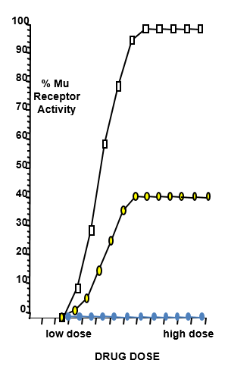
Activation of the Mu-Opioid Receptor
Mu-Opioid
Receptor
Full Agonist
Full agonist binds & fully activates receptor
Partial agonist binds & activates to a ceiling
Mu-Opioid
Receptor
Partial Agonist
Mu-Opioid
Receptor
Antagonist binds but does not activate
Antagonist
MAT, medication for addiction treatment.

Slide 38
Medication Treatment of OUD
Effective in reducing relapse, overdose, infections and other harms
Options
Agonist therapy with methadone
Partial agonist therapy with buprenorphine/naloxone
Antagonist therapy with naltrexone
Team approach best, to address co-occurring medical and psychological conditions and social barriers
Schuckit MA. N Engl J Med. 2016;375(4):357-368.

Slide 39
Medication Treatment of OUD: Options
 | Methadone | Buprenorphine | Naltrexone (IM)
Action on Mu-Opioid Receptor | Full Agonist | Partial Agonist | Antagonist
Dosing | 80 mg to ≥100 mg | 4 to 32 mg SL | 380 mg depot injection
Advantages | Highly structured supervised setting Additional services on-site & diversion unlikely For individuals who need structure and support | Safer than full agonist Available in office settings Allows some patient schedule and travel flexibility | No addictive potential or diversion risk Option for individuals seeking to avoid all opioids Daily oral dose or monthly injection
Schuckit MA. N Engl J Med. 2016;375(4):357-368.

Slide 40
Medication Treatment of OUD: Options (cont)
 | Methadone | Buprenorphine | Naltrexone (IM)
Barriers/ Concerns | Stigma Must be prescribed through a registered program Daily, in-person dosing early in treatment Restricts patient travel QT prolongation Drug-drug interactions | Daily adherence Diversion “Bridge” between illicit opioid use Providers must complete training, apply for a waiver to prescribe Child ingestions Pain management | Must be opioid-free Risk of overdose if stop NTX and resume opioid Pain management
Schuckit MA. N Engl J Med. 2016;375(4):357-368.

Slide 41
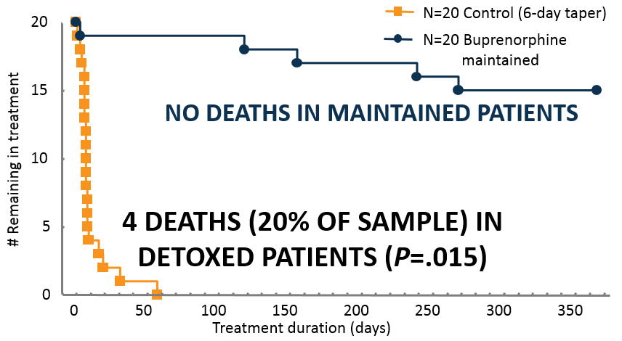
MAT (Buprenorphine): Maintenance vs Taper
All received weekly individual cognitive-behavioral counseling and thrice-per-week supervised urine toxicology
Kakko J, et al. Lancet. 2003;361(9358):662-668.

Slide 42
Relapse While on Treatment
Relapse less often on medication, but still occurs
Patients may still struggle with other substances such as cocaine, even when not relapsing with opioid use
Use privileges as behavioral contingencies
Longer prescriptions depend on progress
Negotiate responses to concerning behavior
Plan has to make sense for patient, you and your office
Increase frequency of visits, counseling, urine tox
Consider increased level of care: Methadone maintenance, intensive outpatient program, partial hospitalization, or residential care

Slide 43
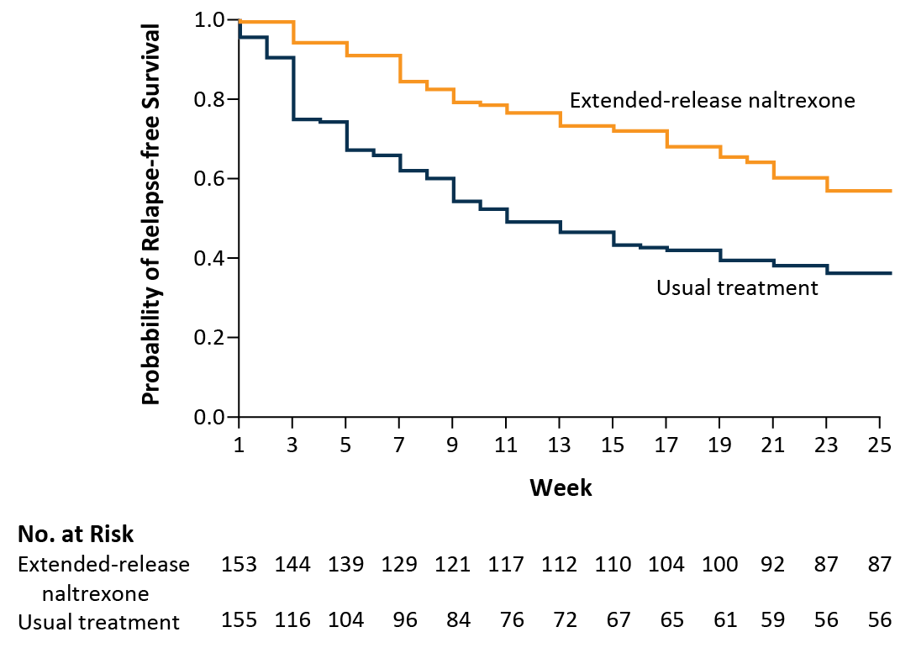
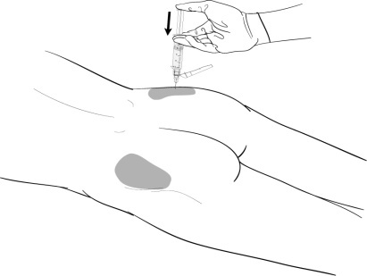
Monthly Naltrexone XR
Monthly gluteal IM injection
Must be completely opioid-free
Lee JD, et al. N Engl J Med. 2016;374:1232-1242.

Slide 44
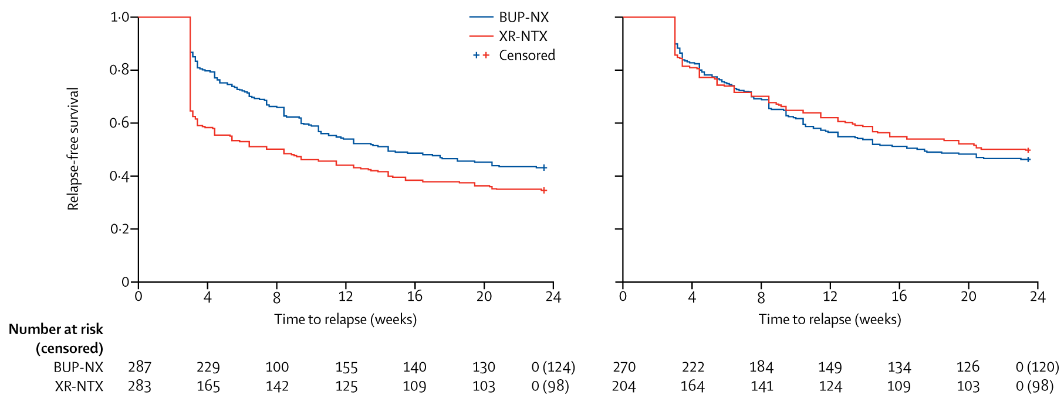
Relapse-Free Survival: Naltrexone XR vs Buprenorphine/Naloxone
Relapse-free survival (ITT population)
Relapse-free survival (PP population)
HR 1.36
95% CI 1.10-1.68
HR 0.92
95% CI 0.71-1.18
ITT, intention-to-treat; PP, per-protocol.
Lee JD, et al. Lancet. 2018;391(10118):309-318.

Slide 45
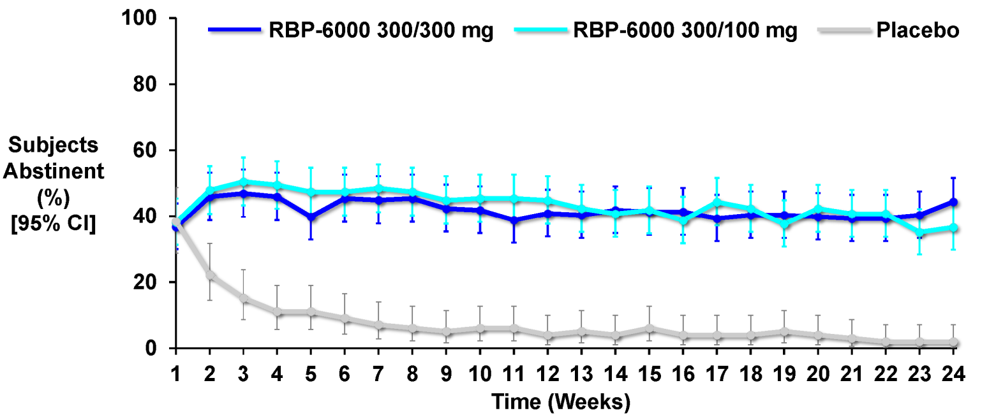
Monthly Injectable Buprenorphine
N=201
FDA Psychopharmacology Drugs Advisory Committee 10/31/2017. Available at https://www.fda.gov/downloads/AdvisoryCommittees/CommitteesMeetingMaterials/Drugs/ PsychopharmacologicDrugsAdvisoryCommittee/UCM582447.pdf. Accessed June 26, 2018.

Slide 46
Medication for OUD Saves Lives, but Not Often Prescribed!
Retrospective cohort study
17,568 Massachusetts individuals without cancer surviving OD over next 12 months
30% received medication
11% received methadone (median 5 months)
17% buprenorphine (median 4 months)
6% naltrexone (median 1 month)
All-cause mortality
Cohort 4.7 deaths/100 person-years
Methadone (AHR 0.47; 95% CI 0.32-0.71)
Buprenorphine (AHR 0.63; 95% CI 0.46-0.87)
Naltrexone (AHR 1.44; 95% CI 0.84-2.46)
AHR, adjusted hazard ratio; CI, confidence interval.
Larochelle MR, et al. Ann Intern Med. 2018;doi:10.7326/M17-3107.

Slide 47
The Science is Clear: Medication-Assisted Treatment Works
“The use of opioid agonist medications to treat opioid use disorders has always had its critics. Many people, including some policymakers, authorities in the criminal justice system, and treatment providers, have viewed maintenance treatments as ‘substituting one substance for another’ and have adhered instead to an abstinence-only philosophy that avoids the use of medications, especially those that activate opioid receptors. Such views are not scientifically supported; the research clearly demonstrates that MAT [medication-assisted treatment] leads to better treatment outcomes compared to behavioral treatments alone. Moreover, withholding medications greatly increases the risk of relapse to illicit opioid use and overdose death. Decades of research have shown that the benefits of MAT greatly outweigh the risks associated with diversion.”
Surgeon General’s Report on Alcohol, Drugs, and Health. Published 2016. https://addiction.surgeongeneral.gov/sites/default/files/surgeon-generals-report.pdf. Accessed June 25, 2018.

Slide 48
Primary Care Models for OUD Treatment
12 major models, including
Hub-and-spoke and collaborative opioid treatment model
Vermont model
Central intake, induction then transfer to PCP
Massachusetts Nurse Care Manager Model
Typically in federally qualified health centers
Nurse provides day-to-day management in support of the prescriber
Korthuis PT, et al. Ann Intern Med. 2017;166(4):268-278.

Slide 49
Primary Care Models for OUD Treatment
4 major components
Pharmacotherapy
Educational interventions
Coordination and integration with other medical and psychosocial needs
Psychosocial services
Counseling on-site or by referral
Korthuis PT, et al. Ann Intern Med. 2017;166(4):268-278.

Slide 50
Educational Resources
CDC Guideline for Prescribing Opioids for Chronic Pain — United States 2016
(https://www.cdc.gov/mmwr/volumes/65/rr/pdfs/rr6501e1.pdf)
HHS Treatment & Recovery Resources
(http://www.hhs.gov/opioids/)
Prescription Drug Monitoring Program (https://www.cdc.gov/drugoverdose/pdmp/providers.html)
SAMHSA’s Buprenorphine Physician Locator
(https://www.samhsa.gov/medication-assisted-treatment/physician-program-data/treatment-physician-locator)
SAMHSA’s Buprenorphine Waiver
(https://www.samhsa.gov/programs-campaigns/medication-assisted-treatment/training-materials-resources/buprenorphine-waiver)

Slide 51
Educational Resources (cont)
SAMHSA’s Medication-assisted Treatment
(https://www.samhsa.gov/medication-assisted-treatment)
SAMHSA’s Opioid Overdose Prevention Toolkit
(https://store.samhsa.gov/shin/content//SMA16-4742/SMA16-4742.pdf)
SAMHSA’s Opioid Treatment Program Directory (http://dpt2.samhsa.gov/treatment/directory.aspx)
SAMHSA’s Provider’s Clinical Support System for Medication-Assisted Treatment
(http://pcssmat.org)
SAMHSA’s Store
(http://store.samhsa.gov)

