Slide 2
Daniel J. Wallace, MD, FACP, MACR Associate Director, Rheumatology Fellowship Program Board of Governors, Cedars-Sinai Medical Center Professor of Medicine, Cedars-Sinai Medical Center David Geffen School of Medicine Center at UCLA In affiliation with Attune Health

Slide 3
Learning Objectives
Apply the ACR diagnostic criteria to recognize patients who may have SLE
Utilize and interpret laboratory findings to investigate possible SLE
Develop SLE treatment plans based on individual patients’ disease characteristics, treatment goals, and consensus recommendations
Identify a validated SLE disease activity measure for regular patient monitoring

Slide 4
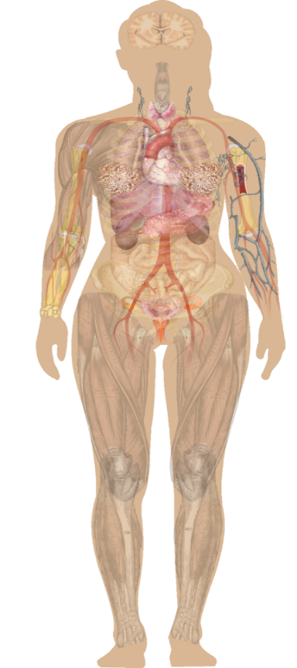
What Is Systemic Lupus Erythematosus?
Systemic lupus erythematosus (SLE) is a progressive chronic autoimmune disease that results in inflammation and tissue damage
Characterized by flares, spontaneous remission, and relapses
Highly heterogeneous
Can affect any part of the body
Often damages skin, joints, heart, kidneys, lungs, nervous system
Notes:
CC

Slide 5
What Are Some Characteristics of Patients with SLE
85% are women
Sex, Race, and Ethnicity
♀
♂
Ratio peaks in reproductive years
Half develop organ-threatening disease
Organ-threatening
PREVALENCE
Nonorgan-threatening
1st
2nd
3rd
4th
5th
6th
7th
8th
9th
10th
DECADE
Notes:
38:47
(check my edit)

Slide 6
Primary Care Physicians
Lupus Care Specialist
SLE Suspected
Establish Diagnosis
Referral
Assess Activity and Severity
Develop Treatment Plan
Monitoring
Disease Activity
Treatment Toxicities
Mild Disease
Disease Activity Monitoring
Annual Consultation
 Disease Activity
Moderate/Severe Disease Management
Complication
Refractory/Serious Disease Management

Slide 7
ACR (1997) Revised Criteria for Classification of SLE
Skin Criteria
Butterfly rash Discoid rash | Sun sensitivity Oral ulcerations
Systemic Criteria
Arthritis Serositis | Kidney disorder Neurological disorder
Laboratory Criteria
Blood abnormalities | Positive ANA blood test
Immunologic disorder Antiphospholipid antibodies, lupus anticoagulant, anti-DNA, false-positive syphilis test, positive anti-Sm
4 of 11 needed for a diagnosis
Notes:
Hochberg MC, Arthritis and Rheumatism, 1996

Slide 8
SLICC Revision of the ACR Classification of SLE
Renal biopsy OR
Clinical criteria (at least 1)
Cutaneous: acute or subacute cutaneous lupus, chronic cutaneous lupus, nasal/oral ulcers, nonscarring alopecia
Inflammatory synovitis in ≥2 joints or ≥2 tender joints with morning stiffness that are observed
Organs: renal (U Pr/Cr >0.5G or RBC casts), neurologic (seizures, psychosis, mononeuritis multiplex, myelitis, peripheral or cranial neuropathy, cerebritis), hematologic (hemolytic anemia, WBC<4000 x 1 or lymphs <1000 x 1, platelets <100K once)
Laboratory (at least 1)
ANA, anti ds DNA (2x reference range if ELISA), anti Sm, anticardiolipin Ab 2X normal, lupus anticoagulant, biologic false positive, anti beta-2 glycoprotein, low C3, C4 or CH50, direct Coombs without hemolytic anemia
Total of 4 clinical/lab criteria need to be present
94% sensitive, 92% specific, fewer misclassifications (P=0.0082). 716 scenarios.

Slide 9
Common Signs and Symptoms of Lupus
Painful or swollen joints and muscle pain
Unexplained fever
Rashes, most common in sun exposed areas
Chest pain upon deep breathing
Unusual loss of hair
Raynaud’s phenomenon
Sensitivity to the sun
Edema in legs or around eyes
Mouth ulcers
Swollen glands
Extreme fatigue

Slide 10
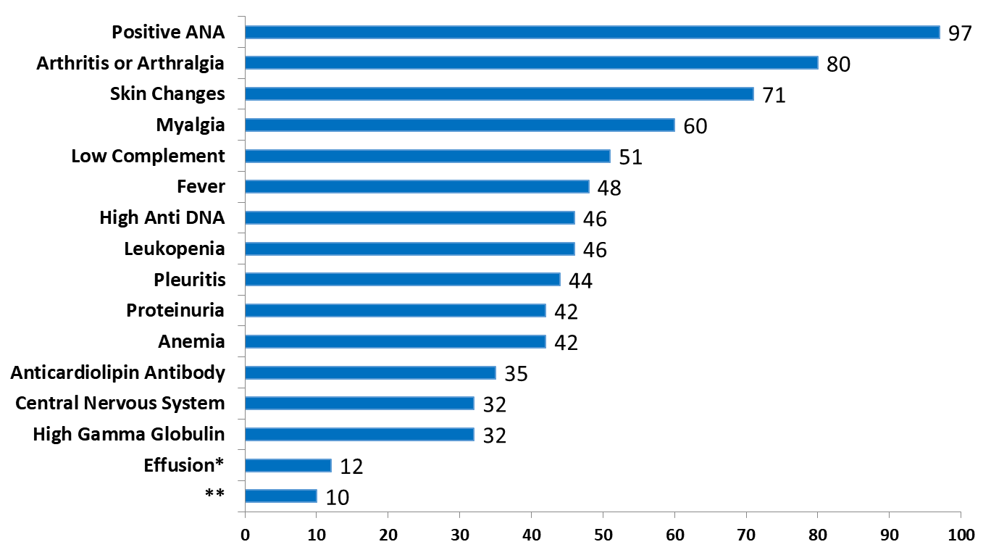
Incidence of Clinical and Laboratory Manifestations of SLE
Pleural or Pericardial Effusion
Adenopathy

Slide 11
Mucocutaneous Features of SLE
Malar (butterfly) rash
Discoid lupus (DLE)
Mucosal ulcers
Alopecia
Subacute cutaneous lupus (SCLE)
Cutaneous vasculitis
Bullous lupus
Panniculitis
Notes:
CC

Slide 12
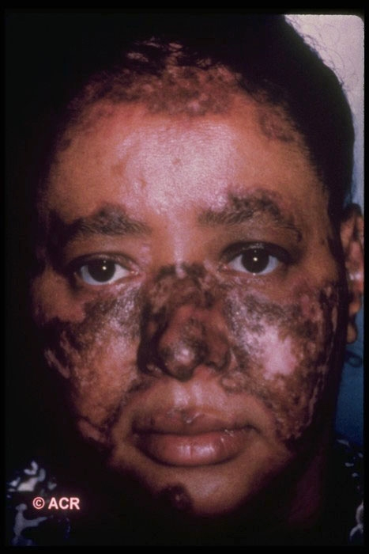
Malar Rash
Erythema (redness)
Flat or raised
Over the malar eminences (cheek bones) and bridge of the nose
Resembles a butterfly
Spares the nasolabial folds
Differentiates from rosacea which has a similar appearance
Photosensitive
Can be transient (several days or weeks)

Slide 13
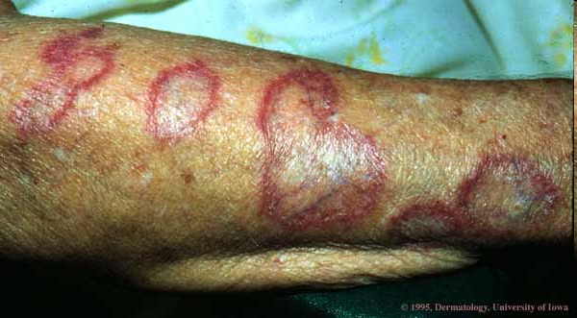
Discoid Lupus
Can occur as part of systemic lupus or exist in isolation without any other organ involvement
10% of discoid lupus patients will develop SLE
Coin-shaped scaly plaques
Plaques expand to form lesions with depressed central scarring and increased skin pigment around the edge
Can occur anywhere on the body, cause hair loss in the scalp

Slide 14
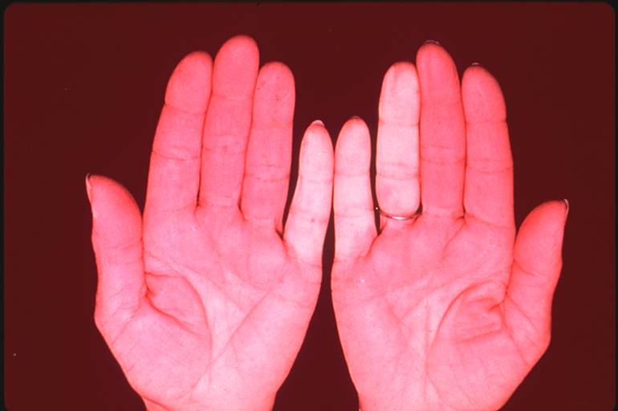
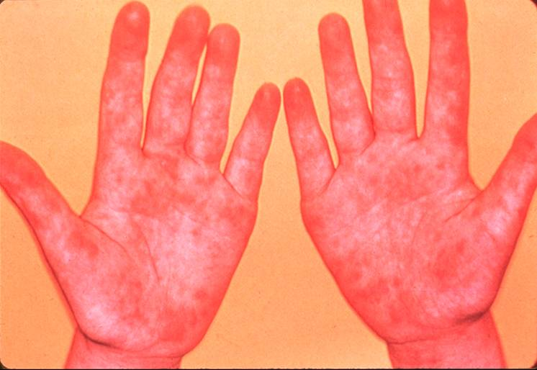
Vascular Features
Raynaud’s phenomenon
Vasomotor instability; dysautonomia

Slide 15
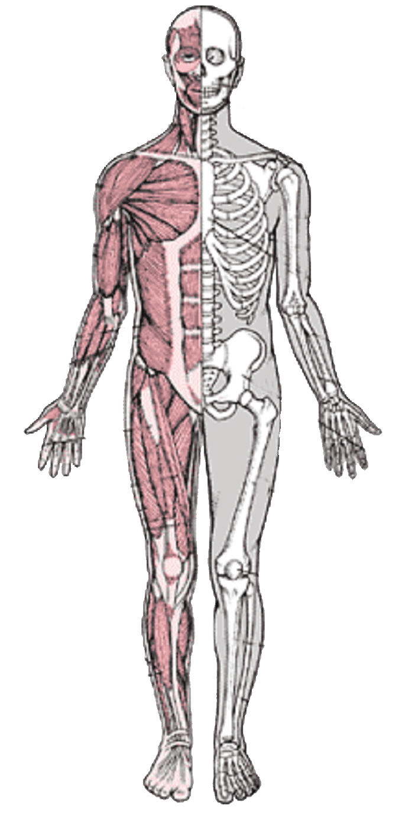
Musculoskeletal Involvement
Musculoskeletal symptoms
Arthralgia
Common presenting symptom (>76%)
Usually symmetric hand and knee joints
Arthritis
Swelling erythema, warmth less common
No bone erosion or fixed deformities
Myositis
Inflammatory tendonitis
Myalgia
Musculoskeletal system organ damage
Tendon degeneration
Fixed deformities
Osteoporosis
Notes:
CC
Wallace
CNS:
Cognitive impairment rates have been reported as high as 66% of patients.¹
Patients may be impaired despite disease activity.²
One report revealed 85% of patients with active disease also had cognitive impairment, and of these patients, 85% also had neurologic abnormalities.³
Other neurologic symptoms associated with SLE are less common, such as delirium (7%) and dementia (5%).³
The frequency of stroke is unknown but stroke increases the risk of future strokes and the risk of seizures.⁴
Musculoskeletal:
In the musculoskeletal system, signs and symptoms of SLE disease activity include arthritis, myositis, inflammatory tendonitis, arthralgia, and myalgia.⁵
SLE-related end-organ damage in the musculoskeletal system includes tendon degeneration, fixed deformities, and osteoporosis. End-organ damage may be treatment related (eg, osteoporosis associated with glucocorticoid use).⁵
¹Denburg et al. Neurology. 1987;37:464-467.
²Carbotte RM, et al. J Rheumatol. 199522;863-867.
³Miguel ED, et al. Medicine. 1994;73:224-234.
⁴Futrell N, et al. Neurology. 1992;42:1649-1657.
⁵Egol KA, et al. Bull Hosp Jt Dis. 2001;60(1):29-34.

Slide 16
Serositis
Lining of heart, lungs, abdomen
Pleuritis is inflammation of the lining of the lungs
Pericarditis is inflammation of the lining of the heart
Symptoms include pain in chest with deep breathing or when lying flat
Fluid may accumulate (effusion) causing increased shortness of breath

Slide 17
Blood Abnormalities
Anemia
Decreased red blood cells due to immune destruction/hemolysis
Thrombocytopenia
Platelets < 100k
Lymphopenia/neutropenia
Decreased white blood cells < 4k, particularly lymphocytes < 1.5k
Exclude other reasons
Medications
Blood loss
Infection

Slide 18
Differential Diagnosis of SLE
Autoimmune Rheumatoid arthritis, scleroderma, myositis, vasculitis, spondyloarthropathies, inflammatory bowel disorder, Behçet's disease, sarcoidosis, Sjogren’s syndrome, thyroiditis, polymyalgia rheumatica, undifferentiated connective tissue disease
Infections Tuberculosis, Lyme, Bacterial endocarditis, HIV, CMV, EBV
Fibromyalgia
Allergies
Neurologic disorders (esp myasthenia gravis, multiple sclerosis)
Malignancy (esp, lymphoproliferative disorders)
Drug-induced lupus Chlorpromazine, methyldopa, isoniazid, hydralazine, procainamide, quinidine
Psychiatric disorders Bipolar illness, malnutrition, substance abuse

Slide 19
Diagnosis
No single test can determine whether a person has lupus, but several laboratory tests may help make a diagnosis
Diagnostic Tests
Antinuclear antibody (ANA) test
Autoantibodies: anti-DNA, anti-Sm, anti-RNP, anti-Ro (SSA), and anti-La (SSB)
Anticardiolipin antibody
Antiphospholipid antibody
Skin biopsy
Kidney biopsy

Slide 20
Summary of Useful Tests in SLE
LEVEL
1
Routine screening for all patients
2
Readily available and inexpensive testing for select patients
3
Reflex panel testing to characterize nature of lupus involvement
4
Specialized testing limited to selected clinical circumstances

Slide 21
Summary of Useful Tests in SLE
1
Routine screening for all patients
Total cost under $500
CBC
Comprehensive metabolic profile
Urinalysis
Muscle enzymes
Acute phase reactants (eg, CRP, ESR)
Chest X-ray
EKG
ANA
C3 or C4 complement
Anti-dsDNA
2
Readily available and inexpensive testing for select patients
3
Reflex panel testing to characterize nature of lupus involvement
4
Specialized testing limited to selected clinical circumstances

Slide 22
Summary of Useful Tests in SLE
1
Routine screening for all patients
Relatively inexpensive
Clotting tests (eg, PTT)
2D echo
Musculoskeletal X-rays/ultrasound
Rheumatoid factor
Anti-CCP
Bone densitometry
2
Readily available and inexpensive testing for select patients
3
Reflex panel testing to characterize nature of lupus involvement
4
Specialized testing limited to selected clinical circumstances

Slide 23
Summary of Useful Tests in SLE
1
Routine screening for all patients
Extractable nuclear antigens
Anti-Sm
Anti RNP
Anti SSA (Ro) and SSB (La)
2
Readily available and inexpensive testing for select patients
3
Reflex panel testing to characterize nature of lupus involvement
Antiphospholipid panel
RPR (false positive syphilis serology)
Lupus anticoagulant
Anticardiolipin
Other antiphospholipid antibodies
4
Specialized testing limited to selected clinical circumstances

Slide 24
Summary of Useful Tests in SLE
1
Routine screening for all patients
CT or MR imaging
Electrical studies (eg, EEG, EMG)
Bone scan
Niche serologies (eg, Coombs, anti-histone, myositis panel)
2
Readily available and inexpensive testing for select patients
3
Reflex panel testing to characterize nature of lupus involvement
4
Specialized testing limited to selected clinical circumstances

Slide 25
Case Study: Diagnosing SLE
Kelsey, a 23-year-old Caucasian woman
Unremarkable history until 3 months ago
Currently feels tired and achy, flu-like symptoms, heavier than usual periods
Physical exam
Some fullness at MCP joint
Dull discomfort on taking deep breaths
Mild erythematous rash on cheeks
Mild erythema on forearms
Social
Under stress at work, poor sleep, lack of exercise

Slide 26
Case Study: Laboratory Findings
Normal blood chemistry panel
Mild anemia (Hb = 11.0 g/dL)
Ferritin = 8 ng/mL
Urine: trace proteinuria, no casts or red cells
ANA screen: notable for a 1:160 speckled pattern
Sed rate = 30 mm/hr
CRP 1.5 mg/L (normal < 1.0 mg/L)

Slide 27
Case Study: Work-Up
Serology
Rheumatoid factor: 25 (normal <20)
Anti-CCP: negative
C3 complement: 68 (normal ≥ 70)
C4 complement: 13 (normal ≥ 14)
Anti-Sm, RNP, SSA, SSB, and anti-dsDNA: negative
Chest X-ray: small right pleural effusion
Urine protein/creatinine ratio: essentially negative

Slide 28
Kelsey’s SLE Diagnosis
Sun
Sensitivity
Malar
Rash
ANA
Discoid
Rash
Serositis
Inflammatory Arthritis

Slide 29
Primary Care Physicians
Lupus Care Specialist
SLE Suspected
Establish Diagnosis
Referral
Assess Activity and Severity
Develop Treatment Plan
Monitoring
Disease Activity
Treatment Toxicities
Mild Disease
Disease Activity Monitoring
Annual Consultation
 Disease Activity
Moderate/Severe Disease Management
Complication
Refractory/Serious Disease Management

Slide 30
Commonly Used SLE Medications
Inflammation, pain, fever
NSAIDs (multiple)
Anti-malarials (HCQ)
Cortico-steroids (prednisone)
Immuno-suppressants (CYC, AZA, MMF)
Monoclonal antibodies (belimumab)
B-cell survival and development
T-cell, cytokines
T- and B-cells
Inflammation

Slide 31
Currently Available Options
Establish Diagnosis
Determine Likely Prognosis
No Major Organ Involvement
Assess Severity and Organ Involvement
Major Organ Involvement
Physical Measures (All Patients)

Slide 32
Currently Available Options
Establish Diagnosis
Determine Likely Prognosis
No Major Organ Involvement
Antimalarials
Low-dose steroids
Azathioprine/methotrexate
Assess Severity and Organ Involvement
Major Organ Involvement
Physical Measures (All Patients)

Slide 33
Management of Nonorgan-Threatening Lupus
Physical measures (eg, sun avoidance, exercise, splinting)
Medication
Counseling
Surgery (eg, biopsy)

Slide 34
Physical Measures
Sun avoidance, use of sunscreens
Temperature
Physical therapy (use of heat)
Occupational therapy
Vocational rehabilitation
Exercise
Diet and vitamins
Management of fatigue

Slide 35
Proactive and Preventive Strategies in SLE
Patient education programs
Eliminate patient nonadherence
Specialist access
Exercise, PT, OT, ergonomic work stations
Cognitive therapy (lupus fog), biofeedback (Raynaud’s)
Aggressive vigilance for hypertension, hyperglycemia, hyperlipidemia, obesity, smoking cessation
Yearly bone densitometry and use of bisphosphonates
Annual EKG, chest X-ray, duplex scanning, stress tests, 2-D echo for pulmonary pressures in high-risk patients
Prompt evaluation of all fevers
Antiphospholipid antibody screening and prophylaxis
Notes:
Wallace DJ, Curr Opinion Rheumatol, 2002, 14: 212-219

Slide 36
Using NSAIDs for SLE
Fevers
Headache
Arthralgias, myalgias, arthritis
Pleurisy, pericarditis

Slide 37
Treatment Algorithm (Partial)
Organ Involvement | 1st Line or Induction | 2nd Line or Failure of Induction | 3rd Line
Constitutional symptoms | GC, HCQ, or combination | MMF, AZA, MTX | Switching to RTX or BLM
Widespread DLE | HCQ ± GC | MMF, CsA, AZA | BLM
Uncomplicated digital/cutaneous vasculitis | GC ± HCQ ± MTX | AZA or MMF | Switching to IV CYC
GC = systemic glucocorticoids
HCQ = hydroxychloroquine
IMM = immunomodulators
MMF = mycophenolate mofetil
AZA = azathioprine
MTX = methotrexate
RTX= rituximab
BLM = belimumab
CsA = cyclosporine A
DLE = discoid lupus erythematosus
IV CYC = intravenous cyclophosphamide
Notes:
20.30

Slide 38
Summary of Outcome Benefits and Disease-modifying Effects of Antimalarials in SLE
Hydroxychloroquine
Sustained benefit on overall survival, disease free survival, and damage accrual
Delays the onset of SLE and reduces clinical flares
Early use maximizes these benefits
Protective against thrombosis, even in APLA positive patients
Antimalarial class*
Improve survival in time-dependent manner
All 3 AMs have lipid-lowering properties which are apparent also in patients taking corticosteroids
Beneficial effect on glycemic status in SLE patients, and this benefit possibly increases with duration of use
Protective effect against renal damage and major infections

Slide 39
Using Antimalarials for Lupus
After 6-12 weeks, anti-inflammatory and sun protective
80% response rate for nonorgan-threatening disease and cutaneous lupus
Decreases flare rate and risk for organ dissemination
Antiplatelet effects
Lipid lowering effects
No serious toxicity if appropriately monitored
Can be used in pregnancy and lactation

Slide 40
AAOS Recommendations on Screening for HCQ Retinopathy
At recommended doses (5.0 mg/kg real weight), the risk of toxicity…
Up to 5 years  < 1%
Up to 10 years  < 2%
After 20 years  almost 20%
Screening
Baseline fundus exam to rule out preexisting maculopathy
Annual screening after 5 years for patients on acceptable doses and without major risk factors
Primary screening tests
Automated visual fields
Spectral-domain optical coherence tomography (SD OCT)
Retinopathy is not reversible
Patient education is crucial

Slide 41
HCQ Therapy
Effective in early, mild disease
Associated with fewer thromboembolic events
Decreases damage scores at 5 years
Without HCQ
With HCQ
P=0.003

Slide 42
Glucocorticoid Therapy
Multiple agents
Cortisol/hydrocortisone
Prednisone/prednisolone
Methylprednisolone
Dexamethasone
Betamethasone
Well-established benefits
Anti-inflammatory
Immunosuppressive
Well-established side effects
CV events
Diabetes mellitus
Osteoporosis, osteonecrosis
Infections
Glaucoma, cataracts
Psychological disorders

Slide 43
Corticosteroids and Immune Suppression
Suppress virtually every component of the immune response
With chronic administration, expose patients to greater risk of viral and fungal infections

Slide 44
Steroid Use in Phase 3 Trials
Post-hoc analysis of 2 randomized trials
Trial designs allowed for steroid dose-adjustment based on patient’s disease activity
Patients treated with belimumab had a smaller increase in cumulative corticosteroid dose because of greater decreases and smaller increases in doses
†
*
**

Slide 45
Effect of Prednisone on Organ Damage
Prednisone Average Dose* | Hazard Ratio
> 0-6 mg/day | 1.16
> 6-12 mg/day | 1.50
>12-18 mg/day | 1.64
> 18 mg/day | 2.51

Slide 46
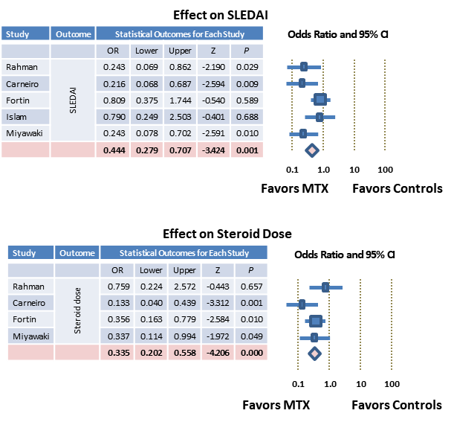
Methotrexate (MTX)
Most commonly prescribed RA DMARD
Not FDA-approved for SLE
Used for moderate disease after HCQ failure/nontolerance
Commonly used for joint manifestations and as a steroid-sparing agent

Slide 47
Mycophenolate and Azathioprine
Mycophenolate
Primarily used for renal, or pulmonary involvement
Azathioprine
Can be used for renal, hematologic, musculoskeletal, dermatologic involvement
Can be steroid sparing

Slide 48
Other Agents Used to Manage Lupus
Specific agents for cutaneous subsets
Retinoids, antileprosy drugs, topical pimecrolimus or tacrolimus
Immune thrombocytopenia (ITP)
Danazol, intravenous immunoglobulin (IVIg), splenectomy, rituximab
CNS
Intrathecal methotrexate, cyclophosphamide, rituximab
Antiphospholipid antibody syndrome (APS)
Warfarin, heparin, platelet antagonists
Raynaud’s
Calcium channel blockers, phosphodiesterase inhibitors, nitrates
Pulmonary hypertension
Prostaglandins, phosphodiesterase inhibitors, endothelin blockers

Slide 49
Currently Available Options
Establish Diagnosis
Determine Likely Prognosis
No Major Organ Involvement
Assess Severity and Organ Involvement
Major Organ Involvement
Cyclophosphamide (IV)
Mycophenolate mofetil
Calcineurin inhibitors (cyclosporin A or tacrolimus)
Biologics (eg, rituximab or belimumab) or
Clinical trial
Physical Measures (All Patients)

Slide 50
Prevalence of Serious Organ- or Life-Threatening Complications With Idiopathic SLE
Complication | N | %
Nephritis | 128 | 28
Thrombocytopenia | 73 | 16
Cerebritis | 49 | 11
Thromboemboli | 36 | 8
Hemolytic anemia | 34 | 8
Seizures | 30 | 6
Lupus pneumonitis, alveolar hemorrhage, or pulmonary hypertension | 29 | 6
Avascular necrosis | 25 | 5
Complication | N | %
Psychosis | 24 | 5
Organic brain syndrome | 22 | 5
Lupoid hepatitis | 22 | 5
Retinal vasculitis/infarct | 17 | 4
Myocarditis | 12 | 3
Mesenteric vasculitis | 4 | 1
Thrombotic thrombocytopenic purpura | 4 | 1
Total | 252 | 54

Slide 51
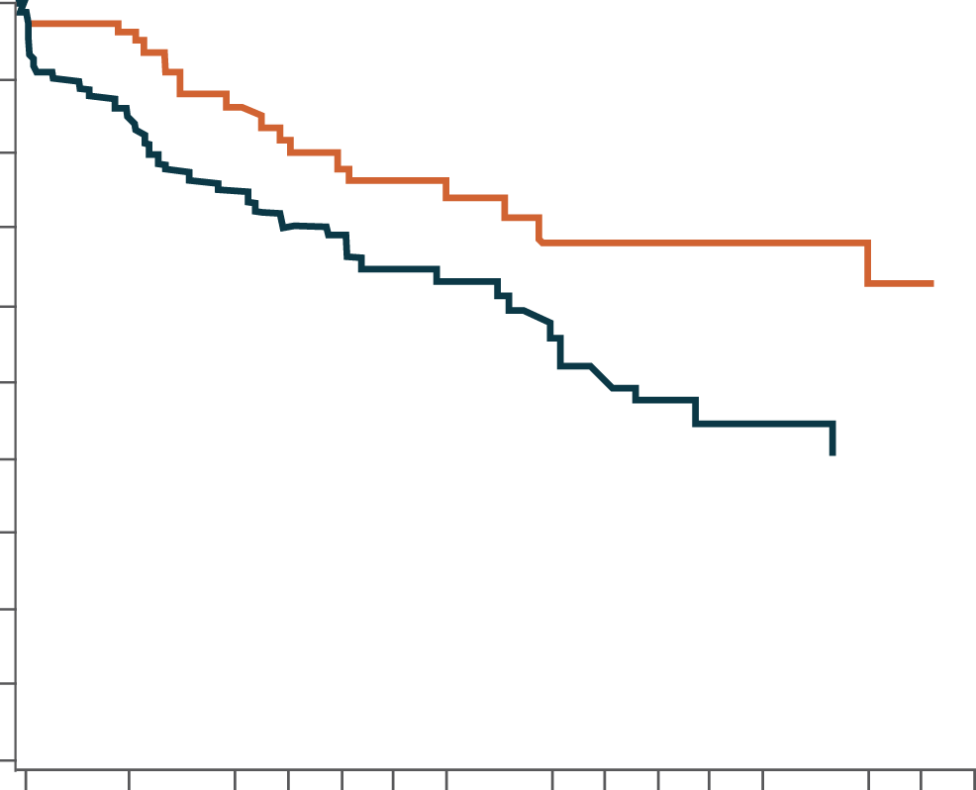
Disease Activity Predicts Organ Damage and Death
Time to SDI Δ ≥1 by Disease Activity Level* (N=350)
A 1-point increase in adjusted BILAG score was associated with:
8% increase in the risk of any new organ damage
11% increase in risk of CV, pulmonary, or musculoskeletal damage
15% increase in mortality
100
80
60
Percent Survival
40
20
0
0
2
4
6
8
10
12
14
16
20
*Low disease activity=BILAG score 0 to <2.59; high disease activity=BILAG score ≥6.84
Length of Follow-up (years)

Slide 52
Clinical Features of Active Lupus Nephritis
Urine protein excretion—edema
Active urine sediment—WBCs, RBCs, protein casts, cellular casts
Decreased glomerular filtration rate
Hypertension

Slide 53
ACR Guidelines for Monitoring Activity of Lupus Nephritis¹
Recommended Monitoring of Lupus Nephritis (monthly monitoring intervals)*
 | BP | UA | Protein:CR | Serum CR | C3/C4 Levels | Anti-DNA
Active nephritis at onset of treatment | 1 | 1 | 1 | 1 | 2† | 3
Previous active nephritis, none currently | 3 | 3 | 3 | 3 | 3 | 6
Pregnant with active GN at onset of treatment | 1 | 1 | 1 | 1 | 1 | 1
Pregnant with previous nephritis, none currently | 1 | 1 | 3 | 3 | 3 | 3
No prior or current nephritis | 3 | 6 | 6 | 6 | 6 | 6
*Values are the monthly intervals suggested as the minimum frequency at which the indicated laboratory tests should be measured in the SLE scenarios shown in the left-hand column. †Opinion of the authors based on a study published after the Task Force Panel had voted.²

Slide 54
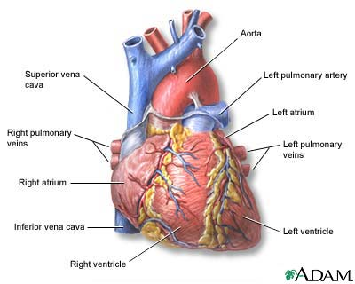
Cardiac Manifestations of SLE
Pericarditis
Myocarditis, congestive heart failure
Hypertension
Coronary vasculitis
Libman-Sacks endocarditis
Valvular insufficiency
SLE patients have a 7–10x increased risk of coronary heart disease and stroke
Notes:
CC

Slide 55
Pulmonary Manifestations of SLE
Pleuritis (also pericarditis)
Susceptibility to infection
Lupus pneumonitis/alveolitis
Pulmonary hemorrhage
Pulmonary fibrosis
Shrinking lung syndrome
Pulmonary embolism/in situ thrombosis
Pulmonary hypertension
Notes:
CC

Slide 56
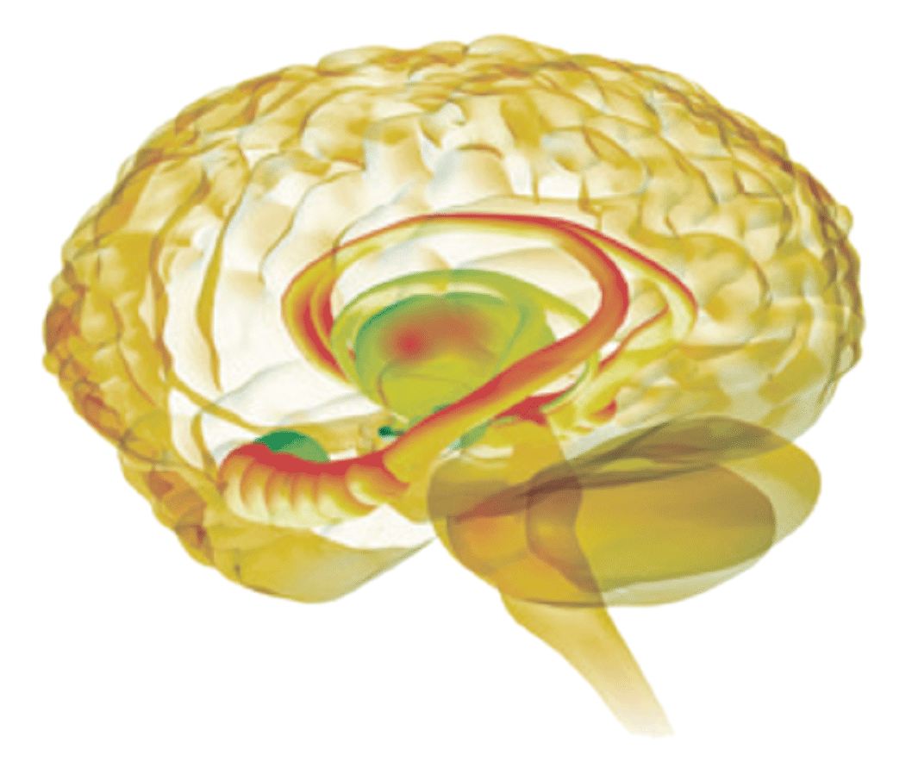
Neuropsychiatric Manifestations of SLE
Central nervous system
Diffuse cerebral manifestations
Psychiatric manifestations (depression)
Cognitive impairment
Seizures
Headache
Focal manifestations
Peripheral nervous system
Notes:
CC

Slide 57
B-cell Inhibition
Rituximab
Open label trials suggested efficacy and safety
Both major US trials failed but had faulty design
EXPLORER (78-wk)¹
Patients with moderately-severely active, extrarenal SLE
Rituximab + prednisone + AZA/MMF/MTX
No differences between rituximab and placebo in 1° or 2° endpoints
“…aggressive background treatment and sensitive cutoffs for nonresponse.”
LUNAR (52-wk)²
Patients with class III/IV lupus nephritis
Rituximab vs placebo with background MMF and corticosteroids
Numeric difference (P=0.2) in response rate, and significant differences in several biomarkers
“Rituximab…did not improve clinical outcomes after 1 year of treatment.”

Slide 58
When Is Rituximab Used?
Central nervous system lupus
Usually after steroids and cyclophosphamide have failed
Hematologic SLE
In the setting of idiopathic thrombocytopenia or hemolytic anemias where treatment with steroids and IVIG has failed
Catastrophic antiphospholipid antibody syndrome
When IV steroids, heparin, and plasma exchange or IVIG have failed
Refractory inflammatory arthritis
None of these uses are FDA-approved

Slide 59
Belimumab Is a BLyS-Specific Inhibitor
Indicated for the treatment of adult patients with active, autoantibody-positive SLE who are receiving standard therapy
Only biologic approved for SLE
First drug approved for SLE (2011) since 1957

Slide 60
Belimumab Pivotal Trial (BLISS-52)
SLE Responder Index (1º Endpoint)
Randomized controlled trial (N = 865)
Seropositive
Active disease (SELENA-SLEDAI ≥6)
Treatment (plus standard therapy)
Belimumab 1 mg/kg (n=288)
Belimumab 10 mg/kg (n=290)
Placebo (n=287)
Higher response rate at 52 weeks
1 mg: 51% (P=0.013 vs placebo)
10 mg: 58% (P=0.0006 vs placebo)
Other treatment benefits
Fewer symptoms and signs of disease activity (ie, lower SELENA-SLEDAI score)
Fewer patients with very active disease or flares (ie, BILAG A or BILAG B)
No worsening in global assessment scores (ie, PGA score)
Similar rate of adverse events

Slide 61
Long-term Safety and Efficacy Study
Continuation of phase 2 trial with 10 years of follow-up
Belimumab 10 mg/kg every 4 weeks plus standard of care
Response to Belimumab Increased *
Prednisone Use Decreased†

Slide 62
Currently Available Options
Establish Diagnosis
Determine Likely Prognosis
No Major Organ Involvement
Assess Severity and Organ Involvement
Major Organ Involvement
Physical Measures (All Patients)
Lifestyle (sun avoidance, etc)
Topical agents
Symptomatic agents
Comorbid conditions

Slide 63
Case Study: Treatment for Kelsey
Therapy should begin with prednisone and HCQ
Also consider NSAIDs
Treat associated comorbidities (eg, heavy periods with iron-deficiency anemia)

Slide 64
Case Study: What Would Necessitate Escalating Therapy?
Symptoms not resolving
Kidney involvement
Intolerable side effects
Nonadherence
New increase in anti-dsDNA antibodies
Decrease in C3 or C4 levels
New increase in CRP and sed rate

Slide 65
Primary Care Physicians
Lupus Care Specialist
SLE Suspected
Establish Diagnosis
Referral
Assess Activity and Severity
Develop Treatment Plan
Monitoring
Disease Activity
Treatment Toxicities
Mild Disease
Disease Activity Monitoring
Annual Consultation
 Disease Activity
Moderate/Severe Disease Management
Complication
Refractory/Serious Disease Management

Slide 66
Case Study: Assessing Kelsey
Signs/symptoms
Labs
Adherence
“Have you been adherent?”
“How many doses did you miss last month?”
Are symptoms from
Lupus?
Medication?
Lack of medication?
Comorbidity?
Lifestyle factor?

Slide 67
Medication Nonadherence is a Problem
US Medicaid data from 2000-2006
Adults ages 18-64 years with SLE
New users of HCQ (n = 9600) or ISMs (n = 3829)
Outcomes
All-cause and SLE-related ED visits
Hospitalizations
Nonadherence
79% of HCQ users
83% of ISM users

Slide 68
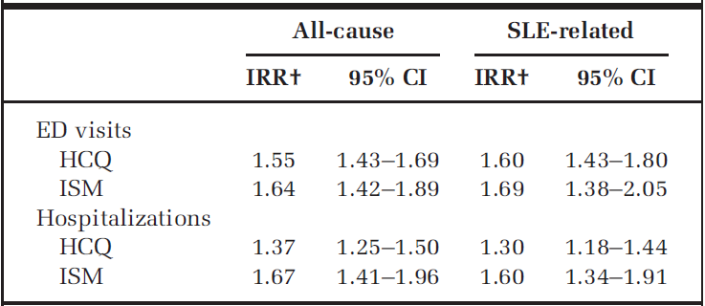
Medication Nonadherence is a Problem
Incidence Rate Ratio for Nonadherers

Slide 69
Case Study: Monitoring Kelsey
Screen for organ-threatening disease
Patient education, disease monitoring, and adherence assessment should be reinforced in the next office visits
Benefits of educational sessions are documented in the literature
Review benefits, side effects, and complications of NSAIDs, antimalarials, corticosteroids

Slide 70
Key Points
Diagnosis by rheumatology is the gold standard
Screen early for organ-threatening disease
Early treatment
NSAIDs should be considered
Steroids may be useful in early, active disease, if used with caution
Patients should receive an antimalarial
Adherence is critical at all disease stages
Patient education, disease monitoring, and adherence assessment
Even mild disease should be overseen by a lupus care specialist at least annually or by phone consultation
Flares happen and can be subtle

