Slide 1
Learning Objectives
After participating in this program series, the participant will be able to:
Diagnose interstitial lung diseases (ILDs) in a timely manner through optimal use of diagnostic criteria and radiologic findings
Chart disease course during the management of ILDs
Optimize treatment response in the management of ILDs with appropriate assessment and follow-up
Develop evidence-based, individualized treatment plans for ILD management

Slide 2
Introduction
Notes:
Hi , I'm Doctor Steven Nathan. I'm the Director of the Advanced Lung Disease and Lung Transplant Program at Inova Fairfax Hospital in Falls Church, Virginia. I'm also a professor of medicine at Virginia Commonwealth University .

Slide 3
Interstitial Lung Disease (ILD)
Large number of heterogeneous conditions characterized by variable amounts of inflammation and/or fibrosis
Share similar clinical, roentgenographic, physiologic, or pathologic manifestations
Variable course
  Some have a poor prognosis
  Some are entirely reversible
Considerable morbidity and mortality
Little consensus on the best management
Notes:
Today we're going to be talking about interstitial lung disease. Interstitial lung disease encompasses a large number of heterogeneous conditions that are characterized by variable amounts of inflammation and/or fibrosis. You can have some of these conditions that are mostly inflammation, others that are fibrosis. Even though there are 150 plus different courses, many of these interstitial lung diseases share common CT findings, physiologic changes, pathologic manifestations, and each of them has, can have a variable course. Some of them have a rather poor prognosis. Other ones can be entirely reversible. There's a wide spectrum of these different diseases in terms of the manifestations and potential outcomes. Some of them can carry a significant morbidity as well as mortality, and for most of them there's little consensus on the best forms of management.

Slide 4
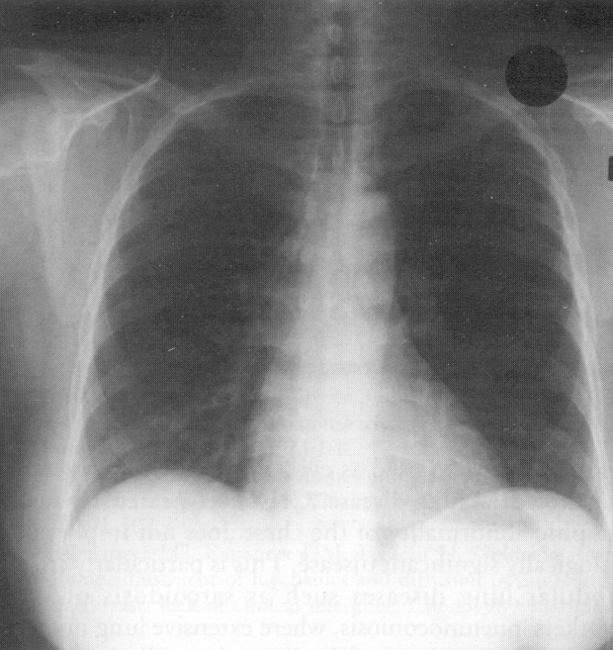
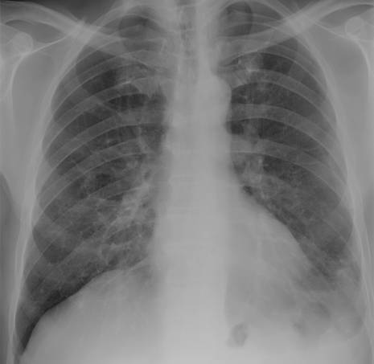
What is Interstitial Lung Disease?
Notes:
What is interstitial lung disease? It’s variable diseases that involve the interstitium of the lung. They don't necessarily involve all the other aspects, although there can be some involvement of all the other air spaces, but that fine lattice work that constitutes the interstitium of the lung is the primary area where the disease manifests. Typically you can see this on chest x-ray. You can see it more in greater detail on a chest CT and it involves both lungs diffusely. Sometimes upper lobes might be more involved, sometimes the lower lobes, but invariably it is a form of diffuse parenchymal lung disease.

Slide 5
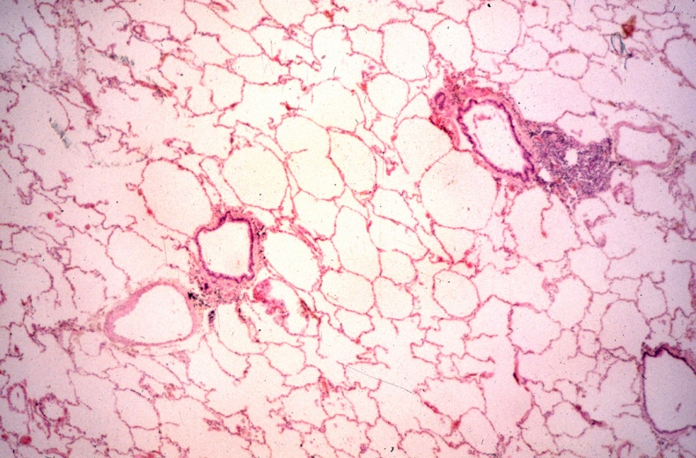
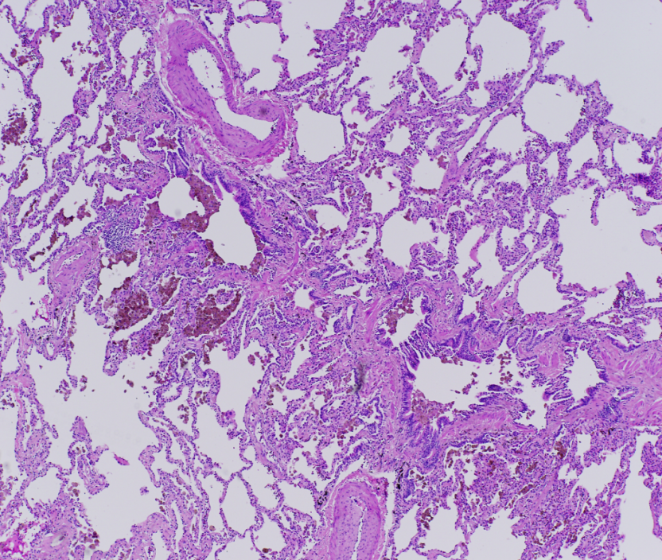
Interstitial Lung Disease
→
Notes:
On this side we have a demonstration pathologically of what normal alveola look like and to the right we have changes that might be seen with various forms of interstitial lung disease where there's diffuse fibrotic changes present through the lung. How do we categorize interstitial lung disease, variably known as diffuse parenchymal lung disease? On this side you can see one of the categorizations, which is a little complex in terms of known cause or association, things like connective tissue disorders, occupational diseases. We have the broad group of idiopathic interstitial pneumonias. We have the granulomatis diseases and then we have other unique entities that are typically more rare, such as pulmonary alveolar proteinosis, lymphangioleiomyomatosis, and pulmonary Langerhans cell granulomatosis, all quite a mouthful.

Slide 6
Another Way to Categorize ILD
Category | Diseases | Sub-categories/examples
Idiopathic | Idiopathic Interstitial Pneumonias (IIPs) | IPF NSIP Unclassifiable COP RB-ILD DIP AIP LIP PPFE
 | Sarcoidosis Amyloidosis Lymphangioleiomyomatosis PLCH, Eosinophilic pneumonia Neurofibromatosis, DAH
Immunologic | Connective Tissue Disorders
Inhalational | Organic: Chronic hypersensitivity pneumonitis | Bird fanciers disease, Farmer’s lung
 | Inorganic | Asbestosis, Silicosis
Iatrogenic | Antiarrhythmics Antimicrobials Chemotherapy agents Radiation
Infectious | Viral | CMV, influenza
 | Fungal | Pneumocystis carinii
Chronic CHF
Neoplastic | Lymphangitic carcinomatosis Bronchoalveolar carcinoma
Notes:
On the next side you see perhaps a more pragmatic, easier way to categorize these diseases. The pneumonic is quite easy. There's five I's, a C, and an N. If you think about these six or seven broad categories, you'll cover all the different diseases that can give you interstitial lung disease. Under the idiopathics we have the IIPs, or idiopathic interstitial pneumonias, and we have our alphabet soup shown on the right of the different disorders, the most common being idiopathic pulmonary fibrosis. Then, we have nonspecific interstitial pneumonia (NSIP), cryptogenic organizing pneumonia (COP), respiratory bronchiolitis interstitial lung disease (RB-ILD), et cetera. Other idiopathic entities include sarcoidosis, amyloidosis, and some of the other rare entities that I mentioned previously.

Slide 7
Another Way to Categorize ILD (cont)
Category | Diseases | Sub-categories/examples
Idiopathic | Idiopathic Interstitial Pneumonias (IIPs) | IPF NSIP Unclassifiable COP RB-ILD DIP AIP LIP PPFE
 | Sarcoidosis Amyloidosis Lymphangioleiomyomatosis PLCH, Eosinophilic pneumonia Neurofibromatosis, DAH
Immunologic | Connective Tissue Disorders
Inhalational | Organic: Chronic hypersensitivity pneumonitis | Bird fanciers disease, Farmer’s lung
 | Inorganic | Asbestosis, Silicosis
Iatrogenic | Antiarrhythmics Antimicrobials Chemotherapy agents Radiation
Infectious | Viral | CMV, influenza
 | Fungal | Pneumocystis carinii
Chronic CHF
Neoplastic | Lymphangitic carcinomatosis Bronchoalveolar carcinoma
Notes:
Under the next ‘I’, which are immunologic, because we have the various connective tissue disorders. The third ‘I’ is the inhalational disorders, things like hypersensitivity pneumonitis and then inorganic materials that might be inhaled, resulting in conditions like asbestosis or silicosis. The iatrogenic, what we do to patients with some of our interventions, including antiarrythmics drugs, antimicrobials, chemotherapeutic agents, and radiation therapy. The fifth ‘I’ are infections. This is usually quite evident clinically. Patients will present with infectious symptoms, but certainly viral infections, fungal infections can give you diffuse parenchymal changes that might mimic interstitial lung disease. Chronic congestive heart failure if left untreated for many years, we don't see that much these days, but that can give you diffuse interstitial changes as well. Then, various neoplastic conditions like lymphangitic carcinomatosis can give you diffuse interstitial lung disease, too. Remember five I's, a C, and an N, and you won't forget much. The terminology can be quite confusing.

Slide 8
A Word on Terminology
Interstitial lung disease (ILD) is the umbrella term
Idiopathic pulmonary fibrosis (IPF) is a very specific type of ILD
“Pulmonary fibrosis” is often used generally to mean ILD, not just IPF
Notes:
Interstitial lung disease is an umbrella term encompassing all these different conditions, whereas IPF is a very specific form of interstitial lung disease. IPF is one of the disease, the prototypical disease categorized under the idiopathic interstitial pneumonias. When we talk about pulmonary fibrosis, we talk about any lung condition that can result in fibrosis. This can get somewhat confusing in terms of the nomenclature. IPF can give you fibrosis, sarcoidosis can give you fibrosis, and pulmonary fibrosis does not refer to specific disease entity.

Slide 9
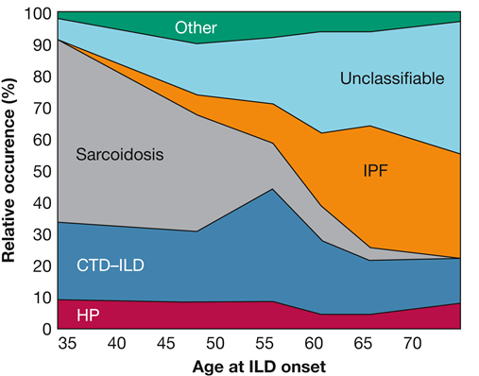
Distribution of Interstitial Lung Disease by Age of Onset
N=327 with ILD
98% had ILD for ≥1 year
Among elderly subjects (≥ 70 years),
43% had “unclassifiable” ILD
Lack of surgical biopsy in most led to inadequate data to make a definitive diagnosis
Patterson KC. Chest. 2017;151(4):838-844.
Notes:
On this next slide where you can see a study that came out fairly recently looking at the distribution of interstitial lung disease by age of onset. This study included over 300 patients and you can see in the diagram by age, the relative prevalence of these different disease conditions. You'll note that as patients age, the likelihood of this being IPF gets higher. IPF is a disease of the elderly. You can also see from this particular study that the number of patients with unclassifiable disease also increases as they get older. Now, practice habits differ in different institutions and my bent and bias is if a patient is more elderly in the context of unclassifiable, there's a good chance that these patients have IPF, because it is a disease of the elderly. Some of these unclassifiable in this particular study might indeed have had IPF.

Slide 10
Prevalence of ILD in Connective Tissue Diseases
1,600 deaths in USA annually
  25% of all ILD deaths
  2% of respiratory deaths
Rheumatoid arthritis: 15‒20%
Polymyositis/Dermatomyositis: 5‒20%
Systemic lupus erythematosus: 5‒18%
Scleroderma: 50‒70%
Sjogrens: 5‒40%
Notes:
What about interstitial lung disease complicating the various tissue disorders? This can be a source of significant morbidity and mortality. The estimates of the number of deaths in the U.S. from CTD-ILD is about 1600 annually. This might be more. This data's a little bit dated. About 25% of all ILD deaths are attributable to an underlying connective tissue disease. In terms of the relative prevalence amongst the different diseases, rheumatoid arthritis, estimated 15 to 20%, polymyositis and dermatomyositis, around same range, five to 20%, SLE, lupus a little bit less, five to 18%, scleroderma very common, 50 to 70% and lastly Sjogren's around five to 40%, so a wide range in terms of how these diseases might be complicated by underlying CTD, the underlying ILD, rather.

Slide 11
ILD & Rheumatoid Arthritis
RA is the presenting manifestation in ∼15‒20%
Cigarette smoking may be risk factor
  Most common cause of pulmonary complications within 1st 5 years
Pulmonary complications ∼10‒20% of mortality
Subclinical lung disease ∼44‒66%
∼5% have clinically significant ILD
Male:female prevalence is 3:1
Notes:
Let's talk about rheumatoid arthritis. First, it can be the presenting manifestation in up to 15 to 20% of cases. Cigarette smoking is a risk factor. It's the most common pulmonary complication within the first five years. If it's going to complicate a patient with rheumatoid arthritis it's usually seen within the first five years. Pulmonary complications account for about 10 to 20% of mortality seen in rheumatoid arthritis. The incidence or prevalence of subclinical lung disease is significantly higher than in those patients who manifest with pulmonary symptoms. Once again, perhaps not mentioned previously, it tends to be more common in males who have rheumatoid arthritis than females.

Slide 12
ILD & Scleroderma
Scleroderma seen in 30‒70% of ILD cases
4th most common manifestation of disease
Nonspecific interstitial pneumonia (NSIP) about 50‒75% of cases
Others
  Usual interstitial pneumonia (UIP)
  Unclassifiable fibrosis
  Organizing pneumonia (OP) (rare)
  Diffuse alveolar hemorrhage (DAH) (rare)
Tansey D, et al. Histopathology. 2004;44(6):585-596.
Notes:
Moving onto scleroderma, the prevalence is quite high. It is a very common manifestation of the disease, and as opposed to rheumatoid arthritis, if one looks at the pathological pattern that we see in scleroderma it's usually a nonspecific interstitial pneumonia (NSIP) type of pattern in most cases. Rheumatoid arthritis, most of the cases tend to be usual interstitial pneumonia (UIP). For all the rest of the connective tissue diseases, it's mostly NSIP pattern, although UIP can be seen as well.

Slide 13
ILD & Sjogrens Disease
Lymphocytic interstitial pneumonia is most common
ILD observed in 5‒40%
Other pathologic entities
  Chronic bronchiolitis
  Organizing pneumonia
  NSIP
  UIP
  Lymphoma
Tansey D, et al. Histopathology. 2004;44(6):585-596. Parambil JG, et al. Chest. 2006;130(5):1489-1495. Frankel SK, et al. Clin Pulm Med. 2006;13(1):25-36
Nakamura Y, et al. Sarcoidosis Vasc Diffuse Lung Dis. 2003;20(3):235-241.
Notes:
Sjogren's Disease is a little bit different since the most common pathologic picture here is lymphocytic interstitial pneumonia. Interstitial lung disease can be seen in about five to 40% of the cases. Other pathologic entities that might be seen include chronic bronchiolitis, organizing pneumonia, NSIP, UIP. Some of the cases can even go on to develop lymphoma of the lung.

Slide 14
Idiopathic Pulmonary Fibrosis
Chronic and progressive disorder that is ultimately fatal, characterized by scar tissue formation in the lungs for no apparent reason
Characteristic pattern on high-resolution chest CT scan
Characteristic pattern on surgical lung biopsy called: Usual Interstitial Pneumonia (UIP)
Notes:
Let's move on to idiopathic pulmonary fibrosis. This is defined or characterized as a chronic and progressive disorder that may be fatal. It's characterized by progressive scar formation with no apparent etiology or precipitating factor. It tends to have a characteristic pattern on high resolution CT of the chest. Although, you can have IPF with somewhat atypical appearing CT patterns, but the CT is the pivotal study that determines the diagnostic algorithm for these patients and in the appropriate clinical context. If you have a UIP pattern, this might be enough to make the diagnosis. An important point though is if you have an inconsistent UIP pattern, some of those patients, especially elderly patients, might still turn out to have IPF. Now, we talk about this term UIP, it was initially a pathologic description usual interstitial pneumonia. This crept its way into the radiographic lexicon nomenclature where we talk about a CT UIP pattern and then you also have a pathologic UIP pattern.

Slide 15
Idiopathic Pulmonary Fibrosis
Clinical presentation
  Subtle onset of breathlessness with exertion and intermittent dry cough
  Symptoms often mistaken for heart disease
  Crackles and clubbing
    Distinctive inspiratory ‘Velcro’ crackles at the bases
Median survival from diagnosis is ∼3‒5 years
Notes:
Clinically, patients with IPF present with shortness of breath, typically over the course of many months and sometimes this is associated with a hacking, dry cough. In some cases, it may be ten to 15% of cases, patients present with cough alone before the onset of shortness of breath. If you think about IPF and how common it is, it's not very common in relation to other more common causes of shortness of breath. A lot of times patients will go misdiagnosed. They might be diagnosed as asthma, COPD, heart failure very common in the elderly as well. It is very important to be aware of this condition and to be on the lookout for things that distinguish IPF from these other more common entities that might present with the same features. One of the typical findings on chest exam that might alert a clinician to the presence of IPF are the distinctive inspiratory Velcro crackles that are typically heard at the bases. IPF is a disease that carries with it significant potential mortality with the median survival estimated at anywhere from around three to five years.

Slide 16
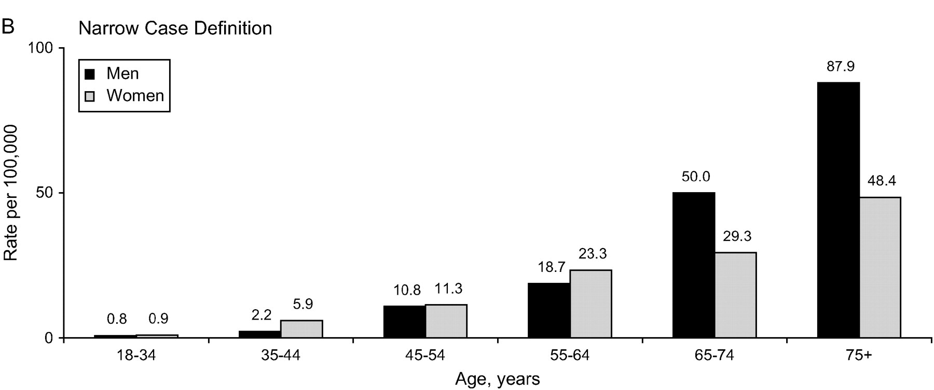
IPF Is Not Common
Prevalence of IPF by Age
Estimated 89,000 Current Patients in the United States
(Annual incidence 34,000 new diagnoses)
Even though rare, fibrotic lung disease accounts for ~1/3 of all lung transplants nationwide
ISHTL database
Raghu G, et al. Am J Resp Crit Care Med. 2006;174(7):810-816.
Notes:
As mentioned previously and as depicted in this slide IPF is a disease of the elderly. The older the patient, the more likely it is that whatever ails him in terms of interstitial lung disease is going to turn out to be IPF, even though it is a relatively rare condition that accounts for about one-third of all lung transplants that are performed nationwide.

Slide 17
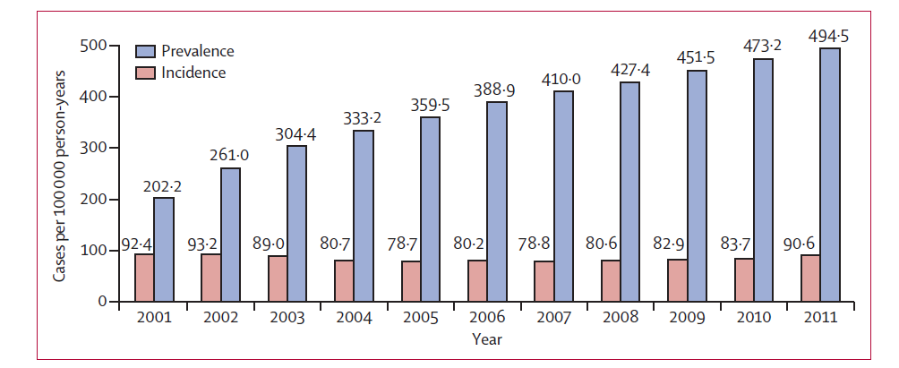
But Prevalence of IPF Is Increasing
Medicare Beneficiaries Age ≥65 y
Factors associated with lower survival: Age, index year, male gender
Median survival = 3.8 y
Raghu G, et al. Lancet Respir Med. 2014;2:566-572.
Notes:
This slide shows that the prevalence of IPF is actually increasing. The study was taken from a large, Medicare database and this alerts us to the fact that we are seeing more and we'll continue to see more IPF in the future. As mentioned, the prognosis terms to be quite poor.

Slide 18
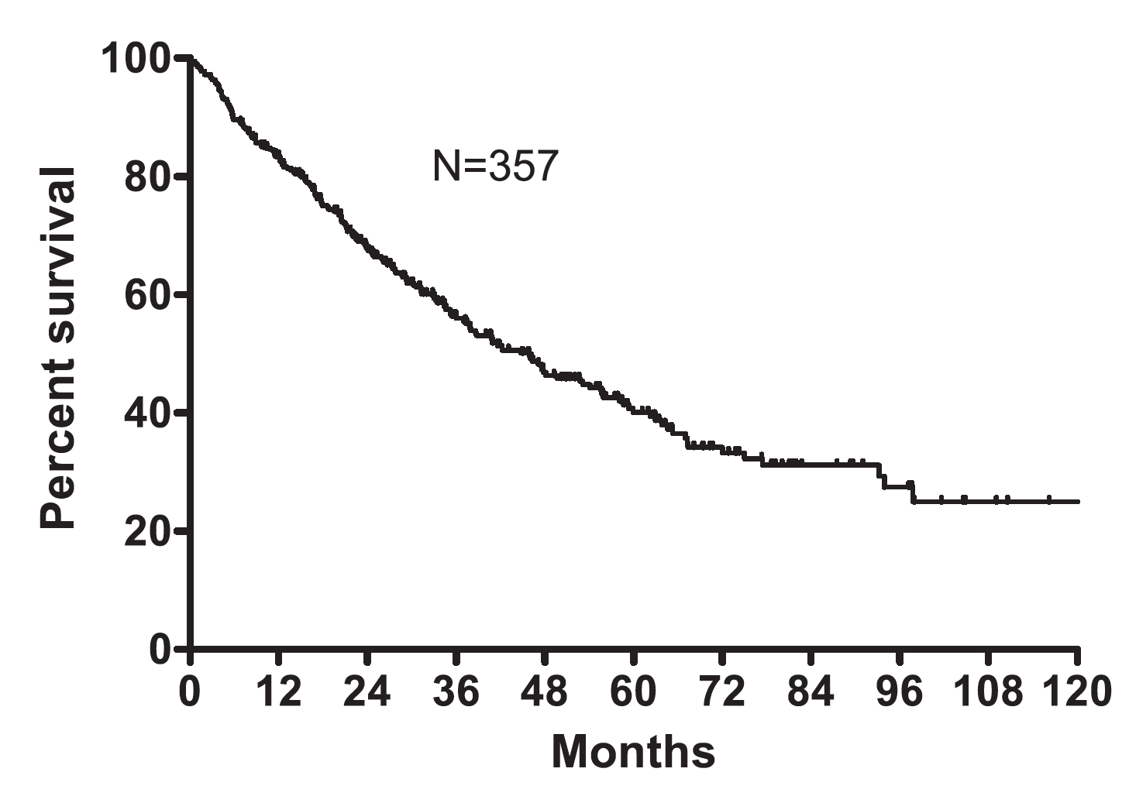
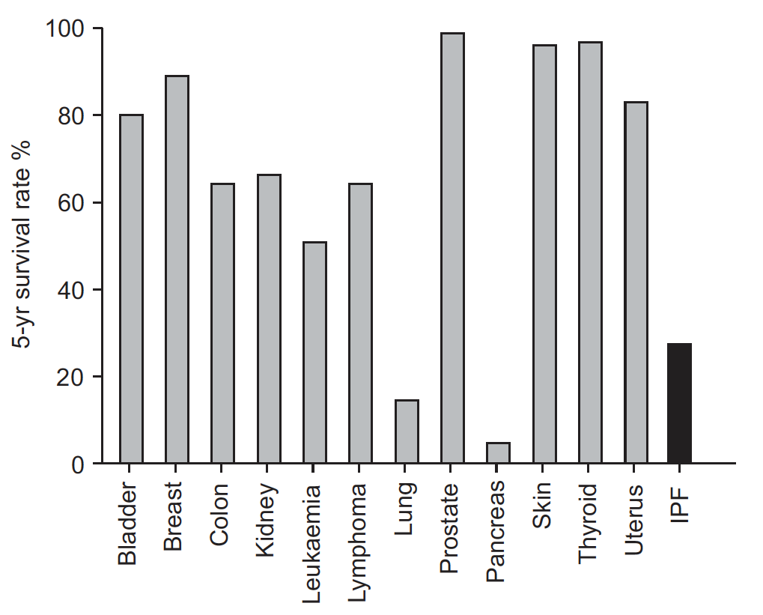
Prognosis of IPF Is Worse Than Most Cancers
5-year survival rate of IPF compared to common cancers
Prognosis
From time of initial spirometry, transplants excluded
Left: Nathan SD et al. Chest. 2011;140(1):221-229. Raghu G, et al. Lancet Resp Med. 2014;2(7):566-572.
Right: Vancheri C, et al. Eur Resp J. 2010;35(3):496-504.
Notes:
From this particular study, the number of patients surviving to five years was around under 40%. If you look at this in the context of cancers, IPF has a worse prognosis than most or many different forms of cancer. The only cancers that have worse prognosis than IPF are stage three and stage four lung cancer, and pancreatic cancer.

Slide 19
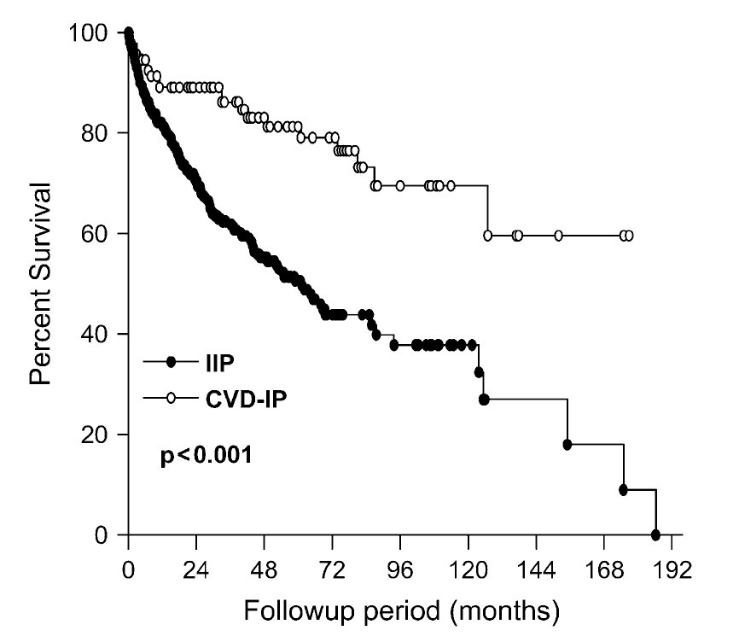
Prognosis of IPF Is Also Worse Than Connective Tissue Disease-Associated Interstitial Pneumonia
CTD-IP
-
IPF
P<0.001
CTD-IP, connective tissue disease-associated interstitial pneumonia.
Park JH, et al. Am J Resp Crit Care Med. 2007;175(7):705-711.
Notes:
It is important to make the distinction of IPF versus other forms of interstitial lung disease because what we tell patients in terms of prognosis is quite different. For example, IPF has a significantly worse prognosis than patients with an underlying connective tissue disease. Hence, the reason to make an accurate diagnosis, because it has prognostic implications and as you'll hear, also has treatment implications as well.

Slide 20
Interstitial Lung Abnormalities and Mortality
4 Research cohorts
  Framingham Heart Study (n = 2633)
  AGES-Reykjavik Study (n = 5320)
  COPDGene Study (n = 2068)
  ECLIPSE (n = 1670)
Interstitial lung abnormality status as determined by chest CT
Outcomes
  All cause mortality over 3‒9 year median follow-up
  Cause of death (AGES-Reykjavik cohort)
Putnam RK, et al. JAMA. 2016;315(7):672-681.
Notes:
Something that is getting more attention is an entity that's been termed interstitial lung abnormalities or rather early interstitial lung abnormalities. There was a paper that was published that looked at four, large databases or cohorts of patients who enrolled in various clinical trials. There was a Framingham Heart Study, the AGES study, which was an Icelandic study, the COPD Gene study, and the ECLIPSE study. A couple a thousand patients in each of these studies, and what was common to all of these studies was that patients had to have a screening baseline CT scan at the start of enrollment. What these authors did was they went back and they looked at the presence of interstitial lung abnormalities on the initial screening CTs, and they followed up on these patients with and without interstitial lung abnormalities to see what the outcomes were.

Slide 21
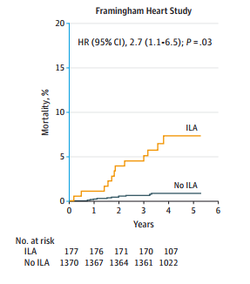
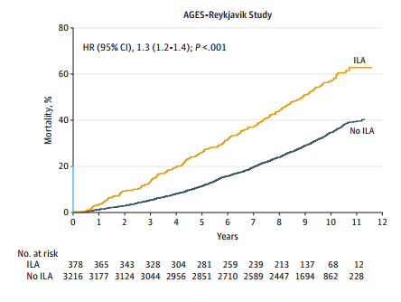
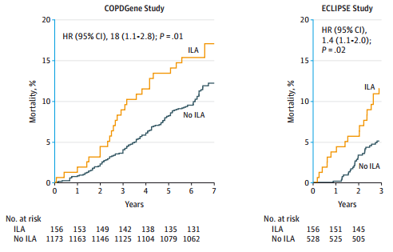
Association Between Interstitial Lung Abnormalities and All-Cause Mortality
Adjusted for age, sex, race, body mass index, pack-years of smoking, current or former smoking status, and GOLD stage of COPD (except AGES-Reykjavik).
ILA, interstitial lung abnormality.
Putnam RK, et al. JAMA. 2016;315(7):672-681.
Notes:
As you can see in this slide over here, a very common feature to all of these studies was that those patients who had interstitial lung abnormalities had worse outcomes and a greater likelihood of mortality in the ensuing years. What was also interesting and quite common through all these four studies was the prevalence of early interstitial lung abnormalities, which was around 7% for all of these cohorts. The message from this was the presence of early interstitial lung abnormalities has clinical meaning and the reason why some of these patients likely have a higher mortality was that some of them evolved to develop various forms of interstitial lung disease, the most common, most likely being idiopathic pulmonary fibrosis, and that's why through the years we see these curves come apart.

Slide 22
Summary
Interstitial lung diseases (ILD) is a broad group of 150+ lung diseases
Identifying the type of ILD has important prognostic and treatment implications
Interstitial pulmonary fibrosis (IPF) is the prototypical ILD
Availability of antifibrotic therapy underscores the importance of early diagnosis and differentiating IPF from other ILDs
Notes:
In summary, the interstitial lung diseases are a broad category of different diseases, 150 plus, if you read or open any textbook. It becomes very important to discern all these different conditions from one another, because their prognosis is very different and the management is very different. The prototypical disease of the idiopathic interstitial pneumonias is IPF. That constitutes about two thirds to three quarters of all their idiopathic interstitial pneumonias. With the availability now of antifibrotic therapy, it's become increasingly important to make the diagnosis early and to differentiate IPF from all the various other forms of interstitial lung disease. Thank you for your attention.

Slide 23
PATHOGENESIS
Notes:
Hello, I'm Dr. Imre Noth and I'm a professor of medicine and Chief of Pulmonary and Critical Care at the University of Virginia. I also run a translational research lab involved in genetics and genomics of IPF. In this module we will discuss our current understanding of the highly complex pathogenesis of interstitial lung disease by discussing what we know about interstitial pulmonary fibrosis.

Slide 24
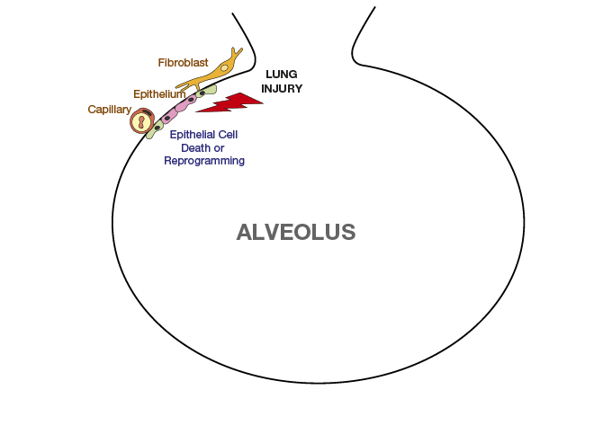
Possible Mechanisms for IPF
Ahluwalia N, et al. Am J Resp Crit Care Med. 2014(8);190:867-878.
Notes:
So on this first presentation what we see is the fibroblast and epithelium interacting with lung injury leading to some kind of process. And we are expecting to see a certain amount of cell death or reprogramming at the capillary and epithelial level.

Slide 25
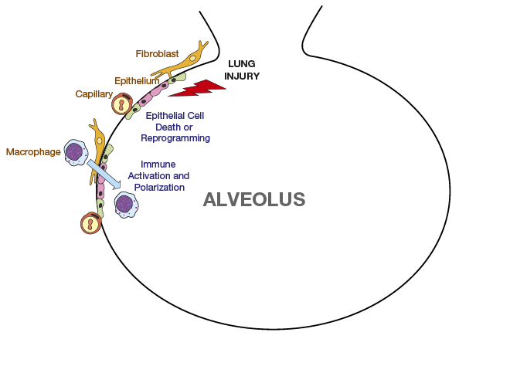
Possible Mechanisms for IPF
Ahluwalia N, et al. Am J Resp Crit Care Med. 2014(8);190:867-878.
Notes:
As we move to the next stage, the results of that lung injury lead to an inflammatory process. And that inflammatory process is immune-mediated with immune activation and polarization of macrophages that get drawn into the alveolar space.

Slide 26
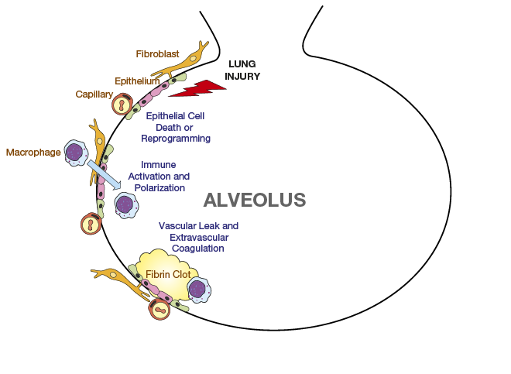
Possible Mechanisms for IPF
Ahluwalia N, et al. Am J Resp Crit Care Med. 2014(8);190:867-878.
Notes:
Those macrophages then provide the cytokines and interleukins if you will that lead to a vascular leak and extravascular coagulation. And finally a fibrinous clot, which is meant to seal off the area of injury in a normal process.

Slide 27
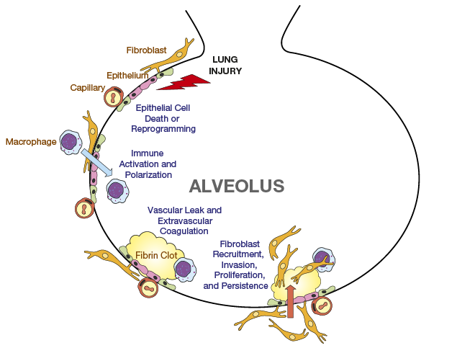
Possible Mechanisms for IPF
Ahluwalia N, et al. Am J Resp Crit Care Med. 2014(8);190:867-878.
Notes:
We then see that there is a recruitment of various cell lines to help that repair process including fibroblast recruitment and invasion and proliferation and persistence of those cells. In fact one of the major thoughts in regards to pulmonary fibrosis is that the fibroblast cell line becomes immortalized while the epithelial cells unfortunately die.

Slide 28
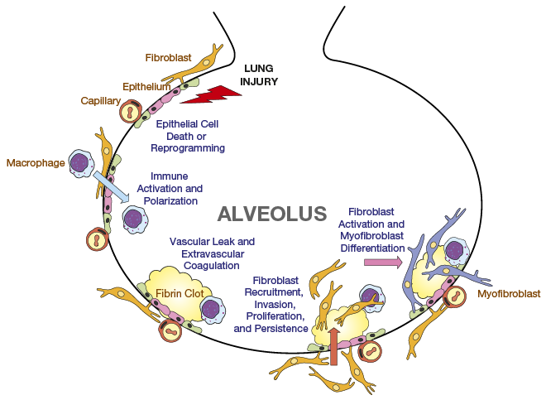
Possible Mechanisms for IPF
Ahluwalia N, et al. Am J Resp Crit Care Med. 2014(8);190:867-878.
Notes:
They next build on that is activation of those fibroblasts and differentiation into a myofibroblast which is a more universal cell with greater pleiotropic activity that helps maleate that process. The fibroblasts, in differentiating to that process, creates worlds of cells called fibroblastic foci which seemed to drive the fibrosis forward.

Slide 29
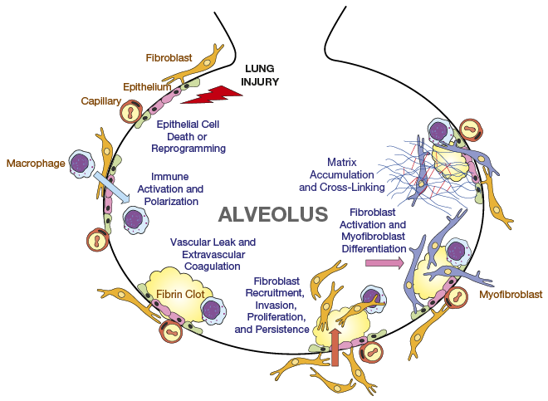
Possible Mechanisms for IPF
Ahluwalia N, et al. Am J Resp Crit Care Med. 2014(8);190:867-878.
Notes:
They then lay down the extracellular matrix which is really the fibrotic component or the building blocks involved in that fibrotic component. And that matrix leads to crosslinking and accumulation, creating that fibrosis.

Slide 30
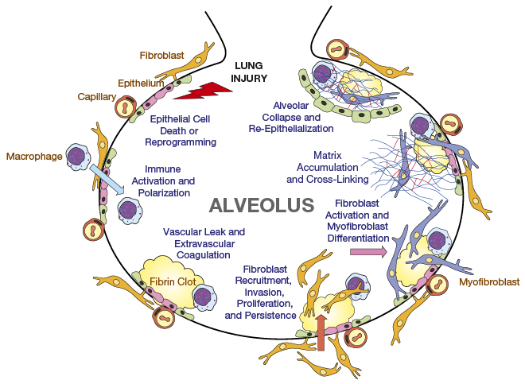
Possible Mechanisms for IPF
Ahluwalia N, et al. Am J Resp Crit Care Med. 2014(8);190:867-878.
Notes:
And then finally we see the alveolar collapse and re-epithelization of that region. As it gets sticky if you will, and the fibrosis shrinks down like any scar that you would have on the back of your hand, it causes restriction and a stiffness in the lung. This is just one of the little outlying possible mechanisms that's been proposed to help put the context of the disease into place.

Slide 31
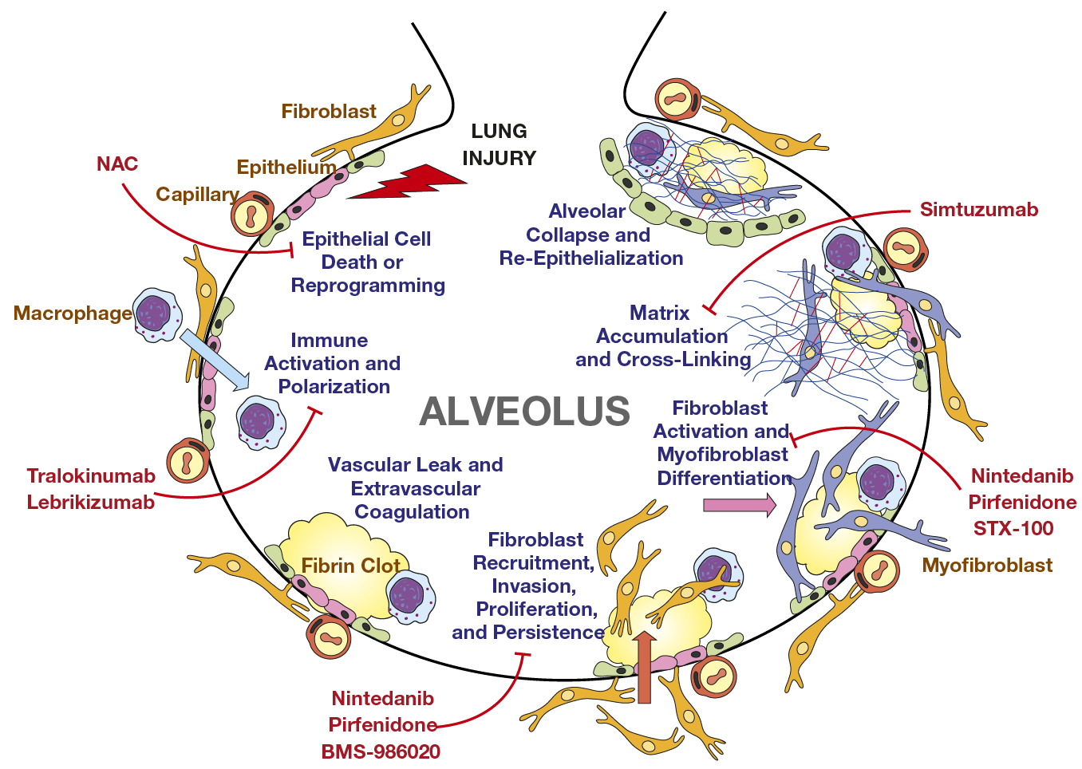
Genetic associations in sporadic disease— predisposition to injury?
NAC, N-acetylcysteine. BMS-986020, lebrikizumab, N-acetylcysteine, simtuzumab, STX-100, tralokinumab are not approved for interstitial lung disease in the United States
Ahluwalia N, et al. Am J Resp Crit Care Med. 2014(8);190:867-878.
Wolters PJ, et al. Annu Rev Pathol. 2014;9:157-179.
Notes:
So on this last portion of the build slide, what we see is an integration of really two parts. The first is showing some of the mechanisms involved and their interaction with various interventions. Those might include things like N-acetylcysteine, lebrikizumab, nintedanib, and pirfenidone and other molecular antibodies acting at the various portions. What that's showing you is, that the particular agents in development are really starting to focus in a far more targeted fashion at where the mechanisms of action may be occurring. Directed molecular activity at the immune activation, less directed activity involving nintedanib and pirfenidone at fibroblast recruitment and certainly at fibroblast activation. And then finally directed molecular activity at the accumulation and cross-linking of the alveolar matrix.
The last part is really integrating the underlying genetics. We know that there's a clear predilection in these patients involving certain predispositions of common polymorphisms and uncommon polymorphisms. A largest group being the MUC5B polymorphism, which represents about 35% of the patients. Now this is not an abnormal polymorphism. It's very important to recognize that. It exists in 10% of the populous and 35% of the patients. So 10% of the populous is certainly not abnormal, it's just a minority of them. We know that by risk stratifying for these things, that we can try to begin to understand where the effects may be in this hypothesis over the possible mechanisms involved in initiating alveolar fibrosis.

Slide 32
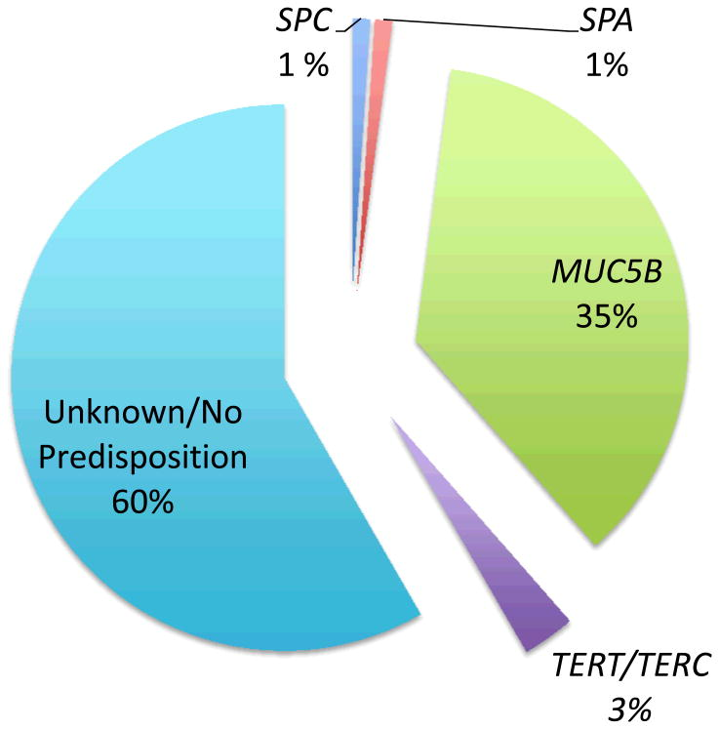
Genetic associations in sporadic disease— predisposition to injury?
NAC, N-acetylcysteine. BMS-986020, lebrikizumab, N-acetylcysteine, simtuzumab, STX-100, tralokinumab are not approved for interstitial lung disease in the United States
Ahluwalia N, et al. Am J Resp Crit Care Med. 2014(8);190:867-878.
Wolters PJ, et al. Annu Rev Pathol. 2014;9:157-179.

Slide 33
Summary
Several potential targets in the pathogenesis cascade
Provides an opportunity to individualize treatment by directing therapies at multiple targets
Genetics may play a role in pathogenesis
Notes:
If you want to think about it, in summary, we have many possible mechanisms of action with a cascade that's been demonstrated to you by that last figure. The first is really the integration of the injury with the repair process, the accumulation of the immune activation system. The fibroblast being mediated into myofibroblast and immortalization if you will with proliferation. And the loss of the epithelial integrity. What that does though is provide a framework for where individualized therapies may be developed and directed at each step. And hopefully provide a cascade of steps that can then be used in concert to have a greater impact on the disease. Then finally how the genetics may play some role in mediating that process.

Slide 34
EVALUATION AND DIAGNOSIS
Part A
Notes:
Hi. I'm Dr. Imre Noth, I'm a professor of medicine and Chief of the Division of Pulmonary and Critical Care Medicine at the University of Virginia. I also run a translational research lab involved in genetics and genomics of IPF.
In this module we will discuss the evaluation and diagnosis of interstitial lung disease. We will talk about the role of history and physical examination, biopsy, pulmonary function testing, and other laboratory measures. We will also discuss risk factors and comorbidities for interstitial pulmonary fibrosis. And last, we will talk about the importance of a multi-disciplinary care team.

Slide 35
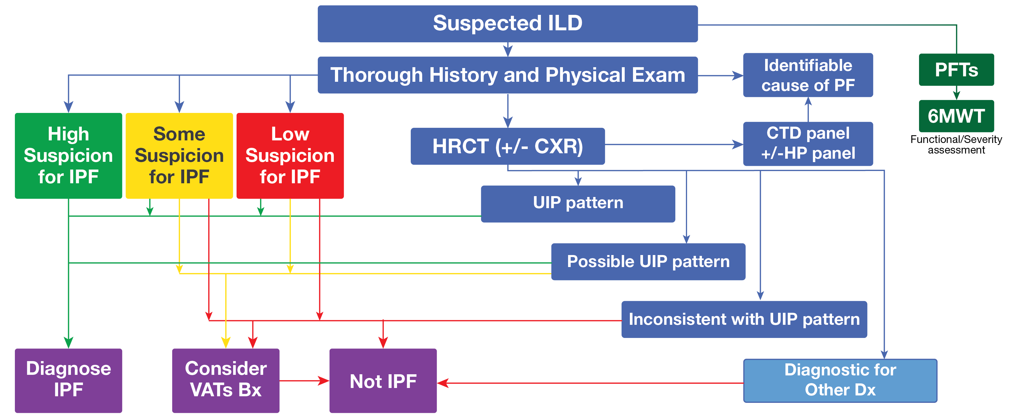
Diagnostic Algorithm for ILD
Notes:
All right, well, at first you notice that subway map and I'm going to show you here how this confusion kind of continues but I want it in a more conceptual fashion. So this diagnostic algorithm for ILD helps marry the key things that we always engage in, in any approach in medicine.

Slide 36

Diagnostic Algorithm for ILD
Notes:
The first is really our clinical suspicion for whatever the underlying disease process is and the second is the integration of the objective data. What this slide has done is shown you that process. So when we have a patient with a suspected ILD, our first role is really just to ask ourselves, "Is there a high suspicion for IPF, some suspicion, or low suspicion?" The most powerful tool that we have is the high-resolution CT scan. I'll talk a little bit more about that. But the first part is, identifying if there are other causes, and then integrating that in to the data and then integrating the possible patterns that we see on that CT scan to make a diagnosis.

Slide 37

Diagnostic Algorithm for ILD
Notes:
Now on the portion of the build, you see that there's an integration of the green line, if you will, which incorporates the clinical suspicion with the CT data to help build out a possible diagnosis. If the CT scan is consistent with the usual interstitial pattern, you'll notice that with a high suspicion, we move directly towards diagnosis of IPF. Whereas, if there's only some suspicion, or only a possible UIP pattern, we move into considering a biopsy by video-assisted thoracoscopic approach.

Slide 38
Diagnostic Algorithm for ILD
Notes:
And then on the red line, if it's an inconsistent pattern of the CT scan, this is where we're going to consider alternative diagnoses.

Slide 39
A Pulmonologist’s Approach to an Interstitial Lung Disease (ILD) Workup
Ask 3 questions:
Is there a discernible cause of the ILD?
And if not, does it appear to be idiopathic pulmonary fibrosis?
If neither of the above, should a biopsy be done to further decipher?
Notes:
And so as we look at the approach from a pulmonary standpoint for the workup, we ask three questions. Is there a discernible cause for the ILD, and if not does it appear to be idiopathic pulmonary fibrosis? And then finally, if neither of the above, should a biopsy be done to further decipher the underlying process.

Slide 40
The Workup for ILD
Thorough History & Physical Exam
Disease symptoms and trajectory
  Acute vs chronic
Exposures
  Jobs, hobbies
  Mold, hot tubs
Comorbidities
Medication history
Physical evidence of autoimmune disease?
  Mechanic’s Hands
  Sclerodactyly
  Arthritis
Spirometry and Diffusion
Notes:
What's involved in the workup? Well the first things that we ask is, has this been around for a long time or is this acute? Is this acute or chronic? Are there possible exposures? This might involve the underlying job of the person, hobbies, things like, it might sound very eclectic, but glassblowers.
Now I spent 22 years in Chicago and silicosis and asbestosis were very high on the list because of the steel mills. Certainly mold from hot tubs or moldy basements. We ask ourselves about comorbidities and you'll see as we move forward, why this becomes so important. But it does become a question of pattern recognition because we know that there's a higher predilection to certain comorbidities with this diagnosis and the alternative diagnosis as well.
And then we look for the evidence of auto-immune diseases. Things like mechanic's hands or sclerodactyly or arthritis. We are certainly going to look at the spirometry and the diffusion capacity. This helps us discern the level of restriction and whether it's present or not.

Slide 41
The Workup for ILD (cont)
Labs
Complete Blood Count (CBC)
Comprehensive metabolic panel (CMP)
Antinuclear antibody (ANA)
Erythrocyte sedimentation rate (ESR)
Rheumatoid Factor (RF)
Anti-cyclic citrullinated peptide (anti-CCP)
Autoantibody levels (SCL-70, SS-A, SS-B)
Anti Synthetase testing (anti Jo-1)
Aldolase, Creatine Kinase (CK)
Immunoglobulin levels (rarely)
High-Resolution Computed Tomography
Usual interstitial pneumonia (UIP)
Something else
  Non-specific interstitial pneumonia
  Hypersensitivity pneumonitis
Notes:
Laboratory work, this is highly important in discerning whether or not an auto-immune disease is present. Now it's true that some of the lab work such as an ANA and an ESR may be elevated in the elderly. But the other ones become very, very specific and very important to certain disease processes. Things like an SCL-70 which will be highly indicative of an underlying scleroderma process, or an SS-A or an SS-B which would suggest Sjogren’s. Alternatively, something like an antisynthetase testing with an anti-Jo would suggest polymyositis.
But most importantly is the high-resolution CT scan because it helps us get at the pathology without needing a biopsy. We know that if there is a usual interstitial pneumonia pattern, on the CT scan, it's almost certainly going to be there on the biopsy as well. What we are really trying to discern is whether or not something else maybe present, such as a non-specific interstitial pneumonia pattern or a hypersensitivity pneumonitis pattern.

Slide 42
ILDs– How to Differentiate by Imaging Techniques
High resolution computed tomography (HRCT) is helpful in determining diagnosis
Is it reticular or is it nodular?
  Interstitial vs granulomatous?
  If interstitial, is there ground glass representing alveolitis?
Where is the disease predominant?
  Upper vs lower, peripheral vs central?
A correct diagnosis can be made by HRCT 60%‒80% of the time
Notes:
When we look at the CT scan, we get more information than just the biopsy possibilities. Our radiology colleagues are very good at helping us. So, some of the first questions are really corollaries to the underlying pathology. Is it reticular or is it nodular? If it reticular, it's going to suggest an interstitial process, if it's nodular, it's going to suggest a granulomatous process. If its interstitial, is there ground glass? Ground glass would represent an alveolitis.
And where is it predominant? Upper versus lower, peripheral versus central. You see upper lobe predominance would suggest things like silicosis. A peripheral process would suggest something more like usual interstitial pneumonia pattern, whereas the central would exclude it. The truth is that as I said, our radiology colleagues would be able to make a definitive diagnosis here 60-80% of the time depending on the underlying pattern.

Slide 43
ILDs– Lung Biopsy Utility
Transbronchial biopsy is diagnostic 38%‒79%
Open lung is not always required
Any open lung biopsy should include 2 biopsy sites
Areas of honeycombing should be avoided
Bronchoalveolar lavage is useful in some instances
  Pulmonary alveolar proteinosis, infectious etiologies, suspected malignancy, some drug-induced lesions, pulmonary interstitial eosinophil syndromes, etc.
Notes:
What's the utility of a lung biopsy? This is going to vary greatly depending on what you think it is. We know that a transbronchial biopsy in the setting of something that's granulomatous could be very high. An example would be sarcoidosis, where we know that 90-96% will be attainable by transbronchial biopsy. But for something that's not going to be granulomatous, the transbronchial biopsy may have very low yields, under 38%. And certainly a video-assisted thoracoscopic biopsy or an open lung biopsy is not always required. But when it is, we want to get two sources. And that's to get confirmatory biopsies so that we're not biased by acquisition. Areas of honeycombing should be avoided because those are always going to represent end-stage lung disease.
Now the bronchoalveolar lavage fluid may be useful in certain instances, primarily infectious etiologies. But other things like pulmonary alveolar prognosis, certainly things like a suspected malignancy or drug-induced lesions, such as pulmonary interstitial eosinophilic syndromes where you might see a rise in the underlying eosinophil counts.

Slide 44
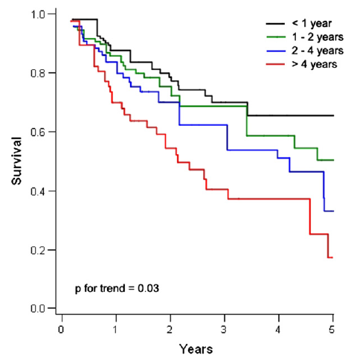
A Challenging Time in IPF
Making the right diagnosis of IPF is more critical than ever
Patients often see multiple doctors prior to diagnosis
Delayed referral to tertiary care center associated with mortality
Survival from the time of evaluation at a tertiary care center adjusted for age and FVC across quartiles of delay. Entry time into the cohort began at study enrollment.
Lamas DJ, et.al. Am J Respir Crit Care Med. 2011;184(7):842-847.
Notes:
Okay so now is a challenging time for more IPF more than ever to really make the right diagnosis. And this is because making the right diagnosis has become not only constant challenge but has more impact now than it ever has. So this slide showing you a great study out of Columbia few years ago demonstrates the sooner patients are referred to a specialized center the better they do. And that's independent of how severe they are sick. That's really important, and I think it reflects a few key details.
It isn't that referral centers are smarter, it's that usually they have a greater resource allocation to these specific and uncommon diseases. And it's simply the Henry Ford principle of patient care. The more you do things over and over again with an algorithm the greater the likelihood you are going to make an impact in these patients' lives. And so often these patients see multiple doctors before getting the correct diagnosis and that's really a reflection in the uncommon nature of these diseases with a really common set of symptoms leading doctors to look at other things first, that's normal. But it's important that we raise the awareness and get them to specialized centers sooner rather than later.

Slide 45
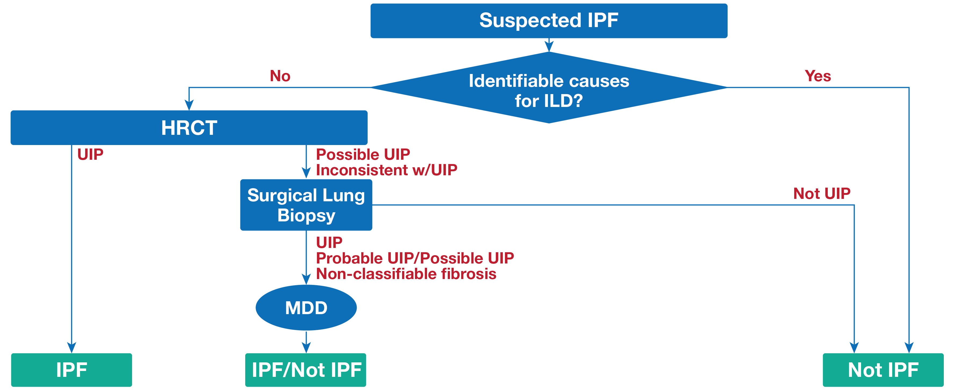
Diagnostic Algorithm for IPF
Raghu G, et al. Am J Resp Crit Care Med. 2011;183:788-824.
Notes:
Okay so now is a challenging time for more IPF more than ever to really make the right diagnosis. And this is because making the right diagnosis has become not only constant challenge but has more impact now than it ever has. So this slide showing you a great study out of Columbia few years ago demonstrates the sooner patients are referred to a specialized center the better they do. And that's independent of how severe they are sick. That's really important, and I think it reflects a few key details.
It isn't that referral centers are smarter, it's that usually they have a greater resource allocation to these specific and uncommon diseases. And it's simply the Henry Ford principle of patient care. The more you do things over and over again with an algorithm the greater the likelihood you are going to make an impact in these patients' lives. And so often these patients see multiple doctors before getting the correct diagnosis and that's really a reflection in the uncommon nature of these diseases with a really common set of symptoms leading doctors to look at other things first, that's normal. But it's important that we raise the awareness and get them to specialized centers sooner rather than later.

Slide 46
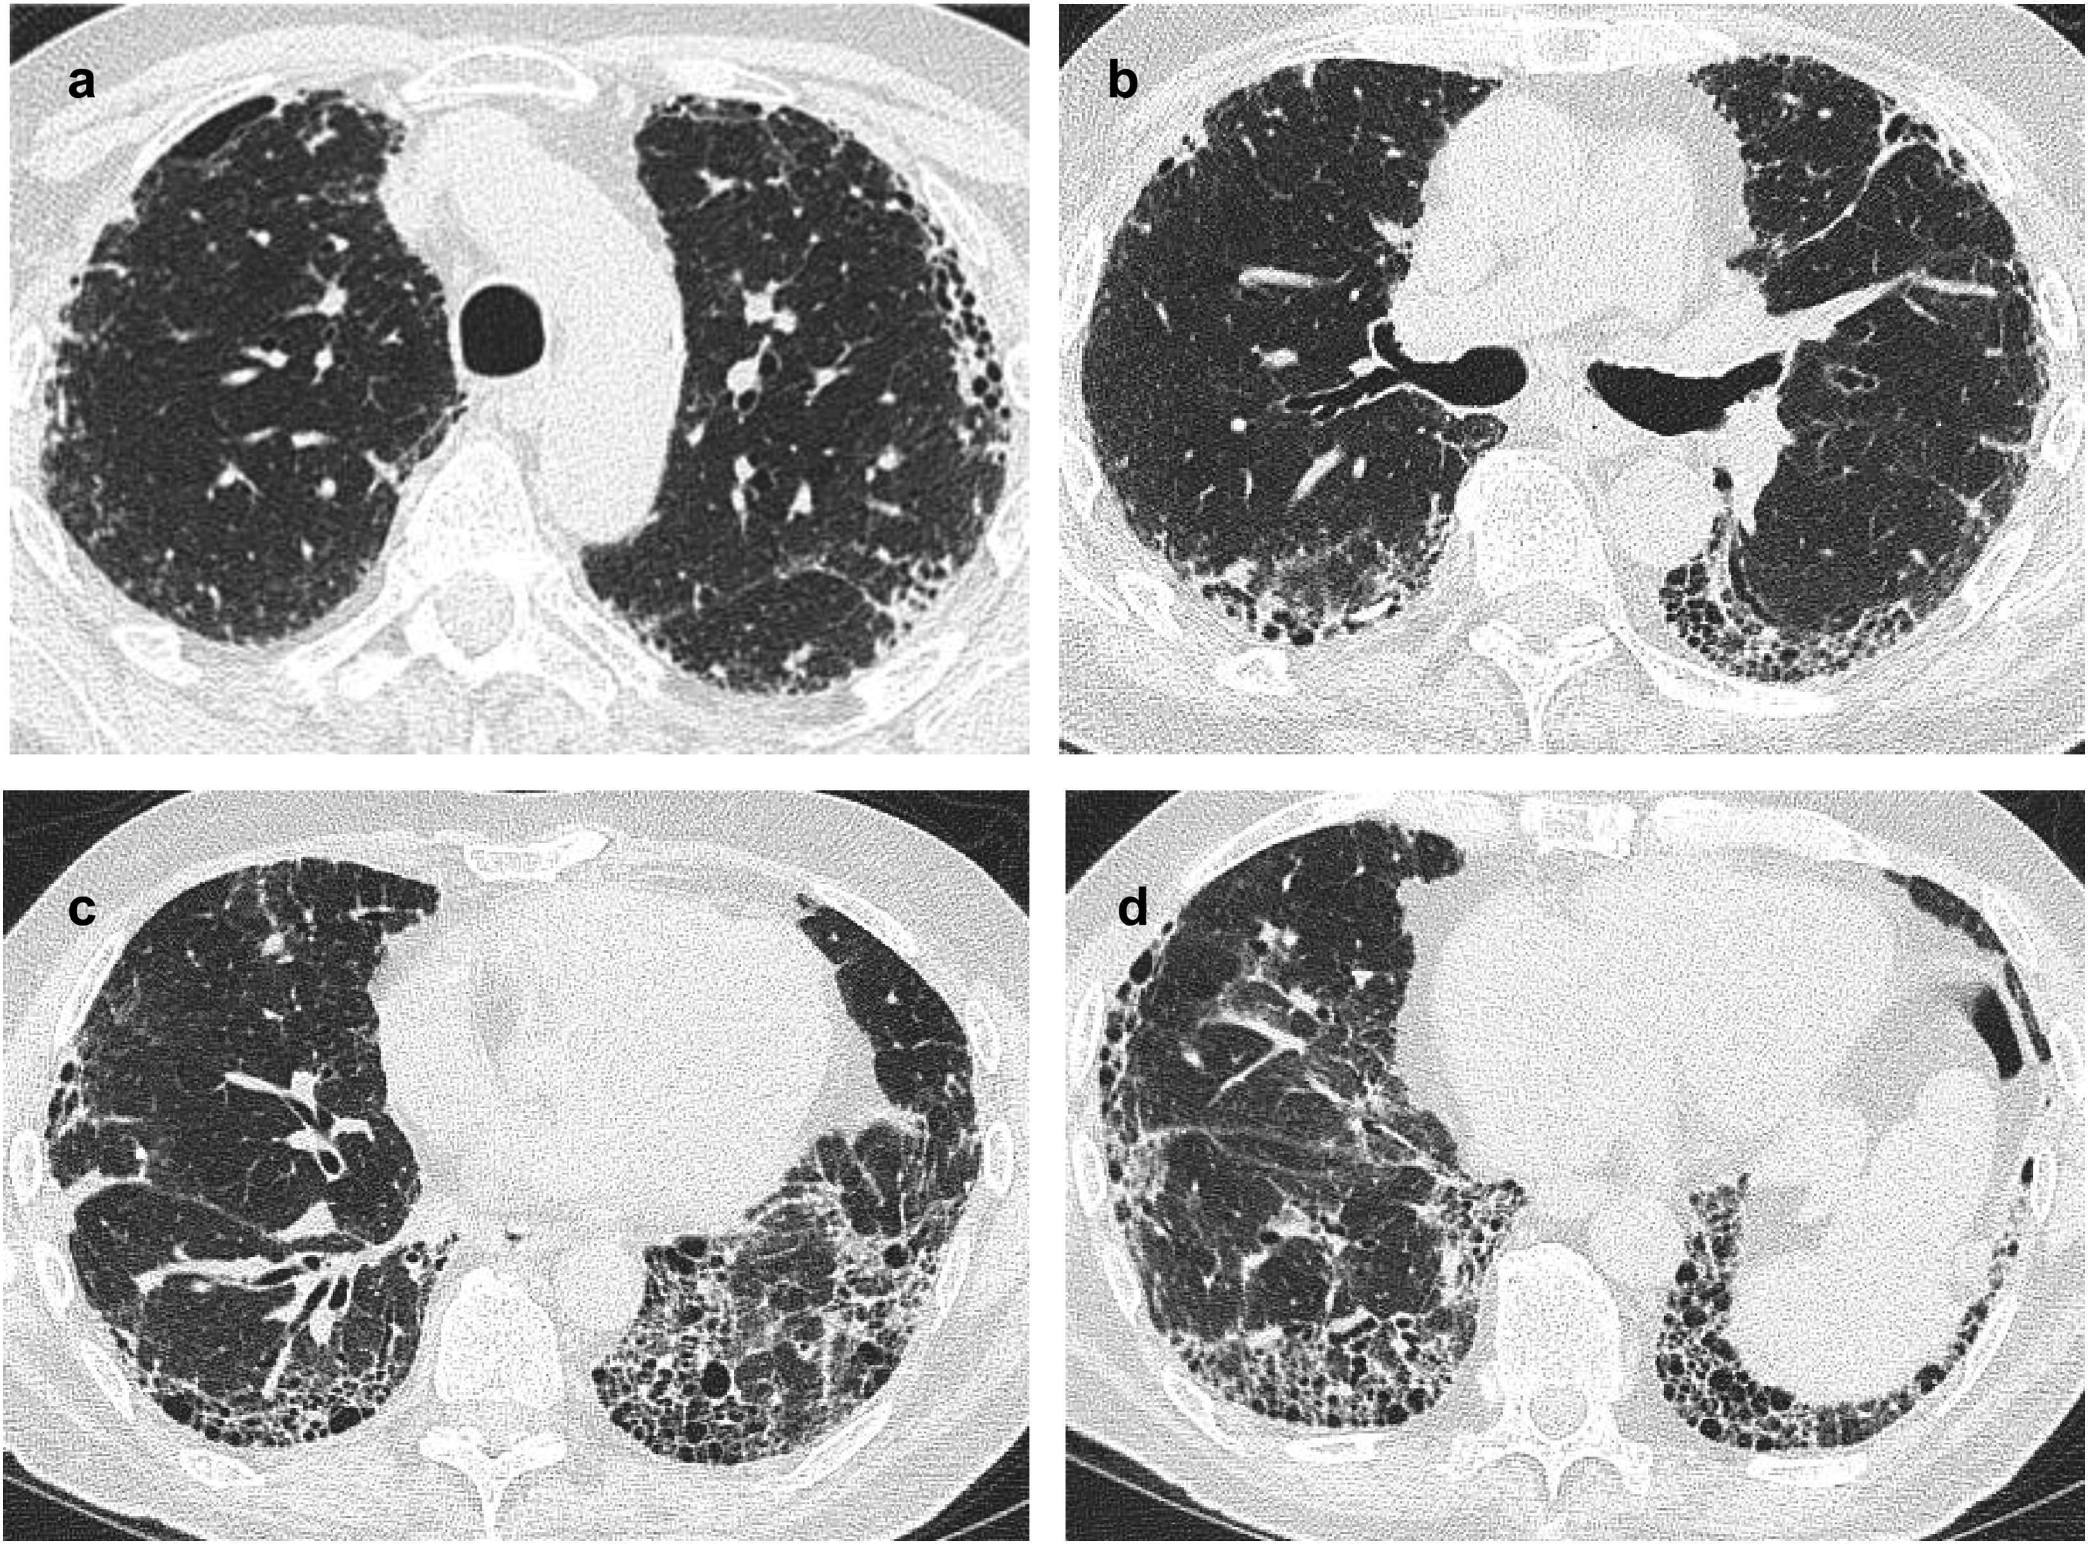
Usual Interstitial Pneumonia Pattern
If this pattern is seen, there is a >90% chance of finding UIP on
surgical biopsy
Hodnett PA, et al. Am J Respir Crit Care Med. 2013;188(2):141-149.
Notes:
What’s that usual interstitial pneumonia pattern? Here we have the CT scans demonstrating that what we can see the honeycomb pattern on the edge or the outside of the lung. These are holes, cystic holes that are seen when they are present, there's a greater than 95% chance that if you biopsy this patient the surgical biopsy will show its usual interstitial pneumonia pattern.

Slide 47
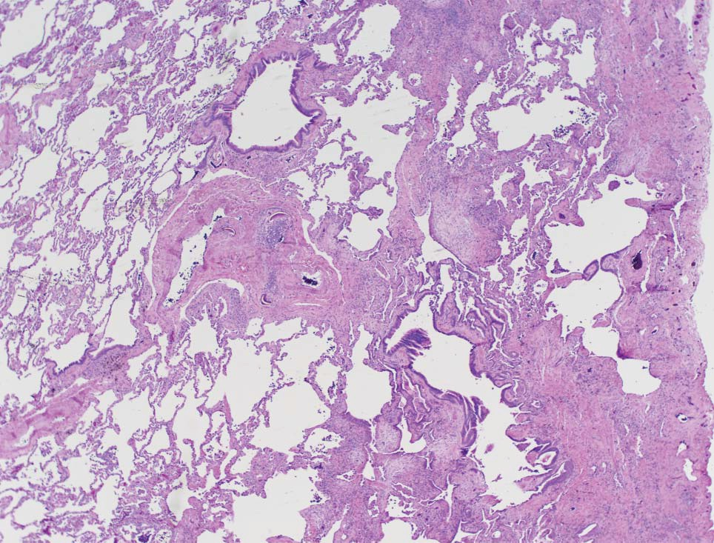
Usual Interstitial Pneumonia
Morrison, LD, Noble, PW. Interstitial and fibrotic lung diseases. ACP Medicine. 2008;1-39.
Notes:
Now that term is important. All that means is the usual or most common type of scar. When you look at this slide it really says everything we need to see. At first what you notice is the just the position of the normal lung and on the left side of the slide versus abnormal fibrotic tissue on the right.

Slide 48
Usual Interstitial Pneumonia (cont)
Morrison, LD, Noble, PW. Interstitial and fibrotic lung diseases. ACP Medicine. 2008;1-39.
Notes:
And in the center when we do the build on the slide you see what called the fibroblastic foci these are the fiberglass lined in parallel leading, they are the leading edge of the extra side of the matrix. This is where the scar tissues gets deposited.

Slide 49
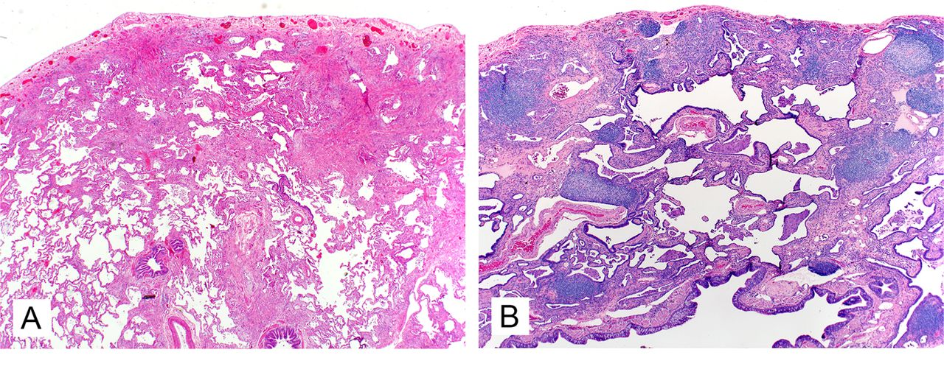
UIP ≠ IPF
IPF
Too blue!
Smith M, et al. J Clin Patho. 2013;66:896-903.
Notes:
What's also important to recognize is the term simply means the most common type of scar, it does not mean IPF. For it to be IPF, it has to be without an etiology. You can certainly have this pathology with an etiology. And we have the two examples here of the UIP pattern in panel A versus this far more blue pattern if you see in slide B portion, and that really represents the greater increase in cellular inflammation. It's far too blue to be IPF.

Slide 50
EVALUATION AND DIAGNOSIS
Part B

Slide 51
How Do IPF Patients Present?
Shortness of breath (dyspnea)
Dry cough
Fatigue
Exercise desaturation
“Velcro” rales at lung bases
Clubbing of fingers and/or toes may be present
Often discovered incidentally
  ILD on routine chest x-ray or chest CT
  ILD at bases of abdominal CT
  Fluoroscopy at time of cardiac catheterization
  Family history
Notes:
All right, what does this mean in the patient? Well, how do patients with IPF often present? The most common presentation is shortness of breath and usually on exertion. They often present with the dry cough, with some measure of fatigue, with exertional dyspnea so exercise de-saturation. This is a key point if you have abnormal normal lungs with scarring you are going to drop your oxygen level when you exercise. When you have normal lungs your oxygen level actually goes up. The Velcro rales or crackles at the lung base are going to be present there almost universally. And the clubbing on the fingers and toes may be present about 50-75%. It's often discovered incidentally usually on a routine chest x-ray or CT scan and as I mentioned on the previous CT scans that I showed you, we really see it at the bases. It's been noted down on fluoroscopy for cardiac catheterization. And what we really discovered often while taking a family history as well.

Slide 52
Distinguishing Dyspnea: IPF Prevalence^{1‒3}
IPF¹
136,170
Heart Failure²
5.1 million
COPD³
15.7 million
Million
1. Raghu G, et al. Am J Resp Crit Care Med. 2006;174:810-816.
2. Go AS, et al. Circulation. 2013;127:e6-e245.
3. Wheaton AG, et al. MMWR Morb Mortal Wkly Rep. 2015;64:289-295.
Notes:
All right, let's talk a little bit about dyspnea or shortness of breath.
It is important to recognize that the patient is really going to come in complaining of that, and this is why it take so much time to work them up. We know that there are roughly 16 million Americans with COPD who are going to have some presentation of shortness of breath. Heart failure 5.1 million Americans, whereas IPF is only going to be represented by the 136 thousand cases. Now what's, one of the things I like to teach the medical students about, number one cause of dyspnea world-wide, anemia, and it's going to dwarf all of these.

Slide 53
Common Risk Factors for IPF
Age
Male gender
Cigarette smoking
Gastroesophageal reflux
Occupational exposure to metal dust or wood dust
Genetic predisposition
Raghu G, et al. Am J Respir Crit Care Med. 2011;183(6):788–824.
Notes:
So really context is important, where you are, who you are and what the other common risk factor looks like. So, when we think about that we quickly realize, that this is the disease of the elderly, it's three times more common in an 80-year-old than a 50-year-old. It's a male predominant disease; 4:1 more in men than in women. We know there's a high predilection towards smoking. We know there are higher rates of reflux disease, 60-80% will have some measure of reflux.
We know that they have often had exposure of some kind, even though those may not have been an etiology. So exposures to metal dust or wood dust and as we mentioned in a previous module, our genetic predisposition.

Slide 54
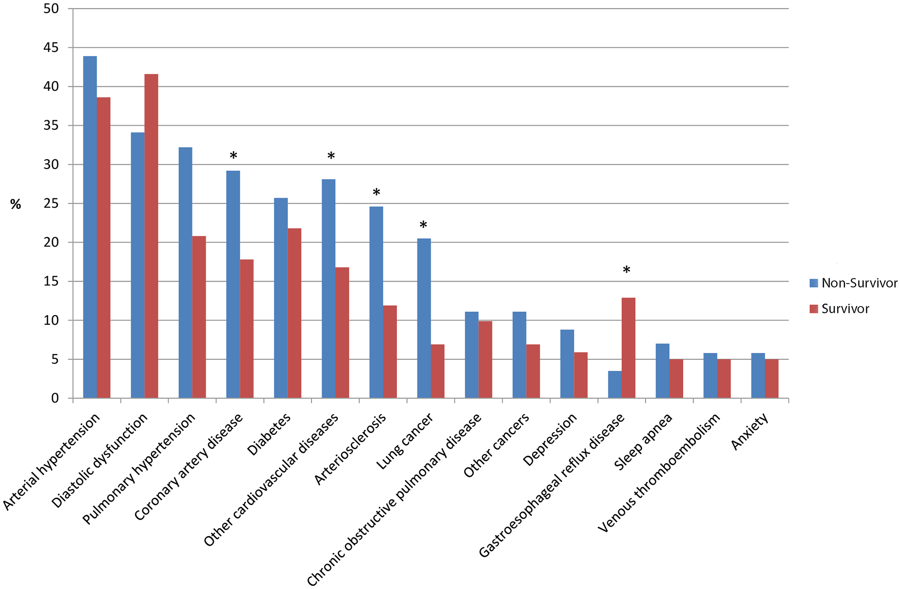
Comorbidities in IPF
IPF patients from tertiary care database (N=272)
Mean number of comorbidities per patient was 2.68
Median survival decreased from 66 months with no reported comorbidities to 12 months with 6 reported comorbidities.
*P<0.05
Kreuter M, et al. PLOS One. 2016;11(3):e0151425.
Notes:
What do those comorbidities look like and what are their impact? This is a great study out of the German natural history cohort that looked at 272 patients in the tertiary care database and comorbidities mattered. Not only were they implicative of the disease, but they also implied differences in survival. So here we have a long list of multiple comorbidities associated with interstitial pulmonary fibrosis at higher rates. Things like coronary disease which is 4 times more likely. Lung cancer rates, reflux disease, depression, anxiety, venous thromboembolic disease. But you will notice the asterisked ones. You are more likely to die when you have these elements. Coronary disease. highly implicative of an increase in death. Lung cancer certainly more so. And even reflux disease seems to have some impact. We know that the median survival is decreased from 66 months to 12 months with 6 reported comorbidities.

Slide 55
Baseline Desaturation on 6-Minute Walking Test Predicts Decreased Survival in IPF
1.0
0.8
0.6
P = 0.0018
Survival Probability
N = 83
0.4
0.2
0.0
0
1
2
3
4
5
Nondesaturators (SaO₂ > 88%, n = 39)
Desaturators (SaO₂ ≤ 88%, n = 44)
Years
Lama VN, et al. Am J Respir Crit Care Med. 2003;168:1084-1090.
Notes:
What are other elements that predicts outcomes in these patients? We know if you de-saturate when you walk below 88% that is the very bad prognostic sign. This is now data that is a decade and half old, by Lama at the University of Michigan where they simply took a look at a small cohort of patients to demonstrate if they de-saturated, that was bad. It shouldn't be a surprise. Reflecting the fact on that, patients who de-saturate often have worse pulmonary hypertension, we know these patients all develop low level pulmonary hypertension and if they have that pulmonary hypertension again this data demonstrates poor outcomes on these Kaplan-Meier survival curves.

Slide 56
Pulmonary Function Testing
Most patients with IPF exhibit the following:
  Decreased FVC (FVC may be normal in early IPF)
  Normal-to-increased FEV₁/FVC ratio
  Reduced DL_{CO}
  Reduction in TLC
Patients with concurrent emphysema may exhibit normal lung volumes and spirometry, but reduced DL_{CO}
Low baseline FVC, decline in FVC, low DL_{CO}, and decline in 6MWT are associated with decreased survival
Oldham JM, et al. Respir Med. 2014;108(6):819-829.
Notes:
We know that pulmonary function testing is very important to predicting outcomes. We know that most patients with IPF will exhibit restrictive disease marked by a decrease in their forced vital capacity. We know that the FEV₁/FVC ratio can be normal to increased representing an increase elastic recoil. We know that the diffusing capacity representing loss in the capillary bed will be reduced and the total lung capacity will be reduced. We know that patients with concurrent emphysema may have a counter balance to that leading to normalization of lung volumes and spirometry, but both attacking the DL_{CO}. Right, emphysema make the lungs big and pulmonary fibrosis makes the lungs small and the result is that you may end up at an even number, but both will reduce the lung capacity.
We know that a low baseline FVC, we know that the decline in FVC, that a low DL_{CO}, and a worsening six-minute walk are all associated with decreased survival.

Slide 57
Dynamic Predictor: Decline in FVC Predicts Mortality
100
Improved
(Increase in % predicted of ≥10)
80
n = 9
Stable
(Change in % predicted <10)
60
Survival (%)
Declined
(Decrease in % predicted of ≥10)
40
20
n = 22
n = 50
0
Data collected every 6 months
Similar characteristics were seen in the 12-month follow up
0
2
4
6
8
10
12
Years
Collard HR, et al. Am J Respir Crit Care Med. 2003;168:538-542.
Notes:
Now probably the most powerful predictors we have are dynamic ones, in other words change over time. If FVC gets worse over time, this is Collard’s data now, being a decade and a half old, that demonstrated that as patients lost FVC, their Kaplan-Meier’s clearly demonstrated worse outcomes.

Slide 58
Dynamic Predictor: Change in Diffusing Lung Capacity (DL_{CO}) at 12 Months
100
(P = 0.0005)
75
n = 21
Survival (%)
50
n = 20
25
Stable/improved DL_{CO}
Decline in DL_{CO}
0
0
12
24
36
48
60
72
Time (months)
Mortality was substantially higher in patients with decrease in DL_{CO} of more than 15%
Latsi PI, et al. Am J Respir Crit Care Med. 2003;168:531-537.
Notes:
Similarly, this is the Latsi data again about a decade and a half old. As patients lost function in their DLCO and dropped their value over a 6- to 12-month period, they also demonstrated poor outcomes. Now, both of these are small patient numbers, 20 and 21 in this particular study, the previous data was also of similar size. But the reality is the data has been proven numerous times at this point for numerous data sets.

Slide 59
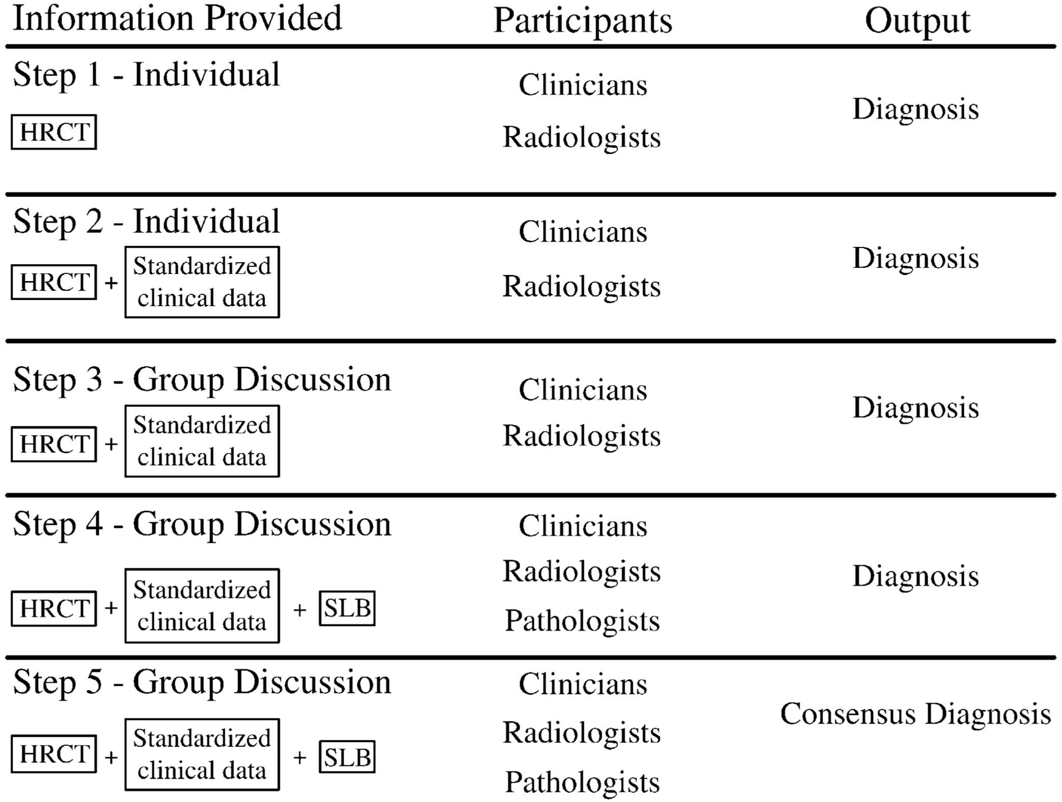
Multi-disciplinary discussion is the gold standard for diagnosing IPF
Flaherty K, et al. Am J Resp Crit Care Med. 2004;170:904-910.
Notes:
All right, what's unusual about this disease is this is an entity that is not yet molecularly defined. What do I mean by that? We don't take a hemoglobin A1C to define it. Ultimately, we have a multi-disciplinary discussion for agreement as to what this idiopathic entity it is. So this study by Kevin Flaherty a number of years ago is still the gold standard for how we approach the diagnosis, which he took a group of clinicians and radiologists and pathologists. And in step one, he simply asked them what the diagnosis was in a separate room and put them together to discuss it and then finally added pieces of data to see what the influence was in the consensus of diagnosis.

Slide 60
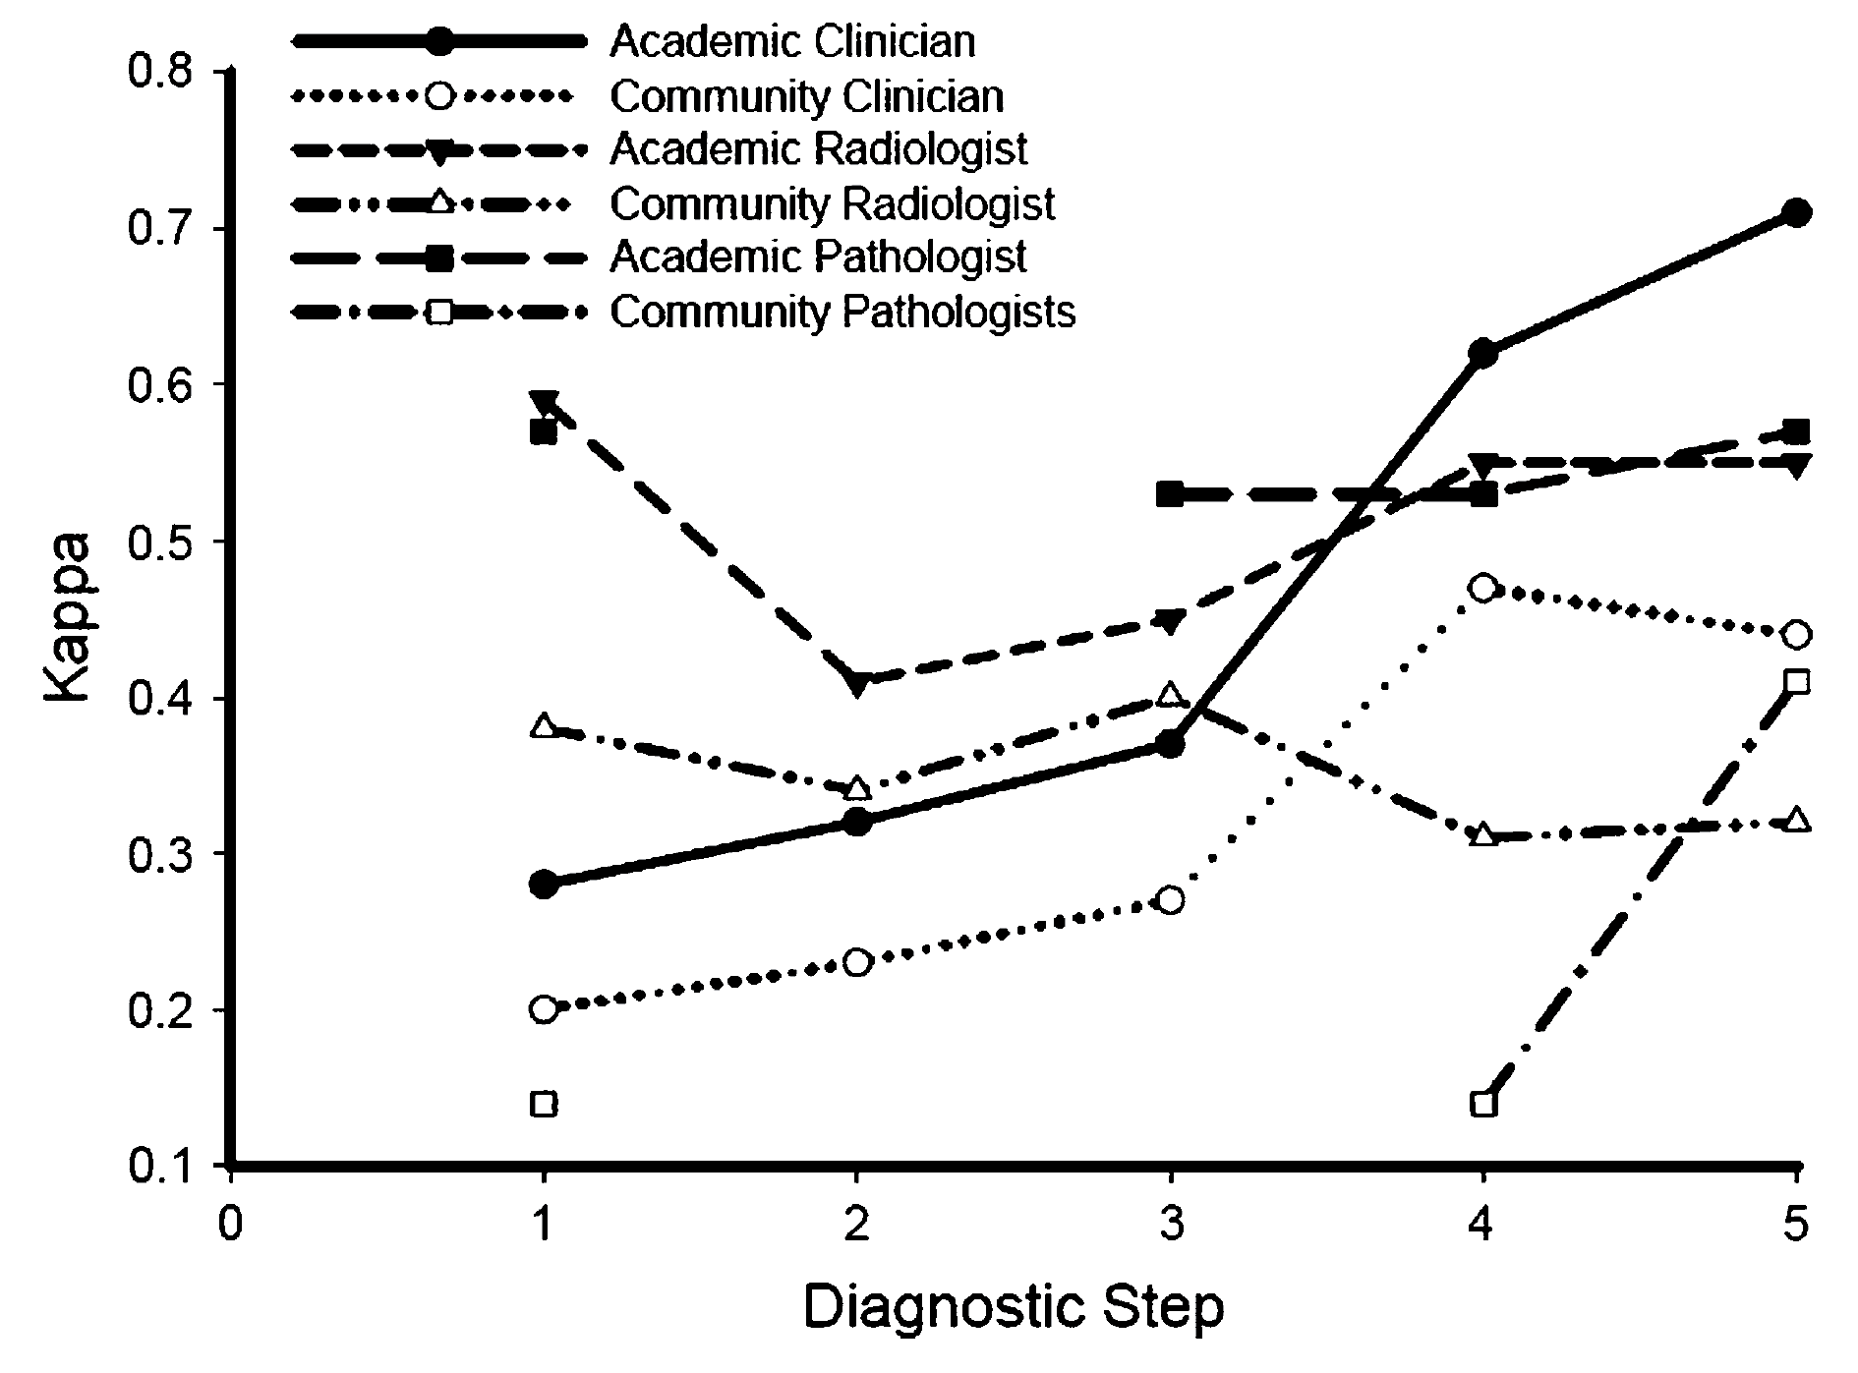
Multi-disciplinary discussion is the gold standard for diagnosing IPF (cont)
Interobserver agreement rose from κ=0.41 (0.29‒0.52) to 0.88 (0.81‒0.94)
Flaherty K, et al. Am J Resp Crit Care Med. 2004;170:904-910.
Notes:
And it should be no surprise that when you take a look at the Kappa statistic which is the level agreement among clinicians, radiologists, and pathologists that they simply improved as people got more data and talked to each other which is what the slide really shows you.
The most important steps aren't between one and two, this is where people kind of came together a bit. It's really between steps three and five when the groups started to add information and discuss it in a room together, the level of agreement improved across the board both between academic clinicians, academic radiologists, and academic pathologists.

Slide 61
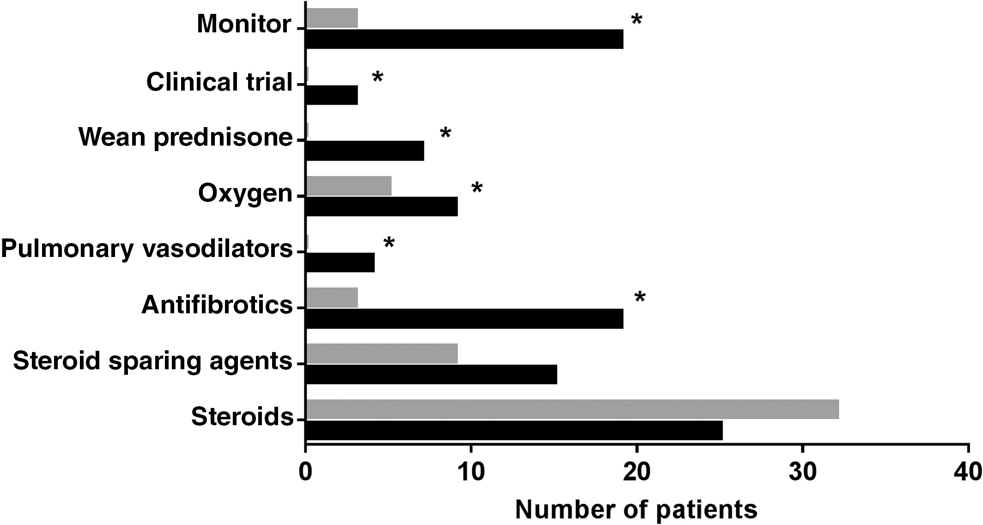
Impact of Multidisciplinary Team Discussion on IPF Diagnosis at Referral Center
Pre-referral
Post referral/
multidisciplinary
team discussion
Referral diagnosis
of IPF (n=27)
No changes in
diagnosis of IPF (n=17)
MDM diagnosis
of IPF (n=25)
*P<0.05 using McNemar’s test.
Jo HE, et al. Respirology. 2016;21(8):1438-1444.
Notes:
Now what's fascinating is there was a recent data published in the paper just a few months ago, that demonstrated that you didn't need to be an academician to be smart at this. It really had to do with how old you were and how many cases you had seen. And so the people who do a lot of this get very good at it and particularly when they talk to their colleagues.
As we integrate that data looking at the impact of a multidisciplinary team discussion on the IPF diagnosis, this study by Jo et al. really helps demonstrate the impact. What we see is that once patients were referred to a center, the multidisciplinary meeting really changed the diagnosis in a significant number of patients. More importantly, it increased the number of monitoring from pre to post, increased exposure to clinical trials, increased the weaning of prednisone, increased oxygen use, increased pulmonary vasodilating use, antifibrotics, and increased steroid-sparing agents, while reducing overall steroid use .

Slide 62
Summary
Multi-disciplinary discussion is the gold standard for diagnosing interstitial pulmonary fibrosis
Diagnosis begins with the history and physical examination
Pathology and radiology findings are critical in making a firm diagnosis
Notes:
All right. Let's summarize that entire module because I think this gets to be very important. I think the first step is to realize that what we see as clinicians matters in this diagnosis that still uses a multi-disciplinary discussion. And that the history and physical is where we start and then how we incorporate the pathology and radiology into that process changes our approach to a final diagnosis and into the treatment and management of these patients.

Slide 63
Treatment Principles
Notes:
Hi, I'm Doctor Steven Nathan. I'm the Medical Director of the Advanced Lung Disease and Lung Transplant Program at Inova Fairfax Hospital in Falls Church, Virginia. I'm also Professor of Medicine at Virginia Commonwealth University. Today we're going to be talking about treatment overview for many different forms of interstitial lung disease.

Slide 64
Treatment Overview for Most ILDs
Disease progression is common and insidious
Cause of ILD can be variable
Major goals of treatment are
  Permanent removal of offending agents when known
  Early diagnosis and aggressive suppression of any acute and chronic inflammatory process
Hypoxemia should always be treated to reduce the consequence of pulmonary vascular hypertension and eventual right heart failure
Notes:
When a patient has any interstitial lung disease, disease progression can be quite common, it can be unpredictable, it can be insidious, it can be sudden. The source of the disease can be quite variable. The major goals of treatment are firstly to remove any potential offending agents where they're known. For example, if a patient's a smoker, they should stop smoking. If a patient is suspected of having chronic hypersensitive pneumonitis and has a bird in the house, then the bird needs to move out of the house or the patient needs to move out of the house or keep the bird in the house, but the patient needs to get away from the bird.
Early diagnosis and aggressive suppression of any acute or chronic inflammation also becomes very important as well. Some of these interstitial lung diseases are characterized by variable amounts of inflammation, whereas others are characterized mostly by fibrosis. If and when the patient develops evidence of hypoxemia, this should also be addressed with supplemental oxygen because hypoxemia, aside from giving the patients increased symptoms, can cause downstream consequences of pulmonary hypertension. Once patients develop pulmonary hypertension they can develop right heart failure and their prognosis can be significantly worse.

Slide 65
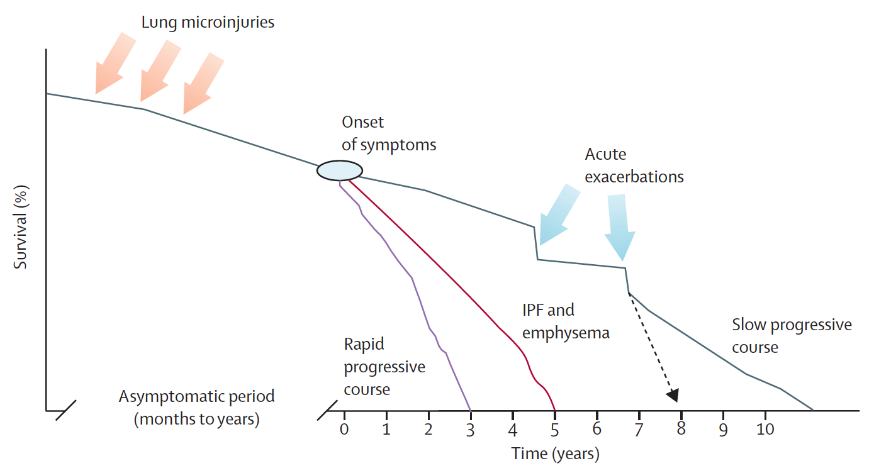
IPF is Unpredictable!
King TE, et al. Lancet. 2011;378(9807):1949-1961.
Notes:
The course of the ILDs and especially IPF is very unpredictable. The patients can stay stable for a period of time, they can have sudden, acute deteriorations or acute exacerbations. They can have a stair step pattern of progression. It becomes very difficult to predict in an individual patient what their course is going to be.

Slide 66
Don’t Forget Primary Care Providers
Early referral from PCP
Early intervention
Maintain lung function
Improve patient outcomes
Notes:
It's very important for primary care providers to be aware of interstitial lung disease and IPF in particular, since it makes intuitive sense that the earlier one makes a diagnosis, the earlier one can intervene and the greater the likelihood of success in terms of maintaining patients’ lung function and affecting their outcomes in terms of maintaining or improving their quality of life, and potentially maintaining and improving their survival.

Slide 67
Holistic Approach Important
Collaborative care enables holistic approach to management
Managing comorbidities
  Obstructive sleep apnea, chronic obstructive pulmonary disease, lung neoplasms, gastroesophageal reflux disease, thromboembolic disease, coronary artery disease
Screening and managing complications
Palliative care
Hospice care
Notes:
When we take care of these patients, we shouldn't only focus on the lung disease aspect of their condition, and focus on treating their ILD or IPF, but we need to take a holistic approach to the management of these patients. This includes being aware of and screening for various comorbidities and comorbidities may be common in these patients especially because they're elderly, but aside from this, patients with IPF in particular, even if you account for age, smoking history, have a higher incidence of various comorbidities including obstructive sleep apnea, concomitant COPD, lung neoplasms, gastroesophageal reflux disease, thromboembolic disease, coronary artery disease.
It's very important for the pulmonologist to work in conjunction with the patient’s primary care physician in screening for these comorbidities and managing them, should they become manifest. At various stages of the disease progression, it becomes appropriate to get other resources in place, such as palliative care to manage patient symptoms, and if the patients progress and to a point where they have hypoxic respiratory failure and they’re not transplant candidates and everything else has been tried, then hospice care can become important as well.

Slide 68
Treatment Options for ILDs other than IPF
Steroids (prednisone)‒ often given for any ongoing alveolitis
Limited evidence from randomized, controlled clinical trials
Balance safety vs potential benefit of treatment
Immunosuppressive therapy commonly used
  Mycophenolate, cyclophosphamide and azathioprine have been added with variable success in IPF, vasculitis, and other ILDs
  Other agents, including methotrexate, colchicine, penicillamine, cyclosporine, tacrolimus, have been tried but remain unproven
Notes:
In terms of treatment options for the various forms of ILD, and I'm not talking about IPF now. That's managed quite differently. Steroids can be used, especially if there's ongoing evidence of alveolitis or information. However, in the ILDs other than IPF, there haven't been many, good, randomized, controlled, clinical trials to guide us in terms of how to treat these patients.
For any individual patient when a clinician is faced with a patient who has interstitial lung disease, they have to balance the safety of any intervention versus the likelihood of a potential benefit. Generally, for most ILDs we use some form of immunosuppression when we do offer therapy. Some of the agents that may be used include mycophenolate, azathioprine, cyclophosphamide. The most common one these days being used is mycophenolate, however. Other agents have also been tried, including methotrexate, colchicine, penicillamine, cyclosporine, tacrolimus, but the data supporting this is very skimpy.

Slide 69
Summary
Important to differentiate IPF from other ILDs
If evidence of inflammation → steroids, other immunosuppressives
(eg, mycophenolate)
Close monitoring for safety, tolerability and response
Balance safety versus benefit
Notes:
In summary, it's very important to differentiate IPF from other forms of interstitial lung disease. Some forms of interstitial lung disease may be characterized by inflammation. If there is evidence of inflammation, treatment options include steroids, as well as other immunosuppressive agents. Most typically these days it'll be mycophenolate. Patients need to be treated and followed very closely for any side effects and response to therapy. If patients do not respond to therapy with immunosuppressive agents and steroids, then one has to gauge on a case by case basis whether the utility, whether there's any usefulness in terms of continuing this, and balancing the safety versus the benefit down the road of these medications, which in some cases can have significant side effects. Thank you for your attention.

Slide 70
Treatment
Part A
Notes:
Hi , I'm Doctor Steven Nathan. I'm the Director of the Advanced Lung Disease and Lung Transplant Program at Inova Fairfax Hospital in Falls Church, Virginia. I'm also a professor of medicine at Virginia Commonwealth University.

Slide 71
Treatment Options for ILDs Other Than IPF
If inflammation is present → steroids + immunosuppressive therapy
  Mycophenolate, cyclophosphamide, azathioprine
  Other agents, including methotrexate, colchicine, penicillamine, cyclosporine, tacrolimus, have been tried but remain unproven
Balance safety vs potential benefit of treatment
  Close monitoring essential
Limited evidence from randomized, controlled clinical trials
Notes:
We're going to be talking about treatment options for interstitial lung disease and idiopathic pulmonary fibrosis. If patients have interstitial lung disease other than IPF, and if the interstitial lung disease is characterized by any element of inflammation, then the treatment options usually include steroid therapy given with other immunosuppressive agents. Some of them that have been used include mycophenolate, cyclophosphamide, and azathioprine. Other ones that have more historical interest with no data to support their use are colchicine, penicillamine, cyclosporine, and tacrolimus, as well as methotrexate.
Typically, if patients have interstitial lung disease, we'll treat them with a combination of mycophenolate, usually, and steroids. We have to follow these patients closely and gauge them for clinical response or stability and decisions have to be made in terms of the utility of continuing these therapies, and for how long we should continue these therapies on a case by case basis. Unfortunately, we don't have many or any randomized, controlled, clinical trials, to guide us in the treatment of patients with various forms of interstitial lung disease. There are some studies in CTD-ILD, specifically scleroderma, attesting to the utility of both cyclophosphamide and more recently mycophenolate, but whether or not the benefits of these medications are sustained beyond one or two years is uncertain. That's why one has to look at each patient individually and decide whether or not to continue therapy based on the benefit versus the safety and side effect profile of each of these medications.

Slide 72
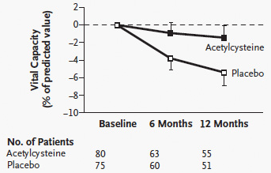
High-Dose Acetylcysteine in Idiopathic Pulmonary Fibrosis
IFIGENIA Study
Demedts M, et al. N Engl J Med. 2005;353(21):2229-2242.
Notes:
There's a lot more data in IPF and there's a lot more studies that have been done in IPF. This slide shows the results of the IFIGENIA study. The IFIGENIA study looked at the use N-acetylcysteine and its effects on the rate of loss of forced vital capacity (FVC) over the course of 12 months. This study was done primarily in Europe and it did show that N-acetylcysteine appeared to be a useful therapy that delayed progression of disease. The problem with this study was that the placebo arm was on what was at that time regarded as standard of care therapy, which include azathioprine and prednisone. One of the criticisms of the study was that there wasn't a true placebo arm and we didn't know and there wasn't good data in terms of what azathioprine and prednisone did for the lungs in patients with IPF.

Slide 73
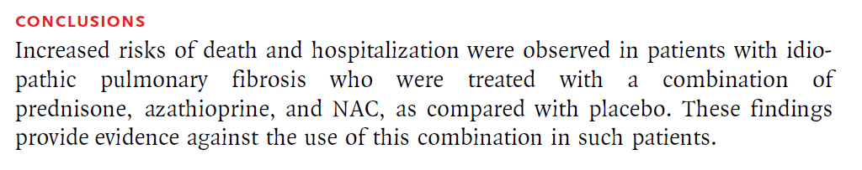
Prednisone, Azathioprine, and N-Acetylcysteine for IPF: PANTHER-IPF Study
NAC, N-acetylcysteine or acetylcysteine.
Raghu G, et al. N Engl J Med. 2012;366(21):1968-1977.
Notes:
This was the underpinnings of the PANTHER Study. This was an NIH sponsored study done by a network of clinical science throughout the United States, which attempted to answer two questions at the same time. The first question was: What is the role of N-acetylcysteine? The second question was: What is the role of prednisone and azathioprine? There were three arms to this study. The first arm included triple therapy with prednisone, azathioprine, and N-acetylcysteine. The second arm included N-acetylcysteine alone. The third arm was placebo.

Slide 74
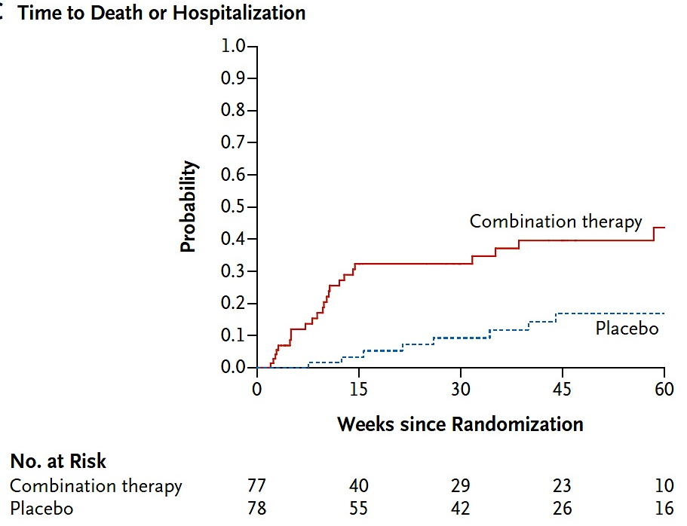
Prednisone, Azathioprine, and N-Acetylcysteine for IPF (PANTHER-IPF): Harm and No Benefit
P=0.001
Raghu G, et al. N Engl J Med. 2012;366(21):1968-1977.
Notes:
The study was followed closely by the data safety monitoring committee who at one point noted that one group was doing particularly worse. That group happened to be the group who was getting triple therapy with prednisone, azathioprine, and N-acetylcysteine. The study was halted and a paper was published fairly expeditiously to warn people about the deleterious effects of combination therapy with prednisone, azathioprine, and N-acetylcysteine. Prednisone and azathioprine are now contra-indicated in patients who have IPF, whereas these medications might and still are used in other forms of interstitial lung disease. Hence, the importance and the critical aspect of making accurate diagnosis with IPF versus other forms of interstitial lung disease.

Slide 75
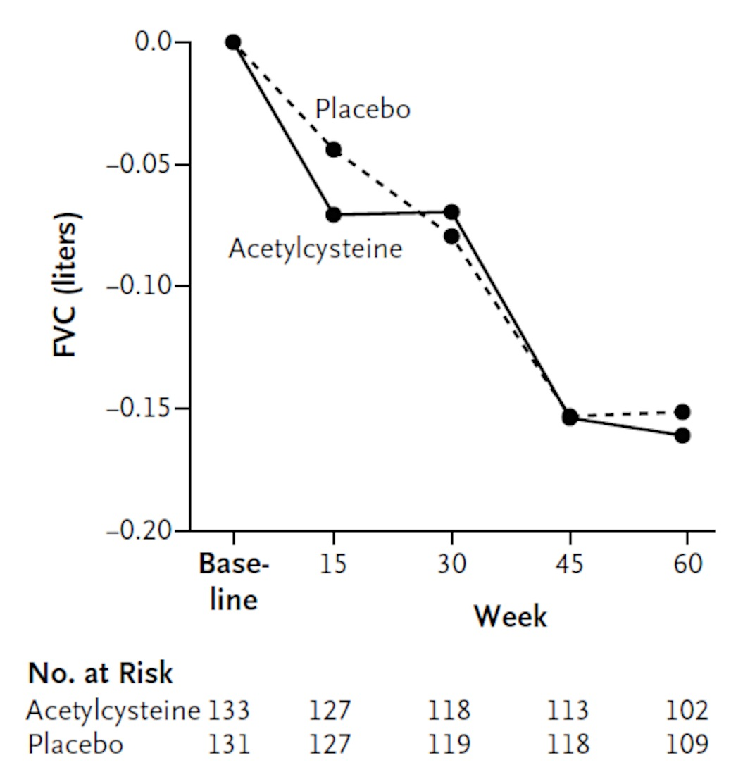
Acetylcysteine in IPF: No Preservation of FVC
Primary Endpoint: FVC
PANTHER-IPF 2-Arm Study
FVC, forced vital capacity.
Martinez FJ, et al. N Engl J Med. 2014;370(22):2093-2101.
Notes:
Getting back to the PANTHER Study, this was continued as a two-arm study comparing N-acetylcysteine to placebo and this turned out to be negative. It wasn't harmful, but it appeared that N-acetylcysteine or NAC in isolation was not a useful therapy in terms of delaying loss of lung function in patients with IPF over the course of this particular study.

Slide 76
Treatment
Part B
Notes:
Hi , I'm Doctor Steven Nathan. I'm the Director of the Advanced Lung Disease and Lung Transplant Program at Inova Fairfax Hospital in Falls Church, Virginia. I'm also a professor of medicine at Virginia Commonwealth University.

Slide 77
Treatment Paradigm Shift
Seismic
V
IPF
say “goodbye” to AZA + Pred
IPF, IIPs and CTD-ILD
historic parallel treatment paths
say “hello” to the antifibrotics
IPF
Treat with immunosuppressive therapies
Other
ILDs
Treat with immunosuppressive therapies
AZA, azathioprine; Pred, prednisone.
Notes:
There's been a seismic shift in the treatment paradigm for patients who have interstitial lung disease, whereas previously everyone was treated the same, and IPF, another form of interstitial pneumonitis, connective tissue disease, or whatever form of interstitial lung disease they had, patients generally, historically were treated with immunosuppressive therapy. Now, IPF is not treated with immunosuppressive therapy. In fact, as shown through the PANTHER Study, azathioprine and prednisone in particular can be harmful to these patients. IPF we now treat with the antifibrotics. We're in the era of antifibrotic therapies. Whereas, these other forms of interstitial lung disease might still be candidates for immunosuppressive therapy, either with azathioprine and prednisone, more commonly these days with mycophenolate and prednisone.

Slide 78
The Lancet
Pirfenidone in patients with idiopathic pulmonary fibrosis (CAPACITY): two randomised trials
Prof Paul W Noble, MD, Prof Carlo Albera, MD, Williamson Z Bradford, MD, Prof Ulrich Costabel, MD, Marilyn K Glassberg, MD, David Kardatzke, PhD, Prof Talmadge E King Jr, MD, Lisa Lancaster, MD, Prof Steven A Sahn, MD, Javier Szwarcberg, MD, Prof Dominique Valeyre, MD, Prof Roland M du Bois, MD, for the CAPACITY Study Group
Published: 14 May 2011
Noble PW, et al. Lancet. 2011;377(9779):1760-1769.
Notes:
Let's move onto the clinical trials that resulted in the antifibrotic therapies being approved. The first one we'll discuss is pirfenidone. Pirfenidone was initially studied in two distinct or disparate clinical trials, the two CAPACITY studies. The reason that there were two clinical phase three studies was that the FDA likes to see two randomized, controlled studies, phase three studies in order to provide an approval for a particular drug.

Slide 79
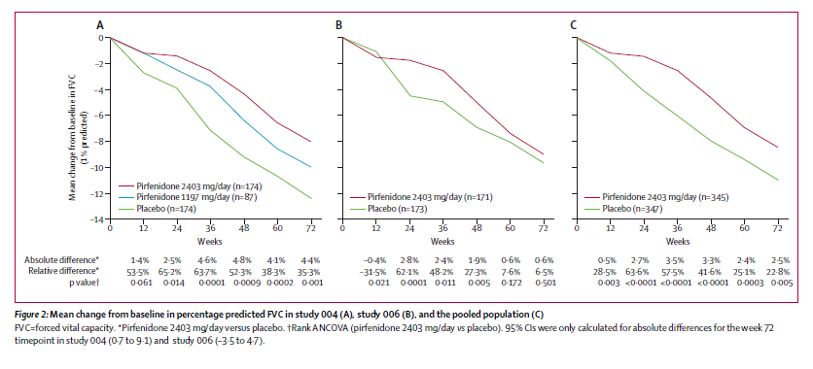
Pirfenidone in Patients with IPF (CAPACITY)
Mean Change from Baseline in FVC
Study 004
Study 006
Pooled Data
Noble PW, et al. Lancet. 2011;377(9779):1760-1769.
Notes:
As can be seen from this slide, what was found from the two capacity studies in study 004 we had a positive result with a slowing in the rate of decline of the FVC over the course of 72 weeks in the pirfenidone arm versus the placebo arm. However, in study 006, the two curves came together and there wasn't a difference at 72 weeks in terms of the rate of decline in FVC. What you can see from the pool data was that if you looked at both studies together, it would have been a positive clinical trial. However, the FDA at the time said, "One study positive. One study negative. You need to go back and do a third study, a so-called tie breaker study."

Slide 80
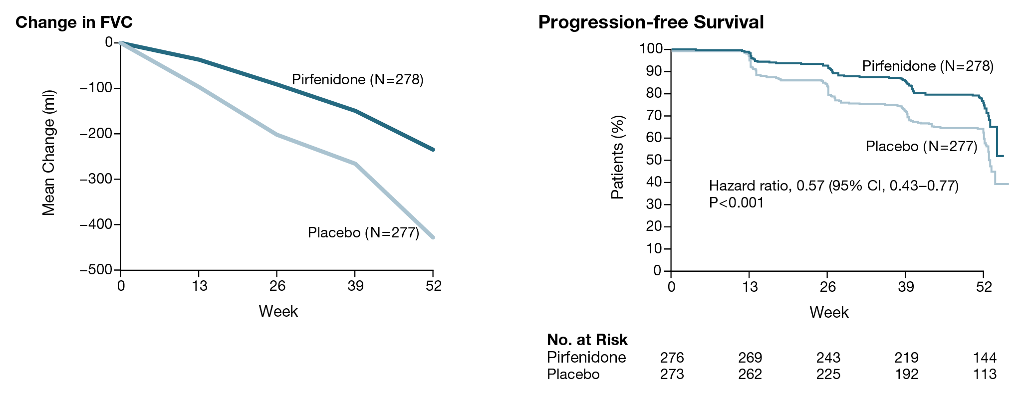
Pirfenidone in Patients with IPF (ASCEND)
FVC, forced vital capacity.
King TE Jr., et al. N Engl J Med. 2014;370(22):2083-2092.
Notes:
This was the underpinnings and foundation for the ASCEND study shown over here, a phase three trial of pirfenidone in patients with IPF, which showed definitively that pirfenidone did slow the rate of progression of disease as shown and demonstrated here, the FVC, as well as improving progression free survival.

Slide 81
ASCEND Study: GI and Skin-related Events Were More Common in the Pirfenidone Group
Patients (%) | Pirfenidone (N=278) | Placebo (N=277)
Cough | 25.2 | 29.6
Nausea | 36.0 | 13.4
Headache | 25.9 | 23.1
Diarrhea | 22.3 | 21.7
Upper Respiratory tract infection | 21.9 | 20.2
Fatigue | 20.9 | 17.3
Rash | 28.1 | 8.7
Dyspnea | 14.7 | 17.7
Dizziness | 17.6 | 13.0
Idiopathic pulmonary fibrosis | 9.4 | 18.1
Bronchitis | 14.0 | 13.0
Constipation | 11.5 | 13.7
Back pain | 10.8 | 13.4
Dyspepsia | 17.6 | 6.1
Nasopharyngitis | 11.9 | 10.8
Anorexia | 15.8 | 6.5
Vomiting | 12.9 | 8.7
Weight decreased | 12.6 | 7.9
Gastroesophageal reflux | 11.9 | 6.5
Insomnia | 11.2 | 6.5
King TE Jr., et al. N Engl J Med. 2014;370(22):2083-2092.
Notes:
Pirfenidone does come with side effects. The major side effects are GI, nausea, diarrhea, and as well as skin rash and photosensitivity. Those are the two major side effects that can be seen with pirfenidone, but not everyone necessarily gets them.

Slide 82
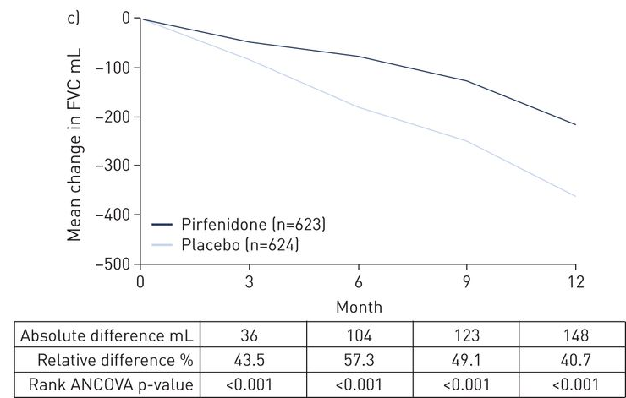
Pooled Analysis of Pirfenidone Efficacy: Change in Forced Vital Capacity (ASCEND + CAPACITY 1 + CAPACITY 2)
Noble PW, et al. Eur Respir J. 2016;47:243-253.
Notes:
If one looks at the pooled data of the three clinical trials, the two CAPACITY studies and ASCEND and look at change in the FVC, this is a positive study. Putting them all together and over a thousand patients, 1256 patients or thereabout, it was a positive signal seen in terms of the change in the FVC.

Slide 83
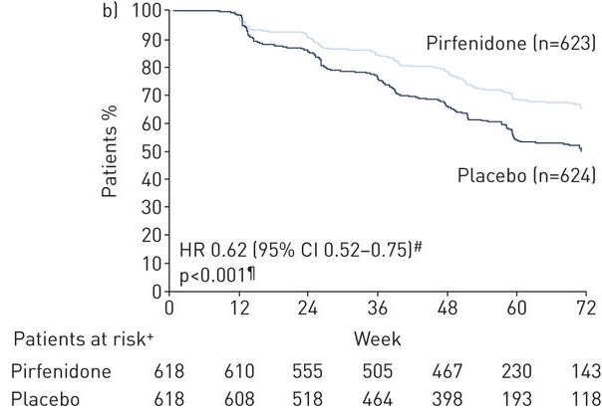
Pooled Analysis of Pirfenidone Efficacy: Progression-free Survival (ASCEND + CAPACITY 1 + CAPACITY 2)
PFS (%)
PFS, progression-free survival.
Noble PW, et al. Eur Respir J. 2016;47:243-253.
Notes:
Looking at progression free survival, which it was a composite of either a 10% decline in the FVC, a 50-meter decrease in the walk distance, or death, it did appear that patients treated with pirfenidone did significantly better than patients who were in the placebo arm of these three clinical studies.

Slide 84
The NEW ENGLAND JOUNRAL of MEDICINE
Efficacy and Safety of Nintedanib in Idiopathic Pulmonary Fibrosis
Luca Richeldi, M.D., Ph.D., Roland M. du Bois, M.D., Ganesh Raghu, M.D., Arata Azuma, M.D., Ph.D., Kevin K. Brown, M.D., Ulrich Costabel, M.D., Vincent Cottin, M.D., Ph.D., Kevin R. Flaherty, M.D., David M. Hansell, M.D., Yoshikazu Inoue, M.D., Ph.D., Dong Soon Kim, M.D., Martin Kolb, M.D., Ph.D., et al., for the INPULSIS Trial Investigators
Published: 29 May 2014
Richeldi L, et al. N Engl J Med. 2014;370(22):2071-2082.
Notes:
Let's move on to the second antifibrotic, which is nintedanib and this particular paper was in the same issue of the New England Journal of Medicine as was the results of the ASCEND study.

Slide 85
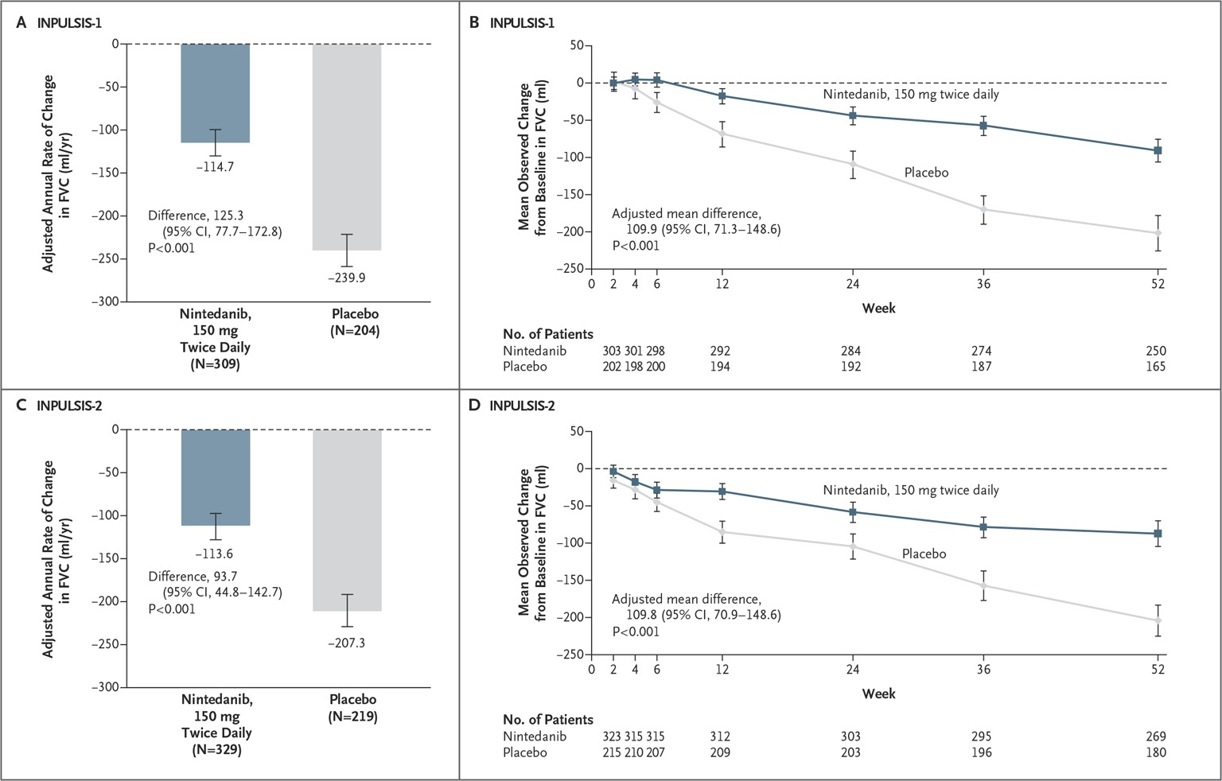
Nintedanib Reduced Loss of Forced Vital Capacity
Richeldi L, et al. N Engl J Med. 2014;370(22):2071-2082.
Notes:
What was shown with nintedanib was very similar to what I showed already with pirfenidone, that it slowed the rate of loss of lung function, specifically the FVC over the course of 52 weeks and there was the same signal seen from the two studies that were done for nintedanib INPULSIS-1 and INPULSIS-2. This was actually very similar to what was seen in the phase two study, which was known as the TOMORROW Study.

Slide 86
Benefit of Nintedanib on FVC Appears Early
Richeldi L, et al. N Engl J Med. 2014;370(22):2071-2082.
Notes:
Also seen over here the curves come apart actually quite early and this attests to the early implementation of therapy. The earlier one can start patients on therapy, the earlier there can be preservation of lung function for both nintedanib as well as for pirfenidone.

Slide 87
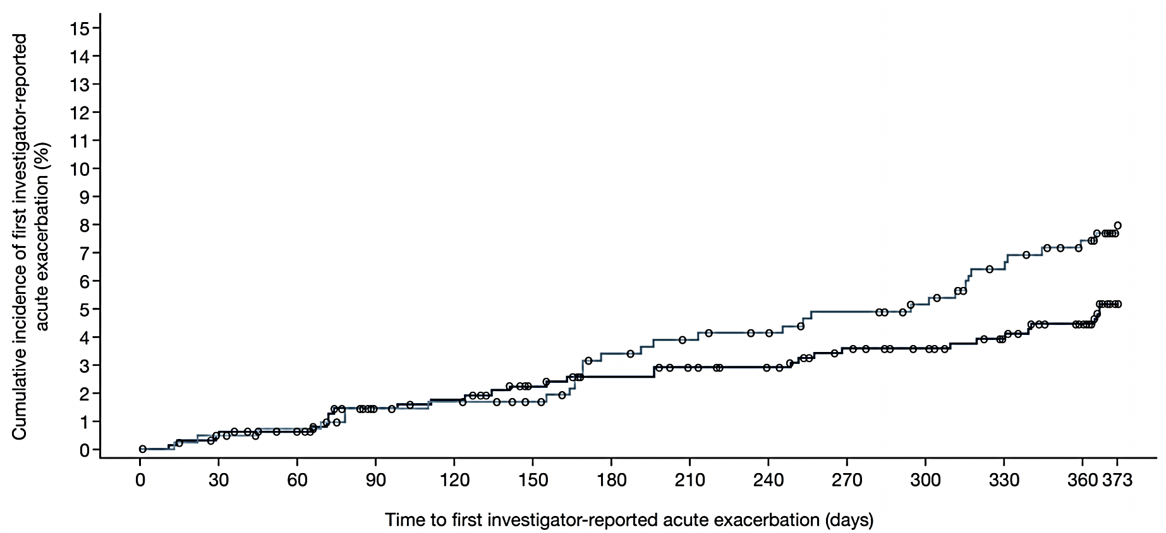
Nintedanib Reduced Time to First Acute Exacerbation (Investigator-reported): INPULSIS Pooled
Nintedanib 150 mg bid
Placebo
HR 0.64
(95% CI; 0.39, 1.05)
P=.0823
 | Nintedanib 150 mg bid (n=638) | Placebo (n=423)
Patients with ≥1 acute exacerbation, n (%) | 31 (4.9) | 32 (7.6)
Adapted from Richeldi L, et al. N Engl J Med. 2014;370:2071-2082.
Notes:
Another end point that was looked at in the INPULSIS studies was the time to first acute exacerbation. There was a positive signal here as well. It did appear that nintedanib resulted in a delay to the time for an acute exacerbation of the disease.

Slide 88
INPULSIS-1 and -2: GI-related Events Were More Common in the Nintedanib Group
 | INPULSIS-1 |  | INPULSIS-2
 | Nintedanib (n=309) | Placebo (n=204) | Nintedanib (n=329) | Placebo (n=219)
GI adverse event leading to discontinuation | 26 (8.4%) | 3 (1.5%) | 21 (6.4%) | 2 (0.9%)
Diarrhea | 190 (61.5%) | 38 (18.6%) | 208 (63.2%) | 40 (18.3%)
Nausea | 70 (22.7%) | 12 (5.9%) | 86 (26.1%) | 16 (7.3%)
Vomiting | 40 (12.9%) | 4 (2.0%) | 34 (10.3%) | 7 (3.2%)
Richeldi L, et al. N Engl J Med. 2014;370(22):2071-2082.
Notes:
As with pirfenidone, there are side effects associated with nintedanib. These are mostly GI once again, most specifically diarrhea, which can affect about two-thirds of patients.

Slide 89
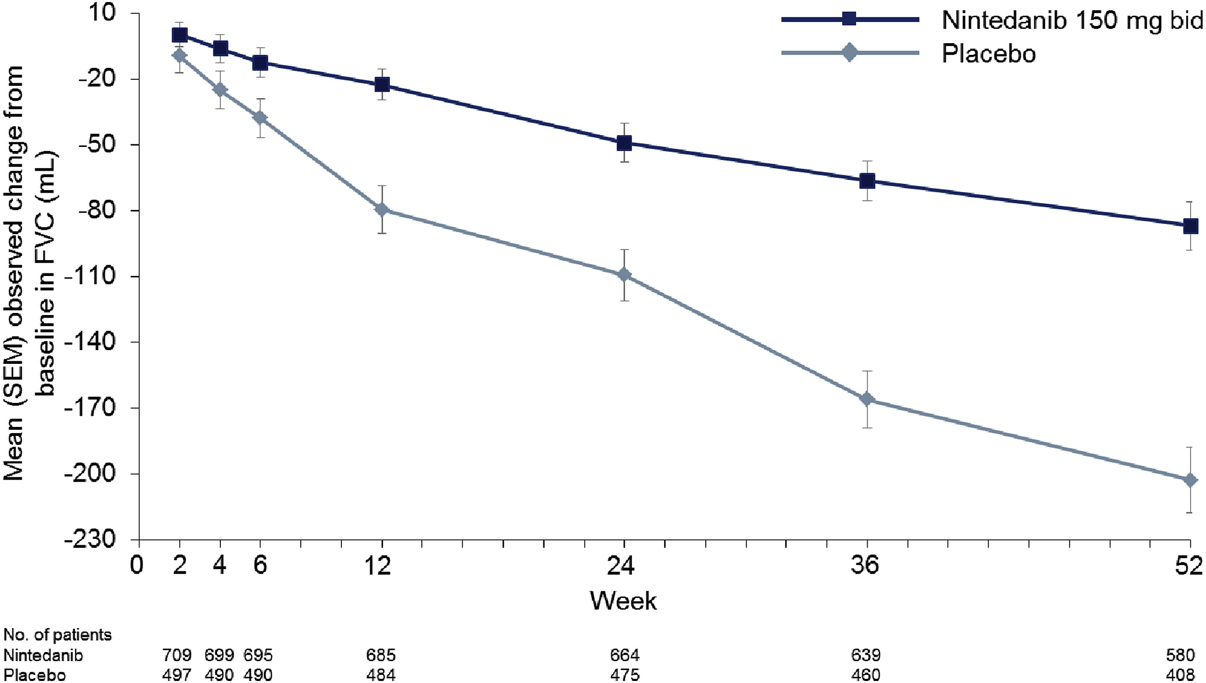
Nintedanib Slowed Reduction in FVC:
Pooled Results of TOMORROW + INPULSIS Trials
Richeldi L, et al. Respir Med. 2016;113:74-79.
Notes:
Now very similar to what I showed you with the pooled result from the three pirfenidone studies, here we see the pooled results from the three nintedanib studies, TOMORROW Study, and the two INPULSIS studies showing a significant difference in the rate of decrement in the FVC over the course of 52 weeks.

Slide 90
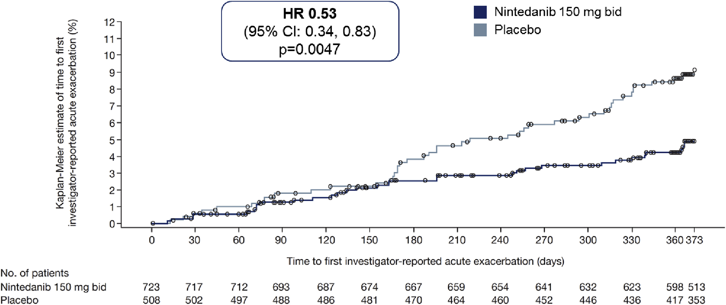
Nintedanib Reduced Time to First Acute Exacerbation (Investigator-reported): Pooled Results of TOMORROW + INPULSIS Trials
Richeldi L, et al. Respir Med. 2016;113:74-79.
Notes:
Similarly, pooled data and the effects on acute exacerbations, once again a significant effect in delaying the time to an acute exacerbation from nintedanib.

Slide 91
Adverse Reactions*
 | Pirfenidone¹ | Nintedanib²
Gastrointestinal | Anorexia (8%), nausea (20%), dyspepsia (12%), vomiting (7%), diarrhea (6%), loss of weight (5%) | Diarrhea (44%), nausea (17%), vomiting (9%), loss of weight (7%), GI perforation (0.3%)
Dermatologic | Rash (20%) Photosensitivity (8%)
Cardiovascular |  | Myocardial infarction (1.1%)
Hematologic |  | Bleeding events (3%)
Hepatic | Transaminitis (2.5%) | Transaminitis (11%)
Embryofetal toxicity |  | yes
*Placebo-adjusted frequency
1. Esbriet [prescribing information]. South San Francisco, CA: Genentech, Inc.; November 2017.
2. Ofev [prescribing information]. Ridgefield, CT: Boehringer Ingelheim Pharmaceuticals, Inc.; January 2018.
Notes:
This side looks at the side effect profile of the two drugs side by side. Both of them can have GI side effects. As mentioned pirfenidone can cause rash or photosensitivity. There's a very small signal of myocardial infarction and bleeding events in patients with nintedanib. Both drugs can cause a mild transaminitis and following LFTs is very important for both of these agents.
When one decides between these drugs, one has to weigh the benefits as well as the risks and potential adverse events. The nice thing about having two antifibrotics is that we have a choice. Typically, what I do in my clinical practice is to decide on the antifibrotic that is most likely to be well tolerated by the patient. For example, and I'll give you two extreme examples. If, one, if I have a patient who likes to play golf six days a week, then probably steer clear of pirfenidone. If I have a patient who's on anti-coagulation therapy for whatever reason, then probably steer clear of nintedanib and direct the patient more to pirfenidone. There is no direct comparison of these two different drugs. Taking all the results together does appear that they have somewhat equivalent effects in treating patients with IPF. I think the important thing is to make an accurate diagnosis and offer the patients the option of going on one of the antifibrotic therapies.
Now, one of the things that can happen with IPF is it can be complicated by the development of pulmonary hypertension. There's a lot of interest in looking at some of these pulmonary arterial hypertension (PAH) medications that have been approved and whether or not they might have any benefit in patients with IPF who develop pulmonary hypertension.

Slide 92
STEP-IPF: Sildenafil Does Not Improve Walking Distance But Significantly Improves Some Secondary Outcomes
Endpoint | Sildenafil | Placebo | Absolute difference | P value
Primary Endpoint
Improved Walking Distance ≥20% | 10% | 7% | — | 0.39
Secondary Endpoints
UCSD SOBQ | 0.22 | 6.81 | -6.58 | 0.006
SGRQ | -1.64 | 2.45 | -4.08 | 0.01
DL_{CO}, % pred | -0.33 | -1.87 | 1.55 | 0.04
Mortality | 5% | 13% |  | 0.07
DL_{CO}, diffusion capacity for carbon monoxide; SGRQ, St. George’s Respiratory Questionnaire; UCSD SOBQ, UCSD Shortness of Breath Questionnaire.
Notes:
The STEP IPF study was one such study that didn't look specifically for patients with pulmonary hypertension, but was certainly enriched for patients with pulmonary hypertension since the one inclusion criteria was a diffusing capacity less than 35% of predicted. The study was a negative study based on the primary end point, which was an improvement in the walk distance of 20% or more. It didn't reach statistical significance. However, various secondary end points suggested that there might be some benefit to sildenafil therapy. Specifically, there was a difference in the shortness of breath questionnaire, quality of life measures, as well as the single breath diffusing capacity. There was the suggestion of a signal of a mortality benefit. However, the numbers were extremely small and one should look at this with some circumspect. I believe the numbers were 11 deaths in the one arm, versus four deaths in the other arm. It was a P value of .07, so certainly no claim that sildenafil affects mortality. There are, however, ongoing clinical trials looking at pulmonary hypertension medications in patients with IPF. Hopefully we'll hear more about this in the future.

Slide 93
ACE-IPF: Warfarin Offers No Benefit But Increases Mortality Risk
All-Cause Mortality and
All-Cause Hospitalization:
↑ Risk with Warfarin
All-Cause Mortality:
↑ Risk with Warfarin
Primary Endpoint*: No benefit
*Composite of time to death, hospitalization (nonbleeding, nonelective), ≥10% absolute decline in forced vital capacity.
Noth I, et al. Am J Respir Crit Care Med. 2012;186(1):88-95.
Notes:
anticoagulation has also been thought to potentially be a treatment modality in patients with IPF. There's evidence of thrombin formation within alveoli and this has been looked at in the context of the ACE study where warfarin was studied in a randomized, clinical, controlled setting. This was one of the NIH IPF networks clinical studies. Unfortunately, what was shown was that not only was there no benefit, but there was also increased risk and increased mortality in patients who were treated with warfarin. Warfarin is contraindicated in patients with IPF, unless patients have a primary indication for it. If a patient has atrial fibrillation (A fib), has a prosthetic valve, or other reason to be on warfarin, this certainly should not be withheld, but as a primarily treatment modality for IPF, this is not indicated.

Slide 94
Treatment
Part C
Notes:
Hi, I'm Doctor Steven Nathan. I'm the Director of the Advanced Lung Disease and Lung Transplant Program at Inova Fairfax Hospital in Falls Church, Virginia. I'm also a professor of medicine at Virginia Commonwealth University.

Slide 95
ATS/ERS/JRS/ALAT Recommendations for Pharmacologic Treatment for IPF
Strong recommendation against | Conditional recommendation against | Conditional recommendation for
Anticoagulation (warfarin)*§ Imatinib†§ Combination prednisone, azathioprine§, and N-acetylcysteine§* Selective endothelin receptor antagonist (ambrisentan§)* | N-acetylcysteine§ monotherapy Phosphodiesterase-5 inhibitor (sildenafil)†§ Dual endothelin receptor antagonists (macitentan§, bosentan§)* | Nintedanib† Pirfenidone† Antacid therapy*§
*Low confidence in effect estimates; †Moderate confidence in effect estimates; §Not approved for IPF in the United States
Raghu G, et al. Am J Respir Crit Care Med. 2015;192(2):e3-19.
Notes:
Our governing bodies, including the ATS and ERS, have come out at various times with recommendations with regards to how we should treat or not treat IPF. They have come out with three categories, strong recommendation against, conditional recommendation against, and conditional recommendation for. There's nothing that has been deemed to constitute a strong recommendation for. The highest recommendation you have is a conditional recommendation for use of the two antifibrotics, either nintedanib or pirfenidone, as well as antacid therapy. Although, the data supporting antacid therapy is somewhat weak and this remains a controversial area.
For patients who progress despite the option of therapy and if they do not have significant comorbidities and if they are young enough, then they might be candidates for lung transplantation. The age cutoff depends on individual centers. Some have a cutoff of 70. Some centers will go as high as 75. There are even a few patients who are older than 75 who have been transplanted.

Slide 96
ISHLT Recommendations for Lung Transplantation: General Candidacy Considerations
Lung transplantation should be considered for adults with chronic,
end-stage lung disease who meet all of the following:
High (>50%) risk of death due to lung disease within 2 years
High (>80%) likelihood of surviving at least 90 days after lung transplantation
High (>80%) likelihood of 5-year post-transplant survival from a general medical perspective provided there is adequate graft function
Weill D, et al. J Heart Lung Transplant. 2015;34(1):1-15.
Notes:
The time to transplant patients with IPF or any condition for that matter is when the risk of mortality from the underlying primary disease is greater than the risk of mortality from having a lung transplant.

Slide 97
ISHLT Recommendations for Lung Transplantation: Absolute Contraindications
Malignancy <2 years
  Except cutaneous squamous and basal cell tumors
  5-year disease-free interval is prudent
Untreatable significant dysfunction of another major organ (unless combined organ treatment can be performed)
  Heart, liver, kidney
Uncorrected atherosclerotic disease with suspected/confirmed end-organ ischemia/dysfunction and/or coronary artery disease not amenable to revascularization
Acute medical instability: sepsis, myocardial infarction, liver failure
Uncorrected bleeding diathesis
Chronic infection with highly virulent and/or resistant microbes that are poorly controlled pretransplant
Weill D, et al. J Heart Lung Transplant. 2015;34(1):1-15.
Notes:
When we look at patients as potential transplant candidates, we look at contraindications as well. There's a number of things in actual effect that may constitute a contraindication: Various malignancies, significant other end organ dysfunction, uncorrected or uncontrolled atherosclerotic disease, medical instability, bleeding diathesis, chronic infections with virulent resistant microbes. These might all be contraindications and the contraindications actually vary as well from center to center. Some centers, especially the larger centers who have greater numbers, might be more inclined to do patients who are perhaps regarded as more marginal candidates at other centers.

Slide 98
ISHLT Recommendations for Lung Transplantation: Absolute Contraindications (cont)
Evidence of Mycobacterium tuberculosis infection
Significant chest wall or spinal deformity
Class II or III obesity (BMI>35.0 kg/m²)
Current non-adherence to medical therapy or history of repeated/prolonged episodes of non-adherence
Psychiatric or psychological conditions associated with the inability to cooperate with the team and/or adhere with complex medical therapy
Absence of an adequate or reliable support system
Severely limited functional status with poor rehabilitation potential
BMI, body mass index.
Weill D, et al. J Heart Lung Transplant. 2015;34(1):1-15.
Notes:
The list carries on in terms of other contraindications, chest wall abnormalities, obesity (BMI greater than 35 kg/m2), psychosocial issues can be contraindications. Patients have to have a good support system and have to have good rehab potential as well.

Slide 99
ISHLT Recommendations for Lung Transplantation: Relative Contraindications
Age >65‒75 years
Class I obesity (BMI 30‒34.9 kg/m2)
Progressive or severe malnutrition
Severe or symptomatic osteoporosis
Extensive prior chest surgery with lung resection
Mechanical ventilation or extracorporeal membrane oxygenation
Colonization with highly resistant or highly virulent bacteria, fungi, or mycobacteria
BMI, body mass index.
Weill D, et al. J Heart Lung Transplant. 2015;34(1):1-15.
Notes:
Relative contraindications are shown here. Age once again, obesity, malnutrition, osteoporosis. Extensive prior to surgery or lung resection, they’re really not a contraindication these days and in actual effect we've taken a good number of patients off mechanical ventilation or extracorporeal membrane oxygenation (ECMO) and offering them transplants, too. This, once again, becomes case by case.

Slide 100
Adult Lung Transplants: Kaplan-Meier Survival by Diagnosis (Transplants: January 1990 – June 2015)
Median survival (years):
A1ATD: 6.7
CF: 9.2
COPD: 5.8
IIP: 4.9
ILD-not IIP: 6.0
Retransplant: 2.9
All pair-wise comparisons were significant at p < 0.05 except A1ATD vs ILD-non IIP and COPD vs ILD-non IIP
A1ATD, alpha-1 antitrypsin deficiency, CF, cystic fibrosis, COPD, chronic obstructive pulmonary disease; IIP, idiopathic interstitial pneumonia.
International Society for Heart and Lung Transplantation. http://www.ishlt.org/registries/slides.asp?slides=heartLungRegistry. Accessed December 28, 2017.
Notes:
The survival after transplant varies. It's not the panacea. It is like trading one disease for another. If you look at the survival of patients with IPF, here shown as IIP, interpathic interstitial pneumonia, it tends to be worse than other disease conditions such as cystic fibrosis. It might be a function of age or the underlying lung condition. As mentioned, IPF is a disease of the elderly, whereas CF patients tend to be in their 20s, 30s, maybe 40s when they get a transplant. Whether it's underlying disease or age, that factors into this difference in survival is a little bit uncertain.

Slide 101
Adult Lung Transplants: Kaplan-Meier Survival by Era (Transplants: January 1990 – June 2015)
Median survival (years):
1990-1998: 4.2; Conditional=7.1
1999-2008: 6.1; Conditional=8.5
2009-6/2015: NA; Conditional=NA
1990-1998 vs 1999-2008: P<0.0001
1990-1998 vs 2009-6/2015: P<0.0001
1999-2008 vs 2009-6/2015: P<0.0001
International Society for Heart and Lung Transplantation. http://www.ishlt.org/registries/slides.asp?slides=heartLungRegistry. Accessed December 28, 2017.
Notes:
We like to think we are getting better with transplant as the years roll by and as we go through different eras. We're not yet where our cardiac colleagues or our hepatology colleagues are in terms of survival. The reason that we aren't improving survival as much as we would like is because we're taking sicker patients and older patients at the same time. Hopefully we'll make further inroads in terms of long-term survival in the coming years.

Slide 102
Adult Lung Transplants: Kaplan-Meier Survival by Procedure Type (Transplants: January 1990 – June 2015)
Diagnosis: Idiopathic interstitial pneumonia
p<0.0001
Notes:
If one looks at IIP or IPF, there is data to suggest that patients who get bilateral lung transplants do better than patients who have single lung transplants. However, one needs to be cautious when one looks at a survival curve like this, because there's a certain bias here. Patients who get bilaterals, once again, tend to be younger and perhaps more robust. Patients who get singles tend to be older and maybe a little less robust. When one controls for all these other factors and does multivariate analysis, it does appear that survivals tend to be fairly similar with singles versus bilaterals in patients with IPF.

Slide 103
Summary
Differentiating between IPF and other ILDs is critical because the treatments are very different
  Antifibrotics are the mainstay of therapy for IPF
Lung transplantation is an option for selected patients
Notes:
In summary, it's important once again to make the distinction between IPF and other forms of interstitial lung disease, because the treatments are very different, especially with availability of the antifibrotic therapies, which have been available for almost four years now. Lung transplant is an option for select patients provided they do not have a contraindication to having a lung transplant. Thank you for your time and attention.

Slide 104
Treating Acute Exacerbations
Notes:
Hi , I'm Doctor Steven Nathan. I'm the director of the Advanced Lung Disease Program and Medical Director of the Lung Transplant Program at Inova Fairfax Hospital in Falls Church, Virginia. I'm also a professor of medicine at Virginia Commonwealth University. In this module we'll be talking about acute exacerbations of IPF.

Slide 105
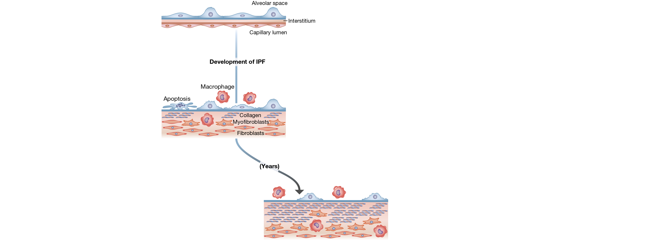
Slow vs Fast Disease Progression in IPF
Collard HR, et al. Am J Respir Crit Care Med. 2016;194(3):265-275.
Notes:
In this first slide you see a very nice cartoon depiction of the pathogenesis of IPF and how this might be complicated by an acute exacerbation. What we know about IPF is that there's initially some epithelial disruption. You have the fibroblast coming in. These might transform to myofibroblasts, then later collagen. Collagen is the scaffold for fibrotic changes and progressive fibrosis, which results in ultimately respiratory failure.

Slide 106
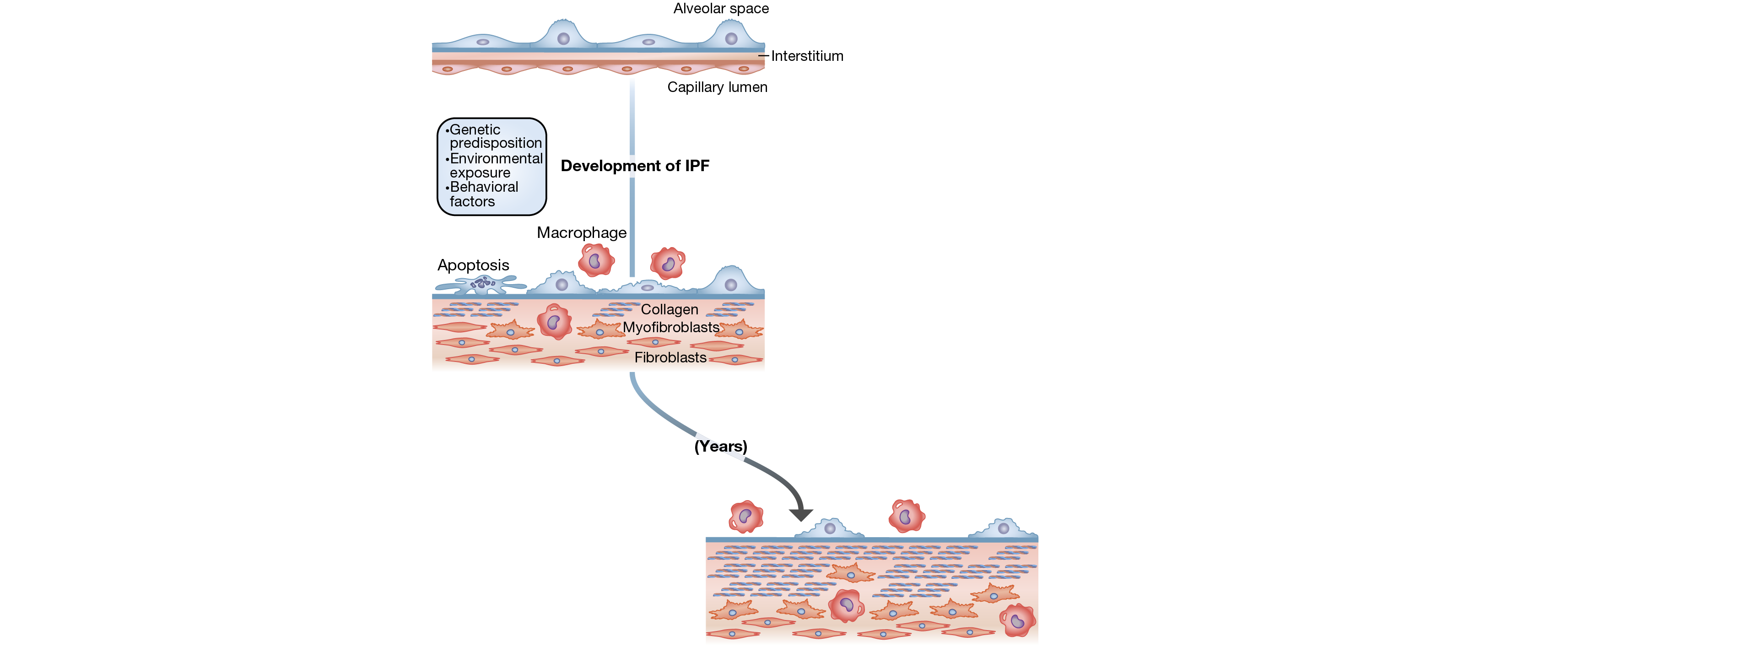
Slow vs Fast Disease Progression in IPF
Collard HR, et al. Am J Respir Crit Care Med. 2016;194(3):265-275.
Notes:
There are many reasons or predisposing factors for IPF. There might be a genetic predisposition in some patients, environmental factors may play a role, behavioral factors such as smoking might play a role in setting off the process, and certainly aging plays a role as well.

Slide 107
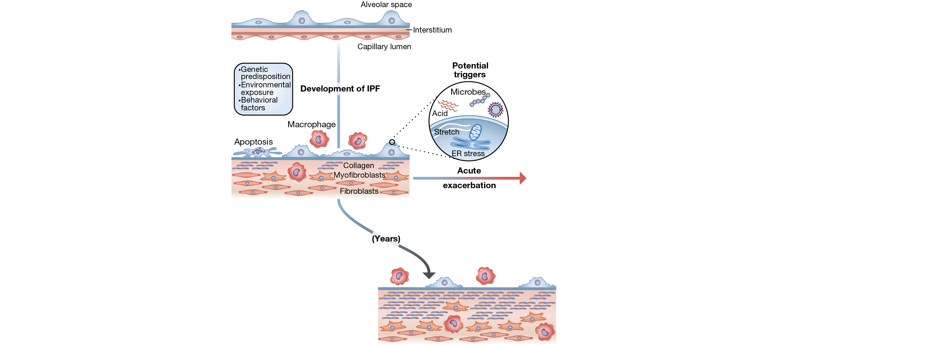
Slow vs Fast Disease Progression in IPF
Collard HR, et al. Am J Respir Crit Care Med. 2016;194(3):265-275.
Notes:
Now, every patient with IPF is at risk of developing an acute exacerbation. Maybe about ten to 15% of IPF patients will develop acute exacerbations.
There might be various precipitating factors for an acute exacerbation, including acid reflux, various infections might precipitate an acute exacerbation, mechanical factors such as stretch might precipitate an acute exacerbation. There's also anecdotal evidence and a suggestion that very high fraction of inspired oxygen (FiO2) might precipitate an acute exacerbation.

Slide 108
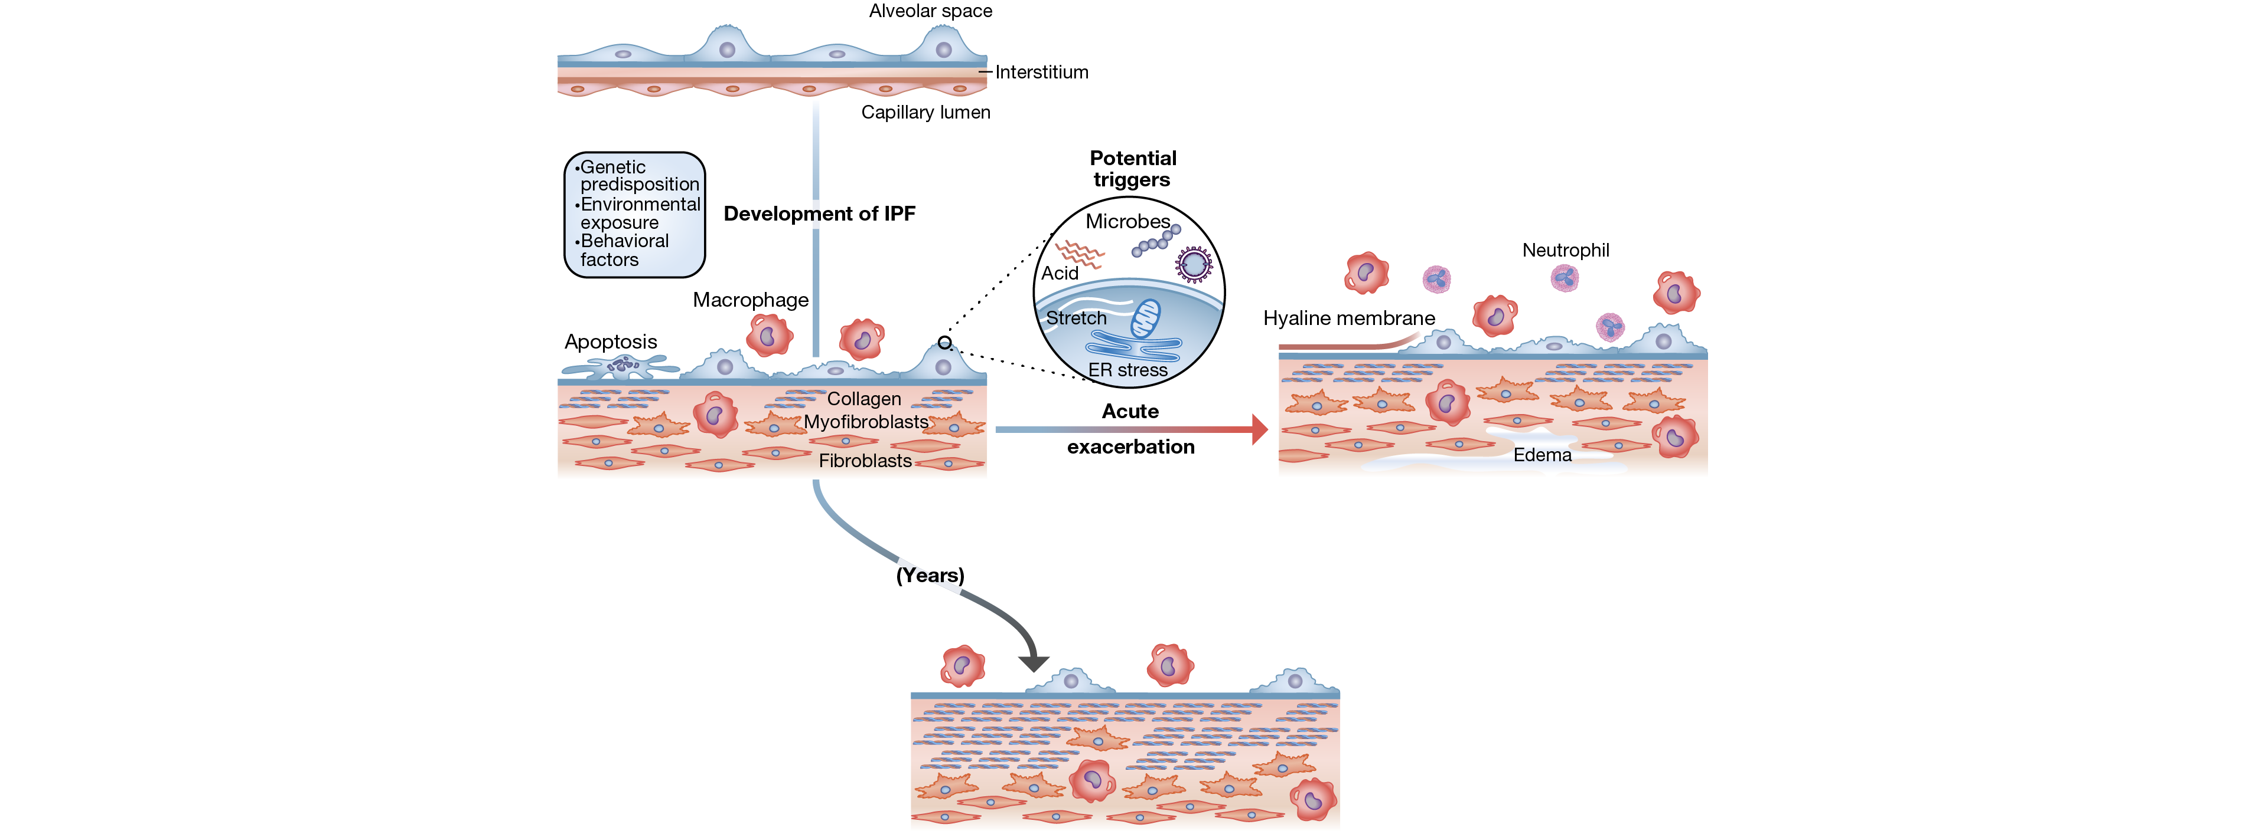
Slow vs Fast Disease Progression in IPF
Collard HR, et al. Am J Respir Crit Care Med. 2016;194(3):265-275.
Notes:
What happens though is that a separate or different and distinct pathologic process is set in place. It looks like it already is, basically. You have hyaline membrane formation, patients manifest on CT and chest x-ray with diffuse alveolar infiltrates, superimposed over the interstitial lung disease that characterizes IPF.

Slide 109
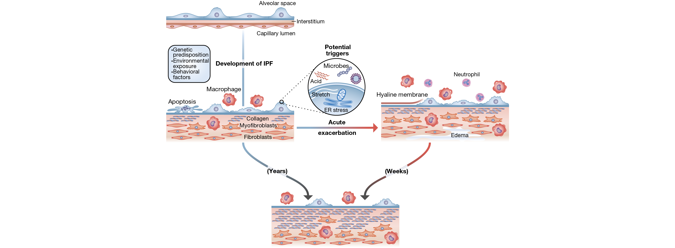
Slow vs Fast Disease Progression in IPF
Collard HR, et al. Am J Respir Crit Care Med. 2016;194(3):265-275.
Notes:
Generally, the prognosis after the onset of an acute exacerbation tends to be quite poor.
Acute exacerbations can happen at any time during the course of disease. Patients can have relatively well preserved lung function, they might have more advanced disease, and sometimes in actual effect acute exacerbations can be the first manifestation of the underlying IPF.

Slide 110
Baseline Factors Associated with Increased Mortality Risk in IPF
Baseline Factors
Level of dyspnea* DL_{CO} <40% predicted Desaturation ≤88% during 6MWT Extent of honeycombing on HRCT* Pulmonary hypertension
6MWT, 6-minute-walk test; DL_{CO}, diffusion capacity for carbon monoxide; HRCT, high-resolution computed tomography.
*Currently, there is no uniformity in approach to quantification
Raghu G, et al. Am J Respir Crit Care Med. 2011;183:788-824.
Notes:
There are various factors associated with increased risk of mortality in patients with IPF. Baseline factors that can be associated with increased risk of mortality include: Level of dyspnea, the lower the diffusing capacity, the worse the prognosis, the more the patient desaturates, the worse the prognosis, the greater the extent of honeycombing on HRCT, the worse the prognosis, and similarly for pulmonary hypertension. If patients develop pulmonary hypertension this generally portends a significantly worse outcome.

Slide 111
Longitudinal Factors Associated with Increased Mortality Risk in IPF
Longitudinal Factors
Increase in level of dyspnea* Decrease in FVC ≥10% absolute value Decrease in DL_{CO} ≥15% absolute value Worsening of fibrosis on HRCT*
DL_{CO}, diffusion capacity for carbon monoxide; FVC, forced vital capacity; HRCT, high-resolution computed tomography.
*Currently, there is no uniformity in approach to quantification
Raghu G, et al. Am J Respir Crit Care Med. 2011;183:788-824.
Notes:
Now there are also longitudinal factors that can portend to worse outcome, so if patients return to the clinic complaining of increasing shortness of breath, increasing dyspnea on exertion, if they have a 10% or more reduction in the FVC or 15% more reduction in the DL_{CO}, and/or worsening fibrosis on HRCT, all of these things longitudinally will portend a worse prognosis for patients with IPF.

Slide 112

Is It an Acute Exacerbation?
GGO, ground-glass opacity.
Collard HR, et al. Am J Respir Crit Care Med. 2016;194(3):265-275.
Notes:
When patients present with increased shortness of breath in the context of IPF, the clinician is often left with the decision as to whether or not this is deterioration or progression of the disease, or if in actual effect they are having an acute exacerbation of the IPF. When patients present with an acute exacerbation, generally the increase in dyspnea is usually less than one month in duration. It's a sub-acute onset.
What we focus on is ruling out some kind of extra-parenchymal cause of their shortness of breath. Do they have coronary artery disease, for example, that is now manifesting with shortness of breath. We know that patients with IPF are at higher risk of having an acute coronary syndrome. Other things might be a pneumothorax or a pleural effusion or pulmonary embolism that can manifest as acute onset or sub-acute onset of shortness of breath. Typically, what characterizes an acute exacerbation is the presence of ground glass infiltrates, or even consolidation that is sometimes evident on chest x-ray, but is more commonly evident on chest CT. Chest x-rays are usually not that helpful in the context of an acute exacerbation. When we see this then it's incumbent on us to try to exclude things that might have precipitated this. Could this be heart failure? …
We are left with distinguishing between a triggered acute exacerbation or an idiopathic acute exacerbation. Previously if something was triggered by infection we wouldn't regard it as acute exacerbation, but there's been a fairly recent change in how we approach acute exacerbation where it's more encompassing, so that even if there's a known infection that sets off the acute exacerbation it's still regarded as an acute exacerbation of the underlying IPF.

Slide 113
Diagnostic Criteria of Acute Exacerbation of IPF
Unexplained worsening of dyspnea within 30 days
HRCT with new changes
  Bilateral ground-glass abnormality and/or
  Consolidation superimposed
  Background of UIP
No evidence of pulmonary infection
  By endotracheal aspirate or
  Bronchoalveolar lavage
Exclusion of alternative causes, including the following
  Left heart failure
  Pulmonary embolism
  Identifiable cause of acute lung injury
Notes:
The diagnostic criteria for an acute exacerbation of IPF are unexplained worsening of shortness of breath within 30 days, new changes on the HRCT that I mentioned already in terms of the bilateral, usually bilateral ground glass infiltrates, sometimes consolidation and on the backdrop of a UIP pattern or a patient with known IPF. There's typically, we try to exclude a pulmonary infection. We either get a sputum culture, if the patient's intubated we'll get a bronchoalveolar lavage. Even if we find a bug down there, in the latest paradigm we'll note the bug, we'll treat the bug, but we'll still regard it as an acute exacerbation of the disease. We still have to exclude other causes of decompensation, including left heart failure, pulmonary embolism, pneumothorax, and other identifiable causes of acute lung injury.

Slide 114
Treatment of Acute Exacerbations
Preventative | Therapeutic
Antifibrotic therapy -Nintedanib -Pirfenidone Antacid therapy* | Corticosteroids* (high-dose) Cyclophosphamide* Cyclosporine* Polymyxin-B immobilized fiber column hemoperfusion* Rituximab*, plasma exchange*, IVIG* Tacrolimus* Thrombomodulin* Mechanical ventilation* Extracorporeal membrane oxygenation*
*Not approved for IPF in the United States.
Collard HR, et al. Eur Respir J. 2017;49(5).
Notes:
The treatment of acute exacerbations is generally not very good. Preventative strategies include the implementation of antifibrotic therapy prior to the development of the acute exacerbation. Nintedanib specifically has been shown to delay the time to acute exacerbation and there's also evidence for pirfenidone from some of the older Japanese studies, that this might have a favorable impact on the subsequent development of acute exacerbations. Typically, what is implemented once a patient has an acute exacerbation include various medications that have been tried, but we don't have any solid evidence that any of these drugs actually work. We'll use steroids, cyclophosphamide's been used, cyclosporine has been used, hemofiltration or hemoperfusion has been used, rituximab, tacrolimus, various things have been used, but there's no good evidence that any of these have any effect.
You'll also use high-dose steroids. There's no good guidance about this, but we all do it. Whether this helps or not is very uncertain. Some patients or candidates have gone to mechanical ventilation, but generally mechanical ventilation as well as ECMO is only recommended for those patients who are being bridged to transplantation. If a patient with IPF develops an acute exacerbation requiring mechanical ventilation, then the prognosis is typically quite dismal and we'll usually talk to the patient and/or their families about more comfort care measures rather than going the route of mechanical ventilation, but definitely ECMO should only be reserved for those patients who are being bridged to lung transplantation.

Slide 115
And remember to…
Treat comorbidities
Provide psychosocial support
  Patient and family
Provide care in collaboration with multidisciplinary care team that includes
  Primary care provider
  Palliative care
  Hospice care
Notes:
Don't forget to also address comorbidities in the context of patients who present with acute exacerbations. I mentioned that things such as coronary artery disease, heart failure, venous thromboembolism (VTE) might all manifest with increased shortness of breath. Don't forget about that. Don't forget about providing psychosocial support, not only for the patient, but also for the family as well. It always helps to have a multidisciplinary care team in place to help to provide care to the patient and to take care of all manifestations of the disease, as well as some of the downstream complications that can ensue in patients who have IPF, especially as they head towards the end stages of their disease. It's very helpful to have palliative care and hospice services involved as well.

Slide 116

BAL Pepsin Levels May Be Increased During Acute Exacerbation of IPF
BAL, bronchoalveolar lavage.
Lee JS, et al. Eur Respir J. 2012;39:352-358.
Notes:
This slide goes back to the etiology of an acute exacerbation showing that some patients who develop acute exacerbations have higher bronchoalveolar lavage (BAL) pepsin levels implicating perhaps that gastroesophageal reflux disease may have a role in some of these patients in terms of precipitating an acute exacerbation of the underlying IPF.

Slide 117
GERD Medication Use Is Associated With a Reduction in the Rate of Acute Exacerbation of IPF
GERD, gastroesophageal reflux disease; H2B, histamine-type 2 blocker; PPI, proton pump inhibitor.
Lee JS, et al. Lancet Respir Med. 2013;1:369–376.
Notes:
Whether or not proton pump inhibitors (PPIs) or histamine type 2 (H2) blockers have a role in preventing acute exacerbations, well, there's some data from some post hoc analyses that maybe these do, but this still remains to be validated in prospective clinical trials.

Slide 118

When should a patient with IPF be considered for a transplant referral?
AT DIAGNOSIS
Notes:
When should a patient with IPF be considered for transplant referral? This is an easy one. They should be considered for transplant referral at the time of diagnosis, for the very reason of acute exacerbations. Acute exacerbations can happen in patients who are asymptomatic, who have normal levels of lung function, and usually this is something that is recommended because we want to put the safety net of a transplant evaluation in place in case a patient has a sudden deterioration related to an acute exacerbation.

Slide 119

Refer early for transplant if appropriate
Transplant Window
not sick enough…
… too sick
Median Survival Benefit
  IPF: ~ 3 y Transplant: 4.9 y (7.1 y if survive 1st year)
Refer EARLY, and then wait
International Society for Heart and Lung Transplantation. http://www.ishlt.org/registries/slides.asp?slides=heartLungRegistry. Accessed December 28, 2017.
Notes:
We talk about a window of opportunity for transplant, for placing patients on the transplant list. We don't want to put them on the list when they're too early or not sick enough, and we don't want to wait until they're too sick to warrant transplantation.
The back end of this window admittedly has grown through the years where we'll now transplant patients on mechanical ventilation and take patients off ECMO and transplant them as well. Sometimes patients with IPF can whiz through this window quite quickly, especially if they're in the process of having an acute exacerbation. Hence, once again, the need for early referral for transplant evaluation. Transplant evaluation doesn't necessarily mean the patient will be placed on the list right away, but should they have an acute exacerbation, it makes it much easier to put them on the list more expeditiously and try and salvage them with a lung transplant.

Slide 120
Timing of Transplant Referral and Listing: ILD
Timing of referral:
Timing of listing:
Histopathologic or radiographic evidence of UIP or NSIP
Abnormal lung function: FVC < 80% or
DL_{CO} < 40%
Any dyspnea or functional limitations related to the lung disease
Any oxygen requirement (even just exertion)
For inflammatory lung disease, failure to improve with a trial of medical therapy
10% or greater drop in FVC during 6 months of follow-up
15% or greater drop in DL_{CO} during 6 months of follow-up
Desaturation to <88% or distance <250 m on 6MWT or > 50 m decline in 6 mo
Presence of pulmonary hypertension
Hospitalization due to respiratory decline, pneumothorax, or exacerbation
6MWT, 6-minute walk test; DL_{CO}, diffusion capacity for carbon monoxide; FVC, forced vital capacity; NSIP, nonspecific interstitial pneumonia; UIP, usual interstitial pneumonia.
Weill D, et al. J Heart Lung Transplant. 2015;34(1):1-15.
Notes:
Once again, the timing of referral is at the time of diagnosis. Timing of listing takes a discussion between the patient and their transplant pulmonologist. Here are some guidelines if the patient has deterioration: A 10% drop in their FVC, a significant drop in the DL_{CO}, if they have increasing oxygen needs, if they're hospitalized. These might all be reasons to go ahead and proceed with listing them for lung transplantation.

Slide 121
Summary
Acute exacerbations are a complication of IPF
High index of suspicion if increasing shortness of breath
Early hospitalization should be considered
Little evidence to support treatment options
  Steroids, antibiotics, diuretics often used
Get on transplant list if candidate
ECMO, mechanical ventilation reserved as bridge to lung transplantation
ECMO, extracorporeal membrane oxygenation.
Notes:
In summary, acute exacerbations are a complication of IPF. That's one of the reasons that some patients who have normal lung function might succumb from their disease relatively quickly or relatively early. We need to have a high index of suspicion for acute exacerbations if patients complain of increasing shortness of breath. They should be seen early and they should perhaps be brought into the hospital for management of their acute exacerbations. Our management, unfortunately, for acute exacerbations is not very good. We use steroids, we use antibiotics, we try diuretics with them, but the mortality remains very high, in excess of 80% and certainly if patients are transplant candidates and they're in the process of having an acute exacerbation, they need to be put on the list pretty expeditiously. ECMO, mechanical ventilation are measures that should be reserved only for patients who are being bridged to lung transplantation. Thank you for your attention.

Slide 122
Palliative Care
Notes:
Hi , I'm Doctor Steven Nathan. I'm the Medical Director of the Advanced Lung Disease and Lung Transplant Program at Inova Fairfax Hospital in Falls Church, Virginia. I'm also a professor of medicine at Virginia Commonwealth University.

Slide 123
Changing the Paradigm of Palliative Care in ILD
ILD is characterized by major reduction in patient (and caregiver) quality of life throughout the course of ILD
Implement palliative care at time of diagnosis
  Goal: Improve quality of life
  Multidisciplinary approach
Notes:
Let's talk about the changing paradigm of palliative care in interstitial lung disease. Interstitial lung disease is characterized by major reduction in patients’ quality of life, especially as the disease progresses and aside from medical therapies, there's a lot that can be done for the patient in terms of palliating their symptoms to maintain or possibly improve their quality of life. This usually involves a multidisciplinary approach, social workers, nurse coordinators, but especially pulmonary rehab specialists are very important.

Slide 124

The Downward Spiral of IPF/ILD
Breathlessness
Deconditioning
Easy fatigue
ILD
Less activity
Social Isolation
Anxiety,
Depression,
↓Emotional well-being
Notes:
What happens with IPF and for any lung disease that causes progressive shortness of breath is that as the patients develop increasing dyspnea on exertion, they do less and when they do less, they become more deconditioned. They have more easy fatiguability, they're less active.
That results in social isolation. Some of these patients are embarrassed perhaps to go out with their supplemental oxygen and this leads into anxiety, depression, and a reduced sense of emotional well-being. This is a vicious, downhill spiral that can effect many of the patients with interstitial lung disease and IPF in particular.

Slide 125

Pulmonary Rehabilitation
Goals:
  Increase physical activity
  Reduce symptoms
  Optimize functional capacity
  Improve self-management
  Increase social participation
Education, exercise, support/counseling
Run by respiratory therapists/physical therapists
Holland AE, et al. Thorax. 2008;63(6):549-554.
Notes:
One of the goals or some of the goals of pulmonary rehab program is to reverse this downhill spiral by getting the patients to exercise, to recondition them, to reduce their shortness of breath, to empower the patient to take a control of their disease and its manifestation. I've had many patients go through pulmonary rehab who have interstitial lung disease and by far and away the majority of them do benefit significantly and have an improved quality of life as a result of this. Pulmonary rehab also provides education for the patients, as well as provides them with a support group. They have the opportunity to meet other people who have the same disease that they do.
This is a benefit to all patients. It's a simple measure, minimal downside, but pretty much all patients with IPF will benefit from pulmonary rehab. And typically it's run by respiratory therapists with the aid of physical therapists as well.

Slide 126
Exercise Training Effect on 6-Minute Walk Distance
100
Control
Exercise
50
*
0
Change in 6MWD (m)
-50
*P < 0.05
-100
Baseline
9 Weeks
26 Weeks
Conclusions
Exercise training improves exercise capacity and symptoms in patients with ILD
Benefits are not sustained at 6 months
Holland AE, et al. Thorax. 2008;63(6):549-554.
Notes:
There have been studies looking at the utility of pulmonary rehab in patients with interstitial lung disease that have shown that pulmonary rehab will result in an increase in the six minute walk distance. However, it's very important for the patients to continue being active and to continue exercise to make sure that these effects are sustained over time.
As a patients progress to the point that they have advanced disease requiring oxygen, they may also be candidates for lung transplant. They have to be young enough, usually less than 70 to 75, and not have significant comorbidities that might preclude them as transplant candidates. However, having a transplant is not necessarily the panacea, and transplantation does carry with it significant risk.

Slide 127
Adult Lung Transplants: Kaplan-Meier Survival by Era (Transplants: January 1990 – June 2015)
Median survival (years):
1990-1998: 4.2; Conditional=7.1
1999-2008: 6.1; Conditional=8.5
2009-6/2015: NA; Conditional=NA
1990-1998 vs 1999-2008: P<0.0001
1990-1998 vs 2009-6/2015: P<0.0001
1999-2008 vs 2009-6/2015: P<0.0001
International Society for Heart and Lung Transplantation. http://www.ishlt.org/registries/slides.asp?slides=heartLungRegistry. Accessed December 28, 2017.
Notes:
Here we have some Kaplan-Meier survival curves after transplantation showing that the one-year survival is around 85%, but as you get out to perhaps five or six years, the median survival is about in that range. We are getting a little bit better with time in terms of different eras. However, transplant still carries with it significant potential mortality as well as morbidity.

Slide 128
Lung Transplantation: General Candidacy Considerations
Lung transplantation should be considered for adults with chronic, end-stage lung disease who meet all the following general criteria:
High (>50%) risk of death due to lung disease within 2 years
High (>80%) likelihood of surviving at least 90 days after lung transplantation
High (>80%) likelihood of 5-year post-transplant survival from a general medical perspective provided there is adequate graft function
Weill D, et al. J Heart Lung Transplant. 2015;34(1):1-15.
Notes:
The time to consider transplantation is when the greater risk for mortality is from their primary disease and that their risk of death from their primary diseases outweighs their risk of death and mortality from having a lung transplant.

Slide 129
Lung Transplantation for IPF: 2014 Referral Guidelines
Ideally, at time of diagnosis
Histopathologic or radiographic evidence of UIP
Abnormal lung function: FVC <80% predicted or DL_{CO} <40% predicted
Any dyspnea or functional limitation attributable to lung disease
Any oxygen requirement, even if only during exertion
DL_{CO}, diffusion capacity for carbon monoxide; FVC, forced vital capacity; UIP, usual interstitial pneumonia.
Weill D, et al. J Heart Lung Transplant. 2015;34(1):1-15.
Notes:
When to refer patients with IPF or transplantation? Well, the belief and the teaching is that they should be referred at the time of diagnosis. Even if patients have normal lung function, they should still be referred, because of the unpredictable nature of progression of disease, yet you can have patients with well-maintained lung function, relatively asymptomatic who might have an acute exacerbation and might miss the window of opportunity for lung transplantation if they have not been referred earlier.

Slide 130
Monitoring for Disease Progression
Every 3 to 6 months:
  Pulmonary function tests
  6MWT (distance/nadir saturation)
  O₂ requirement
  Comorbidities
  Consider dyspnea questionnaire (UCSD Shortness of Breath Questionnaire)
HRCT
  Annually or when suspicion for clinical worsening
  Used as a screen, such as for lung cancer
6MWT, 6-minute walk test; HRCT, high-resolution computed tomography.
Notes:
How to follow patients with IPF? Generally, we'll see them every three to six months. We'll obtain pulmonary function tests (PFTs), even if it's just spirometry at every visit. We'll look at their six-minute walk distance and monitor both their distance as well as their SVO₂ nadir to see if they need supplemental oxygen or not.
We're always aware of comorbidities that might complicate the course of IPF and always on the lookout for that because these might impact both a quality of life as well as their potential outcomes. Things like coronary artery disease, thromboembolic disease, GERD, obstructive sleep apnea. These are all things or entities that can complicate or be associated with the course of patients who have IPF.
A question often comes up as to when to get or repeat the CT. Now, the HRCT is essential to make a diagnosis of IPF, but it's a little bit of a blunt instrument in terms of following the clinical course. Typically, we rely more on physiology, specifically PFTs and the six-minute walk test to follow the course of patients with IPF. I usually will repeat a CT annually, not necessarily or so much as to follow the progression of disease, but to screen for things like lung cancer. Lung cancer is one of the comorbidities that can complicate the course of patients with IPF and it's estimated that perhaps about 10% of patients with IPF will die as a result of developing lung cancer.

Slide 131
Summary
Lung transplantation is an option for select patients
Pulmonary rehabilitation is essential for all patients
Don’t forget comorbidities, eg, lung cancer, coronary artery disease
Notes:
In summary, lung transplantation is an option for select patients who have advanced IPF and have progressive respiratory failure. Pulmonary rehab is an essential element that should be implemented at some point in the patient’s disease course, not only for patients who are transplant candidates, but for any patient with IPF who gets to the point that they're symptomatic and become de-conditioned. This is a very valuable resource that is of benefit to pretty much all patients with IPF at some point in their progression of disease. Don't forget about comorbidities. In the holistic care of these patients, comorbidities may play a significant role in their health disease status and sometimes patients with IPF will die with the IPF, rather than from the IPF. Some of the things that could cause their demise include lung cancer and coronary artery disease. Don't forget about comorbidities. Thank you very much for your attention.

Slide 132
Future directions
Notes:
Hi. I'm Dr. Imre Noth, I'm a professor of medicine and Chief of the Division of Pulmonary and Critical Care Medicine at the University of Virginia. I also run a translational research lab involved in genetics and genomics of IPF.
In this module we'll discuss future directions in interstitial lung diseases. We'll talk about the evolving role of genotyping and how a greater understanding of the drug-gene interaction is beginning to enable us to offer more personalized care.

Slide 133
What is “Precision/Personalized” Medicine?
Precision/Personalized medicine is an emerging approach for disease treatment and prevention that takes into account individual variability in genes, environment, and lifestyle for each person
  Environment/Lifestyle
  Genes
  Treatments
Discover mechanisms and targets involved
Predictive value
  Odds ratios for developing IPF
Prognostic value
  Hazard ratios for disease course outcomes
Pharmacogenomics value
  “Precision” or “personalized” treatment
1. Collins FS, et al. N Engl J Med. 2015;372(9):793-795.
2. Spagnolo P, et al. Curr Opin Pulm Med. 2015;21(5):470-478.
Notes:
Let's just start with what is precision or personalized medicine. It's an emerging approach for disease treatment and prevention that takes into account individual variability in genes, environment, and lifestyle for each person involving their environment, genes, and treatments. They allow us to discover mechanisms and targets involved to predict outcomes in patients and to prognosticate outcomes in patients. And lastly, potentially engage in the pharmacogenomics or precision or personalized treatment approach. There are a great number of biomarkers that have been developed along this line and I'm really only going to discuss a few given our short time-frame.

Slide 134

Telomere length predicts mortality in IPF
Stuart BD, et al. Lancet Respir Med. 2014;2(7):557-565.
Notes:
I want to focus in on this study by Stuart et al. that was published in Lancet Respiratory Medicine a few years ago. It looked at telomere length. Telomeres are portions of the DNA that basically are your lifeline. They allow for the cell to replicate and protect it from DNA damage and this is a bit of a damned if you do and damned if you don't. If they're very, very long they predispose you to cancers through cell immortalization. If they're very short, they predispose you to other processes, one of which is pulmonary fibrosis. In this study, what it really shows you is that the red lines were patients with very short telomeres and those patients in three independent cohorts at Dallas, Chicago, and San Francisco, all had far poorer outcomes than the patients with long telomeres suggesting there is a part to the process involving DNA damage. It speaks to the underlying genetics because we know that the telomere length is directly dependent on underlying both common and rare mutations that are involved in determining that telomere length over time.

Slide 135

Background
Genetic variants associated with idiopathic pulmonary fibrosis susceptibility and mortality: a genome-wide association study
Imre Noth, Yingze Zhang, Shwu-Fan Ma, Carlos Flores, Mathew Barber, Yong Huang, Steven M Broderick, Michael S Wade, Pirro Hysi, Joseph Scuirba, Thomas J Richards, Brenda M Juan-Guardela, Rekha Vij, MeiLan K Han, Fernando J Martinez, Karl Kossen, Scott D Seiwert, Jason D Christie, Dan Nicolae, Naftali Kaminski, and Joe G N Garcia
Association Between the MUC5B Promoter
Polymorphism and Survival in Patients
With Idiopathic Pulmonary Fibrosis
Anna L. Peljto, DrPH; Yingze Zhang, PhD; Tasha E. Fingerlin, PhD; Shwu-Fan Ma, PhD; Joe G. N. Garcia, MD; Thomas J. Richards, PhD; Lori J. Silveira, PhD; Kathleen O. Lindell, PhD; Mark P. Steele, MD; James E. Loyd, MD; Kevin F. Gibson, MD; Max A. Seibold, PhD; Kevin K. Brown, MD; Janet L. Talbert, MS; Cheryl Markin, BA; Karl Kossen, PhD; Scott D. Seiwert, PhD; Elissa Murphy, MS; Imre Noth, MD; Marvin I. Schwarz, MD; Naftali Kaminski, MD; David A. Schwartz, MD
GG
AG
rs5743890 (TOLLIP)
Noth I, et al. Lancet Respir Med. 2013;1(4):309-317.
Peljto AL, et al. JAMA. 2013;309(21):2232-2239.
Notes:
Two studies had come out looking at the underlying genetics of common variants. One was involving a Chicago consortium that demonstrated Toll interactive protein as being highly important and also predictive of outcomes in patients. The other had demonstrated the MUC5B polymorphism was also important in susceptibility and outcomes in these patients.

Slide 136
Background
The NEW ENGLAND JOUNRAL of MEDICINE
Prednisone, Azathioprine, and N-Acetylcysteine for Pulmonary Fibrosis
The Idiopathic Pulmonary Fibrosis Clinical Research Network
The NEW ENGLAND JOUNRAL of MEDICINE
Randomized Trial of Acetylcysteine in Idiopathic Pulmonary Fibrosis
The Idiopathic Pulmonary Fibrosis Clinical Research Network
Randomized controlled trial comparing 3 treatment arms
  Prednisone/Azathioprine/N-acetylcysteine combination (PAN)
  N-acetylcysteine (NAC) monotherapy
  Placebo
Trial stopped and PAN arm terminated after interim analysis showed an increased risk of death and hospitalization
Trial then resumed with NAC and placebo arms
  Resulted in two phases – pre/post clinical alert
Raghu G, et al. N Engl J Med. 2012;366(21):1968–1977.
Martinez FJ, et al. N Engl J Med. 2014;370(22):2093–2101.
Notes:
You may be familiar from a previous module regarding the PANTHER outcome dataset. This was a study looking at prednisone, azathioprine, and N-acetylcysteine versus N-acetylcysteine versus placebo in a three-armed study that was stopped early because of the high increase in mortality related to the triple-arm therapy. The trial was then resumed with NAC versus placebo to take a look at the effect of NAC.

Slide 137
PANTHER Study
Randomization and treatment plan*
NAC alone*
n = 131
1⁰ endpoint: FVC
2⁰ endpoint:
Death; acute
exacerbation;
disease
progression
IPF
patients
(N = 341)
Age 35-85 y
FVC≥50%
DL_{CO}≥3%
Prednisone, azathioprine,
and NAC (n = 77)
STOP
R
Placebo*
n = 131
60-week follow-up
*Combination therapy stopped early. At time of clinical alert, NAC alone (n=81) and placebo (n=78).
PANTHER, Prednisone, Azathioprine and N-acetylcysteine: A Study That Evaluates Response in IPF; FVC, forced vital capacity.
Raghu G, et al. N Engl J Med. 2012;366(21):1968–1977.
Martinez FJ, et al. N Engl J Med. 2014;370(22):2093–2101.
Notes:
Here we have the three arms and the primary end point was supposed to be a decline in FVC, but the secondary endpoint of death, acute exacerbation, or progression.

Slide 138
PANTHER: Part A– Results
Combination therapy of prednisone, azathioprine, and NAC was stopped early for evidence of harm
1.0
0.9
Combination therapy
0.8
Placebo
0.7
0.6
Probability of death
or hospitalization
0.5
0.4
0.3
Hazard ratio 3.74; 95% CI 1.68-8.34
0.2
0.1
0
0
15
30
45
60
Weeks since randomization
Raghu G, et al. N Engl J Med. 2012;366(21):1968–1977.
Notes:
As I mentioned, a combination therapy had a hazard ratio that was dramatically worse than the placebo arm suggesting that the use of immunosuppression was very dangerous.

Slide 139
PANTHER: Part B– Results
NAC alone showed no difference in FVC decline or any secondary endpoints compared to placebo
0
−0.05
FVC (liters)
−0.10
Acetylcysteine
−0.15
Placebo
−0.20
Baseline
15
30
45
60
Week
Martinez FJ, et al. N Engl J Med. 2014;370(22):2093–2101.
Notes:
But when we took a look at the NAC versus the placebo arm, at first it looked favorable and then it all came together and appeared to have no difference whatsoever.

Slide 140
Methods– Challenge: Select SNPs that were potentially functional and with sufficient frequency for analysis!
IPF Susceptibility & Survival SNPs in Functional/Regulatory Regions
Promoter
Long and Short Isoform
Exon
Intronic
miRNA site
rs5743854
rs5743852
rs5743894
rs5743890
rs3750920
77 bp SSR
rs183721096
rs3168046
rs5744034
Short Isoform
Alt Exon
Ch11 pos
1295000
1331500
5’UTR
3’UTR
5 SNPs genotyped in patients consenting to genetic analysis
  rs5743890 (TOLLIP) (intronic)
  rs5743894 (TOLLIP) (intronic)
  rs3750920 (TOLLIP) (exonic)
  rs5743854 (TOLLIP) (promoter)
  rs35705950 (MUC5B) (promoter)
Oldham JM, et al. Am J Respir Crit Care Med. 2015;192(12):1475-1482.
Notes:
The challenge was could there be polymorphisms involved that influenced that outcome? Could there be a reason that the early part of the trial looked like NAC was effective but then disappeared? Given those 2 genes were located very close to each other, we selected five polymorphisms that were located in TOLLIP that we knew were functional and that's what this slide shows you. It shows you polymorphisms, DNA locations that influenced either the promoter region, the exon, which is the actual product level, or the micro-RNA binding site, which also limits production. We knew that these SNPs were involved in susceptibility and survival and function. We took a look at those and we added in the MUC5B promoter SNP because of its proximity and of its high influence in outcomes.

Slide 141
Methods
Genotype counts/frequencies compared using Chi-square or Fishers exact test
Drug-gene interaction tested with multivariable Cox regression model with interaction term
  p_{interaction}<0.01 considered significant based on Bonferroni correction
Composite endpoint used
  death, hospitalization, transplant or ≥10% decline in FVC
Based on SNP distributions, additive model used for rs3750920 (TOLLIP) and dominant models used for all other SNPs
Oldham JM, et al. Am J Respir Crit Care Med. 2015;192(12):1475-1482.
Notes:
We conducted genotype counts and frequencies using the Chi-square and Fisher's exact test to look at the drug-gene interaction in a multi-variable Cox regression model, applying a Bonferroni correction.
To get enough events we used a composite endpoint of death, hospitalization, and transplant or decline in FVC. And then we used an additive model for the TOLLIP polymorphisms and a dominant model was used for all other SNPs.

Slide 142
Result
341 patients enrolled in PANTHER
26 patients identifying as Hispanic ethnicity or non-white race excluded
315 patients eligible for analysis
161 patients did not enroll
in genetics sub-study
154 patients enrolled
in genetics sub-study
54 assigned to Placebo arm
60 assigned to NAC arm
40 assigned to PAN arm
Pre n=31
Post n=23
Pre n=48
Post n=12
Oldham JM, et al. Am J Respir Crit Care Med. 2015;192(12):1475-1482.
Notes:
Now in the panther PANTHER data set, 341 patients were enrolled, 315 were eligible for the analysis, 154 enrolled in the genetic sub-study giving us 54 patients assigned with to the placebo arm and 60 assigned to the NAC arm.

Slide 143

Results– Demographics
Oldham JM, et al. Am J Respir Crit Care Med. 2015;192(12):1475-1482.
Notes:
While there were no differences in the pre and post, I am showing you on the demographics what this population looked like and they were even across the board. Really no differences involved in any of the traits between any of the arcs. And at the bottom of the slide we see the genetics of those polymorphisms laid out in those arms with no real differences. And so we know the non genotype group, again no differences were observed so if we had powered this for the entire group we would've had a much greater power to determine even more polymorphisms.

Slide 144
Results: Drug-Gene Interaction
Multivariable Cox Interaction Model Estimates*
Variable | Coefficient (95% CI) | p-value
rs5743890 (TOLLIP) | 0.84 (-0.32 - 1.99) | 0.16
NAC Therapy | 0.17 (-0.58 - 0.92) | 0.66
PAN Therapy | 1.36 (0.56 - 2.17) | 0.001
rs5743890*NAC interaction | -1.17 (-2.91 - 0.56) | 0.19
rs5743890*PAN interaction | -1.08 (-2.70 - 0.55) | 0.19
rs5743894 (TOLLIP) | 0.05 (-0.91 - 1.00) | 0.93
NAC Therapy | 0.45 (-0.40 - 1.30) | 0.30
PAN Therapy | 0.74 (-0.30 - 1.78) | 0.17
rs5743894*NAC interaction | -1.42 (-2.89 - 0.06) | 0.06
rs5743894*PAN interaction | 0.58 (-0.82 - 1.97) | 0.42
rs3750920 (TOLLIP) | 0.39 (-0.32 - 1.10) | 0.28
NAC Therapy | 1.34 (0.17 - 2.52) | 0.03
PAN Therapy | 0.89 (-0.49 - 2.27) | 0.20
rs3750920*NAC interaction | -1.47 (-2.45 - -0.48) | 0.001
rs3750920*PAN interaction | 0.19 (-0.81 - 1.19) | 0.71
rs35705950 (MUC5B) | 0.61 (-0.53 - 1.75) | 0.29
NAC Therapy | 0.91 (-0.34 - 2.51) | 0.15
PAN Therapy | 0.98 (-0.42 - 2.37) | 0.17
rs35705950*NAC interaction | -1.40 (-2.89 - 0.09) | 0.07
rs35705950*PAN interaction | 0.13 (-1.48 - 1.74) | 0.87
* Adjusted for age, gender, FVC and DLCO
Significant interaction detected between NAC and rs3750920 (TOLLIP) P=0.001
Suggested interaction observed between NAC and rs5743894 (TOLLIP) and rs35705950 (MUC5B)
No interaction observed between these SNPs and PAN combination therapy
Oldham JM, et al. Am J Respir Crit Care Med. 2015;192(12):1475-1482.
Notes:
But as we looked at the drug gene interaction table we still successfully hit several polymorphisms. Most importantly was RS3750920, TOLLIP. That had a clear interaction with N-acetylcysteine. There were also suggestions, just missing the mark in two others. One in TOLLIP and one in the MUC5B promoter polymorphism with a p value of 0.06 and 0.07 respectively .

Slide 145

Results: rs3750920 (TOLLIP) genotype-stratified composite endpoint-free survival between NAC and placebo arms
Harm associated with NAC therapy in those with rs3750920 (TOLLIP)
CC genotype driven primarily by hospitalizations
Benefit associated with NAC therapy in those with rs3750920 (TOLLIP) TT genotype consistent across all endpoints
Oldham JM, et al. Am J Respir Crit Care Med. 2015;192(12):1475-1482.
Notes:
With two other genes hitting the mark or just missing a mark we went on to a replication cohort to confirm our findings and what we found was that we were able to confirm them in the original 3750920. What's most fascinating is if you take a look at the panel on the left you see that NAC was actually harmful with a hazard ratio of 3.23, whereas in the panel on the right it was helpful with a hazard ratio of 0.14. Translating that ratio you were seven-fold less likely to die or hit the composite end point with a proper polymorphism and three times more likely to die with the other polymorphism. What does this translate into? The CC polymorphism represents the homozygote major, that's 25% of the populace. The CT is the heterozygote at 50% and the TT is the homozygote minor at 25%. In other words, a quarter of the patients benefited greatly from NAC whereas a quarter of them were harmed giving us a flat representation that we saw on the study results.

Slide 146
Results: Replication cohort
On replication, only TOLLIP rs3750920 achieved a Bonferroni corrected interaction (P <0.01)
Replication Cohort Genotype-stratified Composite Endpoint Risk* Associated with NAC Therapy
Genotype | INSPIRE |  |  | UChicago |  |  | Combined
 | HR | 95% CI | p-value | HR | 95% CI | p-value | HR | 95% CI | p-value
rs3750920 CC | 5.1 | 1.70-15.3 | 0.004 | 2.1 | 0.22-20.3 | 0.52 | 3.11 | 1.25-7.72 | 0.01
rs3750920 CT | 5.63 | 2.45-12.9 | <0.001 | 1.97 | 0.69-5.60 | 0.2 | 2.18 | 1.14-4.13 | 0.02
rs3750920 TT | 0.22 | 0.04-1.34 | 0.1 | 0.36 | 0.04-3.46 | 0.38 | 0.23 | 0.06-0.94 | 0.04
* Adjusted for age, gender, prednisone use, azathioprine use, FVC (% predicted), DL_{CO} (% predicted) and trial/center
Oldham JM, et al. Am J Respir Crit Care Med. 2015;192(12):1475-1482.
Notes:
When we took a look at the replication cohort as we pointed out, only the 3750920 held up with very similar hazard ratios of 5 and 0.22.

Slide 147
Conclusions or Takeaways
NAC may be effective therapy for 1 in 4 patients with IPF
First time a pharmacogenetic interaction has been demonstrated in the treatment of IPF
No clinical trait differences noted between genotyped and not genotyped patients
  This suggests a much stronger power would have been attained if all subjects had been included.
No genotype differences by treatment arm or enrollment period
Replicated the findings in only the TOLLIP 3570920 SNP in a large combined cohort
These findings provide support for:
  Universal genotyping in clinical trials (CLEANUP)
  A future NAC trial randomized by genotype
Notes:
What were our conclusions or takeaways? The NAC may be effective in one out of four patients. This would be the first pharmacogenetic interaction ever demonstrated in IPF. No real clinical traits were noted to be different between the group that was genotyped and not genotyped. And there were certainly no genotype differences by treatment arm or enrollment, period.
And that we were able to replicate these findings really become supportive of trying to look at a future trial. These findings really supported ongoing universal genotyping in future NIH trials such as CLEANUP.

Slide 148
PRECISIONS Trial in IPF
Hypothesis
  Patients with IPF that have the TOLLIP rs3750920 TT genotype will exhibit improved clinical outcomes when treated with N-acetylcysteine compared to placebo.
Design
  Double-blind, randomized, placebo-controlled trial
  200 subjects with TOLLIP rs3750920 TT genotype
  Background therapy with pirfenidone or nintedanib allowed
  1:1 randomization to
    oral N-acetylcysteine (NAC) 600mg three times daily or
    matched placebo for 24 months
Primary Endpoint
  Time to categorical decline of relative 10% decline in FVC, or DL_{CO}, first respiratory
  non-elective hospitalization, transplant, or death from any cause
PRECISIONS, Prospective tReatment EffiCacy in IPF uSIng genOtype for Nac Selection.
Notes:
And we've currently proposed a new N-acetylcysteine-driven trial driven by genotype. The hypothesis is that we should treat only that subgroup of one in four patients. And that we will do a double-blind, randomized, placebo-controlled trial, 200 subjects, with a TT genotype over a two-year duration where we'll allow pirfenidone and nintedanib in the background and randomize patients to receive the N-acetylcysteine, 600 milligrams, three times a day, for 24 months to match placebo.
The primary endpoint will be a timed categorical decline in FVC, DLCO, first respiratory, non-elective hospitalization, transplant, or mortality from any cause.

Slide 149
PRECISIONS Trial in IPF
Inclusion/Exclusion
  Diagnosis of IPF
  T/T rs3750920 favorable genotype
  Allow concomitant standard of care medications
Goal: randomize 200 patients with TT genotype
  Requires screening 800‒1,000 patients with IPF
Notes:
The inclusion/exclusion criteria, very light. The whole idea here is to really focus on the genotype. Clearly we would need to screen four times as many patients so somewhere between 800 and 1000 patients to enroll those 200 patients to be randomized with a TT genotype.

Slide 150
Some Areas of Exceptional Needs or Opportunities in IPF
Development of systems and new approaches to define the molecular characteristics of ‘reprogrammed’ alveolar epithelial cells
Collaboration among researchers to expedite identification of mechanisms and therapeutic targets
Development of better clinical models that incorporate the effects of aging and relevant genetic information
Integration of ‘omics’ data and incorporation of gene-environment studies
Further development and validation of patient-reported outcomes and biomarkers and establishment of an iterative process to incorporate results of ongoing studies into improved design of future therapeutic trials
Blackwell TS, et al. Am J Respir Crit Care Med. 2014;189(2):214-222.
Notes:
Where are some of the areas that precision medicine can help us move? As we discover new targets using systems and new approaches we help define molecular characteristics of reprogrammed alveolar epithelial cells. This allows for future big science collaboration of researchers to expedite identification of mechanisms and targets and allows development of better clinical models that incorporate the effects of aging and relevant genetic information. It also allows us to integrate omics type level data such as I've just shown you from whole genome sequencing and incorporation of gene-environment studies which have yet to be conducted. We need further development and validation of these patient-reported outcomes and biomarkers to help in establishment of an iterative process to incorporate the results in ongoing studies to improve future designs of therapeutic trials so we can execute them in a more rapid fashion.

Slide 151
Summary
Important advances in precision models are being made
Bridging the gap to move towards pharmacogenetics
Improving study designs to facilitate enrollment and timely completion, leading to more rapid development of precision medicine models
Notes:
What can we summarize? I think we've made great inroads on many of the precision models involving genetics, genomics, and other omic platforms. Comorbidities can be viewed as personalized and precision approaches as well. I think we've started to really bridge the gap to move towards pharmacogenetics in a field that desperately needs it. I think that we're able to really start to bridge how we then create study designs that will help foster faster enrollment, shorter timeframes, and more rapid development of precision medicine models.

