Slide 1
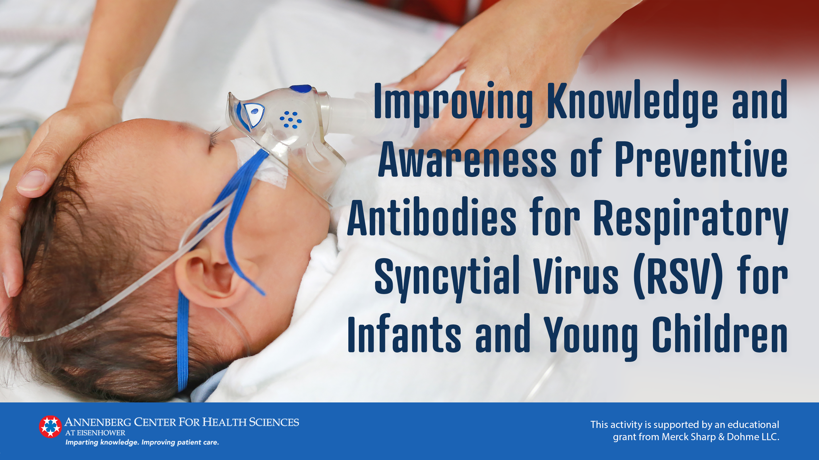

Slide 2
RSVpreF: Phase 3 MATISSE Trial
7392 pregnant parents at 24-36 weeks gestation assigned RSVpreF vaccine vs placebo
Endpoints | RSVpreF vaccine (n=3495) | Placebo (n=3480) | Additional information
Co-primary efficacy: Medically attended severe RSV-associated LRTI in infants within 90, 120, 150, and 180 days after birth | 0.2% at 90 days 0.5% at 180 days | 0.9% at 90 days 1.8% at 180 days | Efficacy at 90 days: 81.8% (99.5% CI: 40.6 to 96.3%) Efficacy at 180 days: 69.4% (97.58% CI: 44.3 to 84.1%)
Co-primary efficacy: Medically attended RSV-associated LRTI in infants within 90, 120, 150, and 180 days after birth | 0.7% at 90 days 1.6% at 180 days | 1.6% at 90 days 3.4% at 180 days | Efficacy at 90 days: 57.1% (99.5% CI: 14.7 to 79.8%) Efficacy at 180 days: 51.3% (97.58% CI: 29.4 to 66.8%)
Safety: Serious AEs (pregnant parent) Serious AEs (infant) | 4.2% 4.5% | 3.7% 3.8% | Most common AEs in pregnant parent: Fatigue 47% Injection-site pain 41%
AE, adverse event; CI, confidence interval; LRTI, lower respiratory tract infection; RSV, respiratory syncytial virus
Kampmann B, et al. N Engl J Med. 2023;388(16):1451-1464.
Simões EAF, et al. Obstet Gynecol. 2025;145(2):157-167.

Slide 3
Nirsevimab: Phase 3 MELODY Trial
1490 infants born ≥35 weeks gestational age assigned nirsevimab vs placebo
Endpoints | Nirsevimab (n=994) | Placebo (n=496) | Additional information
Primary efficacy: Medically attended RSV-associated LRTI ≤150 days after injection | 1.2% | 25 5.0% | Efficacy: 74.5% (95% CI: 49.6 to 87.1%; P<0.001)
Time-to-event analysis: Hazard ratio: 0.23 (95% CI: 0.12 to 0.47)
Secondary efficacy: Hospitalization for RSV-associated LRTI ≤150 days after injection | 0.6% | 1.6% | Efficacy: 62.1% (95% CI: -8.6 to 86.8%; P=0.07)
Safety: Serious AEs AEs grade 3 or higher severity Considered related to trial regimen Death | 6.8% 3.6% 1.0% 0.3% | 7.3% 4.3% 1.4% 0 0% | Most common AEs: Pyrexia 12.7% Nasal congestion 12.1%
AE, adverse event; CI, confidence interval; LRTI, lower respiratory tract infection; RSV, respiratory syncytial virus
Hammitt LL, et al. N Engl J Med. 2022;386(9):837–846.

Slide 4
Nirsevimab: Pragmatic HARMONIE Trial
8058 healthy preterm/full-term infants (≥29 weeks) assigned nirsevimab vs standard care
Endpoints | Nirsevimab (n=4037) | Standard care (n=4021) | Additional information
Primary efficacy: Hospitalization for RSV-associated LRTI | 0.3% | 1.5% | Efficacy: 83.2% (95% CI: 67.8 to 92.0%; P<0.001)
Hospitalization with follow-up to 180 days: 12 (0.3%) vs 68 (1.7%) Efficacy: 82.7% (P<0.0001)
Secondary efficacy: Very severe RSV-associated LRTI (hospitalization with O₂ saturation <90% and need for supplemental O₂) | 0.1% | 0.5% | Efficacy: 75.7% (95% CI: 32.8 to 92.9%; P=0.004)
Safety: Serious AEs Serious treated-related AEs ≤30 minutes of injection | 2.2% <0.1% 0.6% | 1.7% 0% 0% | Most AEs were grade 1 or 2 severity
AE, adverse event; CI, confidence interval; LRTI, lower respiratory tract infection; RSV, respiratory syncytial virus
Drysdale SB, et al. N Engl J Med. 2023;389(26):2425–2435.
Munro APS, et al. Lancet Child Adolesc Health. 2025;9(6):404-412.

Slide 5
Clesrovimab: Phase 3 CLEVER Trial
3614 healthy preterm/full-term infants (≥29 weeks) assigned clesrovimab vs placebo
Endpoints | Clesrovimab (n=2398) | Placebo (n=1201) | Additional information
Primary efficacy: Medically attended RSV-associated LRTI ≤150 days after injection | 2.6% | 6.5% | Efficacy: 60.4% (95% CI: 44.1 to 71.9%; P<0.001)
Secondary efficacy: Hospitalization for RSV-associated LRTI ≤150 days after injection | 0.4% | 2.4% | Efficacy: 84.2% (95% CI: 66.6 to 92.6%; P<0.001)
Safety: Serious AEs Serious AEs related to trial regimen Death | 11.5% <0.1% 0.3% | 12.4% 0.1% 0.2% | Most common solicited AEs: Injection-site pain 5.1% Irritability 18.7%
AE, adverse event; CI, confidence interval; LRTI, lower respiratory tract infection; RSV, respiratory syncytial virus
Zar HJ, et al. N Engl J Med. 2025;393(13):1292-1303.

