Slide 2
Faculty Presenters
Helena W. Rodbard MD FACP MACE
Past President, American Association of Clinical Endocrinologists
Past President, American College of Endocrinology
Founder and Medical Director, Endocrine and Metabolic Consultants
Rockville, MD
Jorge Plutzky, MD
Director, The Vascular Disease Prevention Program
Director, Preventive Cardiology
Associate Professor, Harvard Medical School
Cardiovascular Medicine

Slide 3
Faculty Disclosures
It is the policy of the Annenberg Center to ensure fair balance, independence, objectivity, and scientific rigor in all programming. All faculty participating in accredited programs are expected to identify and reference off-label product use and disclose any relationship with those supporting the activity or any others whose products or services are discussed.
Helena W. Rodbard MD FACP MACE
Consultant | Pacira
Research Support | Eli Lilly, Inversago, Medtronic, Novo Nordisk, Sanofi
Speaker | Bayer, Boehringer Ingelheim, Merck
Jorge Plutzky, MD
No relationships to disclose.

Slide 4
Learning Objectives
Explain how the mechanisms of action of glucagon-like peptide-1 receptor agonists (GLP-1 RAs) address key pathophysiologic mechanisms of type 2 diabetes
Compare and contrast the agents within the GLP-1RA class
Formulate strategies to ease patient safety concerns and improve tolerability to GLP-1 RAs
Justify the use of GLP-1 RAs for secondary prevention of cardiovascular disease in patients with type 2 diabetes
Apply current evidence-based recommendations from the ACC, ADA, and ADA/EASD to individualize GLP-1RA therapy in patients with type 2 diabetes
Notes:
Identify nutrients critical for brain and cognitive development during the first 1,000 days
Associate potential early nutrient deficiencies with long-term consequences
Synthesize current research to recommend infant feeding practices that provide optimal support for brain and neurodevelopment

Slide 5
Treatment of Patients with Type 2 Diabetes
2022 ADA/EASD Type 2 Diabetes Consensus Report
2023 ADA Standards of Care in Diabetes
2023 ACC/AHA Guideline for the Management of Patients with Chronic Coronary Disease

Slide 6
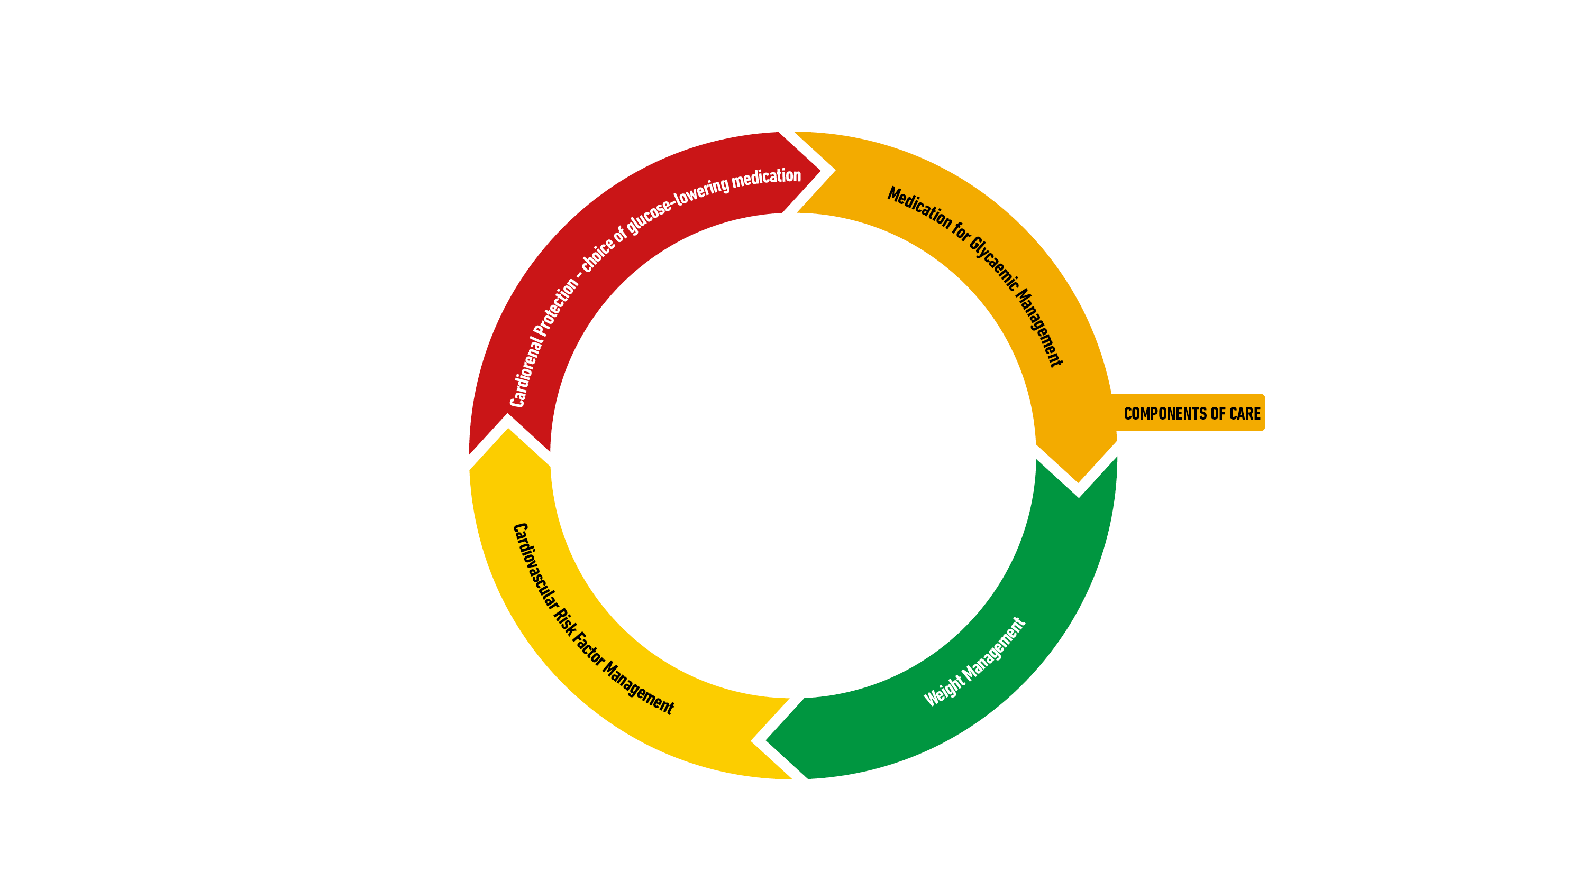
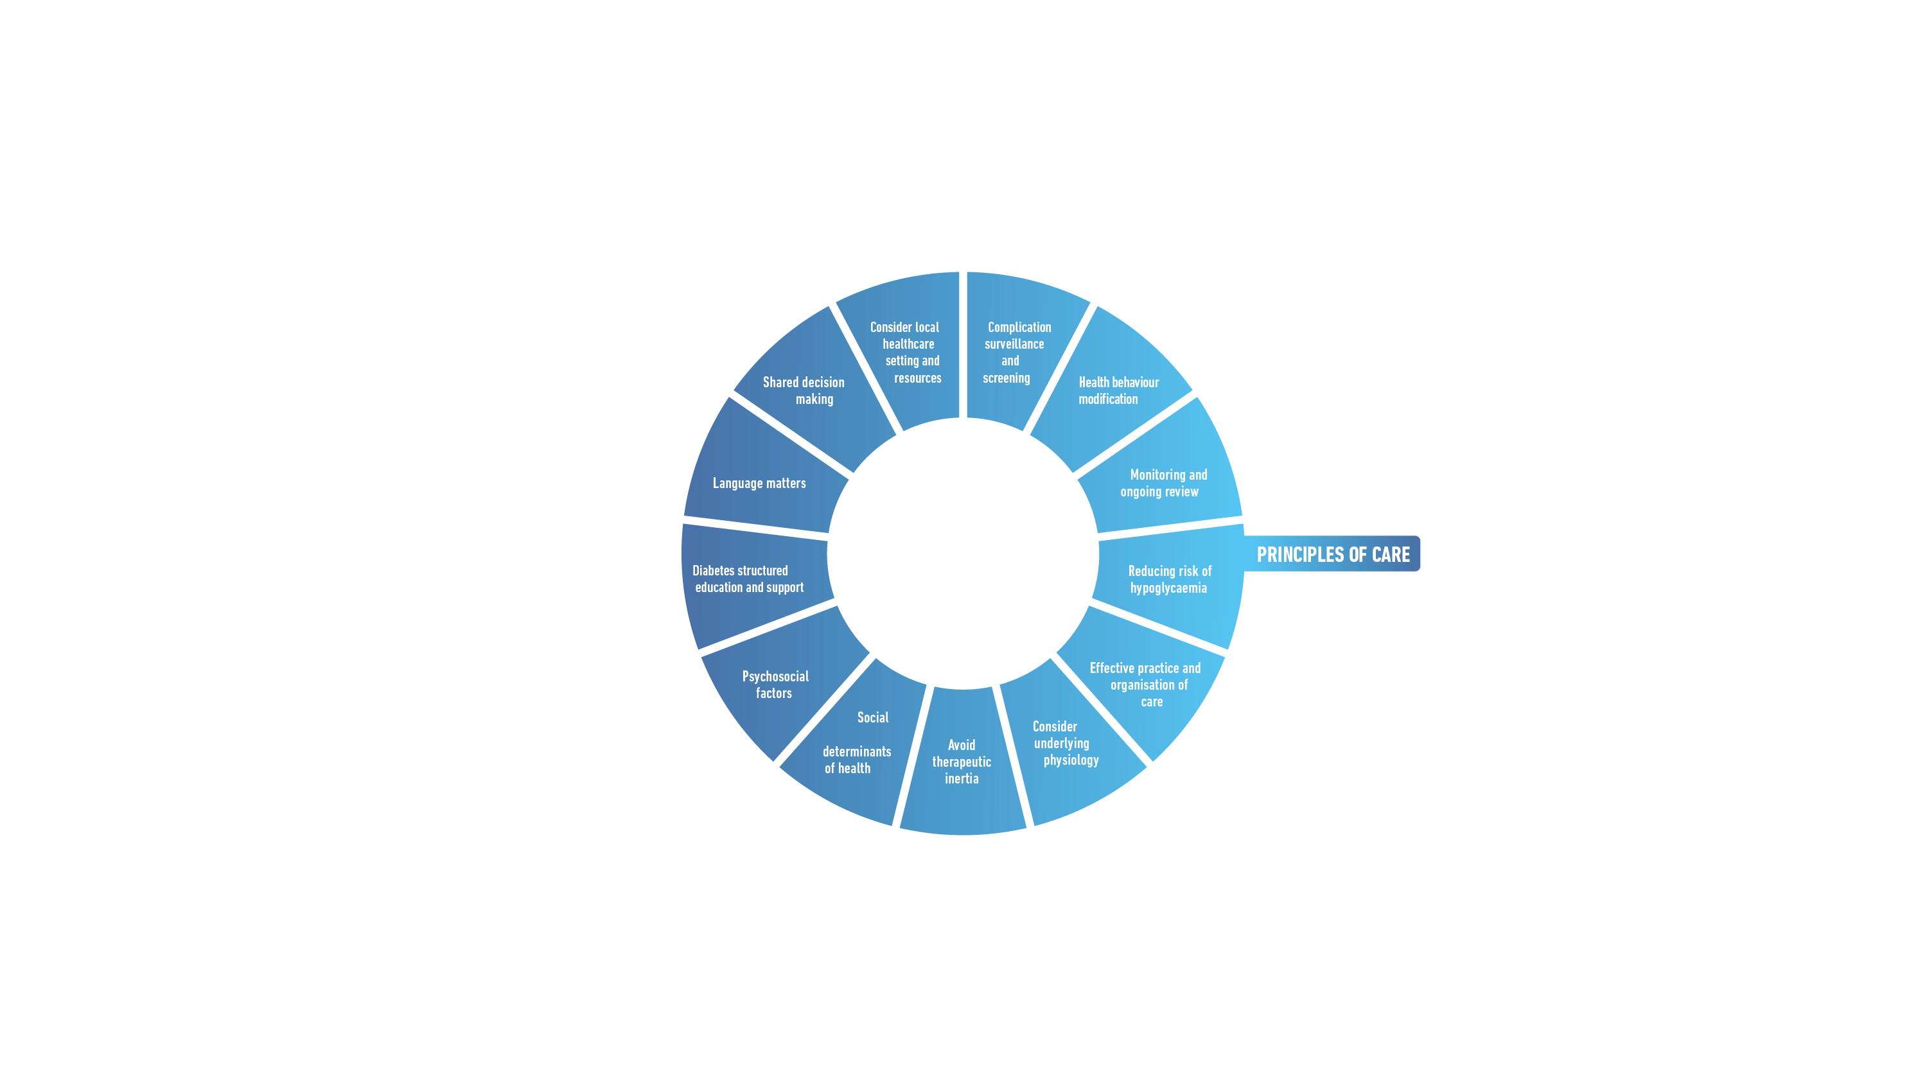
Davies MJ, et al. Diabetes Care. 2022;45(11):2753-2786.
Davies MJ, et al. Diabetologia. 2022;65(12):1925-1966.

Slide 7
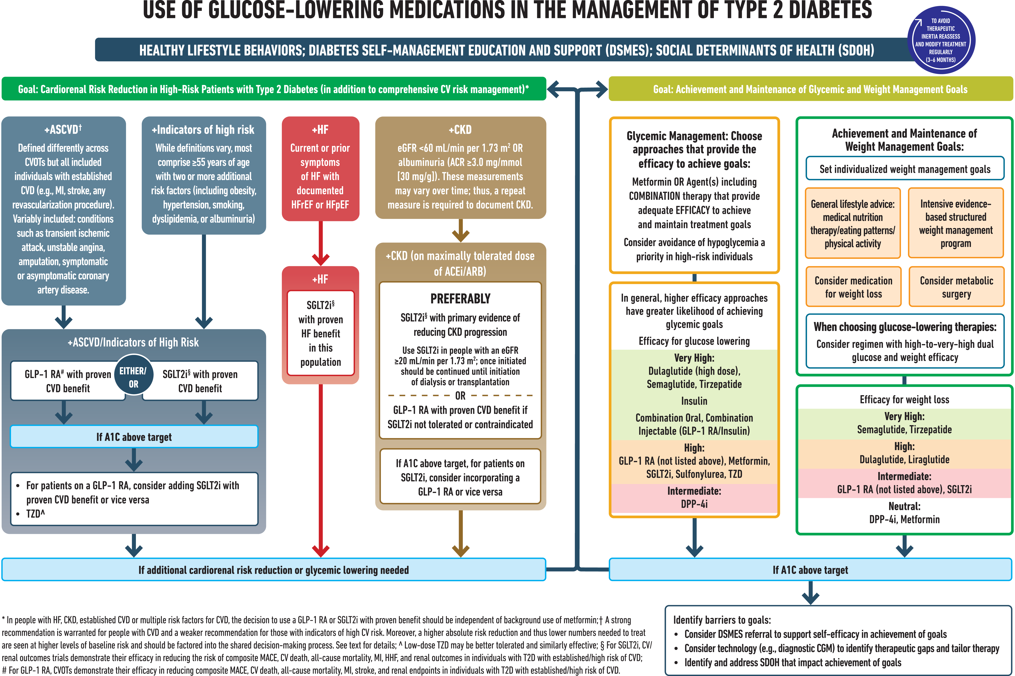
ElSayed NA, et al. Diabetes Care. 2023;46(Suppl 1):S140-S157.

Slide 8
+ASCVD or High Risk
+HF
(HFrEF or HFpEF)
GLP-1 RA w/ proven CVD benefit
SGLT2i w/ proven HF benefit
+CKD
eGFR <60 mL/min per 1.73 m² OR ACR >30mg/g
SGLT2i w/ primary evidence of reducing CKD progression
OR
GLP-1 RA with proven CVD benefit if SGLT2i not tolerated or contraindicated
SGLT2i w/ proven CVD benefit
OR if A1C above target on SGLT2i, incorporate GLP-1 RA
2022 ADA/EASD Consensus Recommendations
Goal: Cardiorenal Risk Reduction in High-Risk Patients with Type 2 Diabetes
ASCVD, atherosclerotic cardiovascular disease; ACR, albumin-creatine ratio; HFrEF, heart failure with reduced ejection fraction; HFpEF, heart failure with preserved ejection fraction; GLP-1 RA, glucagon-like peptide-1 receptor agonist; SGLT2i, sodium glucose cotransporter 2 inhibitor
Adapted from: Davies MJ, et al. Diabetes Care. 2022;45(11):2753-2786.
Davies MJ, et al. Diabetologia. 2022;65(12):1925-1966.

Slide 9
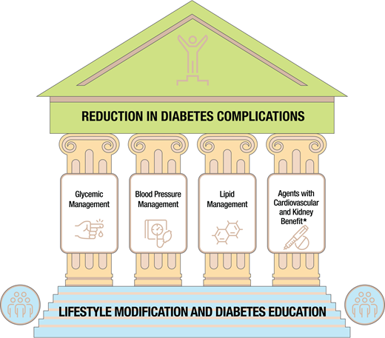
Cardiovascular Disease and Risk Management: ADA 2023
ElSayed NA, et al. Diabetes Care. 2023;46(Suppl 1):S140-S157.

Slide 10
Adults w/T2D and ≥1 of the following: ASCVD, HF, DKD, at high risk for ASCVD
Address concurrently
Optimize guideline-directed medical therapy for prevention
(lifestyle, BP, lipids, glucose, antiplatelet)
Cardiovascular Disease and Risk Management: ADA 2023
Recommend SGLT2i or GLP-1 RA with proven CV benefit
Discuss patient-clinician preferences and priorities
No additional action
SGLT2i selected
GLP-1 RA selected
Consider the addition of the alternative class, if benefits outweigh risks.
Adapted from: ElSayed NA, et al. Diabetes Care. 2023;46(Suppl 1):S140-S157.
Notes:
Approach to risk reduction with SGLT2 inhibitor or GLP-1 receptor agonist therapy in conjunction with other traditional, guideline-based preventive medical therapies for blood pressure, lipids, and glycemia and antiplatelet therapy.

Slide 11
Recommendations for Use of SGLT2 Inhibitors and GLP-1 Receptor Agonists: 2023 AHA/ACC in CCD
COR | LOE | Recommendations
1 | A | 1. In patients with CCD who have type 2 diabetes, the use of either an SGLT2 inhibitor or a GLP-1 receptor agonist with proven cardiovascular benefit is recommended to reduce the risk of MACE
High Value | B-NR | 2. In patients with CCD and type 2 diabetes, addition of a GLP-1 receptor agonist at US prices is projected to be of high value compared with standard of care
Intermediate Value | B-NR | 3. In patients with CCD and type 2 diabetes, addition of an SGLT2 inhibitor at US prices is projected to be of intermediate value compared with standard of care
Class of Recommendation (COR) indicates the strength of recommendation, encompassing the estimated magnitude and certainty of benefit in proportion to risk
Class 1 (Strong) – Benefit >>>> Risk
Level of Evidence (LOE) rates the quality of scientific evidence supporting the intervention based on the type, quantity, and consistency of data from clinical trials and other sources
Level A: high-quality evidence from more than 1 randomized controlled trial (RCT); meta-analysis of high-quality RCTs; one or more RTCS corroborated by high-quality registry studies
Level B-NR: moderate-quality evidence from 1 or more well-designed, well-executed nonrandomized studies, observational studies, or registry studies; meta-analyses of such studies
Virani SS, et al. Circulation. 2023;148(9):e9-e119.

Slide 12
Recommendations for Weight Management: 2023 AHA/ACC in CCD
COR | LOE | Recommendations
1 | C-EO | 1. In patients with CCD, assessment of BMI with or without waist circumference is recommended during routine clinical follow-up
1 | B-NR | 2. Patients with CCD and overweight or obesity should receive counseling on diet, lifestyle, and goals for weight loss
2a | B-R | 3. For patients with CCD and overweight or obesity in whom pharmacologic therapy is warranted for further weight reduction, a GLP-1 receptor agonist can be beneficial in addition to counseling for diet and physical activity,11,12 and it is reasonable to choose semaglutide over liraglutide
Class of Recommendation (COR) indicates the strength of recommendation, encompassing the estimated magnitude and certainty of benefit in proportion to risk
Class 1 (Strong) – Benefit >>> Risk | Class 2a (Moderate) – Benefit >> Risk
Level of Evidence (LOE) rates the quality of scientific evidence supporting the intervention based on the type, quantity, and consistency of data from clinical trials and other sources
Level B-R: moderate-quality evidence from 1 or more RCTs; meta-analysis of moderate-quality RCTs
Level B-NR: moderate-quality evidence from 1 or more well-designed, well-executed nonrandomized studies, observational studies, or registry studies; meta-analyses of such studies
Level C-EO: consensus of expert opinion based on clinical experience
Virani SS, et al. Circulation. 2023;148(9):e9-e119.

Slide 13
Clinical Questions

Slide 14
Which pathophysiologic mechanisms of T2D do GLP-1 RAs target?

Slide 15
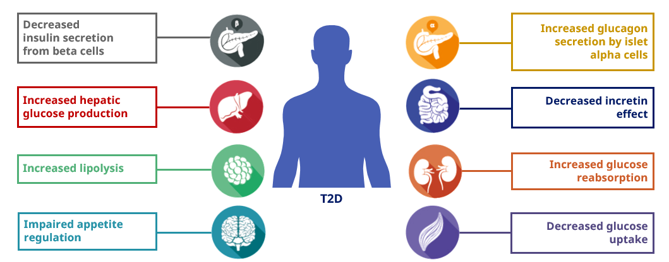
T2D Pathophysiology

Slide 16
Pleiotropic Physiological Effects of GLP-1

Slide 17
Are there differences among the GLP-1 RAs with respect to glycemic effects?

Slide 18
Glycemic Effects of Short-acting versus
Long-acting GLP-1 RAs
Parameters | Short-acting GLP-1 RAs | Long-acting GLP-1 RAs
Compounds | Exenatide-B.I.D. Lixisenatide | Dulaglutide Exenatide OW Liraglutide Semaglutide (injectable and oral)
Fasting blood glucose levels | Modest reduction | Strong reduction
Postprandial hyperglycemia | Strong reduction | Modest reduction
Glucagon secretion | Reduction | Reduction
Adapted from Table 1 of Meier, J. J. (2012). GLP-1 receptor agonists for individualized treatment of type 2 diabetes mellitus.
Meier JJ. Nat Rev Endocrinol. 2012;8(12):728-742.

Slide 19
Are there differences among the GLP-1 RAs with respect to non-glycemic effects?

Slide 20
Non-glycemic Effects of Short-acting versus
Long-acting GLP-1 RAs
Parameters | Short-acting GLP-1 RAs | Long-acting GLP-1 RAs
Compounds | Exenatide-B.I.D. Lixisenatide | Dulaglutide Exenatide OW Liraglutide Semaglutide (injectable and oral)
Gastric emptying rate | Deceleration | No effect [or modest deceleration]
Heart rate | No effect or small increase (0 to 2 bpm) | Moderate increase (2 to 5 bpm)
Body weight reduction | 1 to 5 kg | 2 to 5[+] kg
Systolic blood pressure | Modest reduction (-1.4 mmHg) | Reduction
Lipids | Modest reduction: LDL-C −3.094 mg/dL | TC −5.03 mg/dL | TG −0.886 mg/dL
Adapted from Table 1 of Meier, J. J. (2012). GLP-1 receptor agonists for individualized treatment of type 2 diabetes mellitus. Meier JJ. Nat Rev Endocrinol. 2012;8(12):728-742.
Diallo A., et al. Acta Diabetol. Published online July 13, 2023. Berberich AJ, et al. Curr Opin Lipidol. 2021;32(3):191-199. Sun F, et al. Clin Ther. 2015;37(1):225-241.e8. Cornell S. J Clin Pharm Ther. 2020;45(S1):17-27. Htike ZZ, et al. Diabetes Obes Metab. 2017;19(4):524-536. Monami M, et al. Diabetes Obes Metab. 2014;16(1):38-47.

Slide 21
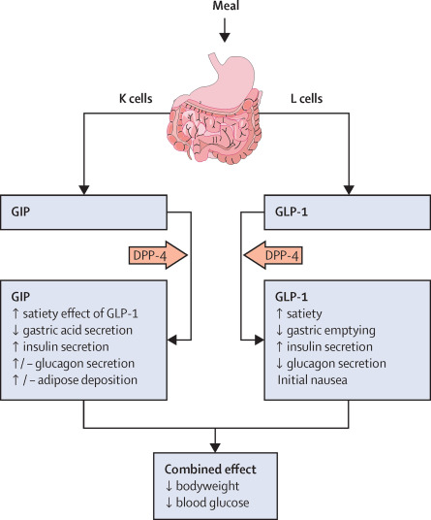
Tirzepatide: Dual GLP-1 RA + GIP
Characteristics
Mechanism of Action | GLP-1 RA and glucose-dependent insulinotropic polypeptide (GIP) receptor that increases glucose-dependent insulin secretion, decreases inappropriate glucagon secretion, and slows gastric emptying
Labeled Indications | As an adjunct to diet and exercise to improve glycemic control in adults with type 2 diabetes mellitus
Dosing | Subcutaneous: Initial: 2.5 mg once weekly x 4 wks, then increase to 5 mg once weekly. Maximum dose: 15 mg/wk
Bailey CJ. Lancet Diabetes Endocrinol. 2021;9(10):646-648.
Mounjaro (tirzepatide) [prescribing information]. Indianapolis, IN: Lilly USA LLC; August 2023.

Slide 22
How well do GLP-1 RAs work as monotherapy and in combination with other classes of medications, including basal insulin, for patients with T2D?

Slide 23
GLP-1 RAs As Monotherapy + In Combination
GLP-1 RAs are efficacious and safe as:
Monotherapy
In combination with many glucose-lowering agents
In combination with basal-bolus insulin, sulfonylureas, and glinides, there is an increased risk of hypoglycemia for patients on GLP-1 RAs
Nauck MA, et al. Mol Metab. 2021;46:101102.

Slide 24
GLP-1 RAs + Basal Insulin…
Achieve targets for fasting and post-prandial glucose as well as overall (A1C) glycemic control¹
As effective as a basal-bolus insulin regimen with a much lower risk of hypoglycemia and weight gain²
Lower hypoglycemic risk compared to insulin treatment alone³
Highly efficacious and safe glucose-lowering regimen that has led to the development of fixed-dose combinations
Meier JJ. Nat Rev Endocrinol. 2012;8(12):728-742.
Diamant M, et al. Diabetes Care. 2014;37(10):2763-2773.
Gough SCL, et al. Lancet Diabetes Endocrinol. 2014;2(11):885-893.

Slide 25
Intensifying to injectable therapies in type 2 diabetes – ADA 2023
(2) When selecting GLP-1 RA, consider individual preference, A1C lowering, weight-lowering effect, or frequency of injection. If CVD is present, consider GLP-1 RA with proven CVD benefit.
(3) For people on GLP-1 RA and basal insulin combination, consider use of a fixed-ratio combination product.
ElSayed NA, et al. Diabetes Care. 2023;46(Suppl 1):S140-S157.

Slide 26
Does it matter which GLP-1 RA is used in a patient with T2D and ASCVD/high risk?

Slide 27
GLP-1 RAs with Proven CVD Benefits: FDA Indications
GLP-1 RA | FDA CVD Indication
Liraglutide Semaglutide (injectable) | Risk reduction of major cardiovascular events (cardiovascular death, nonfatal myocardial infarction, nonfatal stroke) in adults with type 2 diabetes mellitus and established cardiovascular disease
Dulaglutide | Risk reduction of major cardiovascular events (cardiovascular death, nonfatal myocardial infarction, nonfatal stroke) in adults with type 2 diabetes mellitus who have established cardiovascular disease or multiple cardiovascular risk factors
Victoza (liraglutide) [prescribing information]. Plainsboro, NJ: Novo Nordisk Inc; July 2023.
Ozempic (semaglutide) [prescribing information]. Plainsboro, NJ: Novo Nordisk Inc; October 2022.
Trulicity (dulaglutide) [prescribing information]. Indianapolis, IN: Eli Lilly and Company; December 2022.

Slide 28
Meta-analysis: GLP-1 RA CVOTs in T2D at high risk for CVD
 | GLP-1 Receptor Agonist, n/N (%) | Placebo n/N (%) |  | Hazard Ratio (95% CI) | NNT (95% CI) | P Value
3-point MACE
ELIXA (lixisenatide) | 400/3034 (13%) | 392/3034 (13%) |  | 1.02 (0.89, 1.17) |  | .78
LEADER (liraglutide) | 608/4668 (13%) | 694/4672 (15%) |  | 0.87 (0.78, 0.97) |  | .01
SUSTAIN-6 (semaglutide SQ) | 108/1648 (7%) | 146/1649 (9%) |  | 0.74 (0.58, 0.95) |  | .016
EXSCEL (exenatide OW) | 839/7356 (11%) | 905/7396 (12%) |  | 0.91 (0.83, 1.00) |  | .061
Harmony Outcomes (albi – NA) | 338/4731 (7%) | 428/4732 (9%) |  | 0.78 (0.68, 0.90) |  | .0006
REWIND (dulaglutide) | 594/4949 (12%) | 663/4952 (13%) |  | 0.88 (0.79, 0.99) |  | .026
PIONEER 6 (oral semaglutide) | 61/1591 (4%) | 76/1592 (5%) |  | 0.79 (0.57, 1.11) |  | .17
AMPLITUDE-O (investigational) | 189/2717 (7%) | 125/1359 (9%) |  | 0.73 (0.58, 0.92) |  | .0069
Subtotal (I² = 44.5%, P = .082) |  |  |  | 0.86 (0.80, 0.93) | 65 (45, 130) | < .0001
Weights are from random effect analysis. In addition to primary cardiovascular outcome results papers, data were extracted from additional sources. AMPLITUDE-O data were provided by the authors. Three-point MACE consisted of cardiovascular death, myocardial infarction, and stroke. NNTs were calculated over a weighted average median follow-up of 3.0 years. P values are for superiority
Efpeglenatide not FDA-approved. Not all agents and formulations are indicated for cardiovascular risk reduction.
CVOT, cardiovascular outcomes trial; MACE, major adverse cardiovascular event; NNT, number needed to treat.
Sattar N, et al. Lancet Diabetes Endocrinol. 2021;9:653-662.
0.5
1
1.5
Weights are from random effect analysis. In addition to primary cardiovascular outcome results papers, data were extracted from additional sources. AMPLITUDE-O data were provided by the authors. Three-point MACE consisted of cardiovascular death, myocardial infarction, and stroke. NNTs were calculated over a weighted average median follow-up of 3.0 years. P values are for superiority. Efpeglenatide not FDA-approved. Not all agents and formulations are indicated for cardiovascular risk reduction. CVOT, cardiovascular outcomes trial; MACE, major adverse cardiovascular event; NNT, number needed to treat.
Favors GLP-1 RA
Favors placebo
Sattar N, et al. Lancet Diabetes Endocrinol. 2021;9:653-662.

Slide 29
Does it matter which GLP-1RA is used in a patient with T2D and CKD who is not a candidate for SGLT-2i therapy?

Slide 30
Recommended GLP-1 RAs in CKD
GLP-1 RA | FDA CVD Indication
Liraglutide Semaglutide (injectable) | Risk reduction of major cardiovascular events (cardiovascular death, nonfatal myocardial infarction, nonfatal stroke) in adults with type 2 diabetes mellitus and established cardiovascular disease
Dulaglutide | Risk reduction of major cardiovascular events (cardiovascular death, nonfatal myocardial infarction, nonfatal stroke) in adults with type 2 diabetes mellitus who have established cardiovascular disease or multiple cardiovascular risk factors
Victoza (liraglutide) [prescribing information]. Plainsboro, NJ: Novo Nordisk Inc; July 2023.
Ozempic (semaglutide) [prescribing information]. Plainsboro, NJ: Novo Nordisk Inc; October 2022.
Trulicity (dulaglutide) [prescribing information]. Indianapolis, IN: Eli Lilly and Company; December 2022.
ElSayed NA, et al. Diabetes Care. 2023;46(Suppl 1):S140-S157.

Slide 31
Meta-analysis of GLP-1 RA CVOTs Composite kidney outcome including macroalbuminuria
 | GLP-1 Receptor agonist, n/N (%) | Placebo n/N (%) |  | Hazard ratio (95% CI) | NNT (95% CI) | p value
Composite kidney outcome including macroalbuminuria
ELIXA (lixisenatide) | 172/2647 (6%) | 203/2639 (8%) |  | 0·84 (0·68-1·02) |  | 0·083
LEADER (liraglutide) | 268/4668 (6%) | 337/4672 (7%) |  | 0·78 (0·67-0·92) |  | 0·003
SUSTAIN-6 (semaglutide SQ) | 62/1648 (4%) | 100/1649 (6%) |  | 0·64 (0·46-0·88) |  | 0·005
EXSCEL (exenatide OW) | 366/6256 (6%) | 407/6222 (7%) |  | 0·88 (0·76-1·01) |  | 0·065
REWIND (dulaglutide) | 848/4949 (17%) | 970/4952 (20%) |  | 0·85 (0·77-0·93) |  | 0·0004
AMPLITUDE-O (investigational) | 353/2717 (13%) | 250/1359 (18%) |  | 0·68 (0·57-0·79) |  | <0·0001
Subtotal (I²=47·5%, p=0·090) |  |  |  | 0·79 (0·73-0·87) | 47 (37-77) | <0·0001
0.5
1
1.5
Weights are from random effect analysis. In addition to primary cardiovascular outcome results papers, data were extracted from additional sources. AMPLITUDE-O data were provided by the authors. Data on kidney outcomes were not available in Harmony outcomes and PIONEER 6. The composite kidney outcome consisted of development of macroalbuminuria, doubling of serum creatinine or at least 40% decline in eGFR, kidney replacement therapy, or death due to kidney disease; for ELIXA, data are for new-onset macroalbuminuria alone NNTs were calculated over a weighted average median follow-up of 3.4 years.
CI, confidence interval; CVOTs. cardiovascular outcome trials; GLP-1, glucagon-like peptide-1; GLP-1 RAs, GLP-1 receptor agonists; NNT, number needed-to-treat
Favours GLP-1 receptor agonists
Favours placebo
Sattar N, et al. Lancet Diabetes Endocrinol. 2021;9:653-662.

Slide 32
Rossing P, et al. Nephrol Dial Transplant. 2023;38(9):2041-2051.

Slide 33
What education should be provided to address patient concerns related to GLP-1 RA therapy?

Slide 34
GLP-1 RAs: Contraindications & Warnings
History of serious hypersensitivity reaction to drug
History of pancreatitis
Pregnancy or breast feeding
Personal or family history of medullary thyroid cancer
Personal or family history of multiple endocrine neoplasia, type 2 (MEN2)
Das SR, et al. J Am Coll Cardiol. 2020;76(9):1117-1145.

Slide 35
Considerations for Patient Concerns
Diabetic retinopathy complications have been reported which may be due to rapid improvement in blood glucose control
Advise patients to undergo appropriate, guideline-recommended eye exams before starting therapy if not done within the last 12 months
Inform patients regarding prescription assistance programs
Das SR, et al. J Am Coll Cardiol. 2020;76(9):1117-1145.

Slide 36
Considerations for Drug Initiation & Monitoring
Stop DPP-IV inhibitor before initiation
Hypoglycemia risk increased with insulin and sulfonylureas
If patient has history of frequent hypoglycemic events, stop sulfonylurea and reduce insulin dose by ~20% when starting therapy
Das SR, et al. J Am Coll Cardiol. 2020;76(9):1117-1145.

Slide 37
What are common side effects?

Slide 38
Adverse Effects to Monitor
Gastrointestinal:
Nausea/vomiting
Diarrhea
Non-gastrointestinal:
Hypoglycemia when given with insulin or sulfonylureas
Injection site reactions
Das SR, et al. J Am Coll Cardiol. 2020;76(9):1117-1145.

Slide 39
What education should be provided so that patients optimize treatment with GLP-1 RA therapy?

Slide 40
Recommendations to Minimize Occurrence + Severity of GI Adverse Effects with GLP-1 RAs
Improve eating habits:
Eat slowly
Eat only if you are hungry
Eat smaller portions
Avoid lying down after having a meal
Stop eating in case of feeling of fullness
Gorgojo-Martínez JJ, et al. J Clin Med. 2022;12(1):145.

Slide 41
Recommendations to Minimize Occurrence + Severity of GI Adverse Effects with GLP-1 RAs
Additional recommendations for patients with nausea
Wait ≥30 min since GLP-1RA dose → eat foods to ease nausea, if needed
Crackers, apples, ginger root/ginger-based drinks
Avoid strong smells
Additional recommendations for patients with vomiting
Be particularly careful with hydration
Eat smaller amounts of food more frequently
Gorgojo-Martínez JJ, et al. J Clin Med. 2022;12(1):145.

Slide 42
Does dosing need to be adjusted based on kidney function?

Slide 43
ADA/KDIGO: GLP-1 RA Dosing for eGFR <45​
Dual GIP + GLP-1RA
Tirzepatide | No dose adjustment required
de Boer IH, et al. Diabetes Care. 2022;45(12):3075-3090.​

Slide 44
How might the cardiologist collaborate with the multidisciplinary, interprofessional care?

Slide 45
2020 ACC Expert Consensus Decision Pathway on Novel Therapies for CV Risk Reduction in T2D
GLP-1 RAs have encouraged CV specialists to adopt a more active role in prescribing drugs that may have been seen as solely T2D therapies
There is a need for collaborative and multidisciplinary care
CV specialists have a role to address 3 key areas:
Screening for T2D in those with/at high risk of CV disease
Aggressively treating CV risk factors
Incorporating glucose-lowering agents with evidence for improving CV outcomes
Das SR, et al. J Am Coll Cardiol. 2020;76(9):1117-1145.

Slide 46
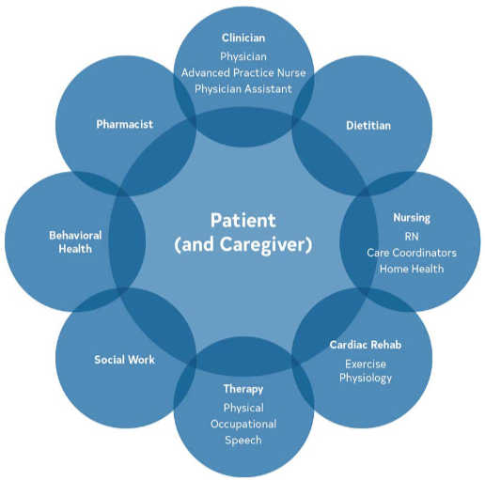
2023 ACC/AHA CCD Guidelines
A multidisciplinary team-based approach is recommended to:
-Improve health outcomes
-Facilitate modification of ASCVD risk factors
-Improve health service utilization
This approach should focus on:
-Shared decision-making
-Continuous communication
Virani SS, et al. Circulation. 2023;148(9)e9-e119.

Slide 47
Questions & Answers

