Slide 1
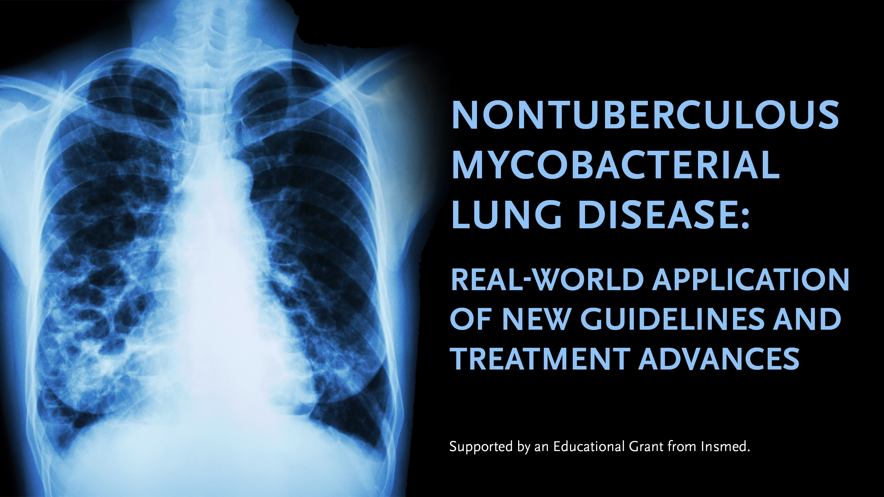
Module 1

Slide 2
Investigational Use
This activity includes extensive discussion about medications not approved in the United States, as well as uses of medications approved in the United States but outside of current approved labeling.
Participants are encouraged to consult the prescribing information for approved medications and other evidence-based sources of information prior to prescribing.

Slide 3
Learning Objectives
Describe key treatment concepts as described in the 2020 clinical practice guideline on nontuberculous mycobacterial lung disease (NTM-LD) jointly sponsored by American Thoracic Society, European Respiratory Society, European Society of Clinical Microbiology and Infectious Diseases, and Infectious Diseases Society of America
Summarize the clinical impact of the latest clinical data and therapeutic advances in NTM-LD
Develop patient-centered treatment strategies for NTM-LD that align with the latest evidence-based guideline recommendations and therapeutic advances
Collaborate with patients to better individualize treatment over the course of the disease

Slide 4
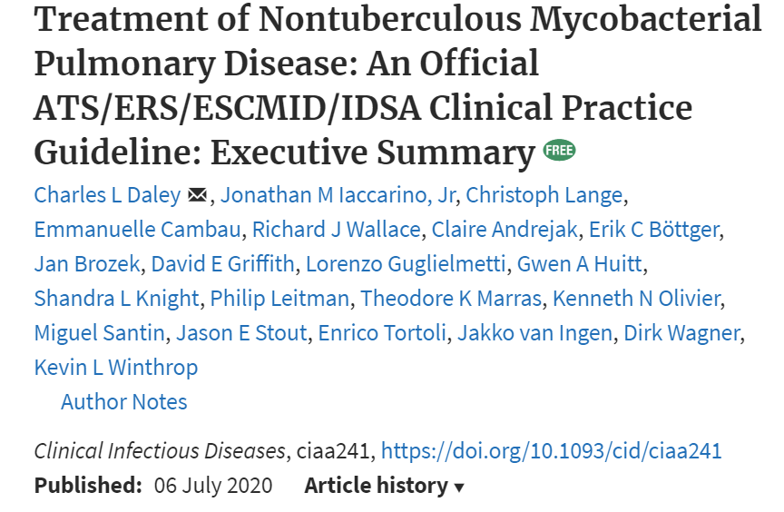
22 PICO Questions
Diagnosis
Tx of NTM-PD
(1-2)
M. avium complex
(3-9)
M. kansasii
(10-14)
M. xenopi
(15-18)
M. abscessus
(19-21)
Surgical Resection
(22)
Daley CL, et al. Clin Infect Dis. 2020;71(4):e1-e36.

Slide 5
I. Should patients with NTM-PD be treated with antimicrobial therapy or followed for evidence of progression (“watchful waiting”)? (continued)
CAVITARY NTM LD
2015
23.6% stable
41.7% spontaneous conversion
488 patients with MAC
62.5% progressed
MAC, Mycobacterium avium complex; PD, pulmonary disease
Hwang JA, et al. Eur Respir J. 2017;49(3):1600537.

Slide 6
Predictors for Progression
NTM species
Host comorbidities
Bacterial load
Radiographic extent
Age, male gender, BMI, anemia, low albumin, elevated C-reactive protein
Hwang JA, et al. Eur Respir J. 2017;49(3):1600537.
Kwon BS, et al. Respir Med. 2019;150:45-50.
Moon SM, et al. Respir Med. 2019;151:1-7.

Slide 7
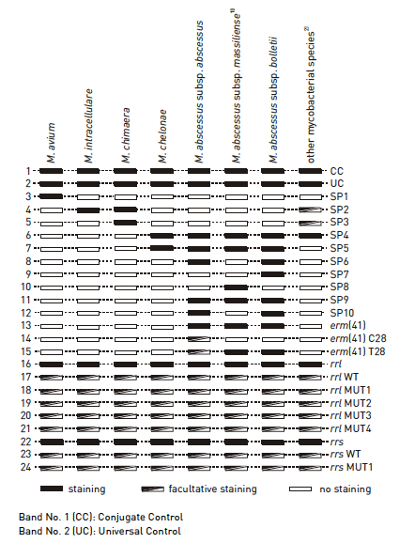
Antimicrobial Susceptibility Testing (AST) for Mycobacterium avium complex
Phenotypic Testing (weeks)
Genotypic Testing (hours/days)
Antimicrobial Agent | MIC, ug/ml
 | S | I | R
Clarithromycin | ≤ 8 | 16 | ≥ 32
Amikacin (IV) | ≤ 16 | 32 | ≥64
Amikacin (liposomal inhaled) | ≤ 64 | - | ≥ 128
rrl mutations (macrolide)
Sensitivity - 96.3%
Specificity - 100%
rrs mutations (aminoglycoside)
Sensitivity - 50%
Specificity - 100%
CLSI. M62 Performance Standards for Susceptibility Testing, 2018
Huh HJ, et al. J Clin Microbiol. 2019;57(8):e00516-19.

Slide 8
III. Should patients with macrolide-susceptible MAC- PD be treated with a 3-drug regimen with a macrolide or without a macrolide? (cont)
Systematic review (21 studies)
Sustained culture conversion incidence rate ratio:
Macrolide-containing 0.54 (0.45-0.63)
Macrolide-free 0.38 (0.25-0.52)
Sputum culture conversion increased in macrolide-containing vs macrolide-free regimens as study quality improved.
Pasipanodya JG, et al. J Antimicrob Chemother. 2017;72(Suppl 2):i3-i19.

Slide 9
IV. In patients with newly diagnosed macrolide-susceptible MAC-PD, should an azithromycin-based drug regimen or a clarithromycin-based regimen be used? (continued)
Systematic review (21 studies)
No difference in sputum culture conversion at:
  6 months
  End of therapy (EOT)
  Sustained (12 months)
No difference in acquired macrolide resistance
Azithromycin
Better tolerated
Lower pill burden
Less drug-drug interactions
Pasipanodya JG, et al. J Antimicrob Chemother. 2017;72(Suppl 2):i3-i19.

Slide 10
V. Should patients with MAC-PD be treated with or without a parenteral amikacin- or streptomycin-containing regimen? (continued)
Randomized placebo-controlled study compared macrolide-based 3 drug regimen with IM streptomycin (15mg/kg thrice weekly) vs placebo
  Higher rate of culture conversion with streptomycin for first 3 months
    71.2% vs 50.7%
  No difference in long-term relapse, clinical or radiographic improvement
Higher culture conversion in those with macrolide-resistant disease when an aminoglycoside is included in regimen
Kobashi Y, et al. Respir Med. 2007;101(1):130-138.

Slide 11
Treatment of Refractory MAC-PD: Efficacy of Amikacin Liposome Inhalation Suspension (CONVERT Study)
Proportion of Patients With Negative Sputum Cultures for MAC
ALIS, amikacin liposome inhalation suspension
Griffith D, et al. Am J Respir Crit Care Med. 2018;198(12):1559-1569.

Slide 12
Three-times Weekly Therapy for Pulmonary MAC
Study | N | Conversion |  | Regimen Modification
 |  | Daily | TIW | Daily | TIW
Wallace¹ | 180 | 7/8 (88%) | 147/172 (85%) | 24/34 (80%)* | 5/180 (3%)*
Jeong² | 217 | 75/99 (76%) | 79/118 (67%) | 46/99 (46%)* | 25/118 (21%)*
*P < 0.001
Lower rate of culture conversion (4% vs 24%) with cavitary disease compared with noncavitary disease on intermittent therapy³
TIW, 3 times per week
1. Wallace RJ, et al. Chest. 2014;146(2):276-282.
2. Jeong BH, et al. Am J Respir Crit Care Med. 2015;191(1):96-103.
3. Lam PK, et al. Am J Respir Crit Care Med. 2006;173(11):1283-1289.

Slide 13
Distribution of NTM Disease
Distribution | Europe | North America | South America | Australia | Asia | South Africa | TOTAL
NTM
MAC
Hoefsloot W, et al. Eur Respir J. 2013;42:1604-1613.

Slide 14
Subspecies Impacts Treatment Choice and Success
M. abscessus subspecies abscessus
  Inducible macrolide resistance
M. abscessus subspecies bolletii
  Inducible macrolide resistance
M. abscessus subspecies massiliense
  Most with macrolide susceptibility

Slide 15
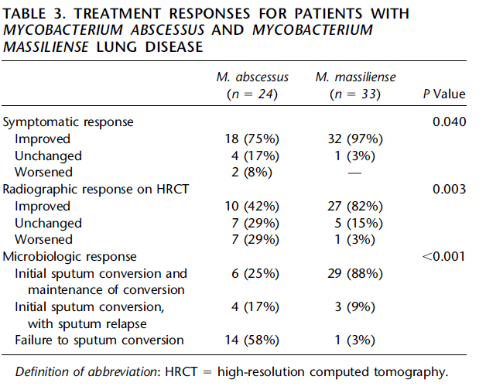
Erythromycin Methylase Gene erm(41)
Koh WJ, et al. Am J Respir Crit Care Med. 2011;183(3):405-410.

Slide 16
Treatment Practice Varies
Novosad SA, et al. Emerg Infect Dis. 2016;22(3):511-514.

