Slide 1
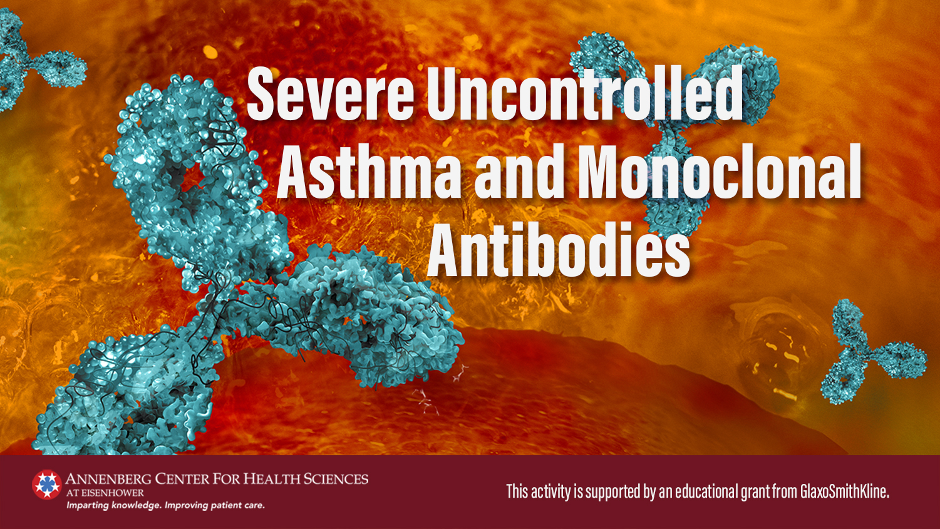

Slide 2
Faculty
Jonathan Corren, MD
Clinical Associate Professor of
Medicine and Pediatrics
Divisions of Clinical Immunology
and Allergy
David Geffen School of Medicine
at UCLA
Los Angeles, California
Reynold A. Panettieri, Jr., MD
Vice Chancellor, Translational Medicine
and Science
Director, Rutgers Institute for Translational
Medicine and Science
Professor of Medicine
Rutgers University
New Brunswick, New Jersey
Emeritus Professor of Medicine
University of Pennsylvania

Slide 3
Faculty CE Info/Disclosure
Jonathan Corren, MD
Research Support | AstraZeneca, Genentech/Roche, Novartis, Regeneron, Sanofi
Consultant | AstraZeneca, Genentech/Roche, Novartis, Regeneron, Sanofi
Speakers Bureau | AstraZeneca, Genentech/Roche, Novartis, Regeneron, Sanofi
Reynold A. Panettieri, Jr., MD
Research Support | AstraZeneca, MedImmune, RIFM, Equillium, Genentech, Metera
Consultant | AstraZeneca, MedImmune, RIFM, Equillium, Theravance, Avillion
Speakers Bureau | AstraZeneca, Sanofi, Genentech

Slide 4
Learning Objectives
Following participation in this activity, the clinician should be able to:
Appraise the latest developments, including monoclonal antibody therapies, in the treatment of patients with severe asthma (knowledge)
Differentiate between currently available monoclonal antibody therapy for severe uncontrolled asthma (knowledge)
Assess and integrate factors determining the choice of monoclonal antibody therapy for patients with severe uncontrolled asthma (competence)

Slide 5
Asthma: A Highly Prevalent and Often Inadequately Controlled Disease
33% of adults with asthma report having fair or poor health³
26.5 million people
in the US have asthma¹
20.4 million adults
have asthma¹
1.7 million ED visits with asthma as primary diagnosis in 2015¹
3.3 million children and 9.1 million adults have inadequately controlled asthma¹
3518 deaths due to asthma in 2016¹
40% of children and 39% of adults with active asthma use long-term control medications²
1.33 million adults have inadequately controlled asthma with eosinophilia⁴
1. Centers for Disease Control and Prevention (CDC). https://www.cdc.gov/asthma/most_recent_data.htm. Accessed August 14, 2018.
2. CDC. https://www.cdc.gov/asthma/asthma_stats/longterm_medication.htm. Accessed August 14, 2018.
3. CDC. https://www.cdc.gov/asthma/asthma_stats/default.htm. Accessed August 14, 2018.
4. McGrath KW, et al. Am J Respir Crit Care Med. 2012;185(6):612-619.

Slide 6
Asthma is Not a Clinically Homogeneous Condition
Multiple areas of difference:
  Clinical presentations
  Physiological characteristics
  Responses to therapy
Time of asthma development is a key factor:
  Children—relatively homogeneous with a strong personal and family allergic history of atopy
  Adults—very mixed group of patients

Slide 7
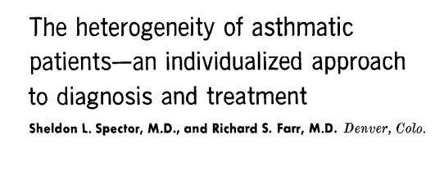
Heterogeneity in Asthma—Not a New Concept
J Allergy Clin Immunol. 1976;57(5):499-511.
Spector SL, Farr RS. J Allergy Clin Immunol. 1976 May;57(5):499-511.
.

Slide 8
Definitions
Asthma
Uncontrolled
Difficult-to-treat
Severe
Uncontrolled despite GINA 4/5‡ or that requires such treatment to maintain good symptom control and reduce the risk of exacerbations
Poor symptom control* and/or frequent exacerbations†
Uncontrolled despite adherence with maximal optimized therapy and treatment of contributory factors, or that worsens when high-dose treatment is decreased.
*Frequent symptoms or reliever use, activity limited by asthma, night waking due to asthma
†2 or more per year requiring oral corticosteroids or serious exacerbations ≥1/year requiring hospitalization
‡Such as medium- or high-dose inhaled corticosteroid with a second controller; maintenance oral corticosteroid
Global Initiative for Asthma. https://ginasthma.org/wp-content/uploads/2019/06/GINA-2019-main-report-June-2019-wms.pdf. Accessed January 13, 2020.

Slide 9
Differentiating Severe from Uncontrolled Asthma: Assess Comorbidities and Contributing Factors
Comorbidities
Obesity
Gastroesophageal reflux disease
Food allergy and anaphylaxis
Rhinosinusitis and nasal polyps
Psychological factors
Vocal cord dysfunction
Smoking and related diseases
Obstructive sleep apnea
Hyperventilation syndrome
Hormonal influences
Medications
Others
Contributing Factors
Poor treatment adherence
Poor inhaler technique
Environmental exposure
Global Initiative for Asthma. https://ginasthma.org/wp-content/uploads/2019/06/GINA-2019-main-report-June-2019-wms.pdf. Accessed January 13, 2020.

Slide 10
Differentiating Severe from Uncontrolled Asthma
● Watch patient using their inhaler
● Discuss adherence and barriers to use
● Confirm the diagnosis of asthma
● If possible, remove potential risk factors
● Assess and manage comorbidities
● Consider treatment step-up
● Refer to a specialist or severe asthma clinic
Global Initiative for Asthma. https://ginasthma.org/wp-content/uploads/2019/06/GINA-2019-main-report-June-2019-wms.pdf. Accessed January 13, 2020.

Slide 11
Severe Asthma: Clinical Features
Clinical Features
Frequent or persistent asthma symptoms
Troublesome comorbidities, eg, anxiety or depression
Persistent loss of lung function
Frequent exacerbations
Substantial impairment of QOL
1. Chung KF, et al. Eur Respir J. 2014;43:343-373.
2. Global Initiative for Asthma. https://ginasthma.org/wp-content/uploads/2019/06/GINA-2019-main-report-June-2019-wms.pdf. Accessed January 13, 2020.

Slide 12
Fitting the Individual Into a Larger Group
What is a phenotype?
The outward manifestation of a disease state related to both genetics and environmental influences
What is an endotype?
A phenotype of a disease state that has been well-characterized with regard to pathophysiologic mechanisms

Slide 13
Phenotypes/Endotypes of Severe Asthma
Phenotype | Clinical/Physiologic Characteristics
Early-onset allergic | History of food allergy, atopic dermatitis and allergic rhinitis
Late-onset minimally atopic eosinophilic | Chronic rhinosinusitis/nasal polyps Severe airway obstruction Subset = AERD
Late-onset non-eosinophilic | Poorly characterized May have significant LRT infection and/or GERD
AERD, Aspirin-exacerbated respiratory disease; GERD, gastroesophageal reflux disease; LRT, lower respiratory tract
Wenzel SE. Nat Med. 2012;18:716-725.
Trejo Bittar HE, et al. Ann Rev Pathol Mech Dis. 2015.10:511-545.
Corren J. Discov Med. 2013;15:243-249.

Slide 14
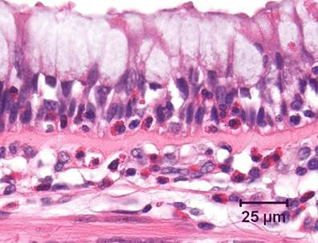
Eosinophilic Asthma
Asthma can be classified phenotypically as eosinophilic (40%-60% of cases) or non-eosinophilic¹
Symptom severity is increased in eosinophilic asthma¹⁻³
Interleukin-5 (IL-5) regulates proliferation, maturation, migration, and effector functions of eosinophils^{1,4}
IL-5 mRNA is increased in patients with asthma, correlates with asthma severity, and is inducible by allergen exposure¹
1. Corren J. Discov Med. 2012;13(71):305-312.
2. Miranda C, et al. J Allergy Clin Immunol. 2004;113(1):101-108.
3. Wenzel SE. Lancet. 2006;368(9537):804-813.
4. Kouro T, et al. Int Immunol. 2009;21(12):1303-1309.
Notes:
Source of image: http://www.frontiersin.org/Respiratory_Physiology/10.3389/fphys.2012.00312/full
Caption: Bronchus from an asthmatic patient, demonstrating numerous eosinophils, both within the airway epithelium and in the underlying lamina propria.
Mark-up – page 2 of Corren Word doc; pages 1 & 2 of Kouro; and Miranda abstract.

Slide 15
Blood Eosinophil Counts Correlate With
Risk of Asthma Exacerbations
Claims database analysis examining eosinophil count and exacerbations
requiring systemic corticosteroid or emergency department/hospital care
Eosinophil Stratum | Severe Exacerbations Relative Risk
201–300 cells per µL (n=25,882) | .8
301–400 cells per µL (n=15,030) | 1.1
401–500 cells per µL (n=8659) | 1.2
501–600 cells per µL (n=4928) | 1.4
601–700 cells per µL (n=2726) | 1.6
701–800 cells per µL (n=1631) | 1.5
801–900 cells per µL (n=947) | 1.6
901–1000 cells per µL (n=1019) | 2.1
>1000 cells per µL (n=1019) | 2.4
Adapted from Price DB, et al. Lancet Respir Med. 2015;3:849-858.

Slide 16
Sputum Eosinophils Identify Patients With Frequent Asthma Exacerbations
Parameter | Non-frequent exacerbators | Frequent exacerbators
ICS dose (mcg/d) | 800 | 1700*
OCS dose (mg/d) | 1.7 | 6.7*
ACQ | 1.4 | 2.3*
Sputum eosinophils (percent) | 8.2 | 25.7*
*P<0.05
ACQ, asthma control questionnaire; ICS, inhaled corticosteroid; OCS, oral corticosteroid
Kupczyk M. et al. Clin Exp Allergy. 2014;44(2):212-21.

Slide 17
Blood Eosinophils Predict Response to IL-5 Inhibition
Treatment difference vs placebo in FEV₁ (L)
Placebo n=16 n=65 n=37 n=44 n=54 n=27 n=68 n=13
Reslizumab n=62 n=282 n=158 n=186 n=239 n=105 n=275 n=69
P value .6537 .1202 .5122 .2401 .2579 .2818 .5422 .0436
Adapted from Corren J, et al. Chest. 2016;150(4):799-810.

Slide 18
Exhaled Nitric Oxide as a Marker of Type 2 Pathway
eNO is produced by NO synthase in respiratory epithelium under direct control of IL-13 and possibly other factors
  Often, but not always, correlated with sputum/blood eosinophil numbers
  Is a moderately reproducible marker of Th2 phenotype (coefficient of variation 20%)
Lack of consensus as to value of FeNO as a biomarker for diagnosing asthma¹⁻³
Type 2 biomarkers predictive of responsiveness to ICS
  NO >33 ppb → positive response to ICS
  NO <22 ppb → successful discontinuation of ICS
ICS, inhaled corticosteroid; eNO, exhaled nitric oxide; ppb, parts per billion
1. National Institute for Health and Care Exchange. 2020. https://www.nice.org.uk/guidance/ng80. Accessed April15, 2020.
2. British Thoracic Society. 2019. https://www.sign.ac.uk/assets/sign158.pdf. Accessed April 15, 2020.
3. Global Initiative for Asthma. 2020. https://ginasthma.org/wp-content/uploads/2020/04/GINA-2020-full-report_-final-_wms.pdf. Accessed April 15, 2020.

Slide 19
Utilization of Inflammatory Markers
Inflammatory markers have been shown to play an important role in predicting severity and responsiveness to therapies
Inflammatory profile may be characterized by:
  Genotyping
  Cytokines
  Cell populations (in airway, tissue and blood)
  Exhaled gases (nitric oxide)
DPP4, dipeptidyl peptidase-4

Slide 20
A Pathophysiologic Basis for Biologic Therapies: T2-High Asthma
A, Allergic asthma.
B, Nonallergic T2 asthma.
B, B cell; BM, basement membrane; DC,
dendritic cell; DR3, death receptor 3; E, eosinophil; EC, epithelial cell; GATA3, GATA3 transcription factor; KIT, stem cell receptor; GC,
goblet cell; MC, mast cell; OX40L, OX40 ligand; PGD2, prostaglandin D2; SM, smooth muscle cell; ST2, IL-33 receptor; T, naïve T helper cell.
Corren J. J Allergy Clin Immunol Pract. 2019;7:1394-1403.

Slide 21
A Pathophysiologic Basis for Biologic Therapies: T2-Low Asthma
BM, Basement membrane; EC, epithelial cell; PMN, polymorphonuclear leukocyte
Corren J. J Allergy Clin Immunol Pract. 2019;7:1394-1403.

Slide 22
Targeted Pathways for Biologic Therapies
Targeted Pathways
IgE | Inhaled allergens stimulate production of IgE by B lymphocytes and bind to mast cells→degranulation
IL-5 | Pro-eosinophilic cytokine that regulates proliferation, maturation, migration, and effector functions of eosinophils
IL-4 | Cytokine found in increased levels in airways and sputum of asthma patients and involved in eosinophil trafficking and B cell production of IgE
IL-13 | Cytokine associated with eosinophil trafficking and production of eNO from epithelial cells
TSLP | Novel target; epithelial-cell-derived cytokine; drives allergic inflammatory responses by activating dendritic cells and mast cells
Non-Type 2 Inflammatory Pathways
IL-17 | Cytokine produced by Th17 cells; receptor activation → secretion of IL-1β, IL-6, TNFα, GM-CSF
CXCR2 | Potent chemoattractant for neutrophils; antagonists decrease IL-8 levels
CXCR2, chemokine receptor 2; IgE, Immunoglobulin E; Th2, T helper 2 cells; TSLP, thymic stromal lymphopoietin
Wechsler ME. Respir Care. 2018;63:699-707.

Slide 23
Biomarkers Targeted by Biologic Therapy
Biomarker | Source | Phenotype | Associated Biologic
Immunoglobulin E | Serum | Allergic (early onset) | Omalizumab
Eosinophil | Blood, sputum | Eosinophilic (late onset)- allergic and non-allergic | Benralizumab Mepolizumab Reslizumab Dupilumab
Exhaled nitric oxide | Breath | Type 2 inflammation | Omalizumab Dupilumab Librikizumab* Tralokinumab*
*Not approved for asthma/Investigational
Kim H, et al. Allergy Clin Immunol. 2017;13:48.
Gauthier M, et al. Am J Respir Crit Care Med. 2015;192(6):660-668.

Slide 24
Effect of Anti-IL-5 on Blood Eosinophil Count
10 m
g
/kg dose
Placebo
Allergen
2–5 m
g
/kg dose
challenge
Allergen
Allergen
challenge
challenge
0.8
Dose
0.7
0.6
0.5
Blood eosinophils (x10⁹/L)
0.4
0.3
0.2
0.1
0.0
e
s
s
s
s
s
s
s
s
ys
r
6 h
12 h
24 h
y
y
y
y
y
y
k
k
a
p
a
a
a
a
a
a
ee
ee
–14 days
–13 d
5 d
8 d
9 d
15 d
29 d
30 d
8
w
w
16
Time relative to dose
Leckie MJ, et al. Lancet. 2000;356(9248):2144-2148.

Slide 25
Systematic Review of Anti-IL-5 Therapies
13 studies; N=6000
  Compared agents targeting anti-IL-5 or anti-IL-5Rα against placebo
    Mepolizumab (4), reslizumab (4), and benralizumab (5)
Showed all anti-IL-5 therapies reduced rates of clinically significant asthma exacerbation by ~50% in severe eosinophilic asthma poorly controlled with standard therapy at baseline
Supports use of anti-IL-5 treatments as an adjunct to standard of care in people with severe eosinophilic asthma and poor control
Noted limited evidence for improved HRQoL scores and lung function
Farne HA, et al. Cochrane Database Syst Rev. 2017;9:CD010834.

Slide 26
Treatment Approach for Severe Asthma
Optimize
  Standard non-pharmacologic and pharmacologic therapies
  Adherence and self-management
  Treatment of comorbidities
Use an individualized approach
Identify asthma type by phenotype and endotype
  May require measuring multiple biomarkers
Select treatment based on underlying asthmatic mechanism of inflammation

Slide 27
If There IS Evidence of Type 2 Inflammation Despite High-Dose ICS…
Assess adherence objectively
Consider type 2 phenotypes for which add-on therapy is available
  Aspirin-exacerbated respiratory disease → add-on leukotriene modifier; consider aspirin desensitization
  Allergic bronchopulmonary aspergillosis → add-on OCS + antifungal
  Chronic rhinosinusitis and/or nasal polyposis → add-on intensive intranasal corticosteroids; consider surgery
Consider increasing ICS dose for 3-6 mos
Consider biologic therapy
Global Initiative for Asthma. https://ginasthma.org/wp-content/uploads/2019/06/GINA-2019-main-report-June-2019-wms.pdf. Accessed January 13, 2020.
Notes:
GINA 2019 pp92,95

Slide 28
Targeted Biologics Approved for Severe Asthma
Medication | Type | Indication
Omalizumab¹ (Xolair) | Anti-IgE mAb | Moderate to severe persistent asthma in patients with a positive skin test or in vitro reactivity to a perennial aeroallergen and symptoms that are inadequately controlled with inhaled corticosteroids | Age ≥6 y
Mepolizumab² (Nucala) | IL-5 antagonist mAb (IgG1 kappa) | Add-on maintenance treatment of patients with severe asthma with an eosinophilic phenotype | Age ≥6 y
Reslizumab³ (Cinqair) | IL-5 antagonist mAb (IgG4 kappa) |  | Age ≥18 y
Benralizumab⁴ (Fasenra) | IL-5 receptor alpha-directed cytolytic mAb (IgG1 kappa) |  | Age ≥12 y
Dupilumab⁵ (Dupixent) | IL-4r-α antagonist | Add-on maintenance treatment of patients with moderate-severe asthma with an eosinophilic phenotype or with oral corticosteroid-dependent asthma | Age ≥12 y
IL-5, interleukin-5; mAb, monoclonal antibody
1. Xolair [package insert]. South San Francisco, CA: Genentech, Inc.; May 2019. 2. Nucala [package insert]. Research Triangle Park, NC: GlaxoSmithKline LLC; September 2019. 3. Cinqair [package insert]. Frazer, PA: Teva Pharmaceutical Industries Ltd; February 2020. 4. Fasenra [package insert]. Wilmington, DE: AstraZeneca Pharmaceuticals LP; October 2019. 5. Dupixent [package insert]. Bridgewater, NJ: sanofi-aventis U.S. LLC; June 2019.

Slide 29
What Are the Goals with Biologic Therapy?
Reduce asthma exacerbations
Improve symptoms and quality of life
Reduce steroid dose and side effects

Slide 30
Which Biologic Is Appropriate to Start First?
Consider
  Insurance coverage/Affordability
  Predictors of asthma response
  Dosing frequency
  Delivery route- potential for self-administration
    If self-administered, educate about proper storage and handling
  Patient preference

Slide 31
Which Biologic Is Appropriate to Start First? The Specifics
 | Anti-IgE (omalizumab) | Anti-IL-5/Anti-IL-5R (mepolizumab, reslizumab, benralizumab) | Anti-IL4R (dupilumab)
Eligibility criteria | Sensitization on skin prick testing or specific IgE Total serum IgE and weight within dosage range More than a specified number of exacerbations in last year | More than a specified number of exacerbations in last year Blood eosinophils ≥150/μL | More than a specified number of exacerbations in last year Blood eosinophils ≥150/μL or FeNO ≥25 ppb Need for maintenance OCS
Factors predictive of a good asthma response | Blood eosinophils ≥260/μL FeNO ≥20 ppb Allergen-driven symptoms Childhood-onset asthma | Higher blood eosinophils More exacerbations in previous year Adult-onset asthma Nasal polyposis Maintenance OCS at baseline | Higher blood eosinophils Higher FeNO Comorbid moderate-severe atopic dermatitis, nasal polyposis
FENO, fractional concentration of exhaled nitric oxide; OCS, oral corticosteroid; ppb, parts per billion
Global Initiative for Asthma. 2020. https://ginasthma.org/wp-content/uploads/2020/04/GINA-2020-full-report_-final-_wms.pdf. Accessed April 15, 2020.
Notes:
GINA 2019/Box 3-16C

Slide 32
Assessing Response to Biologic Therapy
Assess after ≥3 months
Consider exacerbations, symptom control, lung function, side effects, treatment intensity (including OCS dose), patient satisfaction
Good response
Unclear/Partial response
Not a good response
Global Initiative for Asthma. 2020. https://ginasthma.org/wp-content/uploads/2020/04/GINA-2020-full-report_-final-_wms.pdf. Accessed April 15, 2020.

Slide 33
Assessing Response to Biologic Therapy (cont)
If a good response…
Reevaluate every 3-6 months
For oral treatments: consider decreasing/stopping OCS first, then stopping other add-on medication
For inhaled treatments: consider decreasing ICS after 3-6 months; continue at least moderate-dose ICS
Reevaluate need for ongoing biologic therapy; consider discontinuing
after ≥12 mos if well-controlled on medium-dose ICS and (for allergic asthma) no further exposure to well-documented allergic trigger
Order of reduction of treatments based on observed benefit, potential side effects, cost, patient preference
Global Initiative for Asthma. 2020. https://ginasthma.org/wp-content/uploads/2020/04/GINA-2020-full-report_-final-_wms.pdf. Accessed April 15, 2020.

Slide 34
Assessing Response to Biologic Therapy (cont)
If unclear/partial response
If not a good response
Extend trial to 6 months
Stop biologic and consider switching to different Th2-targeted therapy
Global Initiative for Asthma. 2020. https://ginasthma.org/wp-content/uploads/2020/04/GINA-2020-full-report_-final-_wms.pdf. Accessed April 15, 2020.

Slide 35
Assessing Response to Biologic Therapy (cont)
If little or no response after switching to different Th2-targeted therapy…
Stop the biologic
Stop ineffective add-on therapies
Do not stop ICS
Review the basics
Differential diagnosis, inhaler technique, adherence, comorbidities, side effects, emotional support
Consider additional investigations and reassess phenotype and treatment options
High-resolution chest CT; sinus CT
Sputum culture for bacteria, fungi, mycobacteria
Direct laryngoscopy
24-h pH probe
Tailored barium swallow
Consider:
  add-on macrolide
  add-on low-dose OCS; implement strategies to minimize side effects
  bronchoscopy for alternative/additional diagnoses
  bronchial thermoplasty
Global Initiative for Asthma. 2020. https://ginasthma.org/wp-content/uploads/2020/04/GINA-2020-full-report_-final-_wms.pdf. Accessed April 15, 2020.

Slide 36
Summary
Asthma is a heterogenous disease
Improved understanding of asthma pathophysiology has led to the development of biologic therapies that target several phenotypes of severe asthma
Inflammatory markers have been shown to play an important role in predicting asthma severity and responsiveness to therapies
Differences among available biologics provide a greater opportunity to individualize treatment
Key benefits of biologics are a reduction in asthma exacerbations and steroid dose

Slide 37
Questions and Answers

