Slide 2
Module Overview
In this module, we discuss key pathophysiologic mechanisms of atopic dermatitis, such as barrier dysfunction, bacterial over-colonization, and immune dysregulation. We’ll also highlight some of the pathophysiologic mechanisms that serve as treatment targets.

Slide 3
Pillars of AD Pathophysiology
Stratum corneum dysfunction
Filaggrin, ceramides, natural moisturizing factor
Skin sensitization to allergens
Bacterial over-colonization
Increased risk of infection with Staphylococcus
Higher skin colonization with Staphylococcus
Immune dysregulation
Th2 predominates in acute
Th1 predominates in chronic
Notes:
The pillars of atopic dermatitis pathophysiology include stratum corneum dysfunction, and this includes filaggrin, certain ceramides, and natural moisturizing factor among other active agents, skin sensitization to allergens, bacterial over- colonization, especially with staphylococcus, and there is high colonization with staphylococcus and the potential for super infection, as well as immune dysregulation. Th2 system seems to predominate in acute atopic dermatitis whereas Th1 predominates in chronic atopic dermatitis .

Slide 4
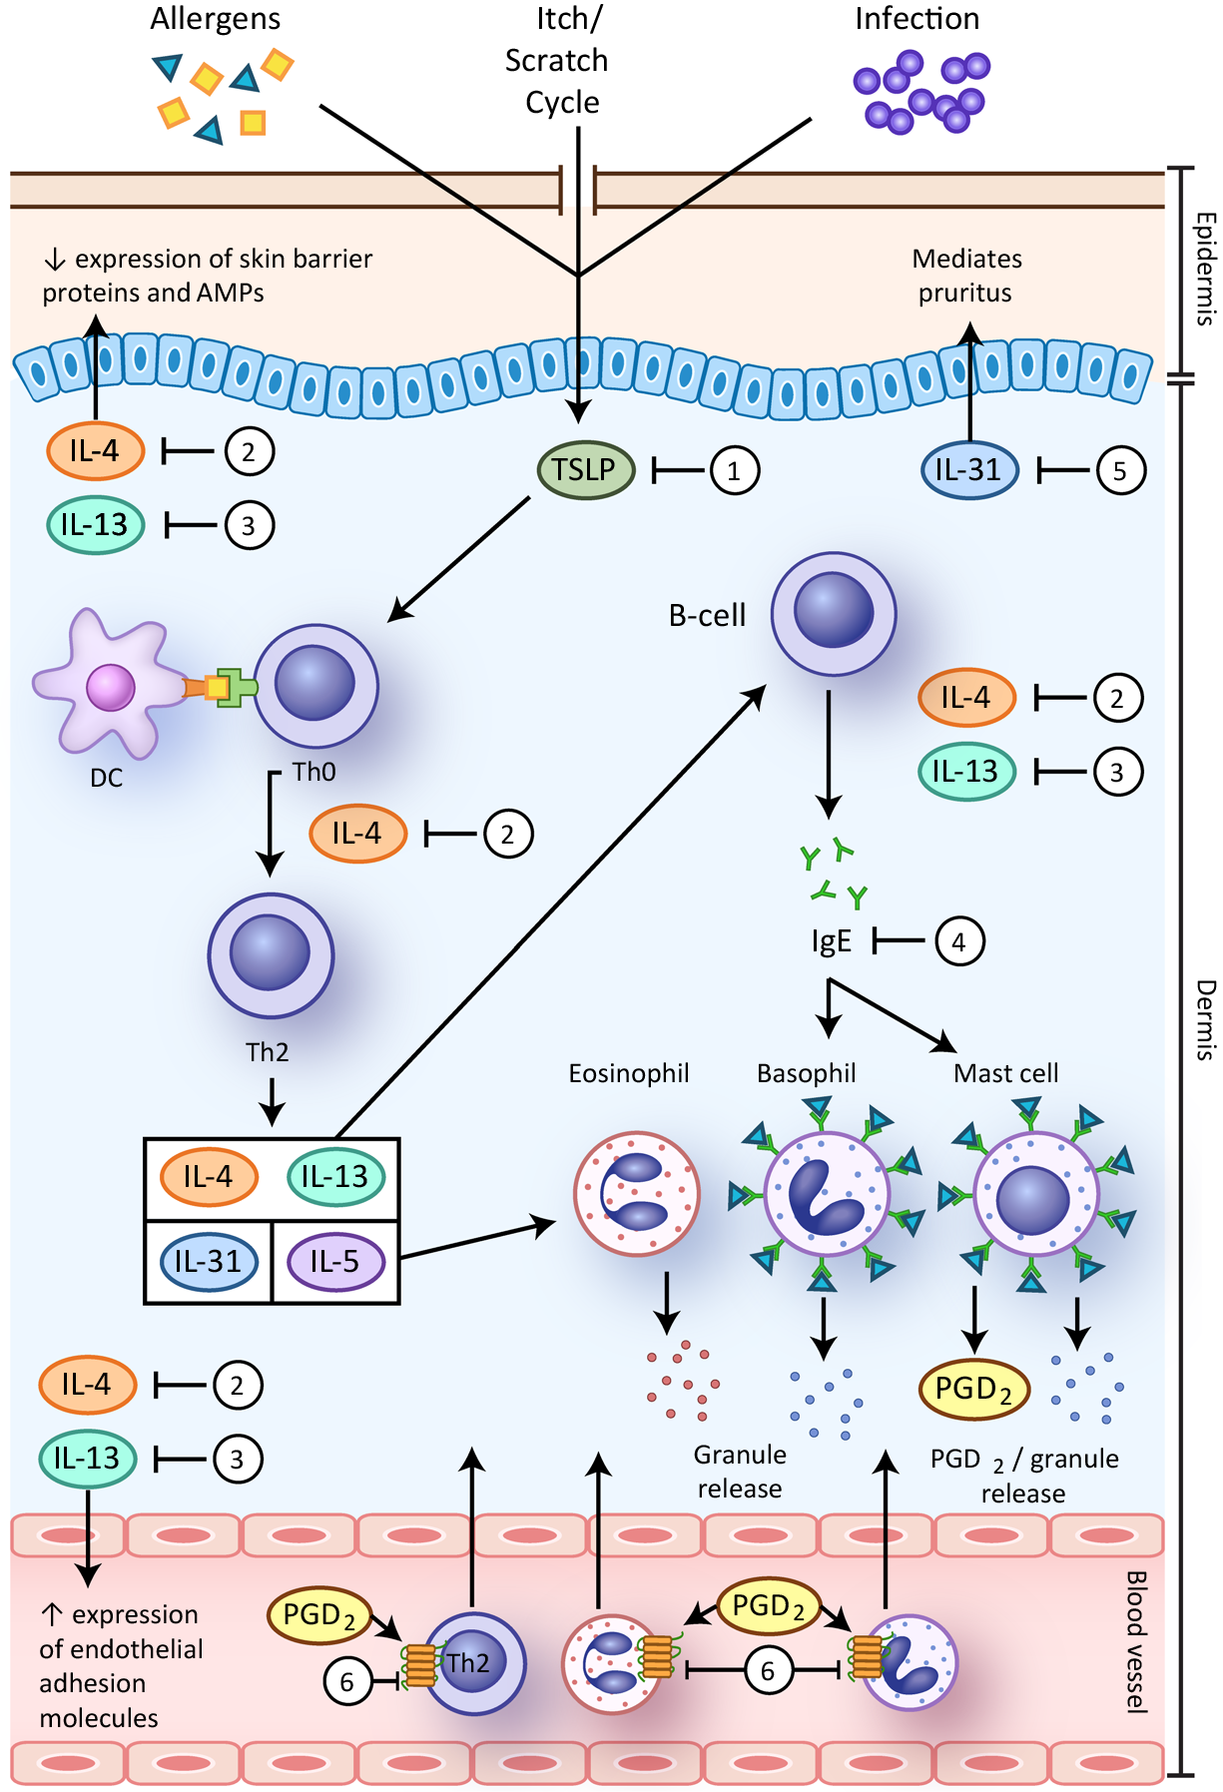
Pathophysiology: Acute Atopic Dermatitis
Wang D, et al. Am J Clin Dermatol. 2016;17:425-443.
Notes:
As we begin to talk about the pathophysiology of acute atopic dermatitis, this figure will illustrate the complexity of the pathophysiology of this disease. There is debate as to whether the inciting initial event in atopic dermatitis comes from external allergens, also known as the outside-in hypothesis, or from initial primary immune dysregulation, also known as the inside-out hypothesis.

Slide 5
Pathophysiology: Barrier Dysfunction
Wang D, et al. Am J Clin Dermatol. 2016;17:425-443.
Notes:
Normal skin has an intact lipophilic stratum corneum containing a mixture of dead keratinocytes, lipid molecules, and proteins. These function to provide a sound barrier between the epidermis and the outside world. In atopic dermatitis skin, this barrier becomes damaged or dysfunctional, which allows external molecules to come in contact with the epidermis.

Slide 6
Pathophysiology: Inflammatory Cells
Wang D, et al. Am J Clin Dermatol. 2016;17:425-443.
AMP, antimicrobial peptides.
Notes:
External allergens, irritants and bacteria activate what is known as thymic stromal lymphoprotein, a type of cytokine, upon entrance into the epidermis. This is also called TSLP. TSLP stimulates dendritic cells to bind to naive Th0 cells and mature them into Th2 cells. These mature and activated Th2 cells release a variety of pro-inflammatory cytokines, including interleukin-4, -13, -31, and -5.

Slide 7
Pathophysiology: Inflammatory Cells (continued)
Wang D, et al. Am J Clin Dermatol. 2016;17:425-443.
AMP, antimicrobial peptides.
Notes:
Production and release of IL-4, IL-13, IL-31, and IL-5 results in further immune activation. IL-5 directly activates eosinophils, causing degranulation and release of eosinophilic granules. IL-4 and IL-13 activate B cells to produce IgE immunoglobulin. This IgE binds to receptors located on the surface of basophils and mast cells. IL-4 and IL-13 also travel to the cutaneous blood vessels and increase endothelial adhesion molecule activity, allowing for more immune cells to hone to the active atopic dermatitis skin. IL-4 also provides a positive feedback loop to naive Th0 cells causing more Th0 cells to differentiate into Th2 cells. IL-31 is thought to mediate pruritus in the epidermis.

Slide 8
Pathophysiology: Acute Atopic Dermatitis
Wang D, et al. Am J Clin Dermatol. 2016;17:425-443.
Notes:
Cytokines released by Th2 cells, including IL-4 and IL-13 further perpetuate the skin barrier dysfunction by directly decreasing expression of skin barrier proteins and antimicrobial peptides. This helps to perpetuate this inflammatory cycle by allowing greater penetration of cutaneous allergens and bacteria to enter the epidermis.

Slide 9
Module Overview
In this module, we discuss the basic epidemiology of atopic dermatitis, noting its close association with other atopic diseases. We focus on the impact of atopic dermatitis on patients and caregivers, and hear from a patient about their experience.

Slide 10
Atopic Dermatitis: Epidemiology
Symptoms in children¹
Percentage of persons with severe AD increases with age¹
Later onset of disease → worse severity²
1. Chernyshov PV, et al. Clin Cosmet Investig Dermatol. 2016;9:159-166.
2. Kim JP, et al. J Am Acad Dermatol. 2016;75(4):681-687.
Notes:
As a component of epidemiology are the symptom severity. The majority—over 65%—have mild disease, but a quarter have moderate severity disease, and severe is approximately 10%. The percentage of patients with severe disease increases with age, and it's also interesting that later onset of disease tends to predict worse severity . So, if you have it early on in childhood, there's a greater likelihood of it disappearing.

Slide 11
Atopic Dermatitis: Epidemiology (continued)
AD in infancy often leads to asthma, allergic rhinitis/conjunctivitis (atopic march)¹
Infants with recent onset AD (≤3 mos) often develop an allergic condition over 3 years²
Asthma (11%)
Allergic rhinitis (22%)
Food allergy (16%)
Allergic conjunctivitis (14%)
≥1 atopic comorbidity (37%)
1. Eichenfield LF, et al. J Am Acad Dermatol. 2014;70(2):338-351.
2. Schneider L, et al. Pediatr Dermatol. 2016;33(4):388-398.
Notes:
Atopic dermatitis in infancy often leads to asthma, allergic rhinitis, conjunctivitis. This is called the atopic march. Infants with recent onset atopic dermatitis often develop an allergic condition over the next 3 years, up to 11% develop asthma, 22% allergic rhinitis, 16% food allergies, and we get allergic conjunctivitis. And not infrequently, more than one atopic comorbidity such as asthma and allergic rhinitis.

Slide 12
Impact of Atopic Dermatitis
Diminished¹⁻⁴
Quality of life
Social activities⁵
Psychological distress (anxiety, depression)⁷
Sleep duration, quality (also family)⁵
Productivity^{5,6}
Absenteeism^{5,6}
1. Whiteley J, et al. Curr Med Res Opin. 2016;32(10):1645-1651. 2. Drucker AM, et al. JAMA Dermatol. 2016;152(8):873-887. 3. Simpson EL, et al. J Am Acad Dermatol. 2016;74(3):491-498. 4. Bridgman AC, et al. J Cutan Med Surg. 2018;22(4):443-444. 5. Simpson E, et al. JAMA Dermatol. 2018;154(8):903-912. 6. Eckert L, et al. J Am Acad Dermatol. 2018;78(1):54-61. 7. Patel KR, et al. J Am Acad Dermatol. 2019;80(2):402-410.
Notes:
When we think about the impact of atopic dermatitis in a patient's life, there are many aspects of their life that can be negatively impacted by this disease. This can include their overall quality of life, their participation in social activities, the quality of their sleep, their productivity, how often they are absent from work or school, as well as the psychologic impact on their mental health.

Slide 13
Impact of AD Varies By Age
0-2 years
Parental exhaustion, emotional distress → impaired maternal-child attachment
3-10 years
Teasing, bullying, peer avoidance
Low self-esteem
10 years to adulthood
Chernyshov PV, et al. Clin Cosmet Investig Dermatol. 2016;9:159-166.
Vivar KL, et al. Int J Womens Dermatol. 2017;4(1):27-31.
Notes:
The impact of atopic dermatitis can vary depending on the age of the patient. In very young patients, oftentimes their caregivers are experiencing severe distress, parental exhaustion, emotional distress, and it can negatively affect the relationship between the child and their caregivers. As children get older and enter school, it can negatively impact their social relationships with their peers. They may be subject to teasing or bullying based on the appearance of their skin. As children age into teenage years and adulthood, they oftentimes can be impacted by chronic low self-esteem. And this may further negatively impact their social relationships.

Slide 14
Risk Factors for AD
Strong Association
Genetics- family history of atopy
If both parents are atopic → 3- to 5-fold higher risk
Impaired skin barrier function- loss of function mutations in FLG gene (≤10%)
Earlier onset; more severe, persistent disease; eczema herpeticum
Moderate Association
African American and Asian Pacific races
Higher parental education
Unclear Association
Pet exposure ● Pollution/Tobacco smoke
Urban living ● Postnatal antibiotic exposure
Daycare
Eichenfield LF, et al. J Am Acad Dermatol. 2014;70:338-351. Kelleher et al. J Allergy Clin Immunol. 2015;135:930-935. Janumpally SR, et al. Arch Dermatol. 2002;138:634-637.
Notes:
There are a series of risk factors for atopic dermatitis. There's a strong association with genetics, that is, a family history of any of the atopic diseases. If both parents are atopic, there's a 3- to 5-fold higher risk of children being affected with one or more atopic diseases. As well, impaired skin barrier function, including the loss of functional mutations in filaggrin, can play a role, although, interestingly, this is found only in about 10% of people in the United States. If, however, they do have filaggrin mutation it predicts earlier onset of disease, more severe and persistent disease, as well as a higher risk of complications. There is a weaker but still present association with race. African-Americans and Asian-Pacific Islanders have a bit higher risk of presenting with atopic dermatitis than white Americans or those of European ancestry. Higher parental education is risk factor in and of itself. There's a bit of an unclear or uncertain association with things like pet exposure, urban living, day care, air pollution, tobacco smoke, and postnatal antibiotic exposure .

Slide 15
Module Overview
In this module, we discuss atopic dermatitis as a clinical diagnosis and review diagnostic guidelines developed by the American Academy of Dermatology. We review the 4 major morphologic features of atopic dermatitis as we consider several other skin diseases included in the differential diagnosis. As we learned in an earlier module, understanding the disease burden is critical; therefore, we highlight several strategies for assessing disease severity. Finally, we include discussion of common comorbidities.

Slide 16
AAD Diagnostic Guidelines
Features
Required
Important
Associated
· Pruritus, eczema
· Typical morphology and age-specific patterns
· Chronic or relapsing history
· Early age of onset
· Atopy (personal or family history)
· IgE reactivity
· Xerosis
· Atypical vascular responses
· Keratosis pilaris/pityriasis alba/hyperlinear palms/ichthyosis ocular/periorbital changes
· Regional findings: perioral changes/periauricular lesions
· Perifollicular accentuation/lichenification/prurigo lesions
Eichenfield LF, et al. J Allergy Clin Immunol. 2017;139:S49-S57.
Notes:
There are required, important, and associated features in the required elements. These include pruritus, eczema. In addition, typical morphology and age-specific patterns which we will discuss later, a chronic or relapsing history is important. Then, we go down to important features which include early age of onset. Atopy and that includes personal or family history. It's very important to ask about this. IgE reactivity and xerosis. Next, associated features can help since its sometimes quite difficult to make a diagnosis. As a result, looking for atypical vascular responses, looking for keratosis pilaris, pityriasis alba, hyperlinear palms, ichthyosis, as well as ocular or periorbital changes. There can be changes as well in other parts of the body including follicular accentuation, lichenification, and prurigo lesions with chronic scratching behavior .

Slide 17
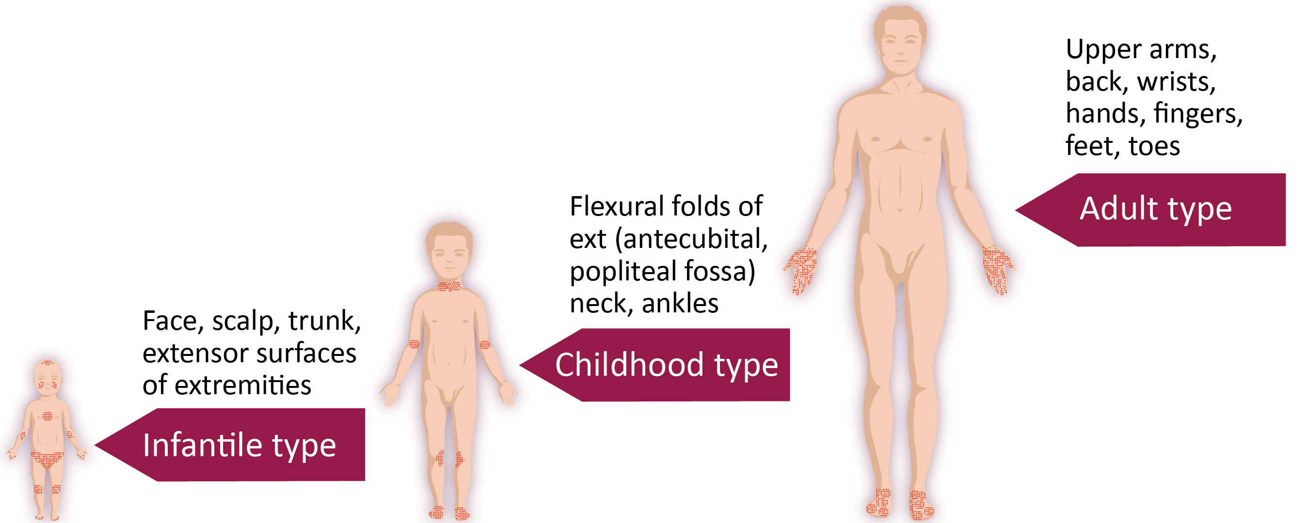
AD Distribution by Age
Weston WL, Lane AT, Morelli JG. Color Textbook of Pediatric Dermatology. 4th ed. Saint Louis: Mosby Elsevier Health Sciences; 2007.
Notes:
The distribution of lesions in atopic dermatitis can change based on the patient's age. In infants, we typically see disease activity located on the face, scalp, trunk and extensor surfaces of the extremities. As children get older, the disease tends to manifest in the flexural folds, including the antecubital and popliteal fossae, as well as around the neck and ankles. In adults, we tend to see atopic dermatitis on the arms, the back, wrists, hands, fingers, feet and toes.

Slide 18
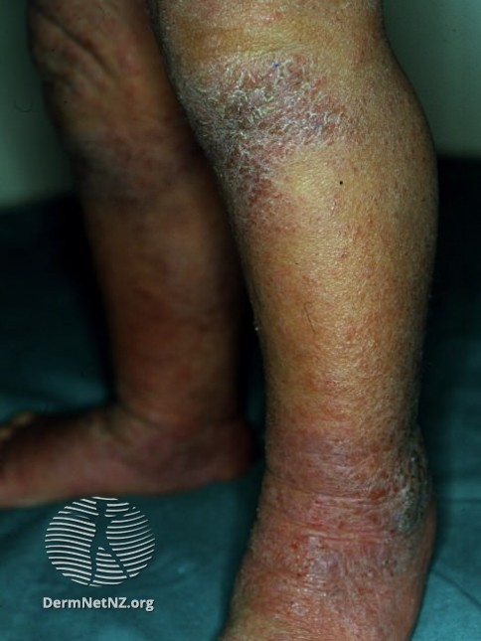
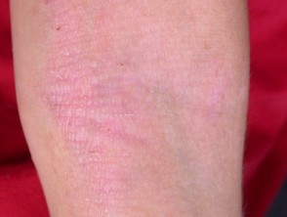
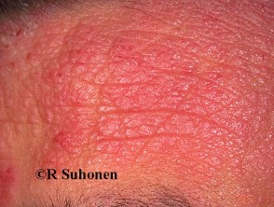
Common Features
© Dr. Amy Stanway. Used from DermNet New Zealand with permission under the Creative Commons Attribution-NonCommercial-NoDerivs 3.0 (http://creativecommons.org/licenses/by-nc-nd/3.0/nz/) with no changes.
© Professor Raimo Suhonen. Used from DermNet New Zealand with permission under the Creative Commons Attribution-NonCommercial-NoDerivs 3.0 (http://creativecommons.org/licenses/by-nc-nd/3.0/nz/) with no changes.
Notes:
It's important to understand how atopic dermatitis can appear based on a person's underlying skin type. You can see here the picture on the left shows a patient with Fitzpatrick 1 or 2 skin type. Here you can see a pale pink lichenified plaque on the antecubital fossae. The picture in the middle shows a lichenified lesion of atopic dermatitis in a patient with a darker skin type. And finally, the picture on the right shows a more severe lesion of atopic dermatitis with the deeper erythema that we discussed earlier, as well as accentuated skin markings.

Slide 19
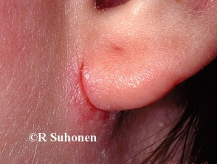
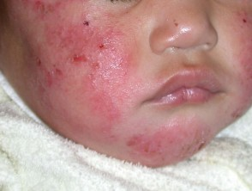
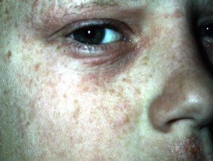
Facial Involvement
Classic findings of facial skin involvement
Perioral skin
Periorbital skin
Periauricular skin
© Dr. Amy Stanway. Used from DermNet New Zealand with permission under the Creative Commons Attribution-NonCommercial-NoDerivs 3.0 (http://creativecommons.org/licenses/by-nc-nd/3.0/nz/) with no changes.
© Professor Raimo Suhonen. Used from DermNet New Zealand with permission under the Creative Commons Attribution-NonCommercial-NoDerivs 3.0 (http://creativecommons.org/licenses/by-nc-nd/3.0/nz/) with no changes.
Notes:
The classic findings of facial skin involvement include perioral skin involvement, periorbital skin, and periauricular skin. Oftentimes, patients with atopic dermatitis that have involvement around the ears may get a fissure which is shown here in the upper picture on the right.

Slide 20
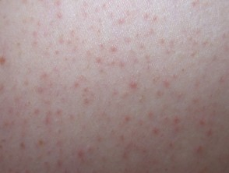
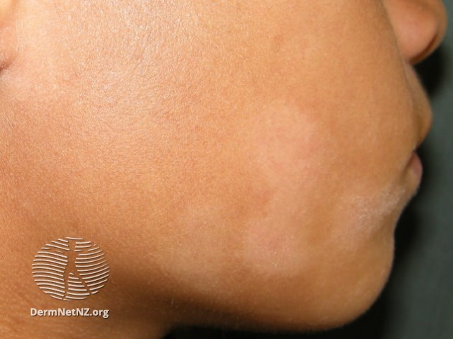
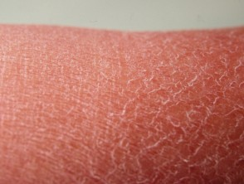
Don’t forget to look for other findings in patients with suspected AD
Keratosis pilaris¹
Pityriasis alba²
Ichthyosis vulgaris³
1. Used from DermNet New Zealand with permission under the Creative Commons Attribution-NonCommercial-NoDerivs 3.0 (http://creativecommons.org/licenses/by-nc-nd/3.0/nz/) with no changes. 2. Used from DermNet New Zealand with permission under the Creative Commons Attribution-NonCommercial-NoDerivs 3.0 (http://creativecommons.org/licenses/by-nc-nd/3.0/nz/) with no changes. 3. ©Waikato District Health Board 2018. Used from DermNet New Zealand with permission under the Creative Commons Attribution-NonCommercial-NoDerivs 3.0 (http://creativecommons.org/licenses/by-nc-nd/3.0/nz/) with no changes.
Notes:
Don't forget to look for other findings to patients that you suspect could have atopic dermatitis, such as keratosis pilaris, often found on the arms and legs, particularly the lateral aspects. Pityriasis alba, the slightly white, slightly scaly eruption that often occurs in association with atopic dermatitis, and ichthyosis vulgaris that lizard skin-like look of excessive scaling that you often find on the legs and, to a lesser extent, arms.

Slide 21
Assessing Severity of AD
Essential to understand the patient’s perspective → prioritize treatment
Multiple tools are available but not used in clinical practice
Eczema Area and Severity Index (EASI)
Scoring Atopic Dermatitis (SCORAD)
Dermatology Life and Quality Index (DLQI)
Numeric rating scale and smiley face scales also used
Notes:
There are a variety of tools for assessing the severity of atopic dermatitis and it's essential to understand [from] the patient's perspective, how to prioritize treatment. There are many assessment tools that are available used in clinical trials, but not necessarily in clinical practice. For instance, we have the Eczema Area and Severity Index, or EASI score. This is a score that encapsulates in 1 score the severity of atopic dermatitis. There's the SCORAD or Scoring Atopic Dermatitis scale and this includes not only a severity score, but as well, an assessment of the itching and sleep interruption. There's the Dermatology Life Quality Index and the DLQI is used to assess the impact of the disease on the patient's whole life. In reality, very few of us use these in clinical practice. Rather, at best, we might use a global assessment such as clear, almost clear, mild, moderate, and severe. Also, just assessing the body surface area can give us a good idea of how severe the disease is . Some people ask about the itch severity in terms of a numeric ratings scale, such as 0 is no itch and 10 is itch as bad as you can imagine. A 0-10 scale can help [us] understand, at a later point, where patients started.

Slide 22
Assessing Severity of AD: A Simple Approach
American Academy of Dermatology practice guidelines suggest asking about:
Itch intensity
Sleep disturbance
Impact on activities of daily living (ADLs)
Eichenfield LF, et al. J Am Acad Dermatol. 2014;70(2):338-351.
Notes:
The AAD practice guidelines suggest asking about the itch intensity and sleep disturbance. Both itch intensity and sleep disturbance are included in the SCORAD, as well as the impact on activities of daily living.

Slide 23
Diseases Associated with AD
Similar to other proinflammatory skin diseases, AD can be associated with additional comorbid diseases
Some of these comorbid diseases share a similar IgE- and Th2-mediated pathogenesis:
Asthma
Allergic rhinitis
Hay fever
Allergic conjunctivitis
Food allergies
Other comorbidities may be a result of the impact of AD on overall health¹⁻⁵
Depression
Anxiety
1. Whiteley J, et al. Curr Med Res Opin. 2016;32(10):1645-1651. 2. Hurwitz EL, et al. Am J Epidemiol. 1999;150:1107-1116. 3. Sanna L, et al. J Affect Disord. 2014;155:261-265. 4. Klokk M, et al. BMC Dermatol. 2010;10:3. 5. Dalgard FJ et al. J Invest Dermatol. 2015;135:984-991.
Notes:
There are other diseases that can be associated with atopic dermatitis. Some of these other diseases share a similar IgE- and Th2-mediated pathogenesis including asthma, allergic rhinitis, hay fever, allergic conjunctivitis, and food allergies. It's important to ask your patients specifically about the presence or absence of these other diseases. Additionally, other comorbidities may be a result of the impact of atopic dermatitis on a patient's overall health, including depression and anxiety.

Slide 24
Module Overview
Keeping in mind the goals of therapy, this module provides an overview of basic management for all patients with atopic dermatitis, particularly general skin care that includes liberal use of moisturizers. We discuss the challenges of poor treatment adherence and the importance of and key steps in shared decision-making. Finally, we provide suggestions for patient education.

Slide 25
Shared Decision-Making
Essential to identify and develop a treatment plan that includes addressing the patient’s concerns
The SHARE Approach
Step 1: Seek your patient’s participation
Step 2: Help your patient explore and compare treatment options
Step 3: Assess your patent’s values and preferences
Step 4: Reach a decision with your patient
Step 5: Evaluate your patient’s decision
Agency for Healthcare Research and Quality. https://www.ahrq.gov/sites/default/files/wysiwyg/professionals/education/curriculum-tools/shareddecisionmaking/tools/tool-2/share-tool2.pdf. Accessed April 25, 2019.
Notes:
It is imperative to utilize shared decision-making with your patient in order to develop a treatment plan that will address the patient's concerns and also optimize their treatment adherence. You should ask for your patient's participation in the development of this treatment plan and help your patient explore and compare different treatment options to find the right one for them. Take the time to assess your patient's values and preferences for treatment, and come together to mutually reach a decision with your patient. Evaluate your patient's decision and give them feedback on their choices.

Slide 26
Overview of Treatment
Education
Skin care and moisturizers
Trigger avoidance
Psychosocial support
TCS
TCI
PDE-4I
Wet wrap therapy
Others
Systemic immunosuppressants
Systemic corticosteroids
Dupilumab
Phototherapy
Others
Basic Management
Topical Therapy
Systemic Therapy
PDE-4I, phosphodiesterase-4 inhibitor; TCS, topical corticosteroid; TCI, topical calcineurin inhibitor.
Kapur S, et al. Allergy Asthma Clin Immunol. 2018;14(Suppl 2):52. Eichenfield LF, et al. Pediatrics. 2015;136(3):554-565.
Notes:
There are 3 main pillars of treatment. This includes basic management, topical therapy, and systemic therapy.

Slide 27
Patient and Family Education
Educate about chronic nature of disease, exacerbating factors, efficacy and safety of treatments
Demonstrate skin care techniques
Provide written treatment plan
Refer to other health care providers as needed
Advise of patient support organizations
Notes:
How can we help our patients do better with their medication? Part of it is increasing their education about the nature of the disease, things that can lead to flares or exacerbations of their atopic dermatitis, as well as the efficacy and safety of the treatments that you're prescribing. We should demonstrate skincare techniques to our patients and provide them with written information that they can take home and refer back to. We should refer to other health care providers as needed and advise patients about the presence of patient support organizations.

Slide 28
Module Overview
Topical medications remain a cornerstone of therapy for atopic dermatitis, yet as we hear from one patient, there are factors to consider in their use. In this module, we highlight topical medications that are supported with good evidence for their use, that is, corticosteroids, calcineurin inhibitors, and crisaborole. We review the efficacy and safety of these medications, and, in the case of crisaborole, we discuss its mechanism of action.

Slide 29
Topical Corticosteroids
Strong evidence supporting effectiveness treating both inflammation and pruritus
‘A’ evidence†
Potency: very high (class I) to low (class VII)
Best approach in AD unclear
High-potency for short periods during flare vs low-potency as maintenance to prevent flare
†Eichenfield L, et al. J Am Acad Dermatol. 2014;71:116-132.
Notes:
Without a doubt, topical corticosteroids are the cornerstone of management of many patients with atopic dermatitis. There's strong evidence supporting the effectiveness of treating both the inflammation and the pruritus of atopic dermatitis with these topical corticosteroids. As you may know, the potency of corticosteroids is from very high class 1, to very low class 7, and every class in between. The best approach in atopic dermatitis is a bit unclear. Some physicians prefer to recommend high-potency drugs for short periods of time during flares vs lower potency drugs as a maintenance therapy to prevent flares.

Slide 30
Topical Corticosteroids (continued)
Potency
Lower for sensitive skin areas, eg, face, intertriginous skin
Mid for trunk and extremities
High for severely lichenified skin or acral skin
Frequency
No consensus
Once-daily vs twice-daily
Green C, et al. https://www.nice.org.uk/guidance/ta81/documents/ta81-atopic-dermatitis-eczema-topical-steroids-assessment-report-4. Accessed March 27, 2019.
Notes:
The potency for sensitive skin areas such as the face and intertriginous areas, lower potency corticosteroids are likely far safer. For the trunk and extremities, you may need mid-potency topical corticosteroids, and for very lichenified skin, that exceptionally thick skin that you see with chronic lichenification, short-term, high-potency corticosteroids can really be advantageous. The frequency as to the treatment is a bit unclear, there's no evidence that twice-daily treatment is more effective than once-daily treatment.

Slide 31
Topical Corticosteroids (continued)
Greater likelihood of multiple AEs with long-term use
Striae and skin atrophy
Telangiectasias
Acne
Skin fragility/bruising
Modulation of collagen synthesis
Children- may be at greater risk for hypothalamic-pituitary-adrenal (HPA) axis suppression
Important to counsel regarding appropriate use, dosing, and to limit duration
Nuutinen P, et al. Br J Dermatol. 2003;148(1):39-45.
Notes:
As for side effects, there's a greater likelihood of multiple adverse events or side effects occurring with longer term use. Striae and skin thinning is a huge issue with corticosteroids, as well as telangiectasias, acne, increased bruising and skin fragility. These drugs decrease collagen synthesis. In a nice study of 3 weeks’ utilization of just hydrocortisone, our weakest drug, 80%-90% reductions in collagen synthesis is seen. Children may be at much greater risk of hypothalamic-pituitary axis suppression, and that's because they have a greater surface-to-volume ratio. It's important to counsel patients regarding the appropriate use of dosing and to limit the duration. I like to encourage patients to use a large amount of treatment for a short time, not keep using their topical corticosteroids indefinitely.

Slide 32
Topical Calcineurin Inhibitors
Tacrolimus²
Pimecrolimus¹
Moderate-severe AD
0.1% for adults
0.03% for age ≥2 y
0.1% more effective than T 0.03%
Mild-moderate AD
1% for age ≥2 y
1. Pimecrolimus [prescribing information]. North Wales, PA: Teva Pharmaceuticals USA, Inc.; May 2018.
2. Tacrolimus [prescribing information]. Melville, NY: E. Fougera & Co; December 2018.
Notes:
We have 2 different topical calcineurin inhibitors. These include pimecrolimus, which is indicated for mild-to-moderate atopic dermatitis patients in those 2 years, and older and tacrolimus, which is used for moderate-to-severe atopic dermatitis, and it is available in 2 concentrations. The 0.1% concentration in adults and the 0.03% concentration in those greater than 2 years of age. There's no question, however, that tacrolimus 0.1% is more effective than the 0.03% concentration.

Slide 33
Topical Calcineurin Inhibitors (continued)
No risk of cutaneous atrophy or acne
Most common AE: transient application site burning and stinging
Black box warning for risk of malignancy
Siegfried EC, et al. Am J Clin Dermatol. 2013;14(3):163-178. Sigurgeirsson B, et al. Pediatrics. 2015;135(4):597-606. Siegfried EC, et al. BMC Pediatr. 2016;16;75. Margolis DJ. JAMA Dermatol. 2015;151(6):594-599. Castellsague J, et al. Clin Epidemiol. 2018;10:299-210.
Notes:
It's worth noting for topical calcineurin inhibitors that there is no risk of cutaneous atrophy occurring even as these are used over the long term. However, they do have some irritating properties in as much as they can cause transient burning of the skin where applied, stinging, and they can even cause transient itching. This is most likely due to a direct neuronal effect of the drug on the skin. There's also a black box warning for the risk of malignancy in as much as some cancers have been seen in the millions of people who have used these drugs.

Slide 34
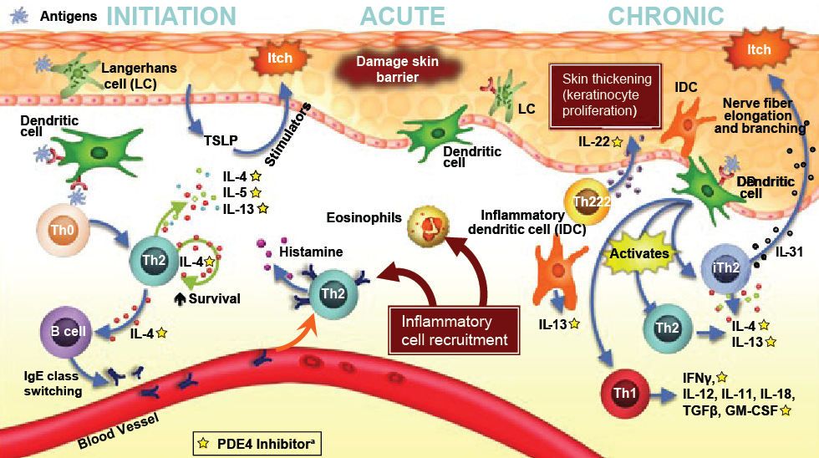
Phosphodiesterase-4 Inhibitor (Crisaborole)
Guttman-Yassky E, et al. Exp Dermatol. 2019;28:3-10. Used with permission from John Wiley & Sons, Inc.
Notes:
Crisaborole is a boron molecule that binds to the bi-metal center of a phosphodiesterase-4 enzyme. As you can see in this figure here, phosphodiesterase-4 is a molecule that is critical to the pathophysiology of atopic dermatitis, both in the acute phase, as well as in the chronic phase. Blockage or inhibition of phosphodiesterase-4 can decrease many pro-inflammatory cytokines involved in atopic dermatitis. Cytokines that are affected by phosphodiesterase-4 inhibition have been outlined in a red box on this diagram. They include cytokines such as IL-4, IL-5, IL-13, IL-22, and interferon-gamma, amongst others.

Slide 35
Crisaborole
Approved for mild-moderate AD in ages ≥2 y
% Experiencing clear/almost clear skin at day 29
(Crisaborole vs vehicle)
AD-301: 51.7% vs 40.6%
AD-302: 48.5% vs 29.7%
Paller AS, et al. J Am Acad Dermatol. 2016;75(3):494-503.
Notes:
Crisaborole is a topical boron molecule that binds to bi-metal center of the phosphodiesterase enzyme and results in a blockage of inflammation. This is currently FDA- approved for mild-to-moderate atopic dermatitis in patients ages 2 years and older. In the studies comparing crisaborole to an emollient vehicle, they found that significantly more patients achieved clear or almost clear skin at day 29 of use with crisaborole.

Slide 36
Module Overview
In this module, we hear of one patient’s experiences with systemic therapies for atopic dermatitis as a prelude to our thoughts on how to individualize systemic therapies. We discuss the efficacy and safety of evidence-based systemic therapies.

Slide 37
Overview of Treatment
Education
Skin care and moisturizers
Trigger avoidance
Psychosocial support
TCS
TCI
PDE-4I
Wet wrap therapy
Others
Systemic immunosuppressants
Systemic corticosteroids
Dupilumab
Phototherapy
Others
Basic Management
Topical Therapy
Systemic Therapy
PDE-4I, phosphodiesterase-4 inhibitor; TCS, topical corticosteroid; TCI, topical calcineurin inhibitor.
Kapur S, et al. Allergy Asthma Clin Immunol. 2018;14(Suppl 2):52. Eichenfield LF, et al. Pediatrics. 2015;136(3):554-565.
Notes:
Systemic therapy, includes systemic immunosuppressants, systemic corticosteroids, dupilumab, phototherapy, and a whole series of other treatments.

Slide 38
Recommendations for Systemic Therapy
Class | Recommendation^{1,2} | Note
Immunosup-pressants | Severe AD refractory to topical therapy and phototherapy | Cyclosporine, azathioprine, MTX before MMF, IFN-γ
Corticosteroids | Generally avoid unless acute exacerbation or as bridge to other systemic therapy | Short course can lead to AD flare after D/C
D/C, discontinuation; IFN-γ, interferon-gamma; MMF, mycophenolate mofetil; MTX, methotrexate.
1. Eichenfield LF, et al. J Allergy Clin Immunol. 2017;139:S49-S57.
2. Sidbury R, et al. J Am Acad Dermatol. 2014;71:327-349.
Notes:
Historically , medications such as cyclosporine, azathioprine, methotrexate, and mycophenolate mofetil have been used for patients with severe atopic dermatitis. Systemic corticosteroids are generally avoided as they can lead to a flare after they are discontinued.

Slide 39
Module Overview
In this module, we discuss the efficacy and safety of evidence-based systemic therapies. Our focus is on dupilumab, the most recent systemic therapy to become available, as we also discuss its mechanism of action.

Slide 40
Dupilumab*: 16-week SOLO 1 and SOLO 2
*Approved dose is an initial dose of 600 mg followed by 300 mg every other week
†Percent achieving Investigator Global Assessment (IGA) score of 0 or 1 and reduction from baseline of ≥2 points on the IGA at week 16.
P<.001 for all comparisons between dupilumab and placebo
Simpson EL, et al. N Engl J Med. 2016;375(24):2335-2348.
Notes:
Here we see the endpoints of the 2 SOLO trials, and I was an investigator in 1 of these trials. These were 16-week studies, randomized controlled trials, which compared placebo injections weekly with either dupilumab 300 mg every other week or dupilumab 300 mg weekly. The primary endpoint was achieving clear or almost clear. And this is a meaningful endpoint for both patients and for physicians, achieving clear or almost clear, we can define as success. You can see both in SOLO 1 and SOLO 2 trials that only 8% or 10% of the placebo patients achieved control that is meaningful, that is clear or almost clear. By contrast, both weekly and every-other-weekly dupilumab in 35% to nearly 40% of patients achieved clear or almost clear, the primary endpoint.

Slide 41
Dupilumab*: 16-week SOLO 1 and SOLO 2 (continued)
*Approved dose is an initial dose of 600 mg followed by 300 mg every other week
§Improvement from baseline of at least 75% on the Eczema Area and Severity Index (EASI) at week 16.
P<.001 for all comparisons between dupilumab and placebo
Simpson EL, et al. N Engl J Med. 2016;375(24):2335-2348.
Notes:
In terms of the secondary endpoint achieving EASI 75, that is a 75% reduction in the Eczema Area Severity Index. In the SOLO 2 on the right, we see a 12% reduction in EASI 75 in placebo, and in the SOLO 1 trial, 15% in placebo and the other, whereas essentially half of all of the participants receiving dupilumab weekly or every other weekly, achieved EASI 75.

Slide 42
Dupilumab*: 52-week LIBERTY AD CHRONOS
*Approved dose is an initial dose of 600 mg followed by 300 mg every other week
Blauvelt A, et al. Lancet. 2017;389:2287-2303.
Notes:
Here we see long-term results from the LIBERTY AD CHRONOS series of studies. These are 52-week results and on the left, we see again the percent achieving clear or almost clear with a greater than 2-point reduction from baseline. In the placebo group, we see only 13% achieve clear or almost clear, whereas 36% to 40% of the patients receiving weekly or every-other-weekly dupilumab, achieved it. he next series of columns are those that achieved EASI 75, 75% reduction in the EASI score, roughly 65% vs 22%. Then on the other outcomes, reduction in body surface area from baseline, roughly 40% in the 2 dupilumab groups vs 20% placebo. And those experiencing, on the far right, a meaningful reduction in itch severity, that is a 4-point improvement on a 0-10 scale. So 39% with the weekly dosing of dupilumab achieved meaningful reduction, 51% achieved it in the every-other-week dupilumab study, whereas only 13% in the placebo group achieved this. Please note that in the United States, the approved dose of dupilumab is initially a loading dose of 600 mg followed by 300 mg every other week.

Slide 43
Dupilumab* Adverse Events: 16-week SOLO 1 and SOLO 2
Adverse Event, % | SOLO 1 |  |  | SOLO 2
 | Placebo (n=222) | Dupilumab QOW (n=229) | Dupilumab QW (n=218) | Placebo (n=234) | Dupilumab QOW (n=236) | Dupilumab QW (n=237)
≥1 Serious AE | 5 | 3 | 1 | 6 | 2 | 3
Injection site reaction | 6 | 8 | 19 | 6 | 14 | 13
Allergic conjunctivitis | 1 | 5 | 3 | 1 | 1 | 1
Conjunctivitis | 1 | 5 | 3 | <1 | 4 | 4
*Approved dose is an initial dose of 600 mg followed by 300 mg every other week
Simpson EL, et al. N Engl J Med. 2016;375(24):2335-2348.
Notes:
When we speak about drugs, it's most important to talk about the adverse event or side effect profile. So these were the side effects that we're seeing most commonly in the 2 pivotal 16-weeks times, the SOLO 1 and SOLO 2. I want to draw your intention to serious adverse events, that first row and roughly the same number of series of events occurred in placebo vs the 2 dupilumab arms ever other week. Injection site reactions are much more common as expected with dupilumab treatment, but still only occur in the minority of people. Both allergic conjunctivitis, as well as conjunctivitis, we're seeing more commonly with dupilumab treatment than placebo.

