Slide 2
Burden of Disease
In this module, we review the definition of idiopathic pulmonary fibrosis (IPF). We discuss its prevalence and how it differentiates from other interstitial lung diseases (ILDs).

Slide 3
Current Definition of IPF
Specific form of chronic, progressive, fibrosing interstitial pneumonia of unknown cause
ATS/ERS/JRS/ALAT 2011 guidelines [updated in 2015]:
“Patients with no identifiable alternative etiology for fibrotic ILD who had usual interstitial pneumonia (UIP) pattern on high-resolution computed tomography (HRCT)”
or
“Had specified combinations of HRCT pattern and surgical lung biopsy pattern were considered to have IPF”
IPF
Differentiation and activation of fibroblasts
→ declining lung function
→ pulmonary failure
→ death
Occurs primarily in older adults
Limited to the lungs
Raghu G, et al. Am J Respir Crit Care Med. 2015;192:e3-e19.
Nathan SD, et al. Chest. 2011;140:221-229.
Notes:
Nathan SD, Shlobin OA, Weir N, et al. Long-term course and prognosis of idiopathic pulmonary fibrosis in the new millennium. Chest. 2011;140:221–229. doi: 10.1378/chest.10-2572.
Raghu G, Rochwerg B, Zhang Y, et al; ATS, ERS, JRS, and ALAT. An official ATS/ERS/JRS/ALAT clinical practice guideline: treatment of idiopathic pulmonary fibrosis. An update of the 2011 clinical practice guideline. Am J Respir Crit Care Med. 2015;192(2):e3-e19. doi: 10.1164/rccm.201506-1063ST.

Slide 4
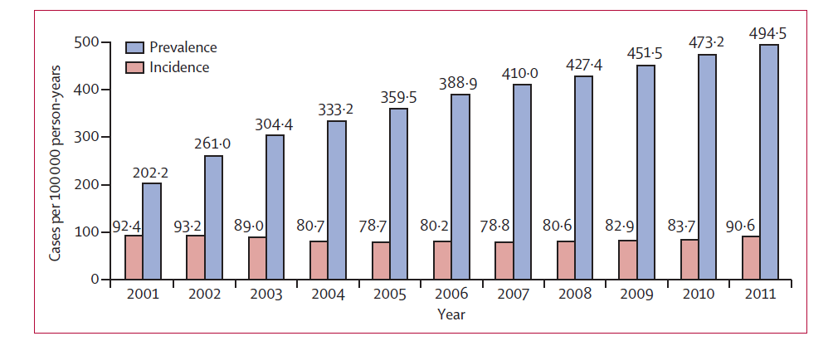
Increasing Prevalence of Idiopathic Pulmonary Fibrosis
Medicare Beneficiaries Age ≥65 y
Factors associated with lower survival: Age, index year, male gender
Median survival = 3.8 y
Raghu G, et al. Lancet Respir Med. 2014;2:566-572.
Notes:
Raghu G, Chen SY, Yeh WS, et al. Idiopathic pulmonary fibrosis in US Medicare beneficiaries aged 65 years and older: incidence, prevalence, and survival, 2001-11. Lancet Respir Med. 2014;2(7):566-72. doi: 10.1016/S2213-2600(14)70101-8.
Incidence of IPF in US Medicare beneficiaries > 65 years remained steady, 93.7 cases per 100,000 per year
Prevalence increased from 202.2 in 2001 to 495.5 in 2011.
Raghu et al suggest this may be due to increased survival time and earlier diagnosis
Annual increase higher in older individuals, males, and Hispanic individuals

Slide 5
Differentiating IPF From Other ILDs…
Category | Diseases | Subcategories/Examples
Idiopathic | Idiopathic Interstitial Pneumonias (IIPs) Sarcoidosis Amyloidosis Lymphangiolyomyomatosis PLCH, Eosinophilic pneumonia Neurofibromatosis, DAH | IPF NSIP Unclassifiable COP RB-ILD DIP AIP LIP PPFE
Immunologic | Connective Tissue Disorders
Inhalation | Inorganic | Asbestosis, Silicosis
 | Organic: Chronic hypersensitivity pneumonitis | Bird fancier’s disease, Farmer’s lung

Slide 6
Differentiating IPF… continued
Category | Diseases | Subcategories/Examples
Iatrogenic | Antiarrhythmics, Antimicrobials, Chemotherapy agents, Biologics, Radiation
Infectious | Viral | CMV, influenza
 | Fungal | Pneumocystis carinii
Neoplastic | Lymphangitic carcinomatosis Bronchoalveolar carcinoma
Chronic CHF
CHF, congestive heart failure; CMV, cytomegalovirus.

Slide 7
Misdiagnosis and Its Consequences
IPF is often misdiagnosed or undiagnosed
Contributing factors
Low awareness
Differential diagnosis
Failure of stepped work-up
Potential impact
Inappropriate treatment
Unchecked disease progression
Lower survival rates
Impaired quality of life
Death
Lee AS, et al. Respir Med. 2014;108:955-967.
Notes:
Lee AS, Mira-Avendano I, Ryu JH, Daniels CE. The burden of idiopathic pulmonary fibrosis: an unmet public health need. Respir Med. 2014;108(7):955-967.

Slide 8
Diagnosing IPF
In this module, we discuss how to diagnose IPF, common symptoms, and the diagnostic tools and criteria used for an accurate diagnosis. In addition, we discuss what to look for in pulmonary function tests and how to measure disease severity.

Slide 9
Improving Early Diagnosis
Awareness of diagnostic criteria
Increased “comfort” with CT diagnosis
Diagnosing IPF without surgical lung biopsy in select cases, when CT shows a probable UIP pattern
Improving pathologic review
Exclusion of alternative diagnosis (eg, autoimmune conditions, chronic hypersensitivity pneumonitis)
CT, computerized tomography.
Lynch DA, et al. Lancet Respir Med. 2018;6:138-153.
Notes:
Lynch DA, Sverzellati N, Travis WD, et al. Diagnostic criteria for idiopathic pulmonary fibrosis: a Fleischner Society White Paper. Lancet Respir Med. 2018;6(2):138-153. doi: 10.1016/S2213-2600(17)30433-2.

Slide 10
Common Symptoms of IPF
Chronic dry cough
Dyspnea
Fatigue
Exercise desaturation
Bibasilar inspiratory crackles
Clubbing on fingers and/or toes (advanced disease)
NIH National Heart, Lung, and Blood Institute. Idiopathic Pulmonary Fibrosis. 2015
Sharif R. Am J Manag Care. 2017;23(11 Suppl):S176-S182.
Notes:
NIH National Heart, Lung, and Blood Institute. Idiopathic Pulmonary Fibrosis. Signs, symptoms, and Complications. May 2015. https://www.nhlbi.nih.gov/health-topics/idiopathic-pulmonary-fibrosis Accessed January 22, 2018.
Sharif R. Overview of idiopathic pulmonary fibrosis (IPF) and evidence-based guidelines. Am J Manag Care. 2017;23(11 Suppl):S176-S182.
How do patients with IPF present?

Slide 11
Improving Diagnostic Tools: Pulmonary Function Tests
Spirometry may help differentiate between cardiac and pulmonary issues
Forced Vital Capacity (FVC )
Forced expired volume in 1 second (FEV1)
Single-breath diffusing capacity for carbon monoxide (DLCO)
Chest X-ray
Echocardiogram
Rule out heart failure, pulmonary hypertension, valvular disease
If uninformative, pursue lung disease route
CHD, coronary heart disease; CV, cardiovascular disease; DLCO, diffusing capacity of the lung for carbon monoxide.
Cosgrove GP, et al. BMC Pulm Med. 2018;18:9.
Notes:
Cosgrove GP, Bianchi P, Danese S, Lederer DJ. Barriers to timely diagnosis of interstitial lung disease in the real world: the INTENSITY survey. BMC Pulm Med. 2018 Jan 17;18(1):9. doi: 10.1186/s12890-017-0560-x.
Forced Vital Capacity (FVC )
Measures how well lungs work based on amount of air exhaled with force after inhaling as deeply as possible
Vital Capacity (VC)
Resembles FVC but expiration in spirometer done slowly

Slide 12
Pulmonary Function Testing
Most patients with IPF exhibit the following:
Decreased FVC (FVC may be normal in early IPF)
Normal-to-increased FEV₁/FVC ratio
Reduced DLCO
Reduction in TLC
Patients with concurrent emphysema may exhibit normal lung volumes and spirometry, but reduced DLCO
Low baseline FVC, decline in FVC, low DLCO, and decline in 6MWT are associated with decreased survival
FVC, forced vital capacity; FEV₁, forced expiratory volume in one second ; DLCO, diffusing capacity of lungs for carbon monoxide; TLC, total lung capacity; 6MWT, six-minute walking test.
Oldham JM, et al. Respir Med. 2014;108:819-829.
Notes:
Oldham JM, Noth I. Idiopathic pulmonary fibrosis: early detection and referral. Respir Med. 2014;108(6):819-29. doi: 10.1016/j.rmed.2014.03.008.

Slide 13
Measuring Disease Severity
FVC
Reductions, even as small as 5%‒10%, over 6 months can indicate an increased risk of mortality
HRCT findings
Most important for diagnosis
May correlate with progression and disease outcomes
FVC, forced vital capacity.
Cosgrove GP, et al. BMC Pulm Med. 2018;18:9.
Notes:
Cosgrove GP, Bianchi P, Danese S, Lederer DJ. Barriers to timely diagnosis of interstitial lung disease in the real world: the INTENSITY survey. BMC Pulm Med. 2018;18(1):9. doi: 10.1186/s12890-017-0560-x.

Slide 14
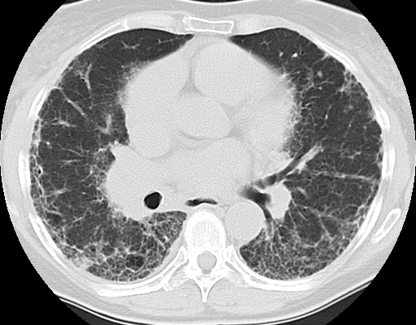
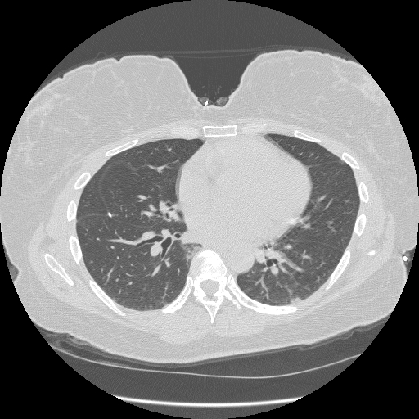
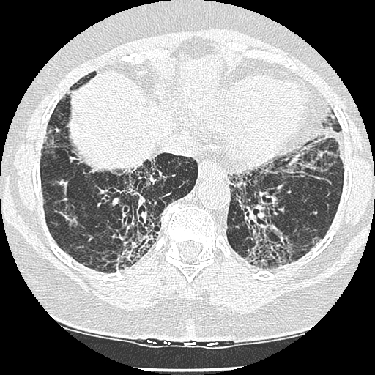
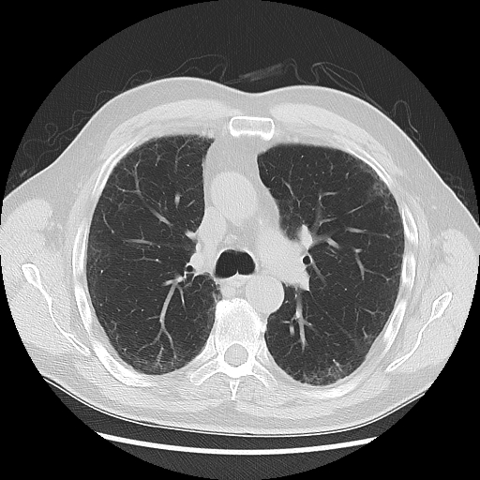
IPF
NSIP
IPF
COP
Notes:
Non-specific interstitial pneumonia (NSIP)-cellular, before and after Rx
COP before and after Rx

Slide 15
Specialist Evaluation
Serology
HRCT imaging
Lung biopsy (select cases)
Management
Pirfenidone
Nintedanib
Lung transplant
Pulmonary rehabilitation
Oxygen therapy
Palliative care
Treat comorbidities
Evaluate for clinical trials
HRCT, high-resolution computed tomography.
King TE Jr, et al. N Engl J Med. 2014;370:2083-2092; Richeldi L, et al. N Engl J Med. 2014;370:2071-2082; Raghu G, et al. Am J Respir Crit Care Med. 2015;192:e3-19.
Notes:
King TE Jr, Bradford WZ, Castro-Bernardini S, et al. A phase 3 trial of pirfenidone in patients with idiopathic pulmonary fibrosis. N Engl J Med. 2014;370(22):2083-2092.
Richeldi L, du Bois RM, Raghu G, et al. Efficacy and safety of nintedanib in idiopathic pulmonary fibrosis. N Engl J Med. 2014;370(22):2071-2082.
Raghu G, Rochwerg B, Zhang Y et al. An Official ATS/ERS/JRS/ALAT Clinical Practice Guideline: Treatment of Idiopathic Pulmonary Fibrosis. An Update of the 2011 Clinical Practice Guideline. Am J Respir Crit Care Med. 2015;192:e3-19.

Slide 16
HRCT Presentation
In this module, we discuss the significance of high-resolution computed tomography (HRCT), how IPF presents, and what IPF looks like on HRCT scans. We also discuss when to consider surgical biopsy and common pathological reviews. And last, we talk about the importance of multidisciplinary collaboration and review common comorbidities.

Slide 17
Radiological Criteria: HRCT
HRCT required for all patients with IPF suspicion
Both inspiratory and expiratory images
May confirm diagnosis with distinct radiographic pattern in the right clinical context
Enables greater detail (≤ 2.5 mm cuts) of lung parenchyma
Usual interstitial pneumonia (UIP)
Basilar predominant subpleural reticulation, honeycombing, +/-traction bronchiectasis, absence of inconsistent features
HRCT, high-resolution computed tomography.

Slide 18
Interpreting HRCT Scans
Presence of Honeycombing
Key characteristic of UIP pattern
Defined as clustered, thick-walled cystic spaces of similar diameters
Typically located in dorsal, basal, and subpleural regions
Sometimes seen only in upper lungs
Honeycombing increases likelihood of UIP pattern
HRCT, high-resolution computed tomography.
Lynch DA, et al. Lancet Respir Med. 2018;6:138-153.
Notes:
Lynch DA, Sverzellati N, Travis WD, et al. Diagnostic criteria for idiopathic pulmonary fibrosis: a Fleischner Society White Paper. Lancet Respir Med. 2018;6(2):138-153. doi: 10.1016/S2213-2600(17)30433-2.
What IPF Looks Like on an HRCT Scan
Fleischner Society checklist for clinical evaluation of patients with suspected UIP

Slide 19
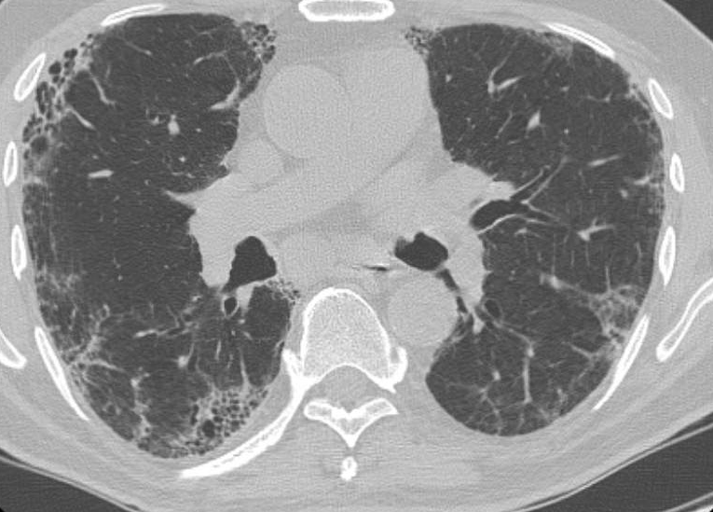
Clinical Presentation
Subpleural reticulation
Honeycombing

Slide 20
What IPF Looks Like on an HRCT Scan
Reticular pattern
Network of fine lines irregularly spaced, with mix of thicker and thinner lines
Traction bronchiectasis
Irregular bronchial and bronchiolar dilatation caused by retractile fibrosis in the surrounding lung parenchyma
Distinguishing honeycombing from traction bronchiectasis can be challenging, but diagnostically important
Honeycombing and traction bronchiectasis often coexist
HRCT, high-resolution computed tomography.
Lynch DA, et al. Lancet Respir Med. 2018;6:138-153.
Notes:
Lynch DA, Sverzellati N, Travis WD, et al. Diagnostic criteria for idiopathic pulmonary fibrosis: a Fleischner Society White Paper. Lancet Respir Med. 2018;6(2):138-153. doi: 10.1016/S2213-2600(17)30433-2.

Slide 21
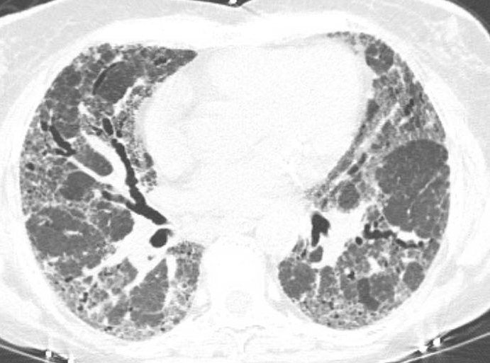
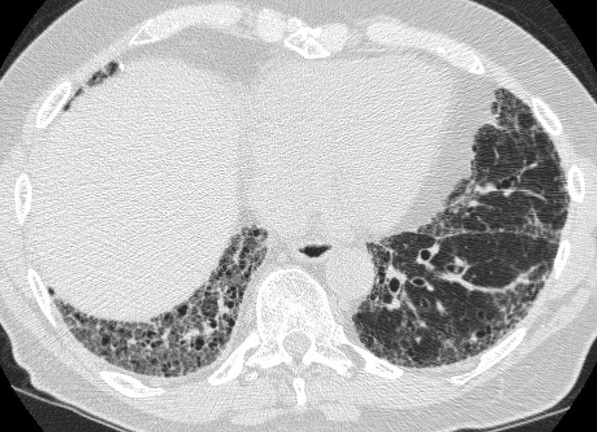
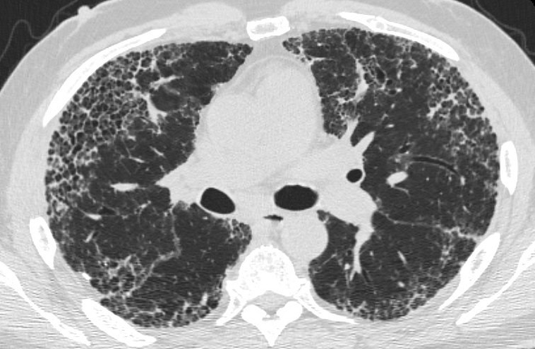
CT Changes With IPF (images)
Traction bronchiectasis
Traction bronchiolectasis
Honeycombing

Slide 22
The Question of a Surgical Biopsy
Surgical lung biopsy should be considered in patients
When clinical or CT findings are indeterminate for IPF
When CT pattern is inconsistent with UIP
When clinical features suggest an alternative diagnosis
Multidisciplinary approach is important when deciding to perform additional diagnostic assessments
Evaluation, care coordination, treatment
Lynch DA, et al. Lancet Respir Med. 2018;6:138-153.
Notes:
Lynch DA, Sverzellati N, Travis WD, et al. Diagnostic criteria for idiopathic pulmonary fibrosis: a Fleischner Society White Paper. Lancet Respir Med. 2018;6(2):138-153. Doi: 10.1016/S2213-2600(17)30433-2.

Slide 23
Surgical Lung Biopsy
Biopsy samples should be taken from multiple lobes
Target areas of diseased but not end-stage lung
Biopsy risk factors for mortality
Increasing age (>65 years)
Comorbidities
Open rather than thoracoscopic surgery
Lung-diffusing capacity <50% predicted
Lynch DA, et al. Lancet Respir Med. 2018;6:138-153.
Notes:
Lynch DA, Sverzellati N, Travis WD, et al. Diagnostic criteria for idiopathic pulmonary fibrosis: a Fleischner Society White Paper. Lancet Respir Med. 2018;6(2):138-153. Doi: 10.1016/S2213-2600(17)30433-2.
- Tissue obtained is usually inadequate for a confident diagnosis of UIP

Slide 24
Transbronchial Cryobiopsy
Alternative to lung biopsy
Cryoprobe cooled to -85° to -95°C is applied to desired tissue
Cryobiopsy samples much smaller than surgical lung biopsy samples
Results in ~80% correct diagnosis
Diagnostic yield and complication rate are variable and depend on operator’s experience
Lynch DA, et al. Lancet Respir Med. 2018;6:138-153.
Notes:
Lynch DA, Sverzellati N, Travis WD, et al. Diagnostic criteria for idiopathic pulmonary fibrosis: a Fleischner Society White Paper. Lancet Respir Med. 2018 Feb;6(2):138-153. doi: 10.1016/S2213-2600(17)30433-2.

Slide 25
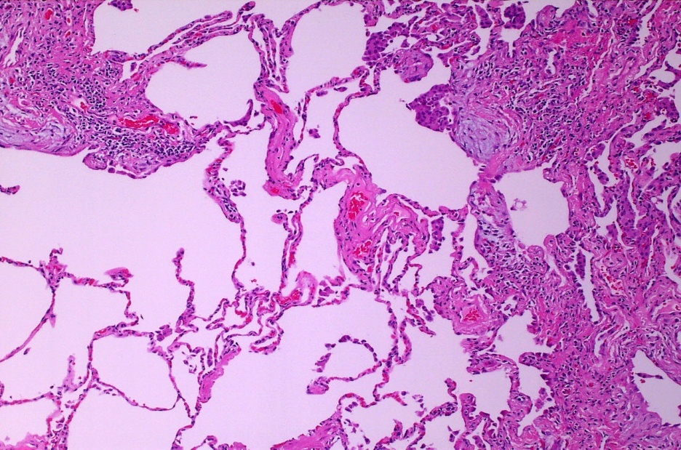
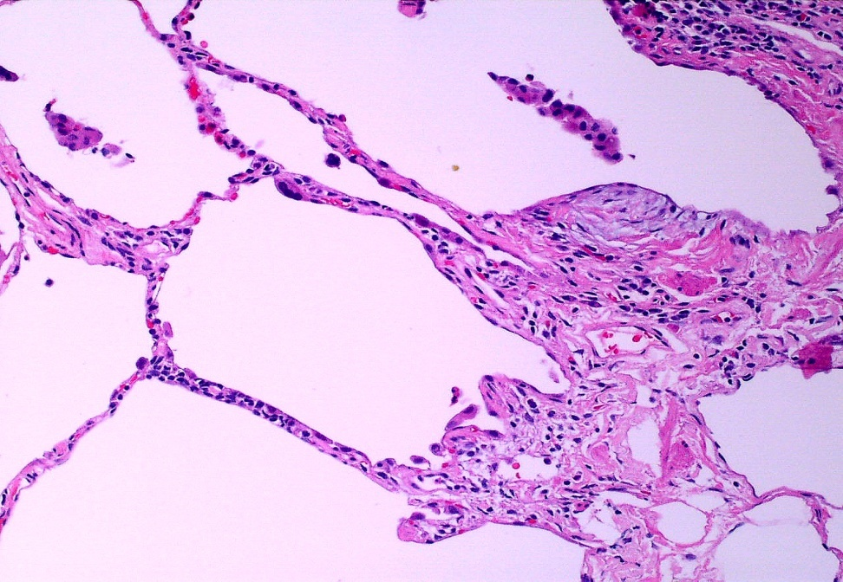
Pathology: UIP Pattern
Notes:
Current Definition of IPF
Consensus statements by the American Thoracic Society and European Respiratory Society (ATS/ERS) define IPF as a distinct type of chronic fibrosing interstitial pneumonia of unknown cause that is limited to the lungs.
There are typical HRCT findings that are often present.
The histopathologic pattern of IPF is usual interstitial pneumonia (UIP), shown in the lower panel.

Slide 26
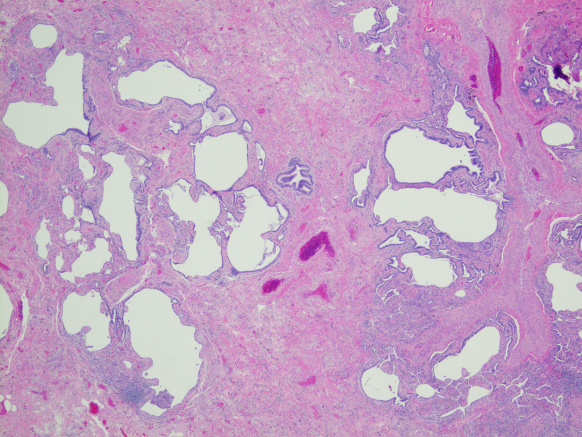
Honeycombing: Pathological Review
Air-filled cystic spaces
Lined by bronchiolar epithelium
Clear, definable walls
1- to 30-mm thick of dense fibrous tissue
Webb WR, Muller NL, Naidich DP. High-Resolution CT of the Lung. 5th ed. Philadelphia: Wolters Kluwer; 2014.
Notes:
Webb WR, Muller NL, Naidich DP. High-Resolution CT of the Lung. 5th ed. Philadelphia: Wolters Kluwer; 2014.

Slide 27
Multidisciplinary Collaboration
Pulmonologist
Thoracic Radiologist
Pathologist
Sharif R. Am J Manag Care. 2017;23(11 Suppl):S176-S182.
Ryerson CJ, et al. Am J Respir Crit Care Med. 2017;196:1249-1254.
Notes:
Sharif R. Am J Manag Care. 2017;23(11 Suppl):S176-S182.
Ryerson CJ, Corte TJ, Lee JS, et al. A Standardized Diagnostic Ontology for Fibrotic Interstitial Lung Disease. An International Working Group Perspective. Am J Respir Crit Care Med. 2017 Nov 15;196(10):1249-1254. doi: 10.1164/rccm.201702-0400PP.

Slide 28
Impact of Multidisciplinary Team Discussion
UK study¹ showed >50% with previous IPF diagnosis inaccurate after multidisciplinary discussion
Australian study² (n=90) multidisciplinary discussion resulted in diagnosis change
10 (37%) of 27 patients referred with a diagnosis of IPF changed to non-IPF diagnosis
7 patients had diagnosis changed to IPF because of discussion
Referral diagnosis
of IPF (n=27)
No changes in
diagnosis of IPF (n=17)
MDM diagnosis of IPF (n=25)
Chaudhuri N, et al. J Clin Med. 2016; 5:66.
Jo HE, et al. Respirology. 2016;21:1438-1444.
Notes:
Chaudhuri N, Spencer L, Greaves M, Bishop P, Chaturvedi A, Leonard C. A review of the multidisciplinary diagnosis of interstitial lung diseases: a retrospective analysis in a single UK specialist centre. J Clin Med. 2016;5(8). pii: E66. doi: 10.3390/jcm5080066.
Jo HE, Glaspole IN, Levin KC, et al. Clinical impact of the interstitial lung disease multidisciplinary service. Respirology. 2016;21(8):1438-1444. doi: 10.1111/resp.12850.

Slide 29
Patient presenting with fibrotic interstitial lung disease
Is there a leading diagnosis that
meets guidelines criteria
or has >90% confidence?
Confident diagnosis
Is there a leading diagnosis that
has >50% confidence?
Provisional diagnosis
High-confidence diagnosis
(70%-89% confidence)
Low-confidence diagnosis
(51%-69% confidence)
Unclassifiable ILD
Document differential
diagnosis
Ryerson CJ, et al. Am J Respir Crit Care Med. 2017;196:1249-1254.
Notes:
Ryerson CJ, Corte TJ, Lee JS, et al. A Standardized Diagnostic Ontology for Fibrotic Interstitial Lung Disease. An International Working Group Perspective. Am J Respir Crit Care Med. 2017;196(10):1249-1254. doi: 10.1164/rccm.201702-0400PP.

Slide 30
IPF Comorbidities
Pulmonary
Extra-Pulmonary
Pulmonary hypertension
Infectious-aspergillomas
Obstructive sleep apnea
Gastroesophageal reflux disease
Coronary artery disease
Heart failure
Thromboembolic disease
Diabetes
Sharif R. Am J Manag Care. 2017;23(11 Suppl):S176-S182.
Notes:
Sharif R. Overview of idiopathic pulmonary fibrosis (IPF) and evidence-based guidelines. Am J Manag Care. 2017;23(11 Suppl):S176-S182.

Slide 31
Therapeutic Strategies
In this module, we discuss current treatment options and therapeutic strategies for IPF, as well as dosing, monitoring, and common side effects from agents used to treat IPF. We also discuss the significance of and data from the Pulmonary Fibrosis Foundation patient registry. We talk about the latest data on emerging therapies and review key takeaways from our presentation.

Slide 32
Current Treatment Options
Medical therapy
FDA-approved therapies only slow progression
Supportive care and nonpharmacologic measures for IPF
Treatment of exacerbations (unproven)
Lung transplant (only in select patients with advanced IPF)

Slide 33
Supportive Care and Other Interventions
Supplemental oxygen therapy may improve QoL
Recommended when patient’s desaturation is < 88% during 6MWT
Nocturnal oxygen with sleep apnea
Pulmonary rehabilitation impacts functional status and QoL
Aerobic conditioning
Strength and flexibility training
Education about condition
Nutritional counseling
Psychosocial support
Mechanical ventilation (only recommended if bridge to transplant)
Palliative care services
QoL, quality of life; 6MWT, 6-minute walk test.
Sharif R. Am J Manag Care. 2017;23(11 Suppl):S176-S182.
Notes:
Sharif R. Overview of idiopathic pulmonary fibrosis (IPF) and evidence-based guidelines. Am J Manag Care. 2017;23(11 Suppl):S176-S182.

Slide 34
Drugs Not To Use for IPF Per ATS/ERS/JRS/ALAT 2011 Guidelines
*Low confidence in effect estimates.
†Moderate confidence in effect estimates.
Raghu G, et al. Am J Respir Crit Care Med. 2015;192:e3-19.
Anticoagulants*
Imatinib†—Studies show no benefit
Selective endothelin receptor antagonist (ambrisentan)*
Combination prednisolone/azathioprine/n-acetylcysteine*
Trials show excess number of deaths
Raghu G, et al. N Engl J Med. 2012;366:1968-77.
ATS, American Thoracic Society; ERS, European Respiratory Society; JRS, Japanese Respiratory Society; ALAT, Latin American Thoracic Association.
Raghu G, et al. N Engl J Med. 2012;366:1968-77.
Raghu G, et al. Am J Respir Crit Care Med. 2015;192:e3-e19.
Trawinska MA, et al. Ther Clin Risk Manag. 2016;12:563–574.
Notes:
Raghu G, Anstrom KJ, King TE Jr, Lasky JA, Martinez FJ. Prednisone, azathioprine, and N-acetylcysteine for pulmonary fibrosis. N Engl J Med. 2012;366(21):1968-77. doi: 10.1056/NEJMoa1113354.
Raghu G, Rochwerg B, Zhang Y, et al. An official ATS/ERS/JRS/ALAT clinical practice guideline: treatment of idiopathic pulmonary fibrosis. An update of the 2011 clinical practice guideline. Am J Respir Crit Care Med. 2015;192(2):e3-e19. doi: 10.1164/rccm.201506-1063ST.
Trawinska MA, Rupesinghe RD, Hart SP. Patient considerations and drug selection in the treatment of idiopathic pulmonary fibrosis. Ther Clin Risk Manag. 2016; 12: 563–574. doi: 10.2147/TCRM.S81144

Slide 35
Differentiating Between Disease-Modifying Agents
Determine therapy based on
Contraindications
Patient choice
Review side-effect profiles with patients
Trawinska MA, et al. Ther Clin Risk Manag. 2016;12:563–574.
Notes:
Trawinska MA, Rupesinghe RD, Hart SP. Patient considerations and drug selection in the treatment of idiopathic pulmonary fibrosis. Ther Clin Risk Manag. 2016;12: 563–574. doi: 10.2147/TCRM.S81144

Slide 36
Current Therapeutic Strategies for IPF
Nintedanib: Tyrosine kinase inhibitor
Reduces fibrogenesis
Prolonged time to acute exacerbation
Reduced rates of FVC decline
Pirfenidone: Distinct antifibrotic properties
Reduced disease progression
Reduced rates of FVC decline
Improved progression-free survival
Check liver function before initiating therapy, also during treatment
FVC, forced vital capacity.
Varone F, et al. Expert Opin Pharmacother. 2018:1-9.
Notes:
Varone F, Sgalla G, Iovene B, Bruni T, Richeldi L. Nintedanib for the treatment of idiopathic pulmonary fibrosis. Expert Opin Pharmacother. 2018:1-9. doi: 10.1080/14656566.2018.1425681.

Slide 37
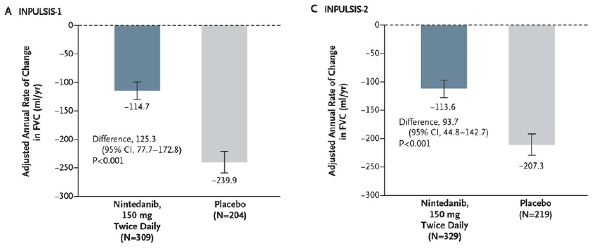
Nintedanib Reduces Loss of FVC
FVC, forced vital capacity.
Richeldi L, et al. N Engl J Med. 2014;370:2071-82.
Notes:
Richeldi L, du Bois RM, Raghu G, et al; INPULSIS Trial Investigators. Efficacy and safety of nintedanib in idiopathic pulmonary fibrosis. N Engl J Med. 2014;370(22):2071-82.

Slide 38
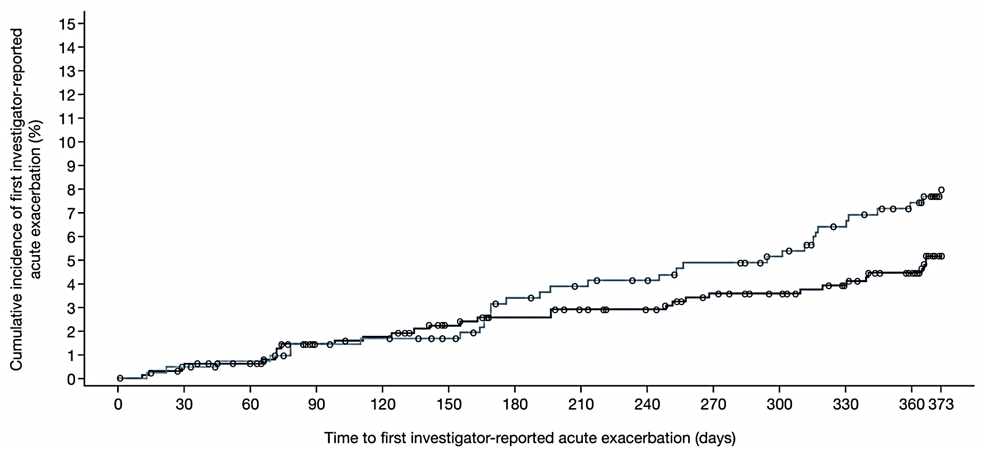
Time to First Acute Exacerbation (Investigator-reported): INPULSIS Pooled
Nintedanib 150 mg bid
Placebo
HR 0.64 (95% CI; 0.39, 1.05) P=.0823
 | Nintedanib 150 mg bid (n=638) | Placebo (n=423)
Patients with ≥1 acute exacerbation, n (%) | 31 (4.9) | 32 (7.6)
Adapted from Richeldi L, et al. N Engl J Med. 2014;370:2071-2082.

Slide 39
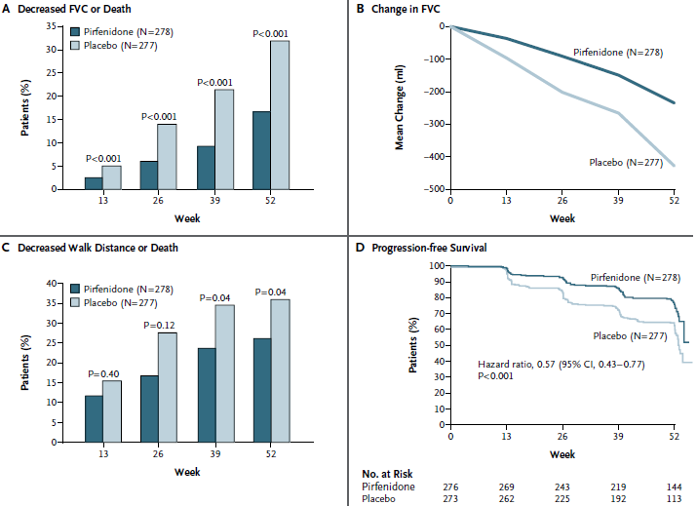
Results from phase 3 ASCEND trial of pirfenidone in patients with IPF
King TE Jr, et al. N Engl J Med. 2014;370:2083-92.
Notes:
King TE Jr, Bradford WZ, Castro-Bernardini S, et al; ASCEND Study Group. A phase 3 trial of pirfenidone in patients with idiopathic pulmonary fibrosis. N Engl J Med. 2014;370(22):2083-92. doi: 10.1056/NEJMoa1402582.

Slide 40
Pirfenidone and Mortality
 | Pooled Analysis |  | P value | Meta-analysis |  | P value
ACM | Pirfenidone (n=623) | Placebo (n=624) |  | Pirfenidone (n=806) | Placebo (n=769)
Week 52 | 22 (3.5%) | 42 (6.7%) | 0.010 | 25 (3.1%) | 50 (6.5%) | 0.004
Week 72 | 32 (5.1%) | 50 (8.0%) | 0.040 | 35 (4.3%) | 58 (7.5%) | 0.016
End of Study | 38 (6.1%) | 54 (8.7%) | 0.078 | 41 (5.1%) | 62 (8.1%) | 0.034
TE ACM
Week 52 | 14 (2.2%) | 32 (5.1%) | 0.009
Week 72 | 20 (3.2%) | 39 (6.3%) | 0.015
End of study | 26 (4.2%) | 43 (6.9%) | 0.042
IPF-related ACM
Week 52 | 10 (1.6%) | 28 (4.5%) | 0.002
Week 72 | 17 (2.7%) | 35 (5.6%) | 0.010
End of study | 22 (3.5%) | 39 (6.3%) | 0.023
Nathan SD, et al. Lancet Respir Med. 2017;5(1):33-41.

Slide 41
Dosing
Nintedanib
One capsule (150 mg) twice a day with food
Pirfenidone
Titrated to 3 capsules, 3 times a day with food
Days 1–7 267 mg (1 capsule) every 8 hrs with food; days 8–14 534 mg (2 capsules) every 8 hrs with food; Day >15 801 mg (3 capsules) every 8 hrs with food
Adjust dosing to manage side effects
Continue to review latest data

Slide 42
Disease Monitoring and Management
Continue pulmonary function tests (PFT)
6MWT used for prognostication
Assess treatment response
6MWT, six-minute walk test.

Slide 43
Common Side Effects
 | Pirfenidone | Nintedanib
Gastrointestinal | Anorexia (8%), nausea (20%), dyspepsia (12%), vomiting (7%), diarrhea (6%), weight loss (5%) | Diarrhea (44%), nausea (17%), vomiting (9%), GI perforation (0.3%)
Dermatologic | Rash (20%) Photosensitivity (8%)
Cardiovascular |  | Myocardial infarction (1.1%)
Hematologic |  | Bleeding events (3%)
Hepatic | Transaminitis (2.5%) | Transaminitis
Embryofetal toxicity |  | Yes
King TE Jr., et al. N Engl J Med. 2014;370:2083-2092.
Richeldi L, et al; INPULSIS Trial Investigators. N Engl J Med. 2014;370(22):2071-82.
Notes:
Richeldi L, du Bois RM, Raghu G, et al; INPULSIS Trial Investigators. Efficacy and safety of nintedanib in idiopathic pulmonary fibrosis. N Engl J Med. 2014;370(22):2071-82.
King TE Jr, Bradford WZ, Castro-Bernardini S, et al; ASCEND Study Group. A phase 3 trial of pirfenidone in patients with idiopathic pulmonary fibrosis. N Engl J Med. 2014;370(22):2083-92. doi: 10.1056/NEJMoa1402582.

Slide 44
Pulmonary Fibrosis Foundation Patient Registry
Goal: Create cohort of well-characterized patients for participation in retrospective and prospective research.
Registry enrollment began in March 2016
As of March 31, 2017 (n=767)
Targeting 60% IPF patients of 2,000 goal of ILD participants across 40 clinical sites
The PFF Patient Registry is actively enrolling participants.
ILD, interstitial lung diseases.
Flaherty KR, et al. Pulmonary Fibrosis Foundation Patient Registry. Pulmonary Fibrosis Foundation. 2017.
Notes:
Source
Flaherty KR, de Andrade JA, Chou W, et al. Baseline Characteristics of the Initial 767 Participants in the Pulmonary Fibrosis Foundation Patient Registry. Pulmonary Fibrosis Foundation. [Poster] 2017.

Slide 45
PFF Data Results
Variable | IPF n=448 | non-IPF n=319 | p-value
Consented Biorepository | 93% | 89% | 0.11
Age, years | 70 (8) | 64 (12) | <0.01
Male | 74% | 45% | <0.01
Former Smoker | 66% | 50% | <0.01
Pulmonary Function
FEV₁, % pred | 71 (17) | 70 (20) | 0.39
FVC, % pred | 67 (17) | 68 (19) | 0.81
DLCO, % pred | 41 (18) | 45 (18) | <0.01
Home oxygen use | 45% | 43% | 0.64
Variable | IPF n=448 | non-IPF n=319 | p-value
Comorbidity
GERD | 64% | 55% | 0.02
Sleep Apnea | 29% | 27% | 0.45
Depression | 17% | 16% | 0.60
Anxiety | 10% | 16% | 0.03
Coronary Artery Disease | 24% | 17% | 0.02
Medical Therapy
Immunosuppression, any | 4% | 59% | <0.0001
Antifibrotic | 65% | 5% | <0.0001
N-acetylcysteine | 3% | 1% | 0.14
PFF, Pulmonary Fibrosis Foundation; FEV₁, forced expiratory volume in one second; FVC, forced vital capacity; DLCO, diffusing capacity of lungs for carbon monoxide.
Adapted from Flaherty KR, et al. Pulmonary Fibrosis Foundation Patient Registry. Pulmonary Fibrosis Foundation. 2017.
Notes:
Source
Flaherty KR, de Andrade JA, Chou W, et al. Baseline Characteristics of the Initial 767 Participants in the Pulmonary Fibrosis Foundation Patient Registry. Pulmonary Fibrosis Foundation. [Poster] 2017.

Slide 46
PFF Patient Registry Conclusions
A large number of patients with IPF and non-IPF are enrolling in the Registry and Biorepository.
The diagnostic process for IPF and non-IPF is similar.
Use of immunosuppression vs anti-fibrotic therapy differs dramatically between IPF and non-IPF.
PFF, Pulmonary Fibrosis Foundation; ILD, interstitial lung diseases.
Flaherty KR, et al. Pulmonary Fibrosis Foundation Patient Registry. Pulmonary Fibrosis Foundation. 2017.
Notes:
Source
Flaherty KR, de Andrade JA, Chou W, et al. Baseline Characteristics of the Initial 767 Participants in the Pulmonary Fibrosis Foundation Patient Registry. Pulmonary Fibrosis Foundation. [Poster] 2017.

Slide 47
Latest Research on Emerging Therapies
Compound | Company | Structure/Route of Administration | Stage of Development | Mechanism of Action | Background Therapy | ClinicalTrials.gov Identifier:
PRM-151 | Promedior/BMS | mAb/IV | Phase 2 | Rh-pentraxin-2 protein | pirfenidone or nintedanib allowed | NCT02550873
SAR-156597 | Sanofi | mAb/SC | Phase 2 | Anti IL-4/IL-13 | pirfenidone or nintedanib allowed | NCT02345070
FG-3019 | Fibrogen | mAb/IV | Phase 2 | Anti-CTGF | pirfenidone or nintedanib allowed only in the sub study | NCT01890265
STX-100/BG00011 | Biogen | nAb/SC | Phase 2 | Anti-integrin avB6 | pirfenidone allowed | NCT01371305
PBI-4050 | Prometric | Sm/oral | Phase 2 | CTGF expression inhibitor | pirfenidone or nintedanib allowed | NCT02538536
TD139 | Galecto/BMS | Sm/Inhalation | Phase 2 | Galectin-3 inhibitor | Not allowed | NCT02257177
Sm, small molecule; mAb, monoclonal antibody; IV, intravenous; SC, subcutaneous; IL, interleukin; CTGF, connective tissue growth factor; BMS, Bristol-Meyers Squibb.
ClinicalTrials.gov

Slide 48
Latest Research on Emerging Therapies (cont)
Compound | Company | Structure/Route of Administration | Stage of Development | Mechanism of Action | Background Therapy | ClinicalTrials.gov Identifier:
MN-001 (tipelukast) | MediciNova | Sm/oral | Phase 2 | Leukotriene receptor antagonist | nintedanib allowed | NCT02503657
KD025 | Kadmon | Sm/oral | Phase 2 | ROCK2 inhibitor | Not allowed | NCT02688647
CC-90001 | Calgene | Sm/oral | Phase 2 | JNK1 inhibitor | NA | NCT03142191
GLPG-1690 | Galapagos | Sm/oral | Phase 2 | Autotaxin inhibitor | NA | NCT02738801
Omipalisib | GSK | Sm/oral | Phase 2 | P13K/mTOR | NA | NCT10725139
GBT440 | Global Blood Therapeutics | Sm/oral | Phase 2 | Hb O2 release stimulant | NA | NCT02846324
Sm, small molecule; mAb, monoclonal antibody; IV, intravenous; ROCK2, Rho-associated protein kinases; JNK, Jun N-terminal kinases; P13K, Phosphoinositide 3-kinases; mTOR, mammalian target of rapamycin; GSK, GlaxoSmithKline.
ClinicalTrials.gov

Slide 49
Emerging Treatments (cont)
Compound | Company | Structure/Route of Administration | Stage of Development | Mechanism of Action | Background Therapy | ClinicalTrials.gov Identifier:
Inhaled Treprostinil | United Therapeutics | Sm/inhalation | Phase 3 | Prostacyclin | NA | NCT00705133
Mesenchymal stem cells |  | Cells/IV | Phase 3 | Regeneration of alveolar epithelium | NA | NCT02013700
Cotrimoxazole/ Doxycycline |  | Sm/oral | Phase 3 | Antimicrobial | NA | NCT02759120
Sildenafil |  | Sm/oral | Phase 3 | PDE5 inhibitor | NA | NCT00517933
Losartan |  | Sm/oral | Phase 3 | ARB | NA | NCT00879879
Sm, small molecule; PDE5, phosphodiesterase type-5 inhibitor; ARB, Angiotensin II receptor blockers.
ClinicalTrials.gov

Slide 50
Key Takeaways
Prognosis for IPF is unpredictable.
An early diagnosis and appropriate management are vital to maintain quality of life and slow disease progression.
Disease management is crucial for patients with IPF, and includes the following:
Antifibrotic therapy
Pulmonary rehabilitation
Managing comorbidities
Supplemental oxygen (if and when needed)
Social/psychological support
Lung transplant for select patients (early referral encouraged)
Clinical trial enrollment.

