Slide 2
Faculty
Steven R. Feldman, MD, PhD
Alan Menter, MD
Professor of Dermatology, Pathology and Public Health Sciences
Director, Psoriasis Treatment Center
Wake Forest University School of Medicine
Winston-Salem, North Carolina
Chair, Division of Dermatology
Baylor University Medical Center
Clinical Professor of Dermatology University of Texas Southwestern Medical Center Dallas, Texas

Slide 3
Disclosures
Steven R. Feldman, MD, PhD
Consultant | Novartis
Speaker | AbbVie, Celgene, Janssen Biotech, LEO Pharma, Lilly, Novartis, Pfizer, Regeneron, Sanofi, Taro, Valeant
Alan Menter, MD
Consultant | Novartis
Investigator | Novartis
Speaker | AbbVie, Amgen, Janssen Biotech, LEO Pharma
For a complete list of disclosures, please see our syllabus.

Slide 4
Learning Objectives
Assess psoriasis patients for disease severity
Discuss safety and efficacy of newly approved and emerging agents for the treatment of plaque psoriasis
Optimize treatment for patients with chronic psoriasis

Slide 5
Establishing Psoriasis Severity

Slide 6
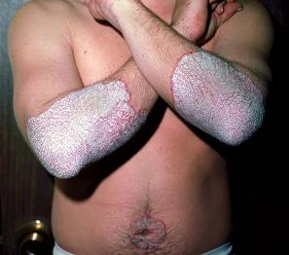
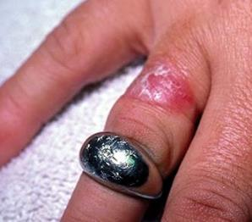
Chronic Plaque Psoriasis
Most common variant
Characterized by well-demarcated erythematous plaques with silver scale
Large plaque psoriasis
Small plaque psoriasis
Koebnerization
Nijsten T, et al. Arch Derm. 2007;143(9):1113-1121.
Photos courtesy Alan Menter, MD.

Slide 7
Other Clinical Psoriasis Manifestations
Guttate
Pustular
Erythrodermic
Inverse
Pitting Onycholysis Subungal Oil drop Nail plate
Hyperkeratosis sign dystrophy

Slide 8
Prevalence of Psoriasis
Overall prevalence among adults 20-59 years in US¹
3.2% (~7.5 million adults)
27.3% report moderate-to-severe disease
Men and women equally affected²
Age of onset²
30-39 years: Type I (majority of patients)
50-69 years: Type II
Rising incidence?³
Retrospective studies suggest incidence increases 1970-1974 and 1995-1999
Rise could be due to increasing diagnosis and/or improved understanding of psoriasis
Helmick CG, et al. Am J Prev Med. 2014;47(1):37-45.
Parisi R, et al. J Investig Derm. 2013;133(2):377-385.
Icen M, et al. J Am Acad Dermatol. 2009;60(3):394-401.

Slide 9
Risk Factors for Psoriasis
Family History
Smoking & Alcohol
Obesity
Drugs
Infections

Slide 10
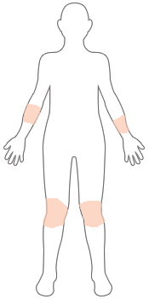
How would you classify the distribution of disease on this figure?
A
<1%
<3%
3%-10%
>10%
B
C
D

Slide 11
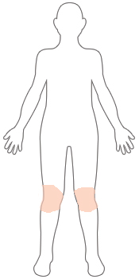
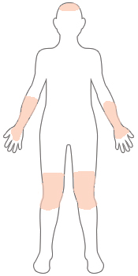
Severity Classification
Patient’s palm (wrist to tips of fingers) = 1% of BSA
Area of involvement = body surface area (BSA)
Measure % of body surface area affected
Determine the location of lesions
MILD
<3% of body
MODERATE
3%-10% of body
SEVERE
>10% of body
~25% of patients with plaque psoriasis have moderate-to-severe disease
Menter A, et al. J Am Acad Dermatol. 2008;58(5):826-850.
National Psoriasis Foundation

Slide 12
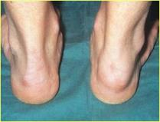
Comorbidity Evaluation
Psychosocial burden
Autoimmune ophthalmic disease
Obstructive sleep apnea
Psoriatic arthritis
Joint pain evaluation is an American Academy of Dermatology competency
Chronic obstructive pulmonary disease
Cardiovascular disease
Kidney disease
Fatty liver disease
Inflammatory bowel disease
Diabetes Metabolic syndrome
Osteoporosis
Dactylitis
Enthesitis
Patients with moderate-to-severe psoriasis are more likely to have comorbidities, especially hyperlipidemia, hypertension, cardiovascular disease, and diabetes.
Menter A, et al. J Am Acad Dermatol. 2008;58(5):826-850.
Boehncke W-H, et al. Lancet. 2015;386(9997):983-994.
Takeshita J, et al. J Am Acad Dermatol. 2017;76(3):393-403.
Feldman SR, et al. J Man Care Spec Pharm. 2015;21(10):874-888.

Slide 13
Quality of Life in Psoriasis
94% say psoriasis is a problem in daily life
Psoriasis Longitudinal Assessment and Registry
Depression = 14.7%
Anxiety = 11.1% Suicide ideation = 1%
88% say psoriasis affects overall emotional well-being
>85% experience anger, frustration, helplessness, embarrassment, self-consciousness
82% say psoriasis interferes with enjoyment of life
Assessing quality of life is an important baseline for treatment decisions. Disease severity and impact on QoL may warrant more aggressive therapy.
83% actively conceal physical manifestations
83% experience pain regularly
75% experience frequent itching
Community study of patients with psoriasis (N=5,604)
Armstrong AW, et al. PLOS ONE. 2012;7;12:e52935.
Heller MM, et al. Dermatol Clin. 2012;30(2):281-291.
Kimball AB, et al. Br J Dermatol. 2014; 171(1):137-47.

Slide 14
Quality of Life Assessment Tools
Dermatology-Specific
Psoriasis-Specific
Dermatology Life Quality Index
Dermatology Quality of Life Scales
Dermatology Specific Quality of Life
Skindex-61, Skindex-29
Psoriasis Disability Index
Psoriasis Symptom Inventory
Psoriasis Life Stress Inventory
Psoriasis Index Quality of Life
Salford Psoriasis Index
Koo-Menter Psoriasis Instrument
Menter A, et al. J Am Acad Dermatol. 2008;58(5):826-850.
Heller MM, et al. Dermatol Clin. 2012;30(2):281-291, ix.

Slide 15
Koo-Menter Psoriasis Instrument (KMPI)

Slide 16
Standard Model of Psoriasis Treatment
Psoriasis
Psychosocial
Psoriasis
Foundation
Joint Symptoms
Rheumatology
collaboration
Yes
Localized?
No
Topical agents
Phototherapy
Promote good
Adherence to treatment
Methotrexate
Acitretin
Cyclosporine
Apremilast
Biologic agents
Stepwise therapy not required—patients with moderate-to-severe psoriasis are candidates for systemic and/or biologic therapy at diagnosis ✝
*Not for women of childbearing age
✝American Academy of Dermatology. Position statement on treatment of psoriatic patients. April 27, 2013.

Slide 17
Which one of the following systemic therapies is currently approved to treat patients with moderate-to-severe plaque psoriasis?
A
Guselkumab
Ponesimod
Risankizumab
Tofacitinib
B
C
D

Slide 18
Current treatment landscape
Biologics and Recently Approved Options for Initiating Treatment

Slide 19
Efficacy of Secukinumab vs Ustekinumab
52-week double-blind study, n=676 patients randomized 1:1 to subcutaneous injection of secukinumab 300 mg or ustekinumab per label
Primary end point was 90% or more improvement from baseline Psoriasis Area and Severity Index (PASI) score (PASI-90) at week 16
Secukinumab approved 2015 for adults with moderate-to-severe psoriasis
Thaci D, et al. J Am Acad Dermatol. 2015;73(3):400-409. Used under CC BY-NC-ND 4.0.

Slide 20
Long-Term Efficacy of Secukinumab
642 patients who completed 52 weeks treatment with secukinumab randomized to secukinumab or treatment as needed
Bissonnette R, Luger T, Thaçi D, et al. Secukinumab sustains good efficacy and favourable safety in moderate to severe psoriasis up to 3 years of treatment: Results from A double-blind extension study [published online June 5, 2017]. Br J Dermatol. Accepted Author Manuscript. doi:10.1111/bjd.15706

Slide 21
Drug Survival: Data from the PSOLAR Registry
Comparison across PSOLAR cohorts (N=4,000) undergoing first‐, second‐ or third‐line treatment of drug survival time from initiation to discontinuation (stop/switch) of biologic therapy.
Menter A, et al. JEADV. 2016;30(7):1148-1158. Used under CC BY-NC 4.0.

Slide 22
Ixekizumab: Pooled Results of Phase 3 Efficacy Data in Plaque Psoriasis
 | PASI-75 | PASI-90 | PASI-100
Placebo* | 4.4% | 1.1% | 0.1%
Etanercept† | 47.7% | 22.3% | 6.3%
Ixekizumab every 4 weeks* | 80.9% | 62.5% | 32.9%
Ixekizumab every 2 weeks‡ | 89.3% | 70.7% | 37.3%
Ixekizumab approved 2016 for adults with moderate-to-severe psoriasis
*Average of UNCOVER-1, UNCOVER-2, and UNCOVER-3 phase 3 trials
†Average of UNCOVER-2 and UNCOVER-3 phase 3 trials
‡Average of open-label trial of ixekizumab treatment in Japanese patients with plaque psoriasis, UNCOVER-1, UNCOVER-2, and UNCOVER-3
Gordon KB, et al. N Engl J Med. 2016;375(4):345-356.
Saeki H, et al. J Dermatol. 2017;44(4):355-362.
Griffiths CE, et al. Lancet. 2015 Aug 8;386(9993):541-51.

Slide 23
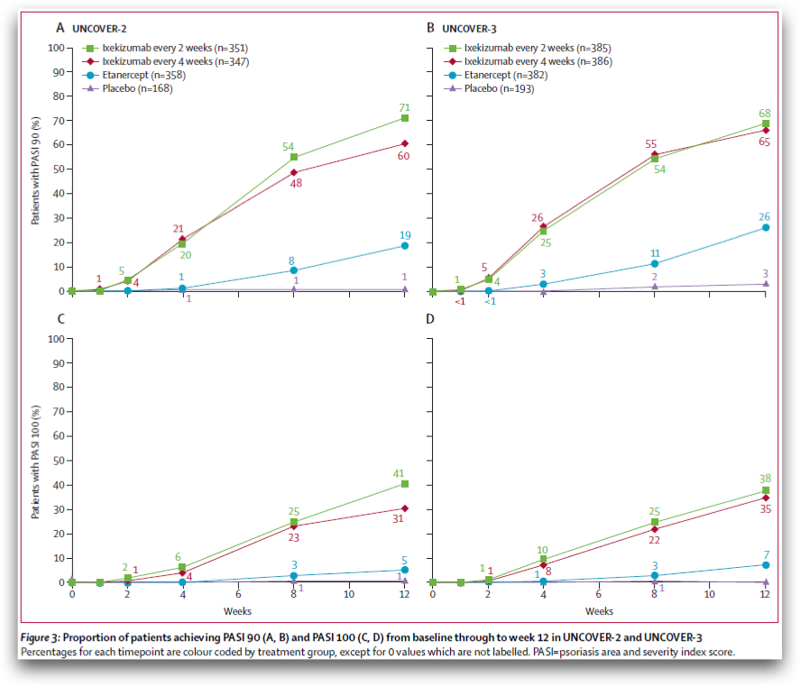
Ixekizumab: UNCOVER-2 UNCOVER-3
PASI-90 & PASI-100
Griffiths CE, et al. Lancet. 2015 Aug 8;386(9993):541-51.

Slide 24
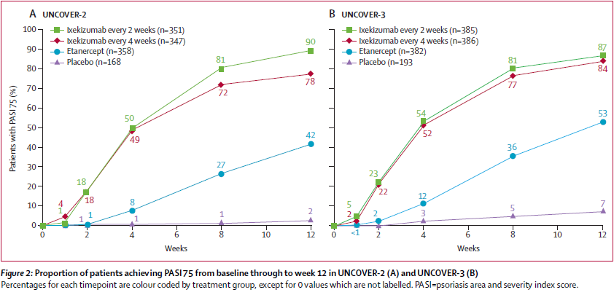
Ixekizumab vs Etanercept
Griffiths CE, et al. Lancet. 2015 Aug 8;386(9993):541-51.

Slide 25
Ixekizumab vs Ustekinumab
(IXE)-treated (N=136) patients
(UST)-treated (N=166) patients from Week 0 to Week 24.
Reich K, Pinter A, Lacour JP, et al. Comparison of ixekizumab with ustekinumab in moderate-to-severe psoriasis: 24-week results from IXORA-S, a phase 111 study [published online May 19, 2017]. Br J Dermatol. doi:10.1111/bjd.15666. Used under CC BY-NC-ND 4.0.

Slide 26
Brodalumab: AMAGINE-2 AMAGINE-3
Brodalumab approved 2017 for adults with moderate-to-severe psoriasis
Boxed Warning: Risk of suicidal ideation and behavior
Lebwohl M, et al. N Engl J Med. 2015;373(14):1318-1328. Copyright © 2015 Massachusetts Medical Society. Reprinted with permission from Massachusetts Medical Society.

Slide 27
Challenges With Biologic Therapies
TNF-alpha inhibitors have the potential to activate latent infections*
PSOLAR registry analysis (N=11,466)
Cumulative incidence rate of serious infections was 1.45 per 100 patient-years
Most common = pneumonia and cellulitis
Treatment with ustekinumab or etanercept was not associated with serious infection
No specific guidelines recommendation for sequencing
Requirement for repeated infusions/injections and cost
*Kalb RE, et al. JAMA Dermatol. 2015;151(9):961-969.

Slide 28
Challenges With Biologic Therapies (cont.)
Biologic fatigue: response to biologic agents can decrease over time as a result of immunogenicity and antidrug antibodies.^{1,2}
One review of phase 3 trial data found that 20%-32% lost PASI-75 response in 0.8-3.9 years of follow-up
Cardiovascular risk reduction benefit is suggestive³
➔ Especially infliximab
Levin EC, et al. J Dermatolog Treat. 2014;25(1):78-82.
Feldman SR, et al. Am Health Drug Benefits. 2016;9(9):504-513.
Nguyen T, et al. Perm J. 2014;18(1):49-54.

Slide 29
Sometimes Treatment Is Not Potent Enough
The most common reason a physician changes the treatment for a patient with moderate-to-severe psoriasis is inadequate control by their current therapy.
Anderson KL, Feldman SR. J Cut Med Surg. 2015;19(4):361-366. Leon A, et al. Expert Opin Pharmacother. 2007;8(5):617-632. Kim IH, et al. Am J Clin Dermatol. 2012;13(6):365-374. Reich K, et al. Br J Dermatol. 2012;166(1):179-188. Gordon KB, et al. J Invest Dermatol. 2012;132(2):304-314. Kavanaugh A, et al. Arthritis Rheum. 2009;60(4):976-986.

Slide 30
Recently approved oral therapies

Slide 31
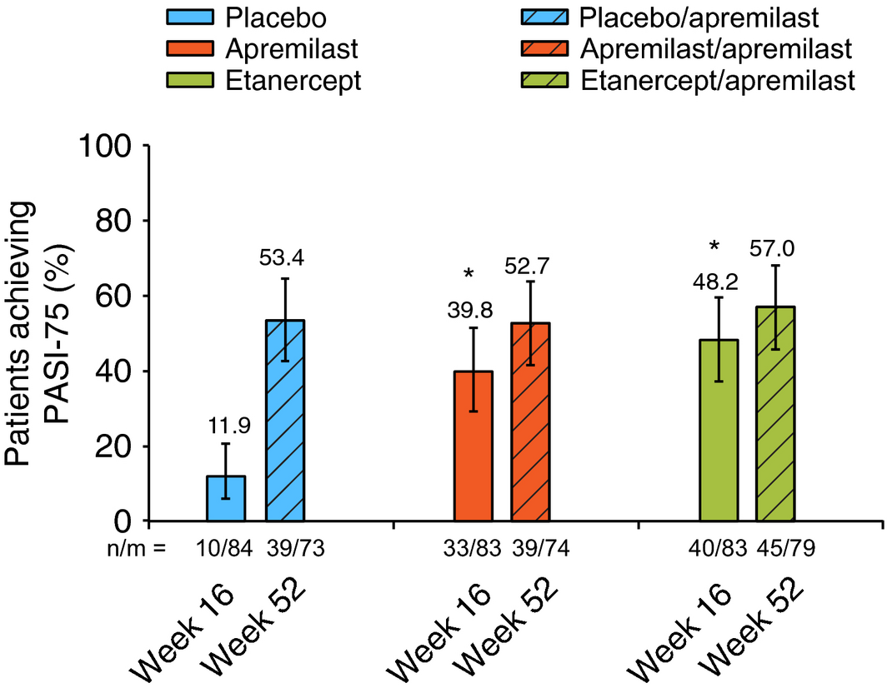
Apremilast: Phase 3 Efficacy Data in Plaque Psoriasis
ESTEEM1: PASI-75 response induced in 33.1% of apremilast-treated patients vs 5.3% of placebo-treated patients.¹
Approved 2014
PASI-75 Response at Week 16 (LOCF) and Week 52 (EOP). *P < 0.0001 vs placebo²
1. Papp K, et al. J Am Acad Dermatol. 2015;73(1):37-49. Used under CC BY-NC-ND 4.0.
2. Reich K, et al. J Eur Acad Dermatol Venereol. 2017;31:507-517.

Slide 32
Guselkumab: Phase 2 Efficacy Data
Percentage of patients with at least a 75% improvement from baseline in PASI score was significantly higher in each guselkumab group.
Approved 2017
Gordon KB, et al. N Engl J Med. 2015;373(2):136-44. Copyright © 2015 Massachusetts Medical Society. Reprinted with permission from Massachusetts Medical Society.

Slide 33
emerging oral therapies

Slide 34
Tofacitinib: OPT Pivotal 1/ OPT Pivotal 2
Papp KA, et al. Br J Dermatol. 2015;173(4):949-961. Used under CC BY-NC-ND 4.0.

Slide 35
Baricitinib: Dose-ranging phase 2b study
(DLQI) total score mean change from baseline and SE (LOCF) and percentage of patients achieving MCID
at weeks 4 and 12
PASI-75 through week 12 and change in baseline PASI score
Papp KA, et al. Br J Dermatol. 2016 Jun;174(6):1266-76. Used under CC BY-NC-ND 4.0.

Slide 36
Risankizumab (BI655066)
Mean PASI percentage improvement from baseline over 24 weeks
PASI improvements with BI 655066
Male (A) and female (B) patient from baseline (left panel) and week 12 (right panel).
Krueger JG, et al. J Allergy Clin Immunol. 2015; 136:116–124. Copyright 2015. Reprinted with permission from Elsevier.

Slide 37
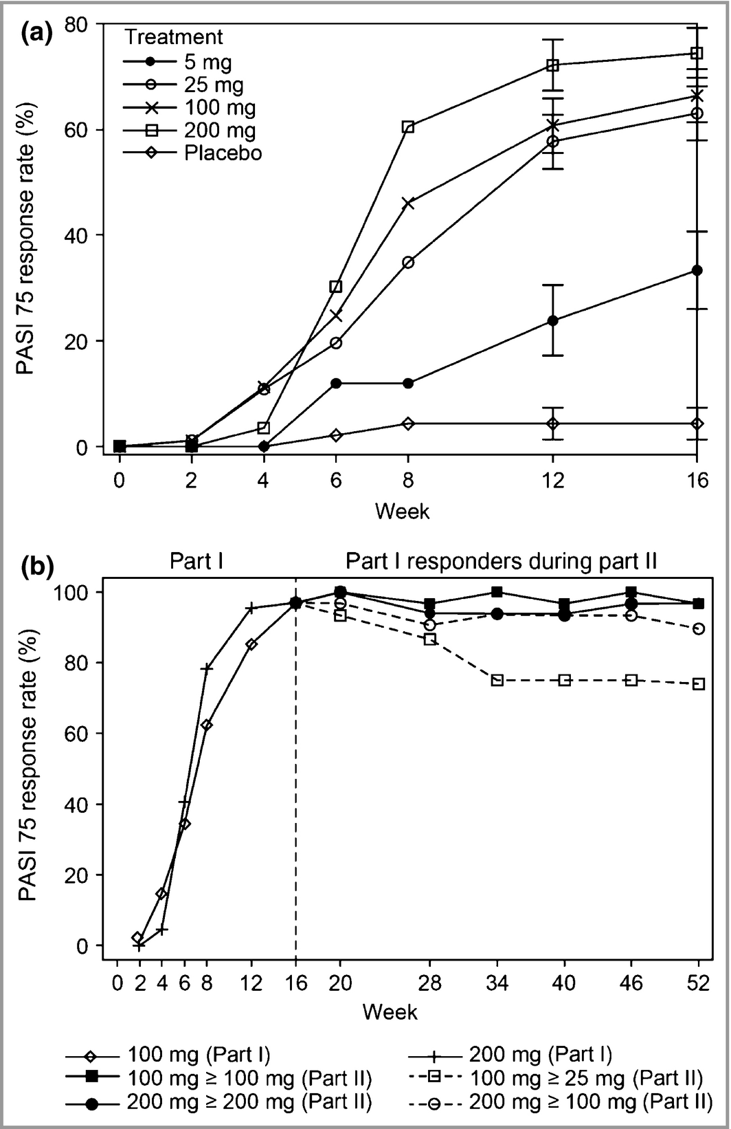
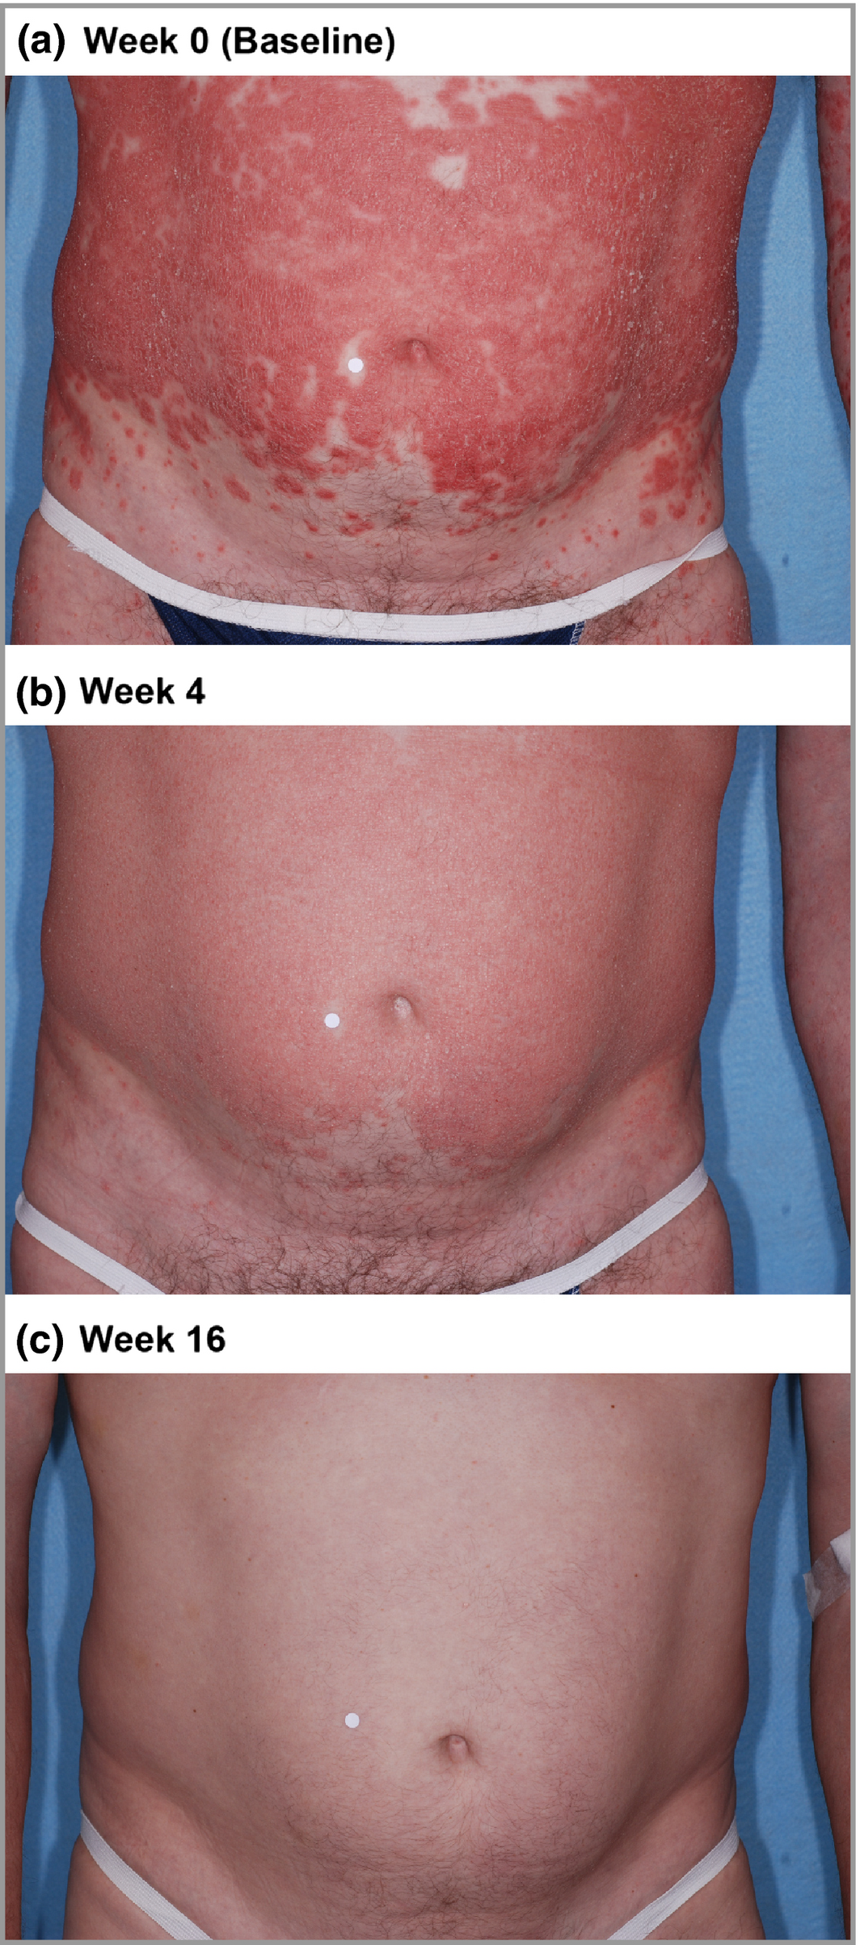
Tildrakizumab
Improvement in patient with baseline PASI-75 score of 14.5
PASI-75 over time
Papp K, et al. Br J Dermatol. 2015 Oct;173(4):930-939. Used under CC BY-NC-ND 4.0.

Slide 38
Optimizing Treatment Success

Slide 39
3 months after starting therapy with infliximab, your patient has not achieved BSA ≤3%. Which of the following strategies is least likely to achieve a target response of ≤1%?
A
Continue current therapy
Adjust dose
Add methotrexate
Switch to a new therapy
B
C
D

Slide 40
Optimizing Treatment Efficacy
Establish and revisit treatment goals with patients
Tailor therapies to maximize treatment response
Dose escalation or intensification with select agents
Select systemic agents comorbidities in mind
Ask the patient,
“What is most important to you?”
Shared decision-making
Solicit patient preferences for medication administration
Consider decision-making aids that present options, and answer questions that patients have about those options
Brezinski E, et al. Seminars in Cutaneous Medicine and Surgery. 2014;33(2):91-97.
Anstey A, et al. Br J Derm. 2014;170(4):759-760.

Slide 41
Real Patients: Primary Nonadherence
~40% of psoriasis patients do not use their medication as recommended by their clinician
0
7
14
21
28
Storm A, et al. J Am Acad Dermatol. 2008;59(1):27-33.

Slide 42
Adherence to Biologics
West C, et al. Dermatol Online J. 2013;19(5):18182.

Slide 43
Why Are Patients Nonadherent?
Perceived burden | Sometimes treatment seems worse than the disease
Passing the responsibility buck | With multiple caregivers, no one may take responsibility
Forgetfulness | “Pavlov’s dog” problem
Laziness | No energy to follow treatment
Resignation | Some patients have just given up
Cost | Annual cost to patient can be more than $2,000/year

Slide 44
Why Are Patients Nonadherent?
Poor motivation | The patient may not be particularly bothered
Secondary gain | Seeking disability or other gain
Lack of trust in doctor | Physician-patient relationship is the foundation
Fear of medication | Founded or unfounded fear of treatment
Don’t know what to do | Patients may not remember oral instructions
Burden of treatment | Sometimes treatment is worse than the disease!

Slide 45
Optimizing Primary Medication Adherence
Initiate treatment during the first consultation
Be aware of patients with chronic conditions
Always follow up if in doubt about adherence
Consider nonadherence when a given therapy fails
Build physician-patient relationship: empathy is key
Use EMR for educational materials and an action plan
Support patient self-efficacy
eg, use shorter follow-up intervals and motivational interviewing
Simplify regimens
Use reminder strategies
eg, text messages, weekly pill boxes, multidrug punch cards
Storm A, et al. J Am Acad Dermatol. 2008;59(1):27-33.
Aslam I, Feldman SR. Southern Med J. 2015;108(6):325-331.
Feldman SR, et al. Derm Online J. 2014;20(8).

Slide 46
Optimizing Medication Access
Total cost burden = $35.2 billion¹
Incremental medical costs = $12.2 billion
Reduced quality of life = $11.8 billion
Productivity losses = $11.2 billion
Annual WAC costs for newer systemic and biologic therapies range from $30,001 to $88,402²
Encourage patients to fully understand their insurance plan
Consider patient assistance programs
Communicate about costs
WAC, wholesale acquisition costs.
Vanderpuye-Orgle J, et al. J Am Dermatol. 2015;72:961-967.
Feldman SR, et al. Am Health Drug Ben. 2016;9(9):504-513.

Slide 47
Notes From the Field
Educate patient
Psoriasis is a lifelong disease
Requires lifelong, safe control
Emphasize adherence
Establish the perception of caring
Plan treatment based on patient preferences
Initiate contact with patient shortly after starting treatment
Less than 16% of eligible psoriasis patients with moderate-to-severe psoriasis being treated with systemic or biologic therapy
Dermatologists too busy to treat?
Payers declining treatment?
Patient reluctance to accept systemic nature of psoriasis?

Slide 48
Summary & Key Takeaways

Slide 49
Assess psoriasis patients for disease severity
History and physical examination as basis for diagnosis
Be aware that psoriasis can affect all body surfaces
Include exam of scalp, nails, body folds, and genitals
Evaluate physical, emotional, social, impact on patients using a quality of life assessment tool
Assess patient for comorbidities

Slide 50
Tailor therapies to maximize treatment response
Establish and revisit treatment goals with patients
Dose escalation or intensification with select agents
Select systemic agents comorbidities in mind
Practice shared decision-making

Slide 51
Factors to consider in treatment selection
Efficacy
Patient preference
Duration
Side effects
Disease severity
Medical risk factors

