Slide 1
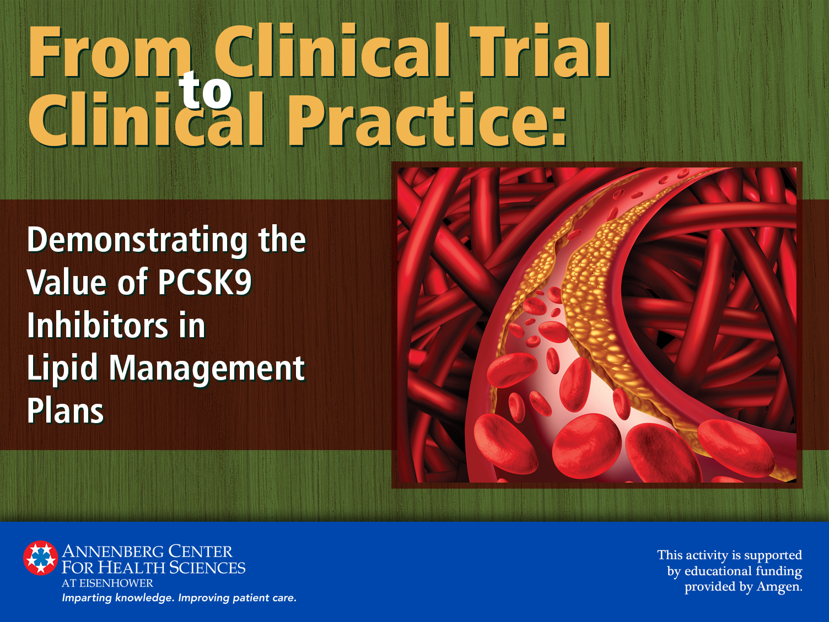

Slide 2
Presenting Faculty
Jennifer G. Robinson, MD, MPH
Professor
Departments of Epidemiology & Medicine
Director
Prevention Intervention Center
College of Public Health
University of Iowa
Iowa City, Iowa

Slide 3
Presenting Faculty
Leslie Cho, MD
Director
Women's Cardiovascular Center
Section Head
Preventive Cardiology and Rehabilitation
Cleveland Clinic
Cleveland, Ohio

Slide 4
Disclosures
Jennifer G. Robinson, MD, MPH
Research Support | Research grants to Institution: Amarin, Amgen, Astra-Zeneca, Eli Lilly, Eisai, GlaxoSmithKline, Merck, Pfizer, Regeneron/Sanofi, Takeda
Consultant | Akcea/Ionis, Amgen, Dr Reddy, Eli Lilly, Esperion, Merck, Pfizer, Regeneron/Sanofi
Leslie Cho, MD
Research Support | Amgen, Eli Lilly, Esperion
Consultant | Amgen

Slide 5
Learning Objectives
Discuss the latest data on the use of PCSK9 inhibitors in patients with cardiovascular disease and hypercholesterolemia
Outline the latest data on the use of PCSK9 inhibitors in patients with familial hypercholesterolemia
Identify opportunities to improve cardiovascular disease risk and outcomes in patients receiving optimal statin therapy
Customize lipid management plans with appropriate therapeutic selection for optimal outcomes improvement

Slide 6
Unmet Needs of Persons with ↑LDL-C
In U.S. adults with T2DM, <20% of statin prescriptions are for high-intensity dose¹
~50% of U.S. adults hospitalized for MI fill a prescription for high-intensity statin within 90 days post-discharge²
Despite intensive medical management with high-intensity statin, RAASi, β-blocker, antiplatelet, most persons remain at substantial increased risk following MI³
Persons with HeFH are at 100-fold greater risk for a nonfatal cardiac event than general population⁴
Persons with HoFH are at high risk of a fatal CV event before age 20 y⁵
Beaubrun AC, et al. Eur Heart J. 2016;37(Suppl):1012-1013. Abstract P4987.
Rosenson RS, et al. Eur Heart J. 2016;37(Suppl):345. Abstract P1716.
Muntner P, et al. Eur Heart J. 2016;37(Suppl):731. Abstract P3634.
Nair DR, et al. Curr Opin Cardiol. 2014;29(4):381-388.
Nordestgaard BG, et al. Eur Heart J. 2013;34(45):3478-3490.

Slide 7
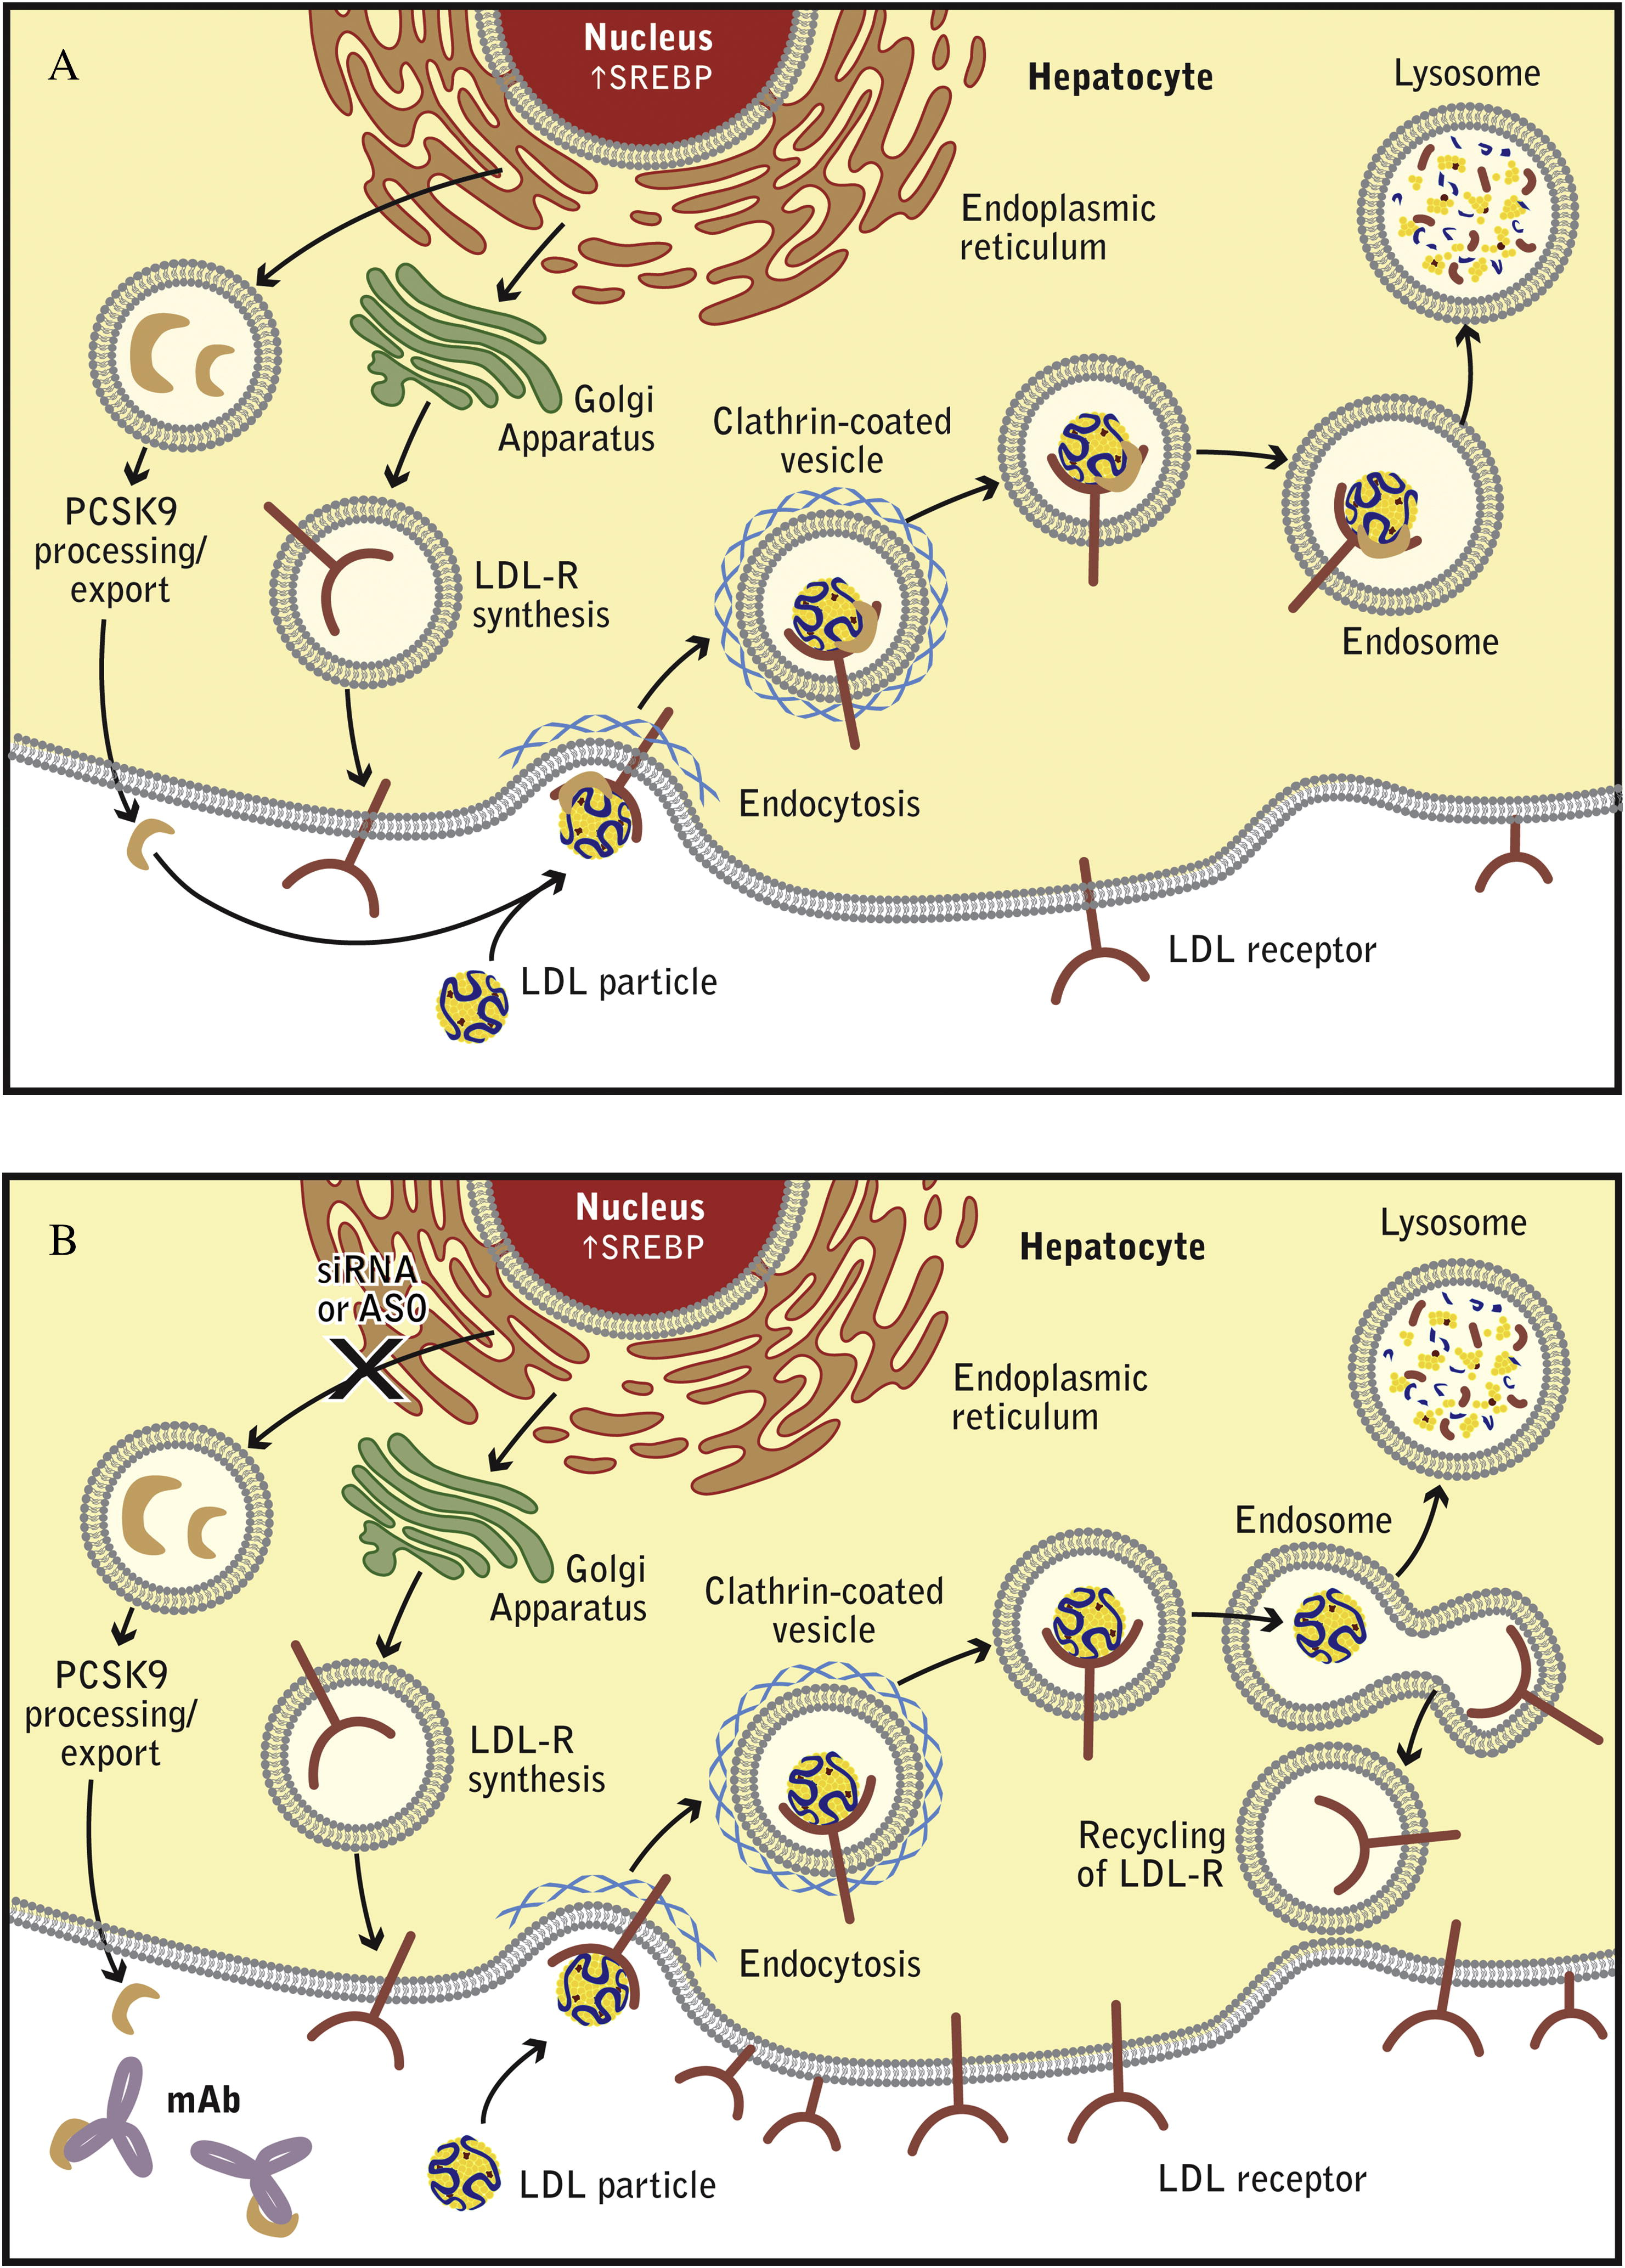
Mechanism of Action
Proprotein Convertase Subtilisin-like/Kexin Type 9 Targets the
LDL-Receptor for Lysosomal Degradation
Catapano AL, et al. Atherosclerosis. 2013;228:18–28.

Slide 8
Mechanism of Action
PCSK9 mAb Inactivate PCSK9 → Increase LDL-Receptor
Expression → ↓ LDL-C levels
Catapano AL, et al. Atherosclerosis. 2013;228:18–28.

Slide 9
LDL-C Lowering Efficacy of PCSK9 mAbs
Added to background statin therapy
Praluent [package insert]. Bridgewater, NJ: sanofi-aventis U.S. LLC; April 2017.
Repatha [package insert]. Thousand Oaks, CA: Amgen Inc.; February 2017.
Kereiakes D, et al. Am Heart J. 2015;169:906-915.
Robinson JG, et al. N Engl J Med. 2015;372(16):1489-1499.

Slide 10
Effect of PCSK9 mAbs on Other Blood Lipids and Proteins
Added to background statin therapy
Percent change from baseline
Baseline 38 nmol/L 87 mg/dL 124 mg/dL 20 mg/dL 177 mg/dL 105 mg/dL 53 mg/dL 152 mg/dL 0.1 mg/dL
  (median) (mean) (mean) (mean) (mean) (median) (mean) (mean) (median)
DESCARTES 52 weeks: Evolocumab 420 mg Q4W
Blom DJ, et al. N Engl J Med. 2014; 370(19):1809-1819.

Slide 11
PCSK9 mAbs Approved Indications
Alirocumab & Evolocumab
  Use as an adjunct to diet and maximally tolerated statin therapy in patients who require additional LDL-C lowering:
  Adults with heterozygous familial hypercholesterolemia
  Adults with clinical cardiovascular disease
Evolocumab
  Patients with homozygous familial hypercholesterolemia on statins, ezetimibe, and/or LDL apheresis
The FDA further noted as a limitation of use that the effect of alirocumab or evolocumab on cardiovascular morbidity and mortality has not yet been determined.
Praluent [package insert]. Bridgewater, NJ: sanofi-aventis U.S. LLC; April 2017.
Repatha [package insert]. Thousand Oaks, CA: Amgen Inc.; February 2017.

Slide 12
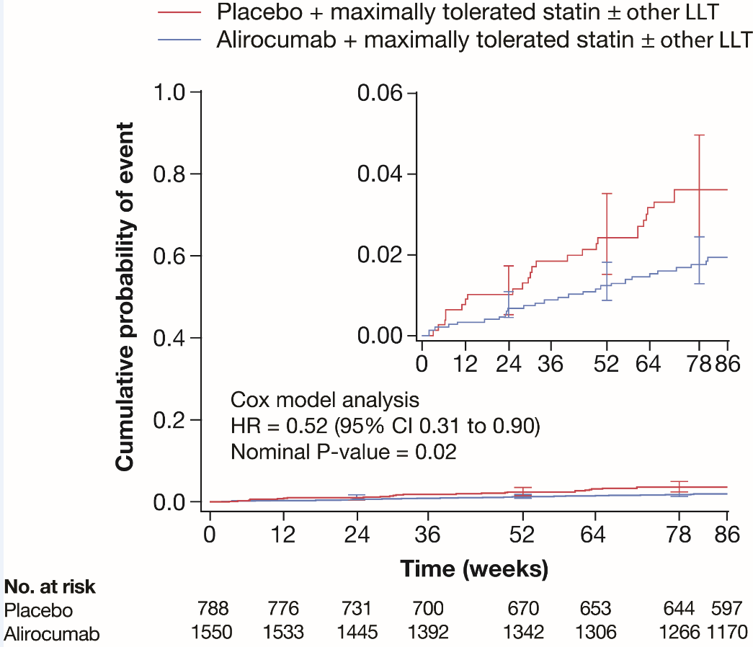
PCSK9 mAbs: Preliminary Data
Cardiovascular Disease Event Reduction
ODYSSEY LONG TERM
Alirocumab 150 mg q2W
Mean 80-week follow-up
Robinson JG, et al. N Engl J Med. 2015;372(16):1489-1499.

Slide 13
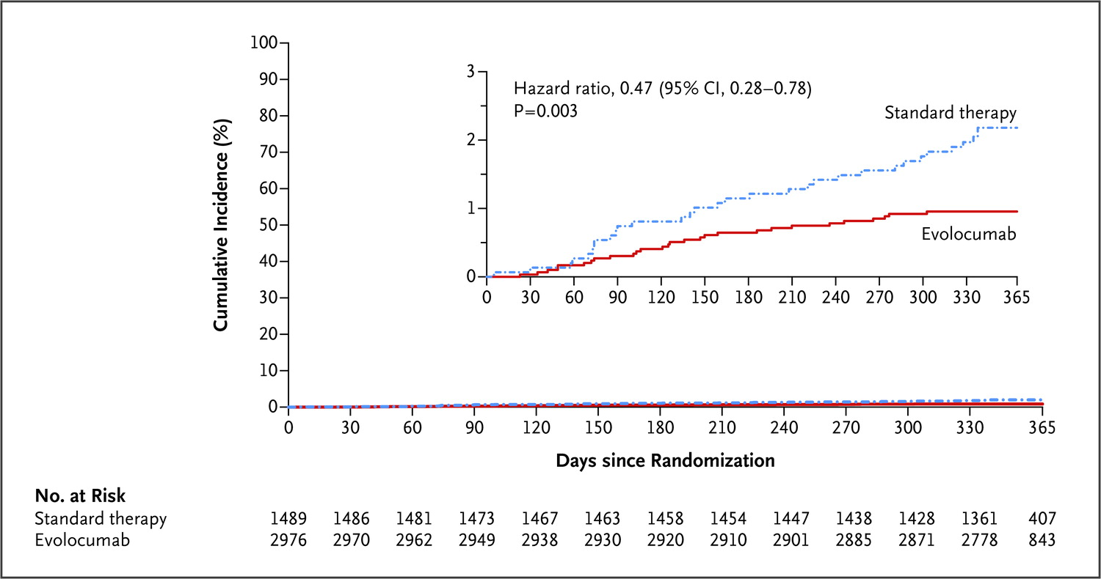
PCSK9 mAbs: Preliminary Data
Cardiovascular Disease Event Reduction
OSLER
Evolocumab 140 q2W/420 q4W
Mean 11-month follow-up
LDL-C at baseline:
~120 mg/dL (3.2 mmol/L)
LDL-C at study end:
~50 mg/dL (1.3 mmol/L)
LDL-C absolute reduction:
~70 mg/dL (1.8 mmol/L)
Sabatine MS, et al. N Engl J Med. 2015;372(16):1500-1509.

Slide 14
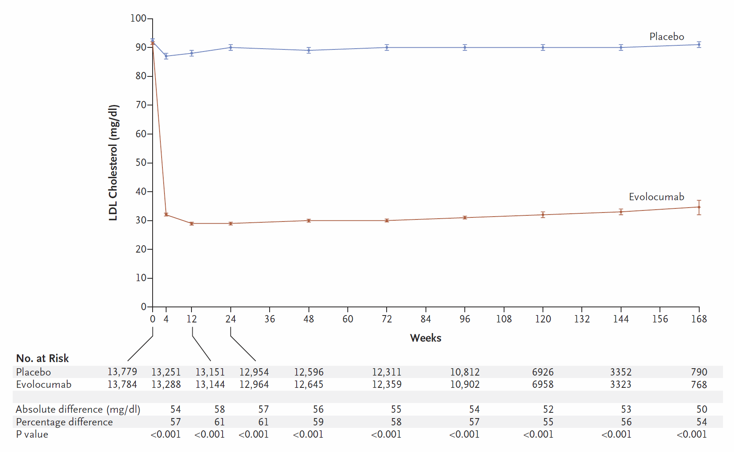
FOURIER
Evolocumab vs Placebo
N=27,564
CVD “plus” (very high risk)
  3.4% ASCVD/year
  34% 10-year ASCVD risk
Guideline-based statin
  High intensity (69%)
  Moderate intensity (30%)
Median follow-up 2.2 years
LDL-C reduction 59%
Baseline LDL-C 92 mg/dL (2.4 mmol/L)
LDL-C reduction ≈
60 mg/dL (1.55 mmol/L)
Evolocumab LDL-C 30 mg/dL (0.78 mmol/L)
Sabatine MS, et al. N Engl J Med. 2017;376(18):1713-1722.

Slide 15
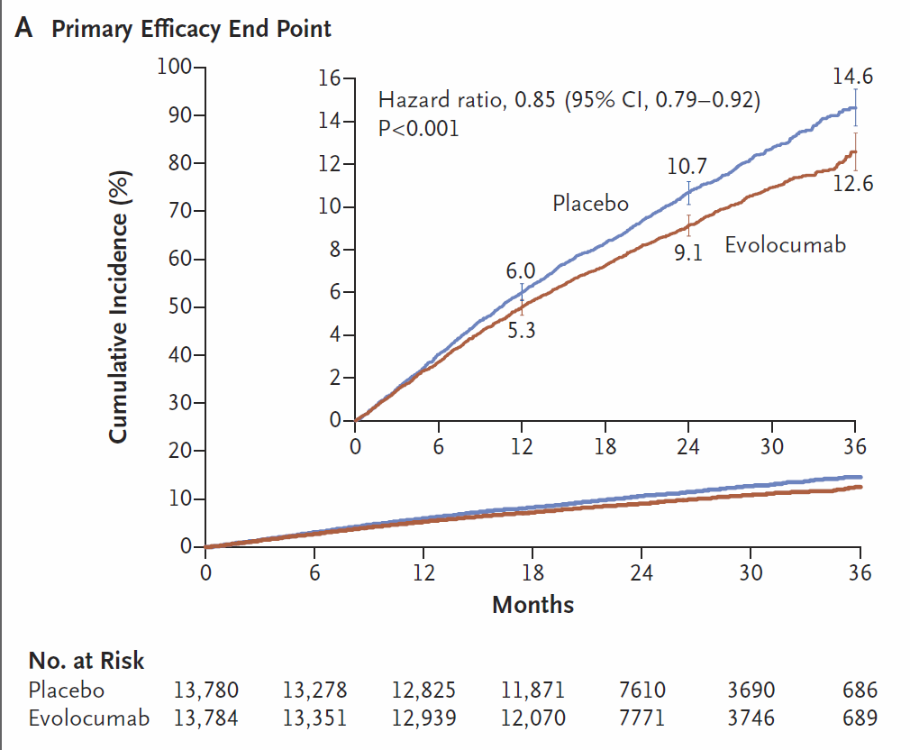
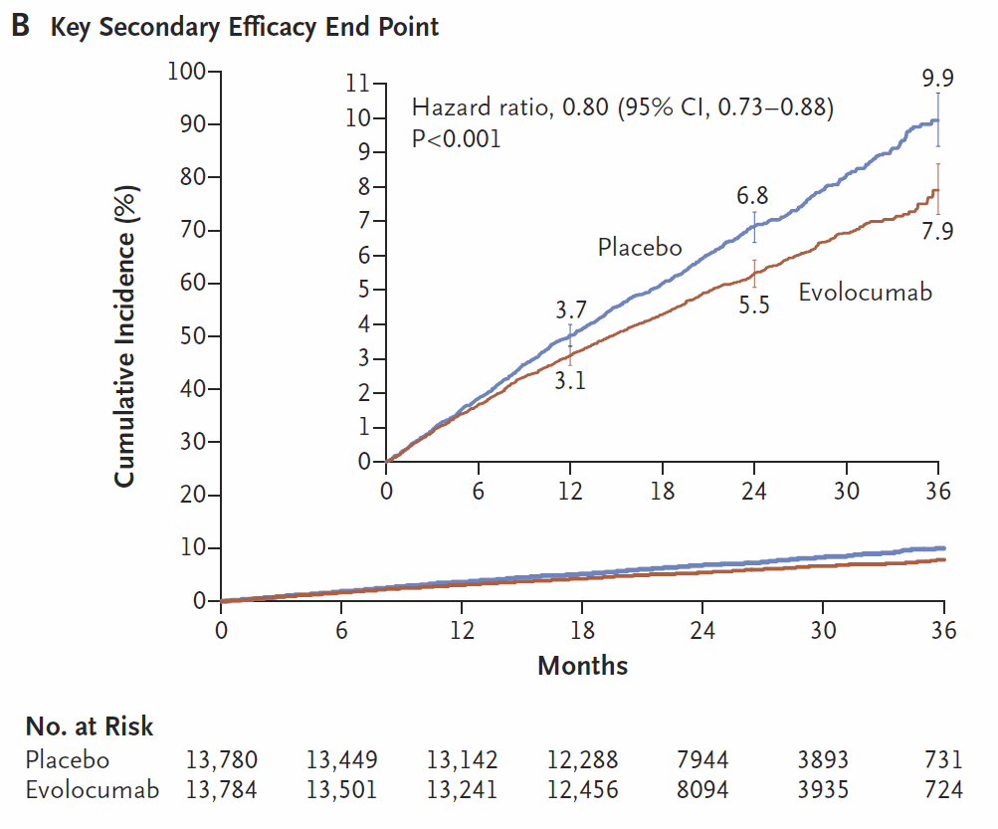
FOURIER
Major CVD
(CVD death, MI, stroke, hospitalized unstable angina, coronary revascularization)
ASCVD
(CVD death, MI, stroke)
RRR
15%
RRR
20%
Sabatine MS, et al. N Engl J Med. 2017;376(18):1713-1722.

Slide 16
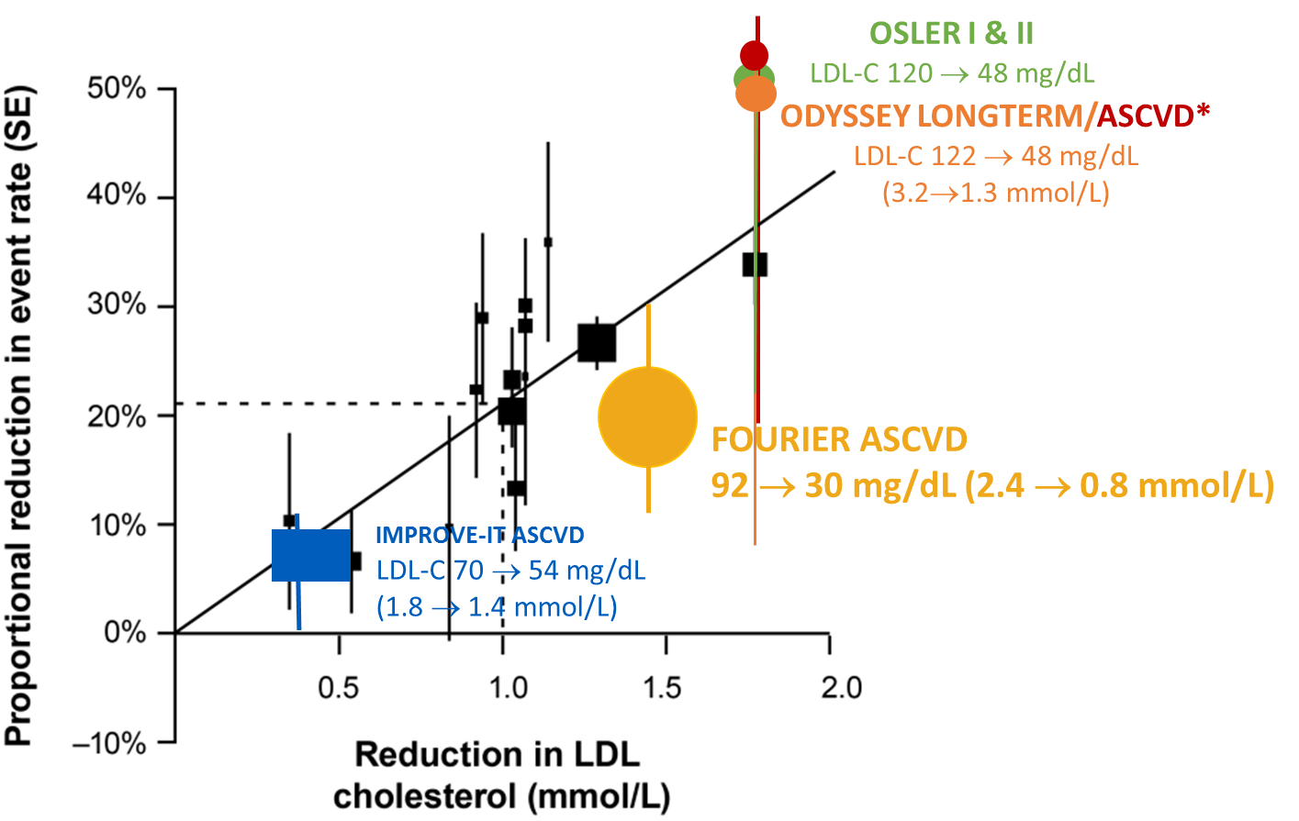
CTT Meta-Analysis LDL-C &
CVD Event Reduction
Statins
(5 years)
Ezetimibe
(7 years)
PCSK9 mAbs
(11-26 months)
*Applied FOURIER inclusion criteria to LONG TERM
CTT Collaboration. Lancet. 2005;366(9493):1267-1278. Cannon CP, et al. N Engl J Med. 2015;372(25):2387-2397.
Robinson JG, et al. N Engl J Med. 2015;372(16):1489-1499. Sabatine MS, et al. N Engl J Med. 2015;372(16):1500-1509.
HPS2-THRIVE Collaborative Group. N Engl J Med. 2014;371(3):203-212. ACCORD Study Group. N Engl J Med. 2010;362(17):1563-1574. AIM-HIGH Investigators. N Engl J Med. 2011; 365(24):2255-2267. Sabatine M, et al. N Engl J Med. 2017;376(18):1713-1722. Robinson JG, et al. J Am Coll Cardiol. 2017’69(11 Suppl):151. Poster 1203-305.

Slide 17
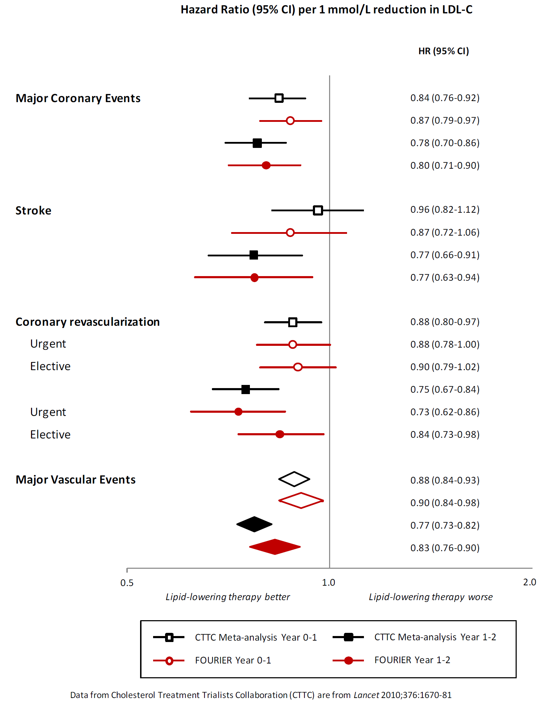
FOURIER
Comparison of Cardiovascular Endpoints to Cholesterol Treatment Trialists’ Collaboration (CTT)
Sabatine M, et al. N Engl J Med. 2017;376(18):1713-1722.

Slide 18
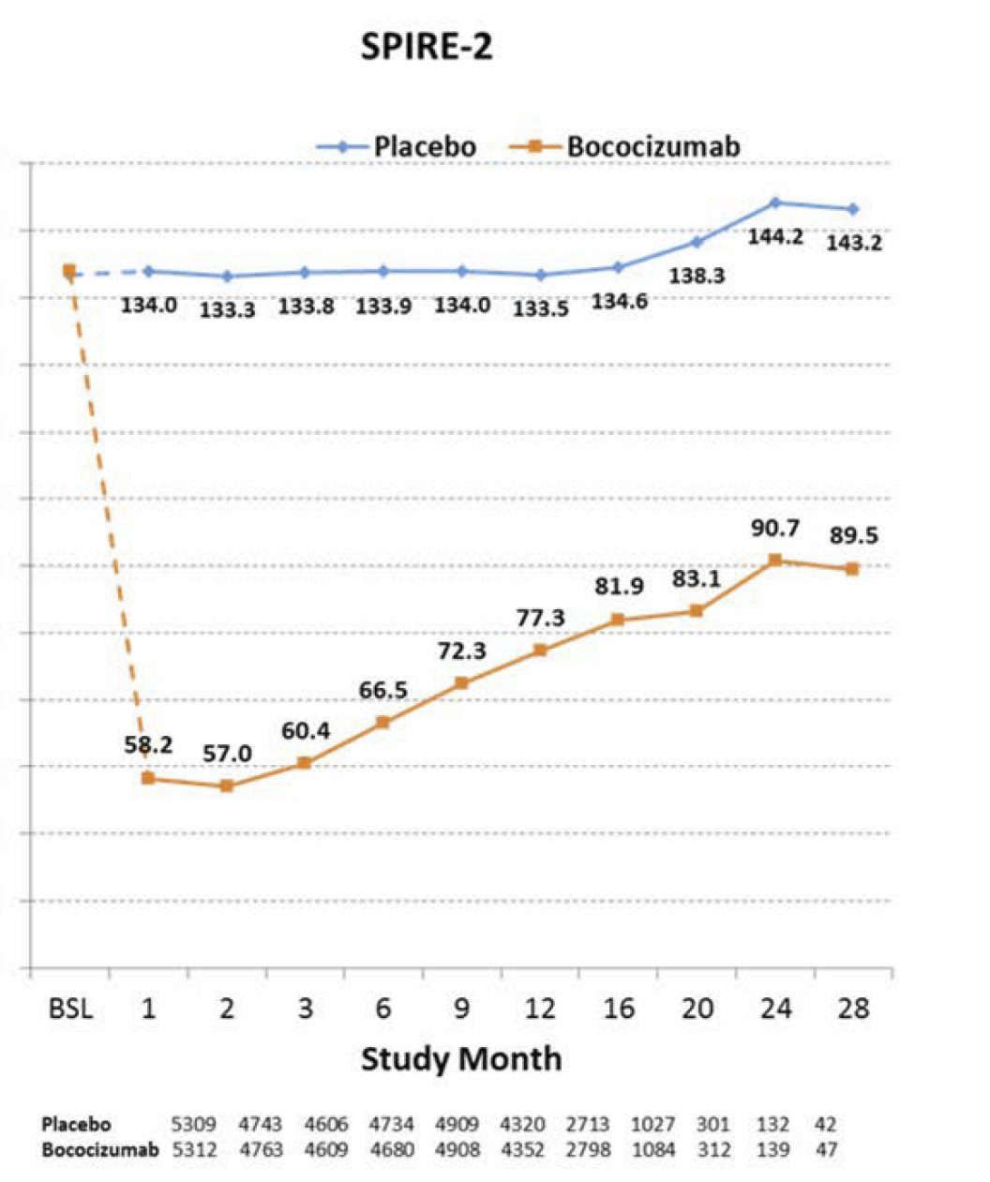
SPIRE-2
Placebo
134 mg/dl (3.5 mmol/L)
Bococizumab* vs Placebo
N=10,621
LDL-C ≥100 mg/dL
CVD or Diabetes “plus”
(very high risk)
  3.4% ASCVD/year
  34% 10-year ASCVD risk
Background statin
  High intensity (73%)
  No statin 17%
Median follow-up 1 year
Mean LDL-C
reduction @ 6 months
59 mg/dL (1.5 mmol/L)
Bococizumab
Mean LDL-C reduction 75 mg/dL (1.9 mmol/L)
(1.5 mmol/L→2.3 mmol/L)
*Humanized antibody; development terminated early for lack of efficacy due to neutralizing antibodies
Ridker PM, et al. N Engl J Med. 2017;376(16):1527-1539.

Slide 19
FOURIER vs CTT vs SPIRE-2 at 1 year
Observed & Expected Relative Risk Reduction Major CVD per mmol/L reduction in LDL-C
Baseline LDL-C 3.4 mmol/L
(≈130 mg/dL)
Baseline LDL-C 2.4 mmol/L
(≈90 mg/dL)
SPIRE-2 Major CVD: CVD death, nonfatal MI, nonfatal stroke, hospitalized unstable angina-urgent revascularization;
FOURIER Major CVD: CVD death, MI, stroke, hospitalized unstable angina, coronary revascularization;
CTT Major CVD: CHD death, nonfatal MI, stroke, coronary revascularization.
CTT Lancet. 2010;376:1670-1681.
Ridker PM, et al. N Engl J Med. 2017;376(16):1527-1539.
Sabatine M, et al. N Engl J Med. 2017;376(18):1713-1722.

Slide 20
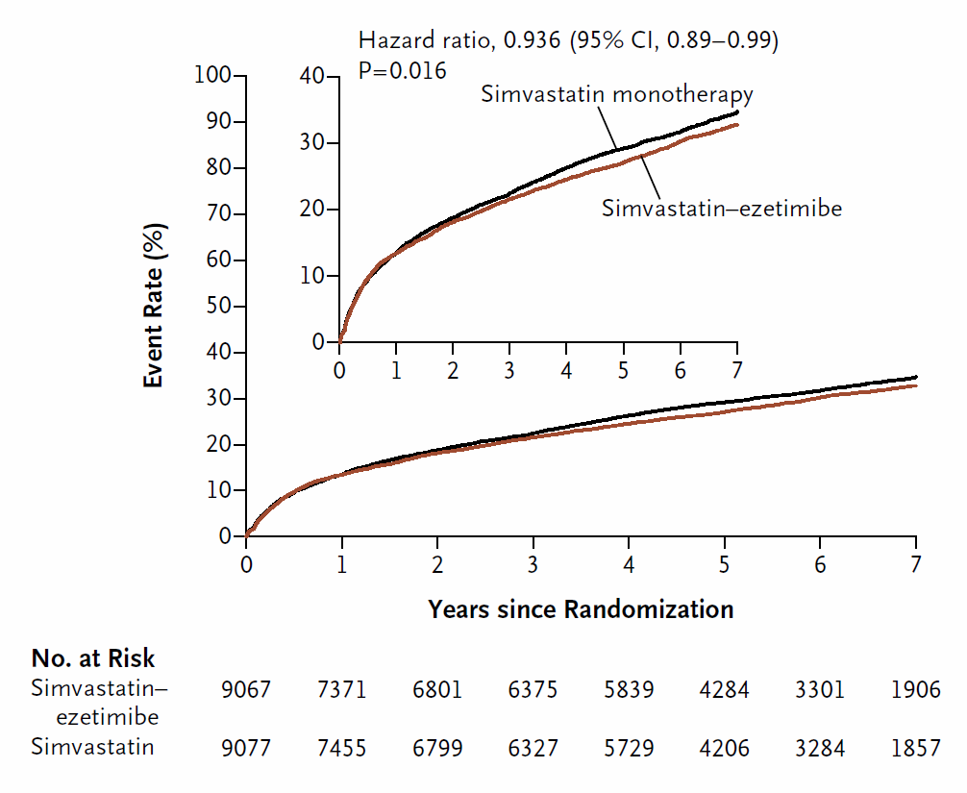
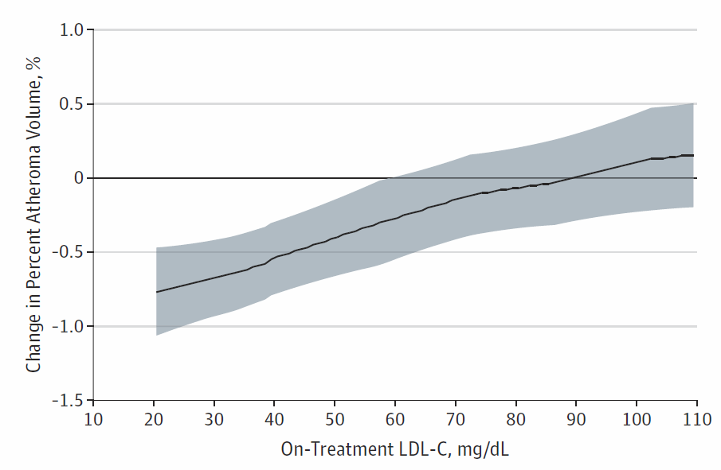
Or does it take longer for CVD event reduction in statin-treated patients with lower LDL-C?
IMPROVE-IT¹ (7 years)
Ezetimibe added to moderate intensity statin
GLAGOV² (18 months IVUS regression)
Evolocumab added to moderate/high intensity statin
Mean baseline
LDL-C 92 mg/dL
(2.4 mmol/L)
Simvastatin
LDL-C 70 mg/dL
(1.8 mmol/L)
Cannon CP, et al. N Engl J Med. 2015;372(25):2387-2397.
Nicholls SJ, et al. JAMA. 2016;316(22):2373-2384.

Slide 21
ODYSSEY OUTCOMES Design
Planned
mean 3.3-year follow-up
All patients followed for ≥2 years
18,536 patients with recent ACS were randomized
Alirocumab 75 mg Q2W
Placebo†
Dose increased (blinded) to
150 mg Q2W if LDL-C remains ≥50 mg/dL
(1.29 mmol/L) at month 1
Dose increase
Dose decreased (blinded) to 75 mg Q2W if two consecutive direct measurements of LDL-C are
<25 mg/dL (0.65 mmol/L)
Patients are monitored by independent,
blinded safety physician
Switched to placebo (blinded) for the remainder of the study if patients on alirocumab 75 mg Q2W experience two consecutive measurements of
LDL-C <15 mg/dL (0.39 mmol/L)
Dose decrease
Alirocumab stopped
Primary outcome: Time to first occurrence of CHD death, non-fatal MI, ischemic
stroke, or hospitalization for unstable angina
†Placebo maintained for the duration of the study.
Goodman SG, et al. J Am Coll Cardiol. 2017;69(11 Suppl):153. Poster 1203-307.

Slide 22
Is PCSK9 inhibition safe?

Slide 23
Safety of PCSK9 mAbs
Highly specific to target PCSK9
Act outside cell to bind PCSK9
Metabolized in reticuloendothelial system
  No hepatic metabolism or renal excretion
Fully human PCSK9 mAbs = alirocumab & evolocumab
  Least immunogenicity
  No neutralizing antibodies
  Minimal excess injection site reactions over placebo injection–mild, reversible
Humanized PCSK9 mAb = bococizumab
  Injection site reaction in 10% of patients over 1 year
Foltz I, et al. Circulation. 2013;127(22):2222-30.
Nelson AL, et al. Nat Rev Drug Discovery. 2010;9(10):767-774.
Roth EM, et al. N Engl J Med. 2017;376(16):1589-1590.
Sabatine M, et al. N Engl J Med. 2017;376(18):1713-1722.

Slide 24
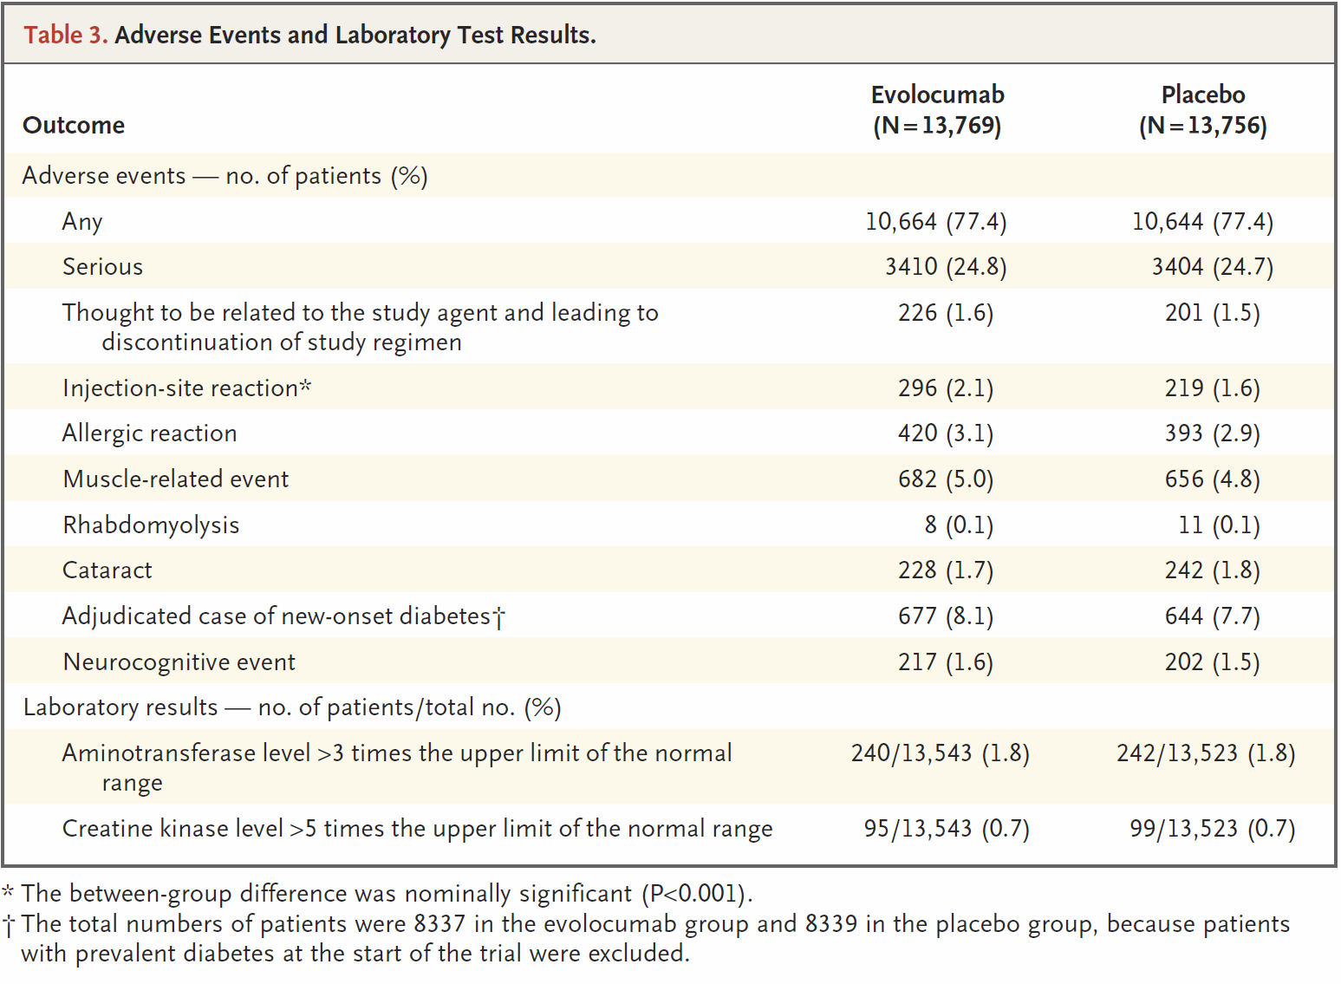
FOURIER–No Significant Safety Signals
Evolocumab vs placebo
Largest patient experience to date
N>27,500 for 1-3 years
  Median 2.2 years
Slight excess injection site reactions (uncommon)
No excess of neurocognitive events
No excess of other adverse events
Sabatine M, et al. N Engl J Med. 2017;376(18):1713-1722.

Slide 25
PCSK9 mAbs
Statin-intolerant Patients

Slide 26
Statin-intolerant Patients
>75% can tolerate blinded atorvastatin 20 mg
Placebo effect: Symptomatic on blinded alirocumab, but asymptomatic on unblinded alirocumab
Moriarty PM, et al. J Clin Lipidol. 2015;9:758-769.

Slide 27
Muscle Symptoms in Statin-intolerant Patients
Phase A1: Nocebo effect
Power of expectation
Phase A2:
≈20% truly intolerant?
Phase B: Ezetimibe 29% vs Evolocumab 21% reported muscle symptoms
GAUSS-3–Evolocumab double-blind randomized, controlled trial; mean intolerant ≥2 statins
Time to first occurrence of muscle symptoms resulting in discontinuation of study drug
Nissen SE, et al. JAMA. 2016; 315(15):1580-1590.

Slide 28
Framework for Using Nonstatins in Clinical Practice

Slide 29
Case 1: Adam
Very High ASCVD risk
65-year-old man
S/P MI & CABG
Type 2 diabetes mellitus
Maximally tolerated statin
  Pravastatin 10 mg daily
LDL-C 98 mg/dL
Baseline LDL-C unknown
TREATMENT OPTIONS
No change
Work on lifestyle
Atorvastatin 80 mg
Add ezetimibe
Add PCSK9 mAb

Slide 30
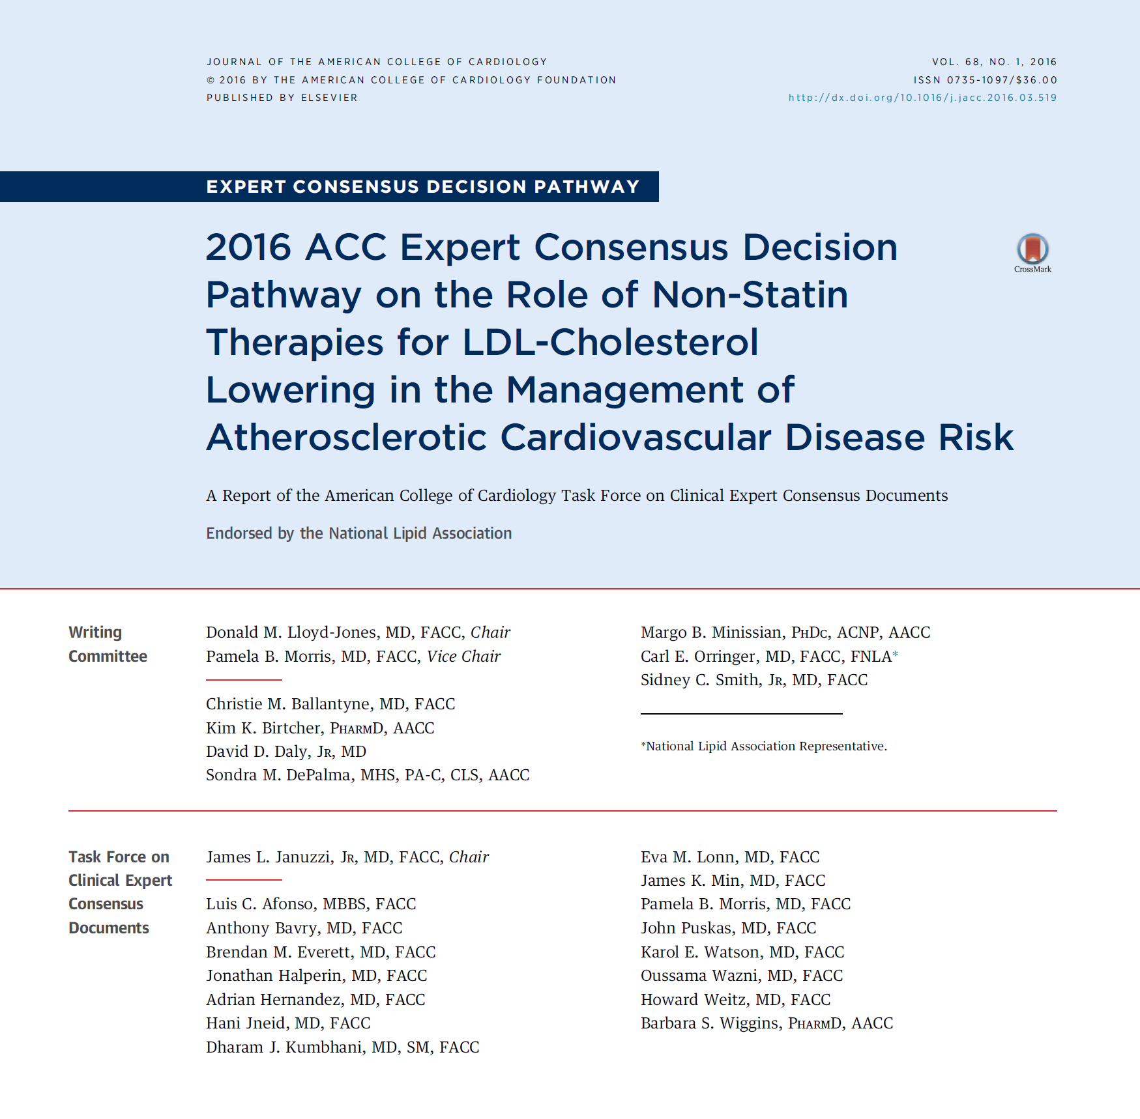
2016 ACC Nonstatin Decision Pathway
NET BENEFIT APPROACH
LDL-C thresholds
to trigger consideration of potential for net benefit from adding
ezetimibe or PCSK9 mAb
Lloyd-Jones D, et al. J Am Coll Cardiol. 2016;68(1):92-125.

Slide 31
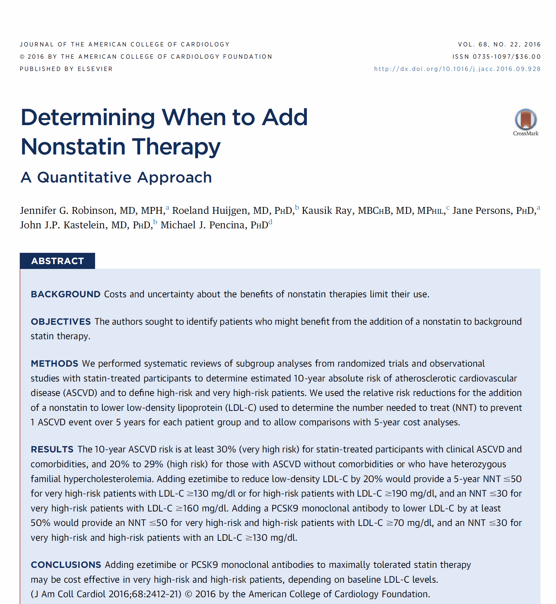
NNT to Inform Nonstatin Decision-making
Determine potential for NET BENEFIT from adding LDL-C lowering or other CVD risk reduction therapy
Robinson JG, et al. J Am Coll Cardiol. 2016;68(22):2412-2421.

Slide 32
LDL-C Lowering with Ezetimibe vs Alirocumab
Achieved LDL-C Over Time on Background of Maximally-Tolerated Statin
2.2 mmol/L
85.3 mg/dL
2.1 mmol/L
82.5 mg/dL
Ezetimibe 10 mg
mg/dL
LDL-C, LS mean (SE), mmol/L
−20.7%
−18.3%
1.3 mmol/L
51.6 mg/dL
Alirocumab
75/150 mg q2w
1.4 mmol/L
53.3 mg/dL
−50.6%
−49.5%
Week
Dose ↑if LDL-C >70 mg/dL at W8
Intent-to-treat (ITT) analysis
Cannon C, et al. Eur Heart J. 2015;36:1186-1194.

Slide 33
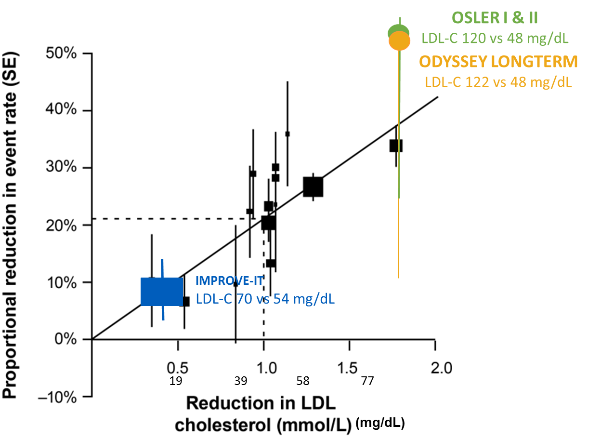
LDL-C & CVD Event Reduction–
Statins, Ezetimibe, PCSK9 mAbs
No clear benefit from adding niacin or fenofibrate to background statin therapy in
AIM-HIGH,
HPS2-THRIVE, ACCORD
Assumed
5-year RRR from PCSK9 mAbs 21% for each 1 mmol/L ↓LDL-C
RRR, relative risk reduction.
CTT Collaboration. Lancet. 2005;366(9493):1267-1278. Cannon CP, et al. N Engl J Med. 2015;372(25):2387-2397. Robinson JG, et al. N Engl J Med. 2015;372(16):1489-1499. Sabatine MS, et al. N Engl J Med. 2015;372(16):1500-1509. HPS2-THRIVE Collaborative Group. N Engl J Med. 2014;371(3):203-212.
ACCORD Study Group. N Engl J Med. 2010;362(17):1563-1574.
AIM-HIGH Investigators. N Engl J Med. 2011; 365(24):2255-2267.

Slide 34
Potential for Net Benefit to Inform Decision-making in Statin-treated Patients
 |  | Projected 10-year ASCVD risk
 |  | Moderate-intensity statin | High-intensity statin
 | Trial
Clinical ASCVD + Diabetes¹ |  | ≈ >30% 10-year ASCVD risk
CHD + Diabetes² CVD + Diabetes³ Stroke/TIA + Diabetes⁴ | TNT ACCORD SPARCL | 37% 38% N/A | 28% -- 38%
CHD + Diabetes– No CKD⁵ | TNT | 29% | 26%
CHD + Diabetes + CKD⁵ | TNT | 43% | 28%
Uptitrate to high-intensity statin if possible!
Robinson JG, et al. J Am Coll Cardiol. 2016;68(22):2412-2421.
Shepherd J, et al. Diabetes Care. 2006;29:1220-1226.
The ACCORD Study Group. N Engl J Med. 2010;362(17):1563-1574.
Callahan A, et al. Arch Neurol. 2011;68(10):1245-1251.
Shepherd J, et al. Mayo Clin Proc. 2008;83(8):870-879.

Slide 35
Very High Risk– CVD “plus”
(≥30% 10-year ASCVD risk ON statin therapy)
Clinical ASCVD + diabetes
Clinical ASCVD + familial hypercholesterolemia (FH)
Clinical ASCVD + poorly controlled risk factors
Clinical ASCVD + chronic kidney disease
Recent acute coronary syndrome (<3 months)
Clinical ASCVD + polyvascular disease*
Clinical ASCVD + age ≥65 years*
Clinical ASCVD + multiple recurrent events**
Clinical ASCVD + elevated lipoprotein(a)**
Robinson JG, et al. J Am Coll Cardiol. 2016;68(22):2412-2421.
*Sabatine M, et al. N Engl J Med. 2017;376(18):1713-1722.
**Lloyd-Jones DL, et al. J Am Coll Cardiol. 2016;68(1):92-125.

Slide 36
CVD PLUS = Very High Risk (≥30% 10-year ASCVD risk)
5-year NNT to prevent 1 ASCVD event
Initial LDL-C | Ezetimibe LDL-C ↓20% | PCSK9 mAb LDL-C↓50%
190 mg/dL (4.9 mmol/L) | 32 | 13
160 mg/dL (4.1 mmol/L) | 38 | 15
130 mg/dL (3.4 mmol/L) | 47 | 19
100 mg/dL (2.6 mmol/L) | 61 | 25
70 mg/dL (1.8 mmol/L) | 88 | 35
Case 1. Adam
Very high risk CVD+DM
(LDL-C 98 mg/dL)
● Little benefit from titrating to LDL-C <70 mg/dL with ezetimibe
● More reasonable to consider PCSK9 mAb
Reasonable NNT thresholds: Physicians: NNT <50 Patients: NNT <30
Robinson JG, et al. J Am Coll Cardiol. 2016;68(22):2412-2421.
Steel N. Br Med J. 2000;320(7247):1446-1447.

Slide 37
Cost Effectiveness–
Based on 2016 ICER Analysis
NNT 10-14 | Very high risk individuals with LDL-C ≥190 mg/dL or LDL-C ≥160 mg/dL if ≥65% LDL-C reduction No discount ≈ $150,000 QALY
NNT 21-28 | Very high risk patients with LDL-C ≥100 mg/dL High risk patients with LDL-C ≥130 mg/dL Depending on discount Discount ≈ 50% (≈ $7700/year) /$150,000 QALY Discount ≈ 60% (≈ $5400/year) /$100,000 QALY Discount ≈ 77% (≈ $3200/year) /$50,000 QALY Discount ≈ 85% (≈ $2200/year) to avoid exceeding growth targets US healthcare costs
Cost per QALY gained over 5 years of treatment (assuming undiscounted acquisition cost of $14,000/year and 50% relative risk reduction with PCSK9 mAb). All costs in US dollars.
Robinson JG, et al. J Am Coll Cardiol. 2016;68(22):2412-2421.
Tice JA, et al. JAMA Intern Med. 2016;176(1):107-108.

Slide 38
Case 2: Ruth
Very High ASCVD Risk
45-year-old woman
Heterozygous FH
S/P MI & CABG
Atorvastatin 80 mg
LDL-C 192 mg/dL
Baseline LDL-C 286 mg/dL
TREATMENT OPTIONS
No change
Work on lifestyle
Add ezetimibe
Add PCSK9 mAb

Slide 39
CVD PLUS = Very High Risk (≥30% 10-year ASCVD risk)
5-year NNT to prevent 1 ASCVD event
Initial LDL-C | Ezetimibe LDL-C ↓20% | PCSK9 mAb LDL-C↓50%
190 mg/dL (4.9 mmol/L) | 32 | 13
160 mg/dL (4.1 mmol/L) | 38 | 15
130 mg/dL (3.4 mmol/L) | 47 | 19
100 mg/dL (2.6 mmol/L) | 61 | 25
70 mg/dL (1.8 mmol/L) | 88 | 35
Case 2. Ruth
Very high risk CVD+FH
(LDL-C 192 mg/dL on max therapy)
● Add ezetimibe
● Add PCSK9 mAb
Reasonable NNT thresholds: Physicians: NNT <50 Patients: NNT <30
Robinson JG, et al. J Am Coll Cardiol. 2016;68(22):2412-2421.
Steel N. Br Med J. 2000;320(7247):1446-1447.

Slide 40
Case 3: Ernie
Very High ASCVD Risk
72 -year-old man
S/P CABG
CKD stage 3
Maximally tolerated statin
  Rosuvastatin 10 mg daily
LDL-C 72 mg/dL
Baseline LDL-C unknown
TREATMENT OPTIONS
No change
Work on lifestyle
Atorvastatin 80 mg
Add ezetimibe
Add PCSK9 mAb

Slide 41
CVD PLUS = Very High Risk (≥30% 10-year ASCVD risk)
5-year NNT to prevent 1 ASCVD event
Initial LDL-C | Ezetimibe LDL-C ↓20% | PCSK9 mAb LDL-C↓50%
190 mg/dL (4.9 mmol/L) | 32 | 13
160 mg/dL (4.1 mmol/L) | 38 | 15
130 mg/dL (3.4 mmol/L) | 47 | 19
100 mg/dL (2.6 mmol/L) | 61 | 25
70 mg/dL (1.8 mmol/L) | 88 | 35
Case 3. Ernie
Very high risk CVD+CKD
(LDL-C 72 mg/dL on max therapy)
● Little benefit from titrating to LDL-C <70 mg/dL with ezetimibe
● Might consider PCSK9 mAb
Reasonable NNT thresholds: Physicians: NNT <50 Patients: NNT <30
Robinson JG, et al. J Am Coll Cardiol. 2016;68(22):2412-2421.
Steel N. Br Med J. 2000;320(7247):1446-1447.

Slide 42
High Risk
(20-29% 10-year ASCVD risk)
CVD without “Plus” on statin therapy
Primary prevention heterozygous familial hypercholesterolemia (FH)
Robinson JG, et al. J Am Coll Cardiol. 2016;68(22):2412-2421.
Lloyd-Jones DL, et al. J Am Coll Cardiol. 2016;68(1):92-125.

Slide 43
Case 4: Adele
High ASCVD Risk
78-year-old woman
S/P PCI to LAD with drug-eluting stent in 2014
HTN
Maximally tolerated statin
  Atorvastatin 40 mg daily
LDL-C 82 mg/dL
Baseline LDL-C unknown
TREATMENT OPTIONS
No change
Work on lifestyle
Atorvastatin 80 mg
Add ezetimibe
Add PCSK9 mAb

Slide 44
HIGH RISK
20‒<30% 10y ASCVD risk
Clinical ASCVD without high risk characteristics (no diabetes/high risk characteristics and primary LDL-C <190 mg/dL) Primary prevention familial hypercholesterolemia (FH) (heterozygous; no clinical ASCVD; age ≥40 years)
 | Percent LDL-C reduction
Initial LDL-C | 20% | 50%
190 mg/dL | 48 | 19
160 mg/dL | 57 | 23
130 mg/dL | 71 | 28
100 mg/dL | 92 | 37
70 mg/dL | 131 | 53
Case 4. Adele
High ASCVD risk
(LDL-C 82 mg/dL)
● Little benefit from titrating to LDL-C <70 mg/dL with ezetimibe
● Probably not reasonable to consider PCSK9 mAb

Slide 45
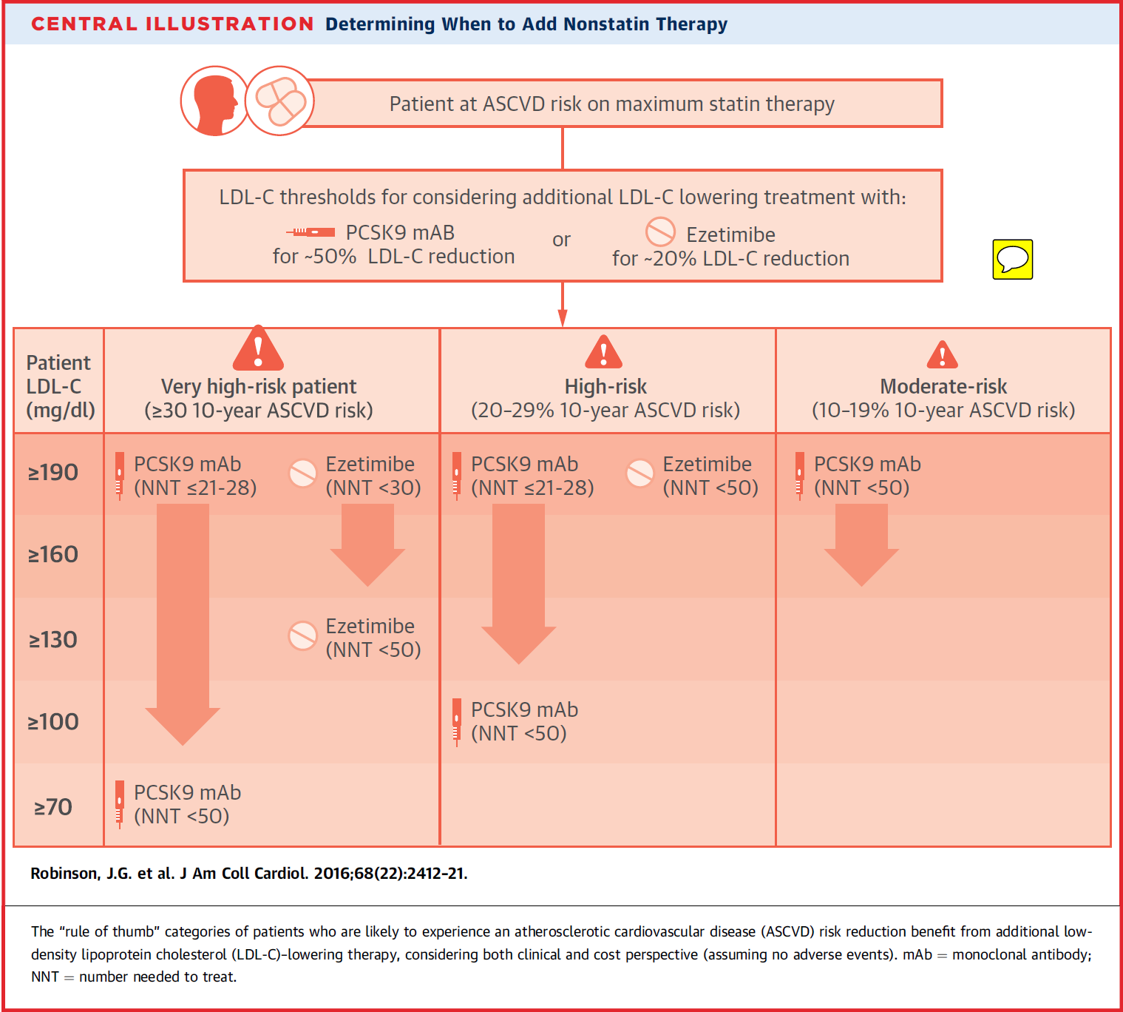
Very high risk
Statin intolerant CVD “Plus”
CVD + FH
LDL-C ≥100-130* mg/dL
  Consider ezetimibe or PCSK9 mAb
High risk
Statin intolerant CVD
FH
LDL-C ≥130 mg/dL
  Consider PCSK9 mAb
LDL-C ≥190 mg/dL
  Consider ezetimibe
NNT Calculator in development for US CVD & statin-treated patients; calibrate for other countries
Robinson JG, et al. J Am Coll Cardiol. 2016;68(22):2412-2421.
Landmesser U, et al. Eur Heart J. 2017;38(29):2245-2255.

Slide 46
Evolving Paradigms for CVD Prevention
1st Paradigm
2nd
Paradigm
Next
Paradigm
TREAT TO GOAL
-ATP I to III-
STATIN
BENEFIT GROUPS for CVD REDUCTION &
SHARED DECISION-MAKING
-2013 ACC/AHA-
INDIVIDUAL POTENTIAL FOR NET BENEFIT &
SHARED DECISION-MAKING
-Future guideline-
New
Evidence/ Methods
New
Evidence/Methods
Robinson JG, et al. Circulation. 2016;133:1533-1536.

Slide 47
Individual’s Potential for Net Benefit
POTENTIAL FOR
NET ASCVD RISK REDUCTION
BENEFIT
ABSOLUTE ASCVD RISK
REDUCTION (ARR) → NNT
ABSOLUTE ADVERSE EVENT
RISK → NNH
PATIENT’S Absolute
ASCVD Risk
Clinical ASCVD
or
Primary prevention
Age, sex, race/ethnicity, diabetes, smoking, total cholesterol, HDL-C, systolic blood pressure, hypertension treatment
+/-
noninvasive imaging plaque burden
(CAC or ABI)
+
Current statin treatment & LDL-C level
+/-
Genetic risk score & Family history
+/-
Biomarkers?
added therapy’s expected
Relative Risk
Reduction
For statins:
Statin intensity
+
Absolute ASCVD risk
+
Baseline LDL-C
+/-
Genetic risk score
+/-
Biomarkers?
ADDED THERAPY’S
Absolute RISK of
ADVERSE EVENTS
(Statin/dose)
+
Drug interactions
+
Patient characteristics
(Age, sex, race/ethnicity, comorbidities including
renal or hepatic insufficiency)
+/-
Genetics & Family history
+/-
Biomarkers?
X
Anticipate
NNT calculator available by AHA
Robinson JG, et al. Circulation. 2016;133:1533-1536.

Slide 48
PCSK9 mAbs Conclusions
Maximize statin therapy
  Most patients can tolerate some dose of statin
    Creative dosing intervals–weekly, every other day,
    4 weeks on/1 week off
    Try all the statins
Alirocumab & Evolocumab
  Added 45% to 65% LDL-C reduction to further reduce
  CVD events
  Safe & well-tolerated
Potential for net benefit
  Very high risk CVD PLUS & CVD+FH
    Consider LDL-C ≥100-130 mg/dL
  High risk CVD or FH
    Consider LDL-C ≥130 mg/dL

