Slide 1


Slide 2
Sipuleucel-T Survival Benefit
Sipuleucel-T was approved based on HR of 0.775
(~4-month OS benefit)
Survival curves separated after 6 months
Significant PSA decline rate ~3%
No improvement in time to progression
Very few side effects
Sipuleucel-T (n=341)
OS (median) = 25.8 mos
Placebo (n=171)
OS (median) = 21.7 mos
Sipuleucel-T Immunotherapy for Castration-Resistant Prostate Cancer, Kantoff PW, et al. N Engl J Med. 2010;363:411-422. Copyright © 2017 Massachusetts Medical Society. Reprinted with permission from Massachusetts Medical Society.
Notes:
I tend to select patients with lower volume disease and longer PSAdt

Slide 3
Survival Benefit of Sipuleucel-T Is Greater When PSA Is Lower
IMPACT: OS by Baseline PSA
Median OS, mo | Baseline PSA (ng/mL) (N=128 for all categories)
 | ≤22.1 | >22.1–50.1 | >50.1–134.1 | >134.1
Sipuleucel-T | 41.3 | 27.1 | 20.4 | 18.4
Control | 28.3 | 20.1 | 15.0 | 15.6
Difference | 13.0 | 7.1 | 5.4 | 2.8
HR (95% CI) | 0.51 (0.31-0.85) | 0.74 (0.47-1.17) | 0.81 (0.52-1.24) | 0.84 (0.55-1.29)
OS, overall survival; PSA, prostate specific antigen.
Schellhammer PF, et al. Urology. 2013;81:1297-1302.
Notes:
Not only is this a surrogate for lower volume disease but patients with earlier disease states also seem to have more competent immune systems. Although not shown here, CD54, which is the marker of an activated antigen presenting cell is better upregulated in a prime-boost fashion for those with earlier stage disease than those with later, symptomatic disease.

Slide 4
Retrospective Experience
Abiraterone after enzalutamide → Very modest response
Study | N | Sequence (order drugs administered) | PSA Response Enzalutamide Therapy (≥50%) | Response to Abiraterone Therapy
 |  |  |  | PSA Response (≥50%) | Median PFS | Median OS
Ileana 2012 | 24 | Docetaxel Enzalutamide Abiraterone | - | 13% | 2.4 months | -
Noonan 2013 | 30 | Docetaxel Enzalutamide Abiraterone | 60% | 3% | 15.4 weeks | 50.1 weeks
Loriot 2013 | 38 | Docetaxel Enzalutamide Abiraterone | - | 8% | 2.7 months | 7.2 months
Ileana E, et al. J Clin Oncol. 2012;30(Suppl):abstract 4554.
Noonan KL, et al. Ann Oncol. 2013;24:1802-1807.
Loriot Y, et al. Ann Oncol. 2013;24:1807-1812.

Slide 5
Retrospective Experience
Enzalutamide after abiraterone → Better outcome
Does this inform sequencing?
Study | N | Sequence (order drugs administered) | PSA Response Abiraterone Therapy (≥50%) | Response to Enzalutamide Therapy
 |  |  |  | PSA Response (≥50%) | Median PFS | Median OS
Bianchini 2013 | 39 | D, A, E | 38.4% | 12.8% | 2.8 months | Not reached
Schrader 2013 | 35 | D, A, E | 45.7% | 28.6% | - | 7.1 months (mean)
Thomsen 2013 | 24 | D, A, E | 58% (>30%) | 46% (>30%) | - | 4.8 months
Badrising 2013 | 61 | D, A, E | - | 21% | 12 weeks | 8 months
Bournakis 2013 | 25 | D, A/O, E | - | 40% | - | -
Cheng 2015 | 165 | D, A, E | - | 19% | 2.8 months (mean) | 12.2 months
A/O, abiraterone or orteronel; D, docetaxel; E, enzalutamide.
Bianchini D, et al. Eur J Cancer. 2014;50:76-84. Schrader AJ, et al. Eur Urol. 2014;65(1):30-36.
Thomsen FB, et al. Scand J Urol. 2014;48(3):268-275. Badrising S, et al. Cancer. 2014;120:968-975.
Bournakis E, et al. European Cancer Congress 2013; abstract 2906.
Cheng HH, et al. Prostate Cancer Prostatic Dis. 2015;18:122-127.

Slide 6
ALSYMPCA: Predisposing Factors for Hematologic Toxicity
Parameter estimates for maximum percentage decrease from baseline during on-treatment period in Hb, neutrophils and platelets
 | Hemoglobin (n=870) |  | Neutrophils (n=867) |  | Platelets (n=870)
Baseline variable | Parameter estimates | P value | Parameter estimates | P value | Parameter estimates | P value
Study tx (Ra-223/Pbo) | -1.57 | 0.027 | -18.56 | <0.0001 | -10.18 | <0.0001
Current use of bisphosphonates (Y/N) | -1.21 | NS | -0.08 | NS | -1.22 | NS
Prior Docetaxel (Y/N) | -1.32 | NS | -3.04 | 0.023 | -6.04 | <0.0001
EOD ≥ 6 mets including superscan (Y/N) | -2.54 | 0.008 | -3.45 | NS | -6.59 | 0.001
Prior EBRT to bone for pain (Y/N) | 2.21 | 0.001 | 3.91 | 0.003 | 2.30 | NS
Total ALP (≥220 U//L / <220 U/L/) | -3.07 | <0.0001 | -2.11 | NS | -4.91 | 0.001
ALP, alkaline phosphatase; EBRT, external beam radiation therapy; EOD, extent of disease; PBO, placebo.
Parker C, et al. J Clin Oncol. 2013;31:abstract 5060.

Slide 7
Radium-223 Before or After Chemotherapy?
Practical Considerations
Only FDA-approved for patients who lack visceral metastasis
Stringent eligibility requirements for treatment
  Initial ANC ≥1,500/L with subsequent ≥1,000/L
  Hb ≥10 g/dL
  PLT ≥100,000/L with subsequent ≥50,000/L
Requires preauthorization, while chemotherapy with docetaxel does not
ANC, absolute neutrophil count; Hb, hemoglobin; PLT, platelets.

Slide 8
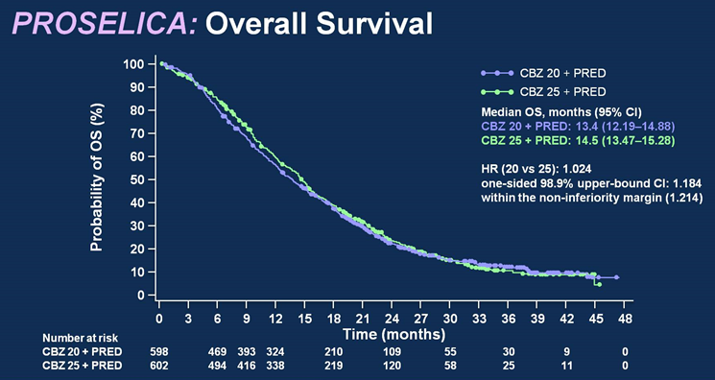
The PROSELICA Study–
Cabazitaxel 20 vs 25 mg/m²
PROSELICA: Overall Survival
Probability of OS (%)
CBZ 20 + PRED
CBZ 25 + PRED
Median OS, months (95% CI)
CBZ 20 + PRED: 13.4 (12.19–14.88)
CBZ 25 + PRED: 14.5 (13.47–15.28)
HR (20 vs 25): 1.024
one-sided 98.9% upper-bound CI: 1.184
within the non-inferiority margin (1.214)
Time (months)
Number at risk
CBZ 20 + PRED
CBZ 25 + PRED
Time (months)
598 469 393 324 210 109 55 30 9 0
602 494 416 338 219 120 58 25 11 0
De Bono JS, et al. J Clin Oncol. 2016;34(Suppl):abstract 5008.
Notes:
Basically superimposed survival curves

Slide 9
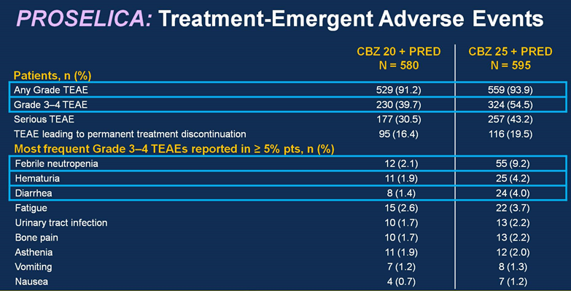
The PROSELICA Study – Adverse Events
De Bono JS, et al. J Clin Oncol. 2016;34(Suppl):abstract 5008.
Notes:
More TEAEs for CBZ 25
Grade 3–4 adverse events: 39.7% C20; 54.5% C25.

Slide 10
Situations to Perform a
Metastatic Biopsy
Visceral lesions especially liver metastasis
Extremely bulky lymph nodes (>5 cm)
Low PSA in the setting of very high volume disease
Predominantly lytic rather than blastic bone metastases

Slide 11
Neuroendocrine/Small-Cell Prostate Cancer
De novo presentation rare (<1% new diagnoses)
May arise as a mechanism of resistance to ADT
Metastatic disease, including unusual sites of metastases
Low or modestly rising PSA
Paraneoplastic syndromes (uncommon)
Elevated CEA or serum neuroendocrine markers (chromogranin, neuron-specific enolase) can support the diagnosis
Tissue IHC expresses chromogranin A and synaptophysin
Treated like small-cell lung cancer platinum-doublet chemotherapy, eg, cisplatin or carboplatin with (etoposide)

Slide 12
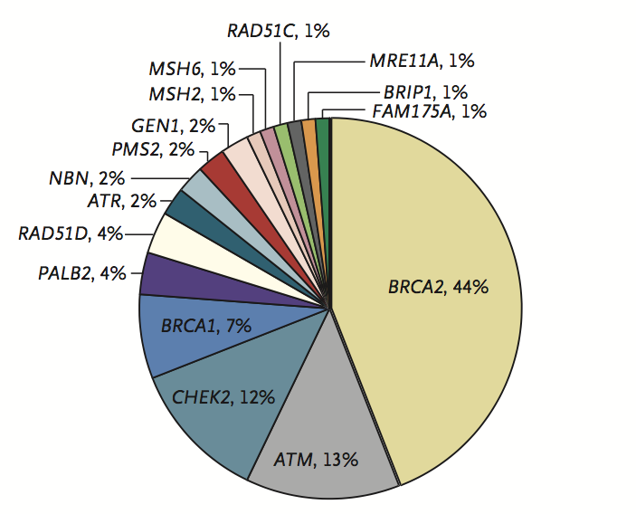
Genomic Landscape of Metastatic Castration-Resistant Prostate Cancer
23% of metastatic castration-resistant prostate cancers harbor DNA repair alterations
2.7% harbor mismatch repair alterations
The frequency of DNA repair alterations increases with disease progression
11.8% of men with metastatic prostate cancer have a germline alteration in 16 DNA damage repair genes
Age and family history did not affect mutation frequency
Robinson D, et al. Cell. 2015; 161(5):1215-1228.
Inherited DNA-Repair Gene Mutations in Men with Metastatic Prostate Cancer. Pritchard CC, et al. N Engl J Med. 2016;375:443-453. Copyright © 2017 Massachusetts Medical Society. Reprinted with permission from Massachusetts Medical Society.

Slide 13
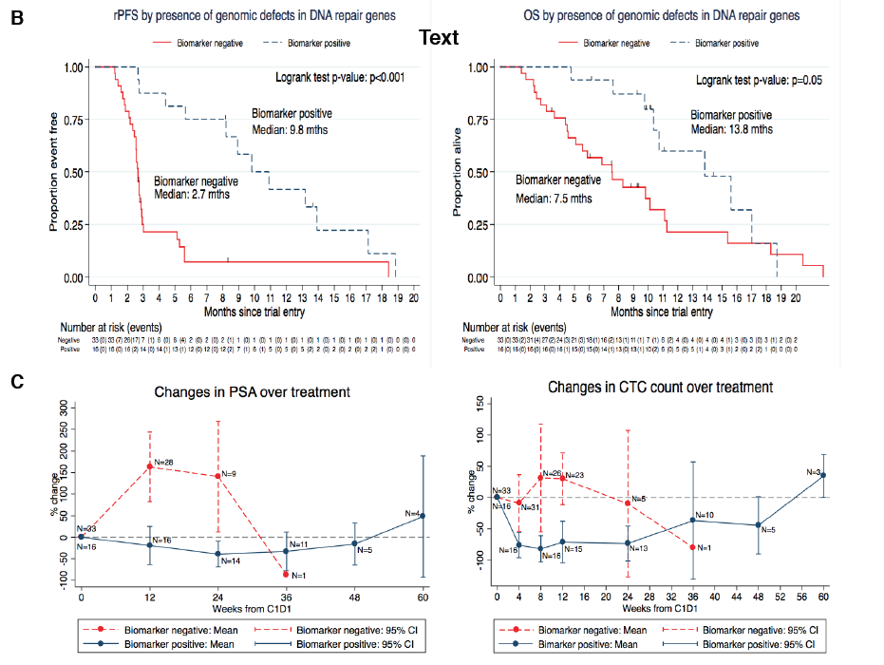
Response to Olaparib Is Highly Enriched in Patients with Defects in DNA Repair Genes
rPFS by presence of genomic
defects in DNA repair genes
OS by presence of genomic
defects in DNA repair genes
P<0.001
P=0.05
Biomarker positive:
Median: 9.8 months
Biomarker positive: Median: 13.8 months
Biomarker
negative:
median 2.7 months
Biomarker negative:
median 7.5 months
Overall response rate of 32.7%—median duration of response ~ 9 months
14/16 (88%) of patients with a DNA repair alteration had a response
2/33 (6%) of patients without a DNA repair alteration had a response
DNA-Repair Defects and Olaparib in Metastatic Prostate CancerMateo J, et al. N Engl J Med. 2015; 373:1697-1708.. Copyright © 2017 Massachusetts Medical Society. Reprinted with permission from Massachusetts Medical Society.

