Slide 1
Module 2

Slide 2
Investigational Use
This activity includes extensive discussion about medications not approved in the United States, as well as uses of medications approved in the United States but outside of current approved labeling.
Participants are encouraged to consult the prescribing information for approved medications and other evidence-based sources of information prior to prescribing.

Slide 3
Learning Objectives
Describe key treatment concepts as described in the 2020 clinical practice guideline on nontuberculous mycobacterial lung disease (NTM-LD) jointly sponsored by American Thoracic Society, European Respiratory Society, European Society of Clinical Microbiology and Infectious Diseases, and Infectious Diseases Society of America
Summarize the clinical impact of the latest clinical data and therapeutic advances in NTM-LD
Develop patient-centered treatment strategies for NTM-LD that align with the latest evidence-based guideline recommendations and therapeutic advances
Collaborate with patients to better individualize treatment over the course of the disease

Slide 4
Common Treatment Challenges in NTM-PD
Pathogen resistance is common
Long-term combination therapy is needed
No evidence supporting therapeutic drug monitoring
Treatment-related adverse events occur in >90
Drug-drug interactions are common
Treatment adherence is suboptimal
Ongoing patient education is needed
Holistic patient management
Shared decision-making
Daley CL, et al. Clin Infect Dis. 2020;71(4):e1-e36.
Griffith DE, et al. Am J Respir Crit Care Med. 2018;198:1559-1569.

Slide 5
Shared Decision-Making
What is it?
A process wherein the healthcare provider and patient work together to make a healthcare decision that is best for the patient
What’s involved?
Engaging the patient in a collaborative process
Evidence-based information about available options
Provider’s knowledge and experience
Patient’s values and preferences

Slide 6
Case Scenario #1
A 69-yo man was diagnosed with nodular-bronchiectatic MAC 9 months ago.
He was started on azithromycin + rifampin + ethambutol.
During his follow-up visit, you notice that he seems irritated. He has asked several times that you repeat a question.

Slide 7
Strategies for Managing Adverse Events
Adverse Event
Monitoring
Education
•Lower dose
•Change medication
•Switch dosage form
•Palliative treatment
•Age
•Comorbidities
•Concurrent drugs
•Resources

Slide 8
Case Scenario #2
63-yo woman diagnosed with M. kansasii NTM-PD at this visit.
Past medical history
Hypertension
Type 2 diabetes
Insomnia
Current medications
HCTZ 25 mg QD
Enalapril 10 mg BID
Metformin 1000 mg BID
Zolpidem 5 mg QHS

Slide 9
Standard of Care Assessments
Procedure | Month
 | 0 | 1 | 2 | 3 | 4 | 5 | 6 | 7 | 8 | 9 | 10 | 11 | 12
Clinical
Medical history, concomitant medication review | X
Disease activity assessment (VAS) | X |  |  | X |  |  | X |  |  | X |  |  | X
Treatment modification |  | X
Follow-up physical examination (AE review) |  |  |  | X |  |  | X |  |  | X |  |  | X
Laboratory
AFB smear/culture (induced if necessary) | X | X |  | X |  | X |  | X |  | X |  | X
NTM susceptibility and speciation | X |  |  |  |  |  | X (if positive)
CBC w/differential | X |  |  | X |  |  | X |  |  | X |  |  | X
CMP | X |  |  | X |  |  | X |  |  | X |  |  | X
Other
Chest CT scan, low dose | X (<3 mos prior) |  |  |  |  |  |  |  |  |  |  |  | X
Airway clearance guidance | X |  |  | X |  |  | X |  |  | X |  |  | X

Slide 10
Recommended Procedures to Consider
Procedure | Month
 | 0 | 1 | 2 | 3 | 4 | 5 | 6 | 7 | 8 | 9 | 10 | 11 | 12
Laboratory
Drug level monitoring |  | X
Inflammatory markers (C-reactive protein) | X |  |  | X |  |  | X |  |  | X |  |  | X
Other
Spirometry, pre-bronchodilator | X (<6 mos prior) |  |  |  |  |  |  |  |  |  |  |  | X
Electrocardiogram | prn |  |  | prn |  |  | prn |  |  | prn |  |  | prn
Hearing screening/monitoring | X |  |  | prn |  |  | prn |  |  | prn |  |  | prn
Vision evaluation | X |  |  | prn |  |  | prn |  |  | prn |  |  | prn
Probiotics guidance | X

Slide 11
Case Scenario #3
A 52-yo woman diagnosed with NTM-PD nearly 3 years ago is being seen for a routine follow-up visit.
Lung exam reveals moderate congestion.
She appears to have copious sputum production.
She reports being frustrated having to take so many medications and how her lung disease has disrupted her life.
She appears tired and depressed.
Further discussion reveals that she takes her medications “most days.”
She last refilled her medications nearly 2 months ago.

Slide 12
Patient Resources
www.impact-be.com
www.NTMinfo.org
www.BronchandNTM360social.org
www.AboutNTM.com

Slide 13
It Takes a Village
PATIENT
Infectious Disease
Mental Health
Respiratory Therapist
Primary Care
Pulmonologist
Nurse
Pharmacist
Social Worker
Nutritionist

Slide 14
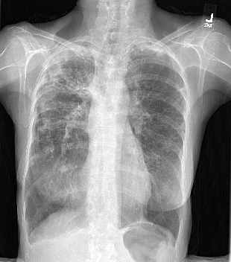
Case #4
80-yo female with chronic bronchiectatic nodular MAC, macrolide susceptible.
Current treatment: clarithromycin, ethambutol, and rifampin.
Notable appetite loss, dysgeusia and weight loss on therapy.
BMI 16.5. kg/m².

Slide 15
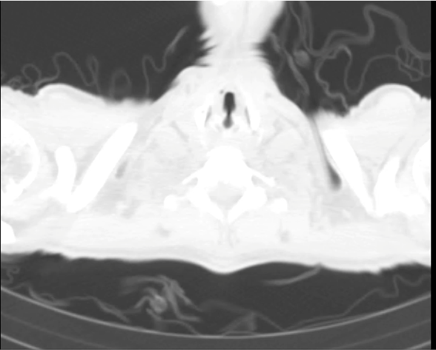
Case #5
59-yo female with a 4-y history of pulmonary MAC
On and off therapy.
Cultures remain persistently positive despite azithromycin, ethambutol, and rifampin.
History of intolerance to standard dosing → she was splitting her doses throughout the day.

